Slide 1
Global Artemia Production Opportunities – Global Cases:
Uganda
Martin Sserwadda

Slide 2
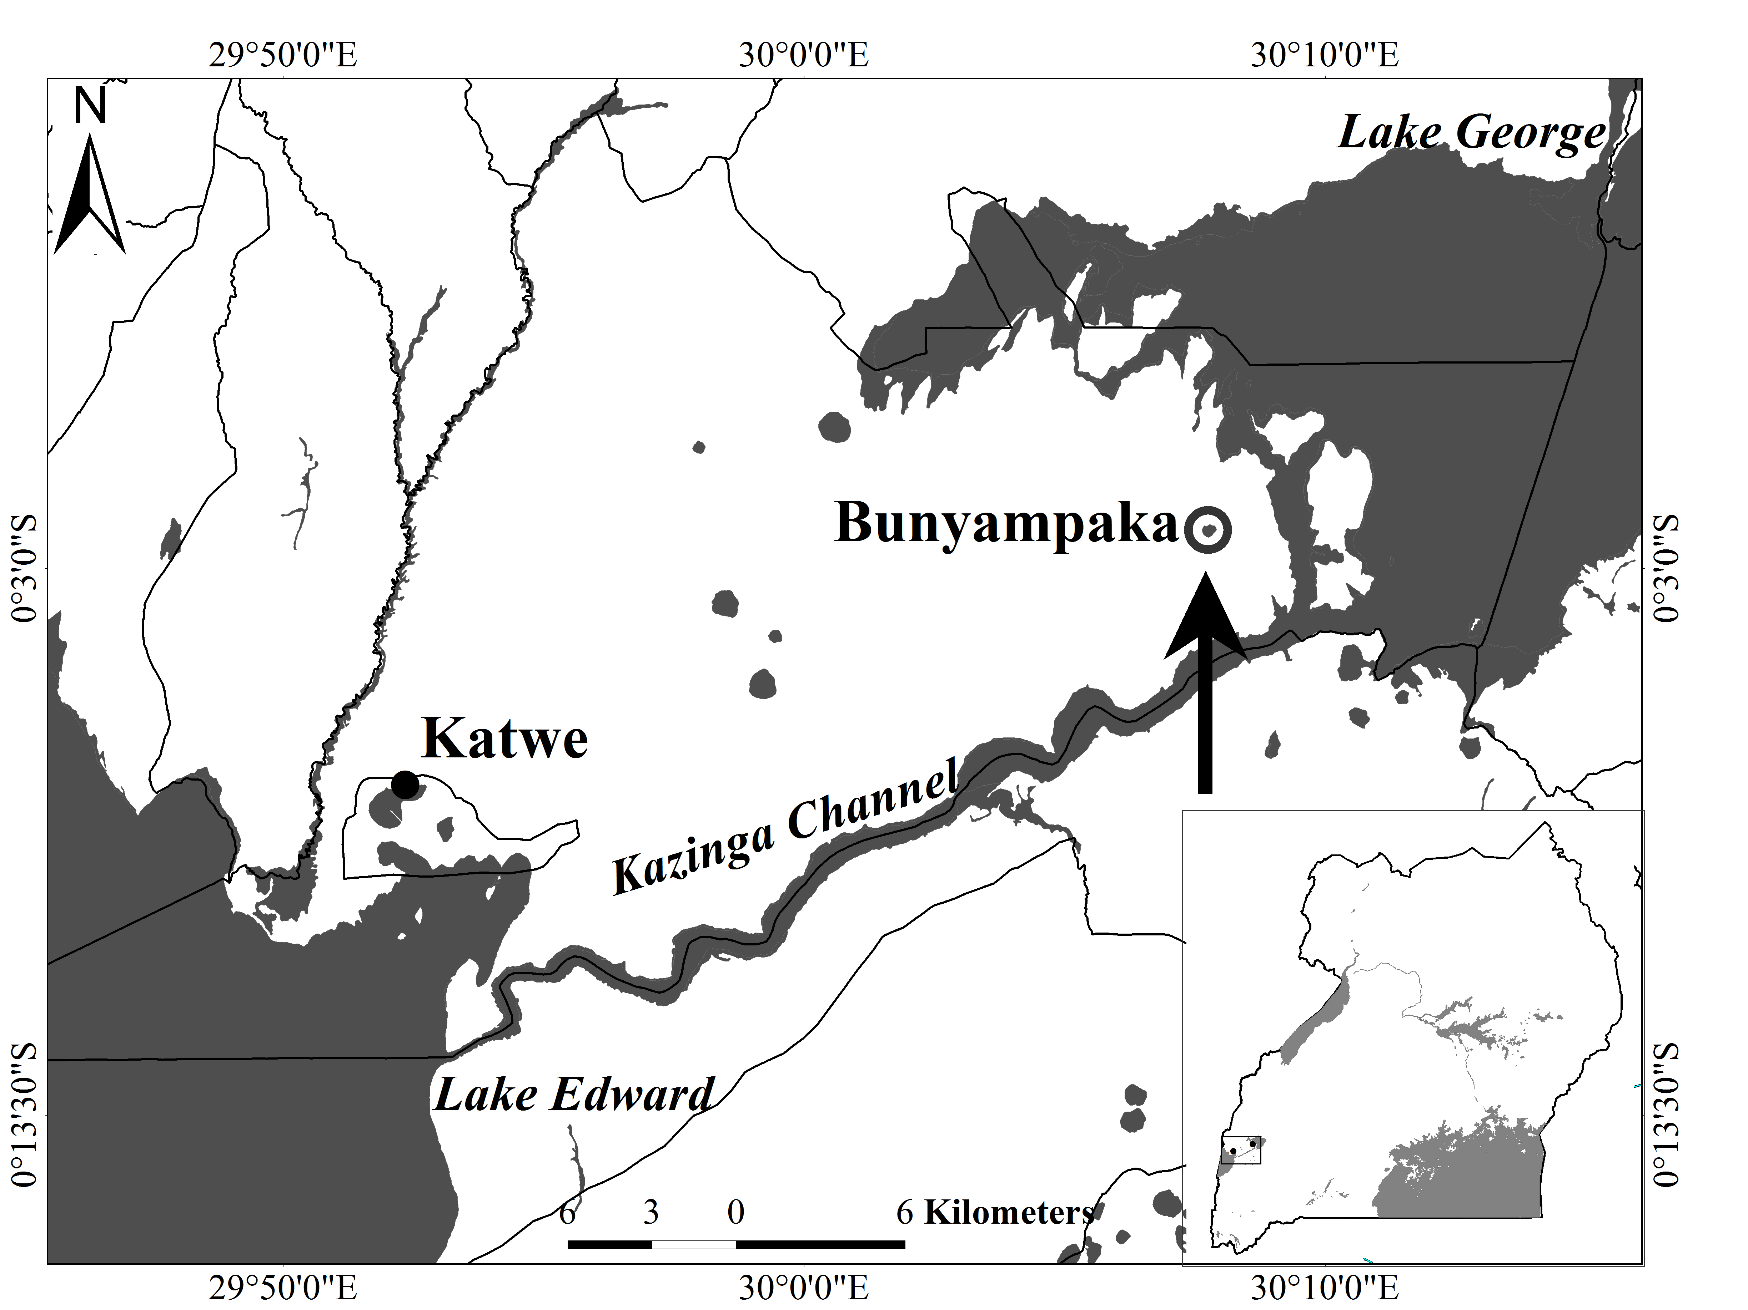
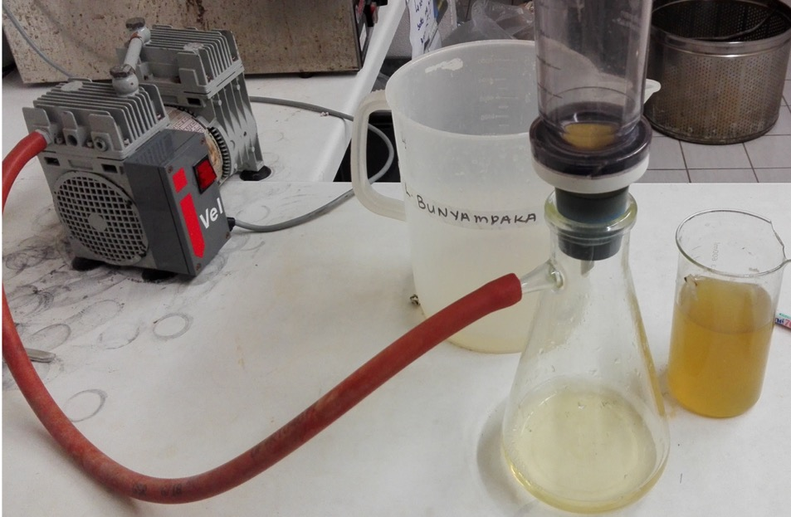
GLOBAL ARTEMIA SUMMIT 2025
WHAT HAS BEEN DONE
Performance of Artemia in brines of a local salt lake

Slide 3
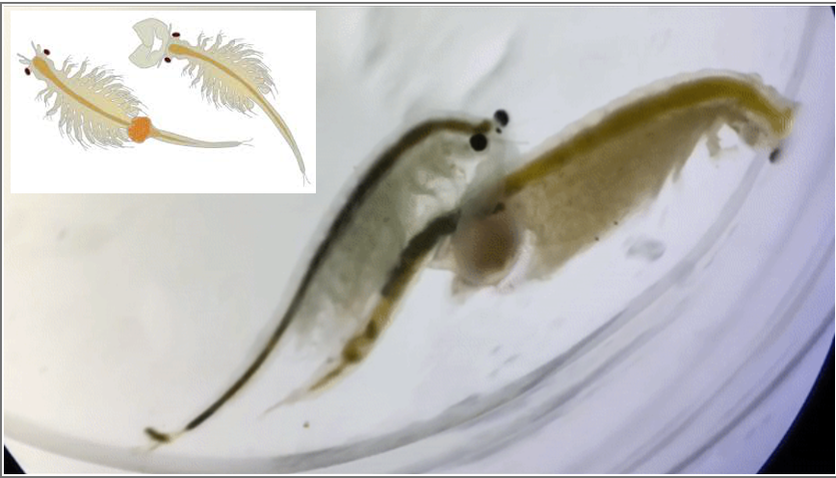
Growth performance

Slide 4
Reproductive performance
Parameter | Lake Bunyampaka saline water |  | control
 | 30 g/l | 50 g/l | 35 g/l
Age at first offspring | 28 ± 0.4 ^{ab} | 35.5 ± 1.6ª | 23.7 ± 1.1^{b}
Offspring/female/day | 18.0 ± 1.0^{ab} | 10.0 ± 4.0^{b} | 28.0 ± 4.0ª
TOT offspring production | 4574 ± 243^{ab} | 2650 ± 871^{b} | 6952 ± 555ª

Slide 5
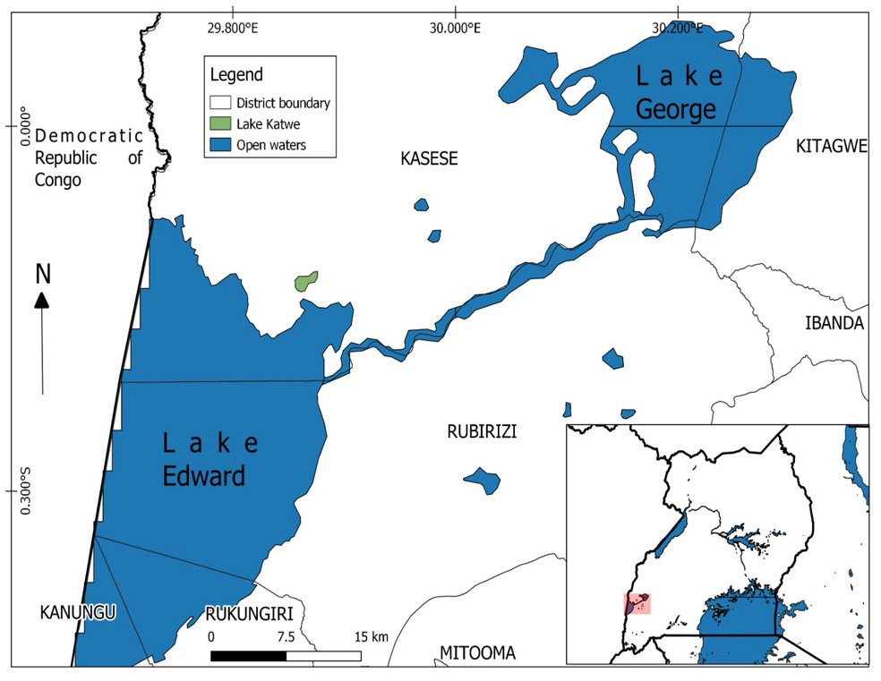
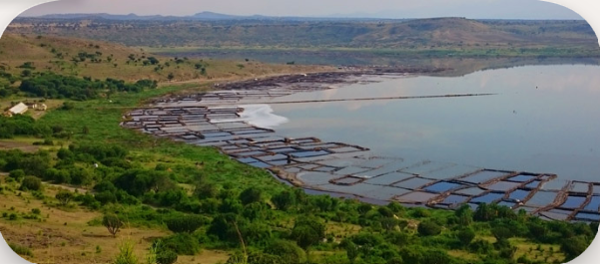
Lake Katwe

Slide 6
FUTURE RESEARCH
Brines from Lake Katwe
Strain selection
Algal species
Local production costs vs importation costs
Stakeholder/community engagement

Slide 7
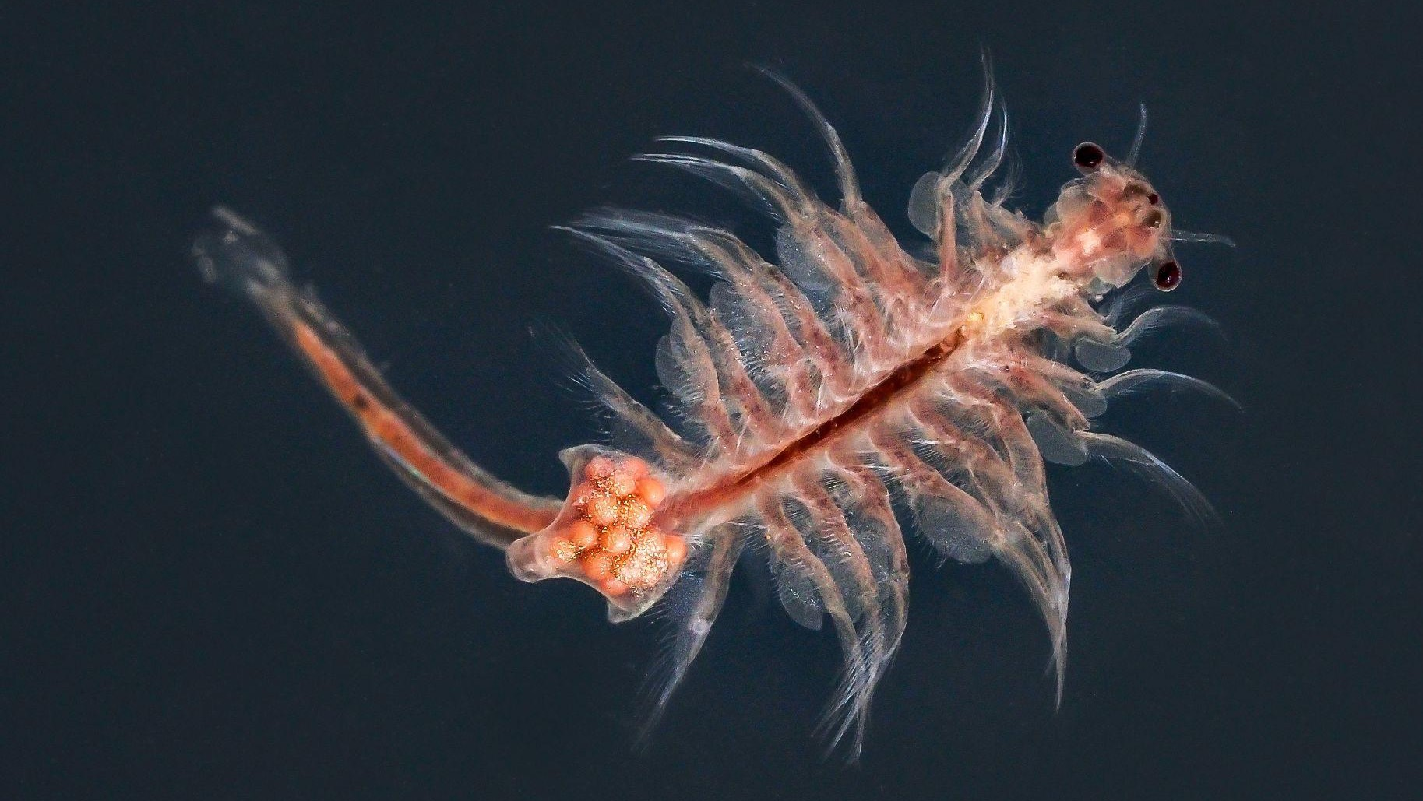
Thank you

