Slide 1
Yeong Yik Sung, Sui Liying & Patrick Sorgeloos

Slide 2
Background

Slide 3
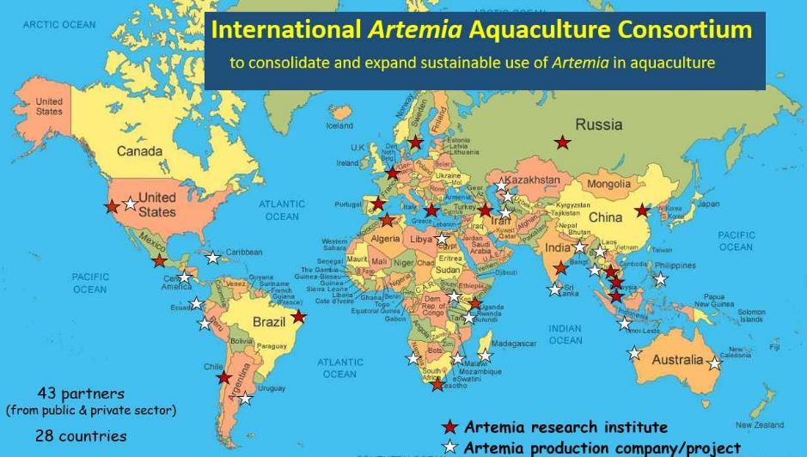
IAAC

Slide 4
Steering and Advisory Committee Members
Steering Committee
Yeong Yik Sung, Universiti Malaysia Terengganu, (Chair)
Sui Liying, Asia Regional Artemia Reference Center, Tianjin University of Science & Technology, China (Co-chair)
Simon Wilkinson, Network of Aquaculture Centres for Asia and Pacific (Secretariat / IAAC host institution)
Nguyen Van Hoa, Can Tho University, Vietnam
Meezanur Rahman, WorldFish, Bangladesh
Betty Nyonje, Kenya Marine Fisheries Research Institute, Kenya
Gonzalo Gajardo, Los Lagos University, Osorno, Chile
Annelies Declercq, Artemia Reference Center, Ghent University, Belgium
Parisa Norouzitallab, SLU, Sweden
Naser Agh, Urmia University, Iran
Advisory Committee
Patrick Sorgeloos (Chair)
Representing the FAO
Matthias Halwart
Representing the academic sector
John Beardmore, honorary member
Theodore Abatzopoulos
Representing the private sector
Philippe Léger
David Christopher Garriques

Slide 5
16. The Sub-Committee appreciated the work on Artemia and supported FAO efforts to explore development of technologies and sustainable management of Artemia resources.
63. The Sub-Committee noted with appreciation new examples of international cooperation such as the International Artemia Aquaculture Consortium and the Center for Ecological Aquaculture. In this regard, the Sub-Committee encouraged FAO to work in partnership with national, regional and international initiatives to promote sustainable aquaculture, such as the Global Sustainable Aquaculture Advancement Partnership (GSAAP).
66. The Sub-Committee welcomed the Artemia workshop held in association with GCA +20 and stressed the value of Artemia as an important aquaculture species and noted concern over the dependence on wild resources. The Sub-Committee further supported proposals for future workshops and recommended development of related guidelines on sustainable development of Artemia aquaculture, including capacity building.
NACA to host and coordinate the International Artemia Aquaculture Consortium

Slide 6
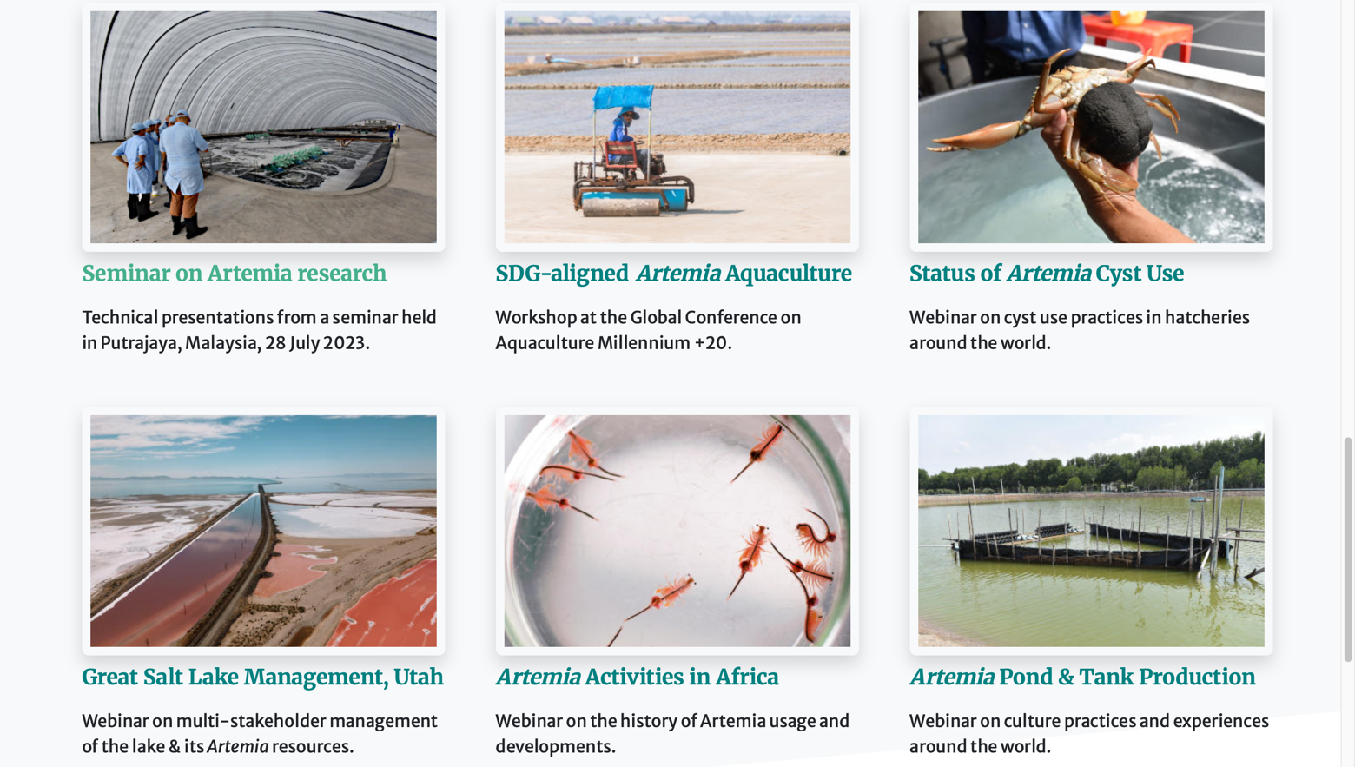
Recent Activities

Slide 7
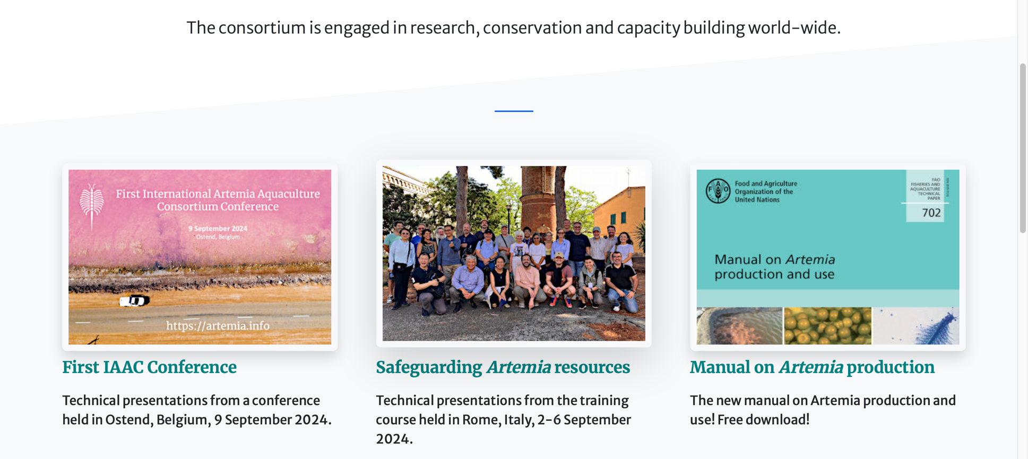
Recent Activities

Slide 8
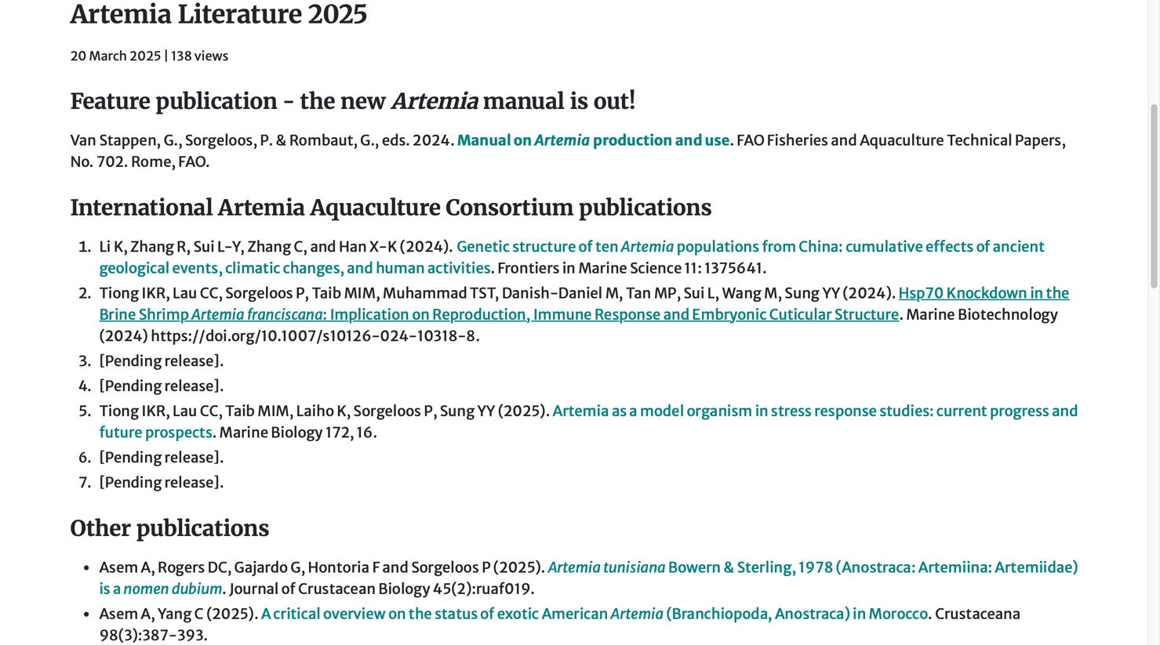
Literatures

Slide 9
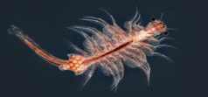
IAAC Global Projects

Slide 10
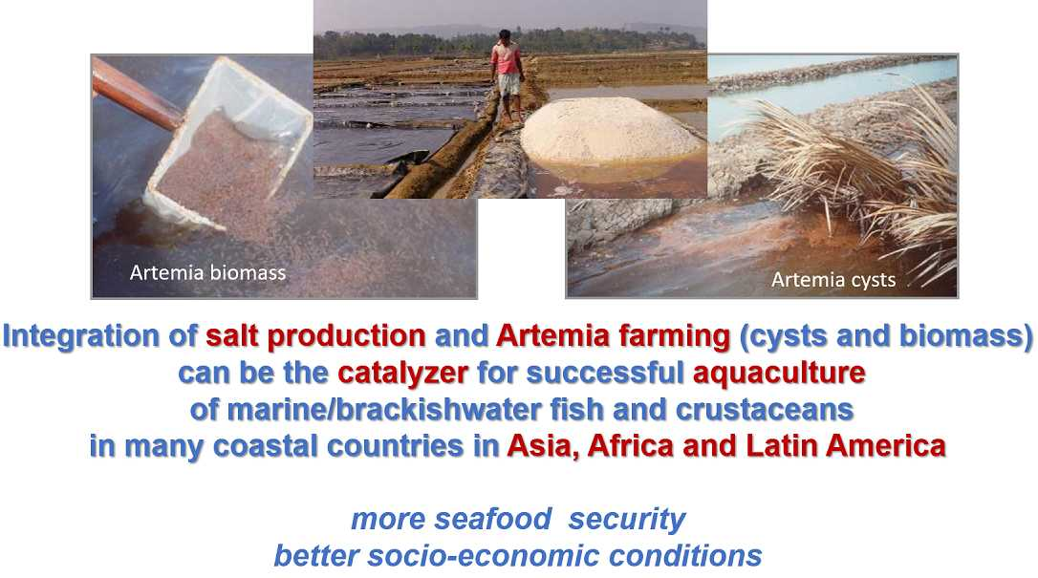
Bangladesh

Slide 11
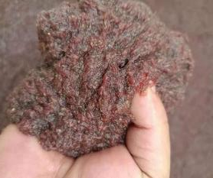
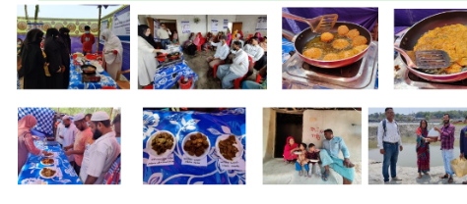
Bangladesh
Artemia biomass as human food

Slide 12
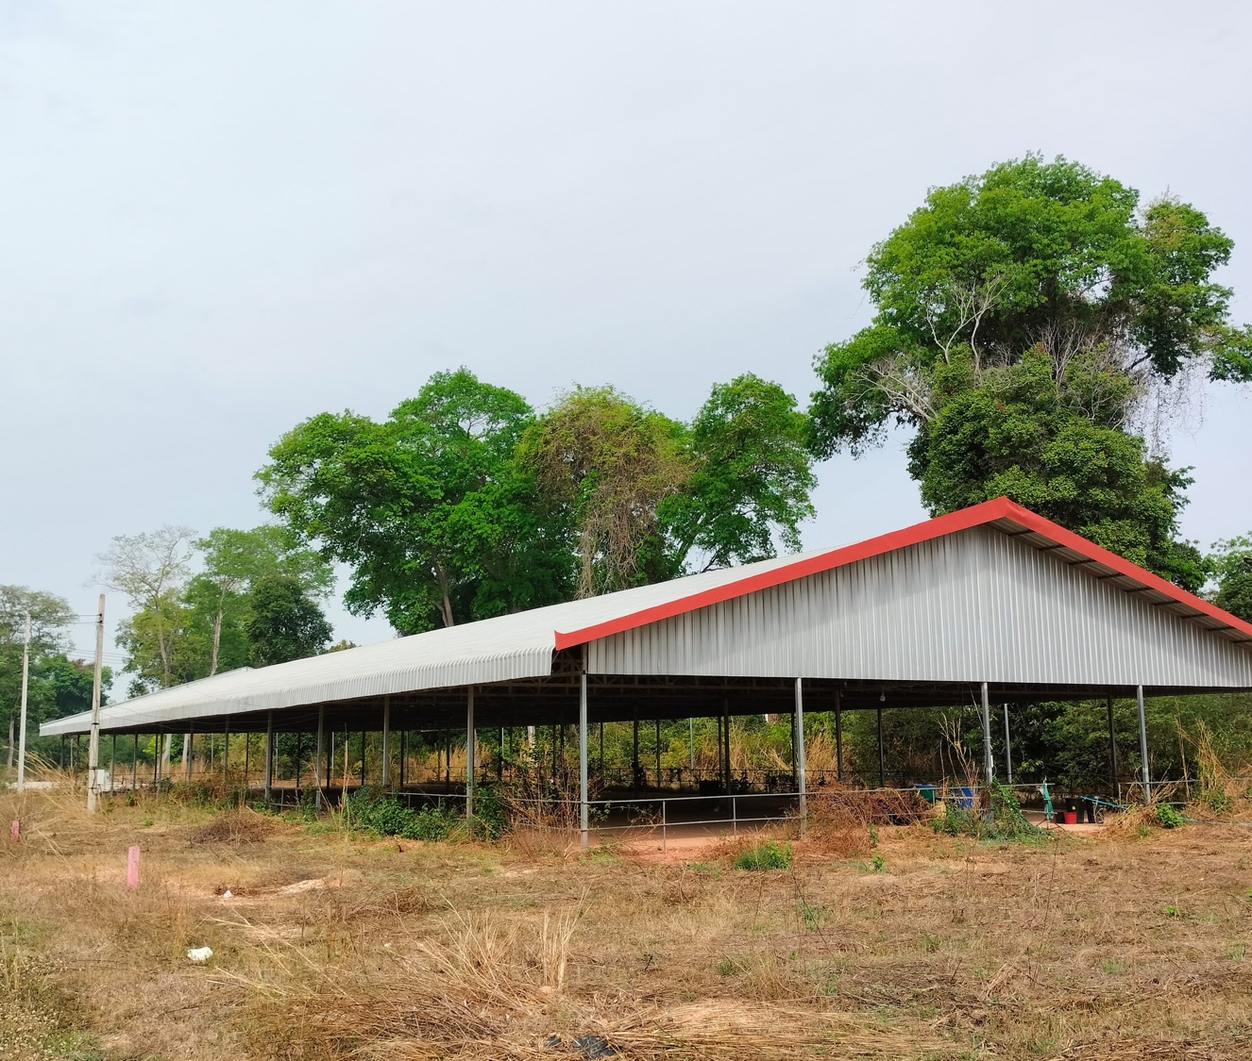
FAO – Indoor Tank production of Artemia
Laos

Slide 13
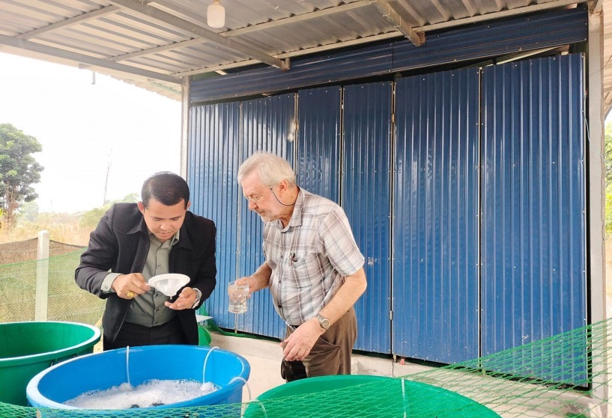
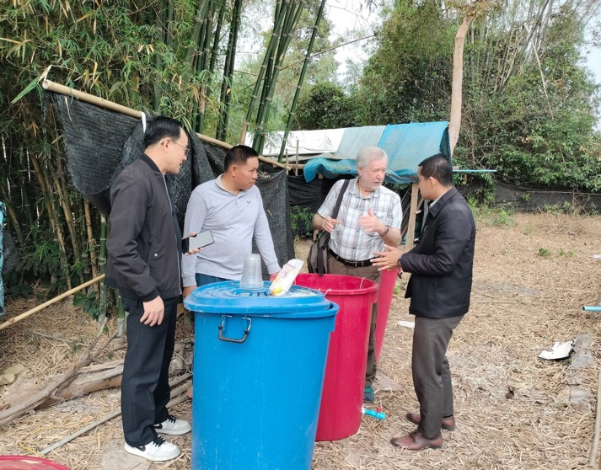
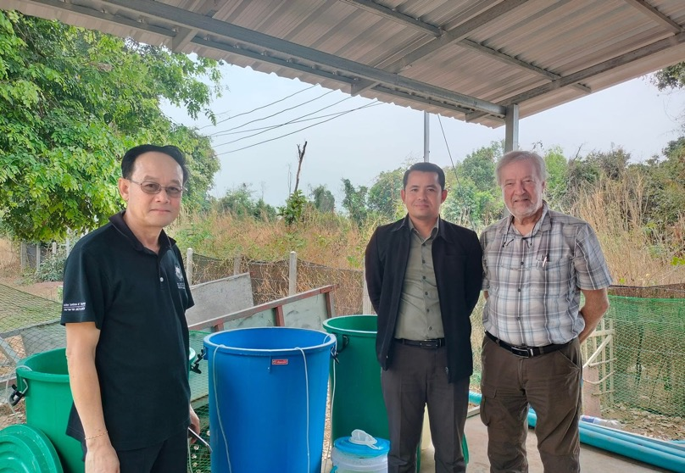
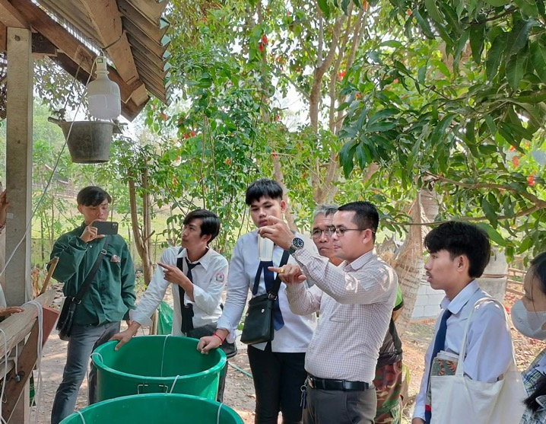
Laos
From backyard culture with water buckets….

Slide 14
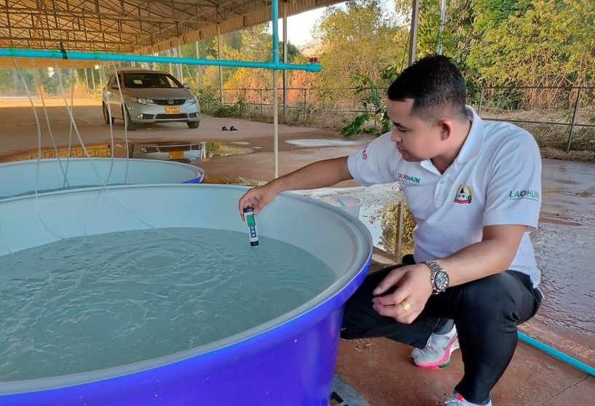
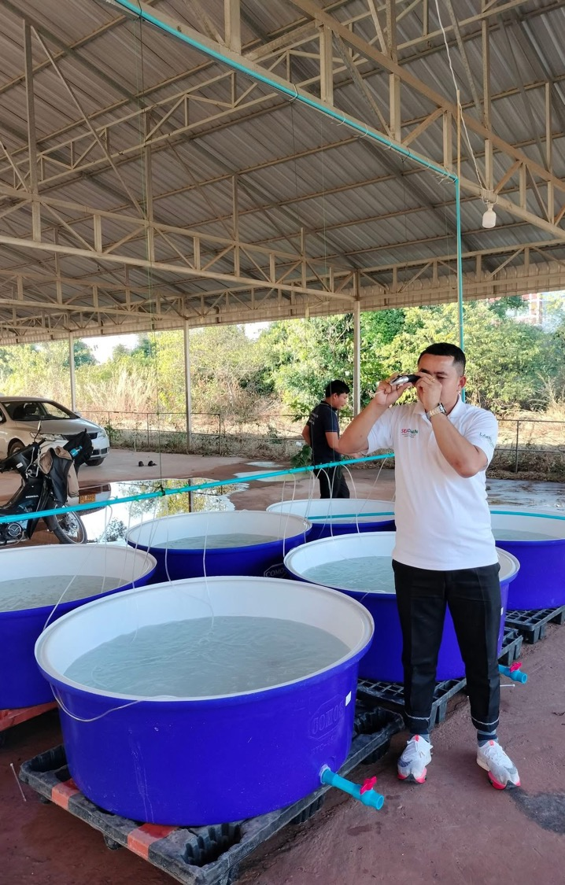
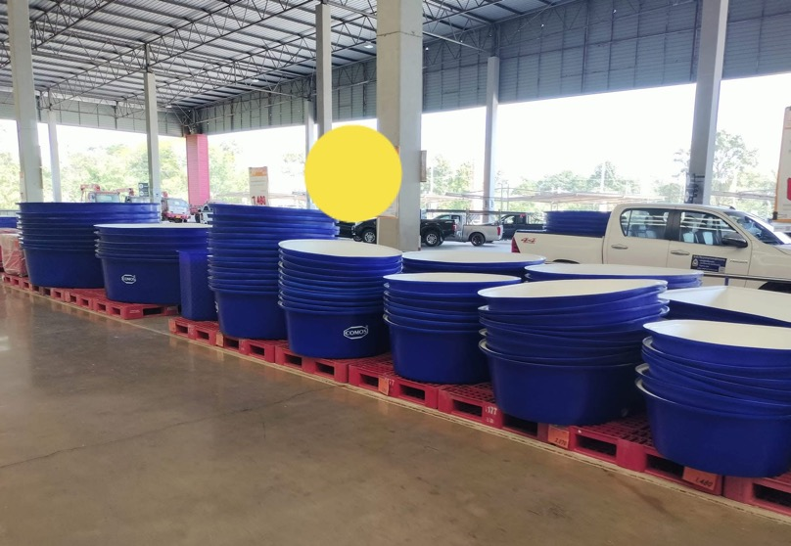
To Artemia Hatchery @ Savannakhet University
Laos

Slide 15
China – Asian Regional Artemia Reference Center; GENE & CYSTS BANK

Slide 16
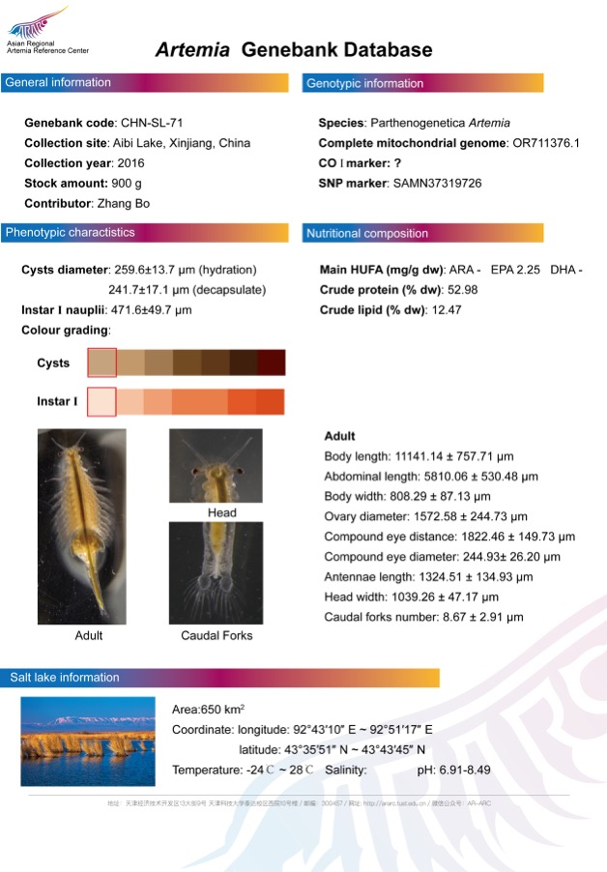
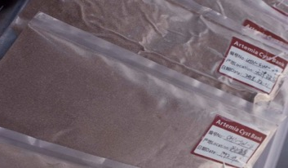
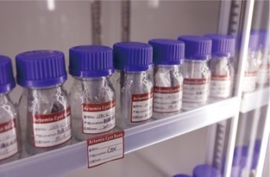
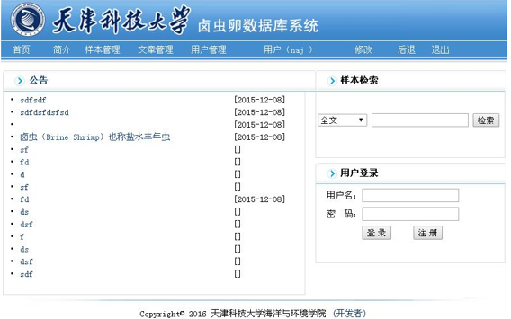
China – ARARC CYSTS BANK

Slide 17
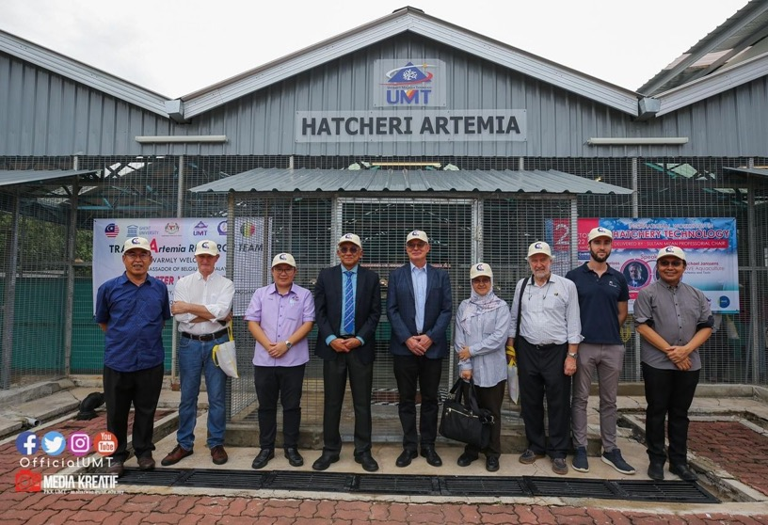
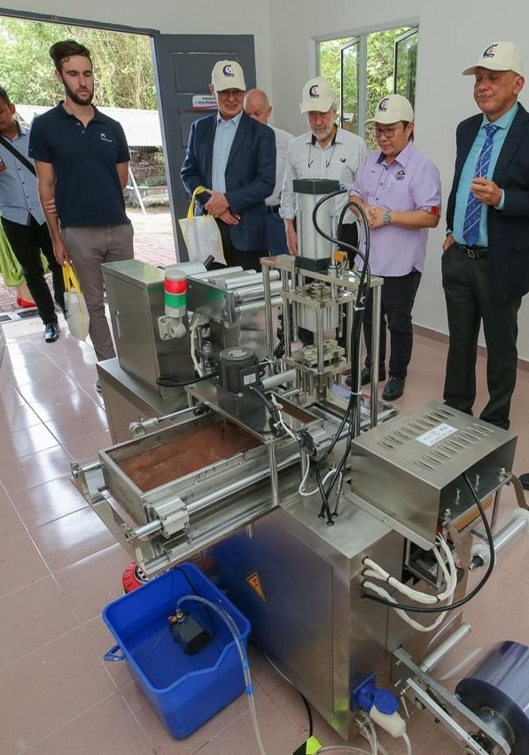
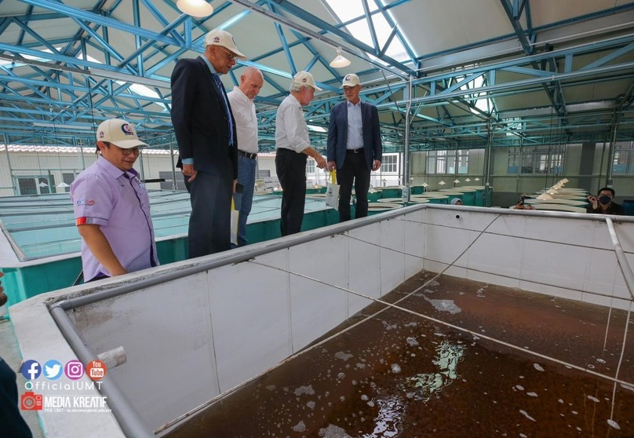
MALAYSIA
Artemia Production Facilities @ UMT
Artemia culture Facilities
Artemia Food Preparation Facilities
Artemia Depuration & Sterilization Facilities
Artemia Packaging Facilities
Artemia QC Laboratory
Artemia cysts production tank - Pilot

Slide 18
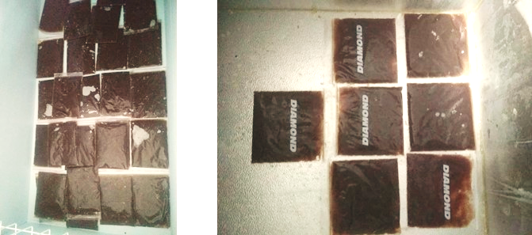
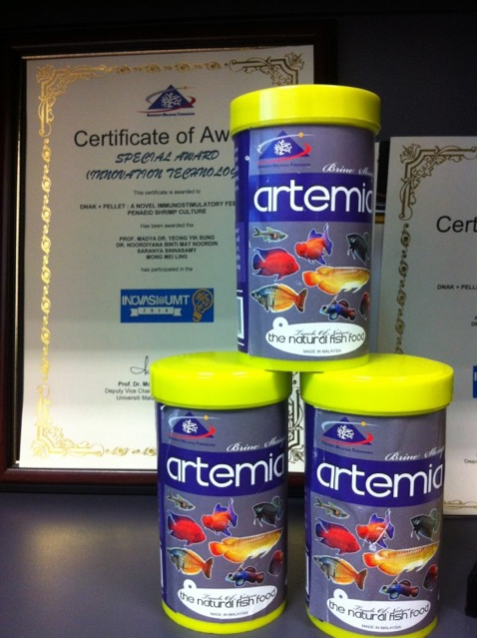
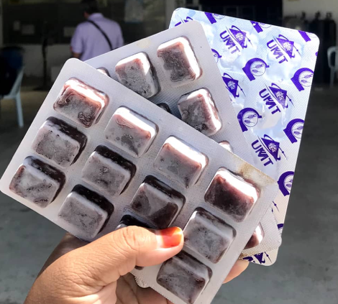
MALAYSIA

Slide 19
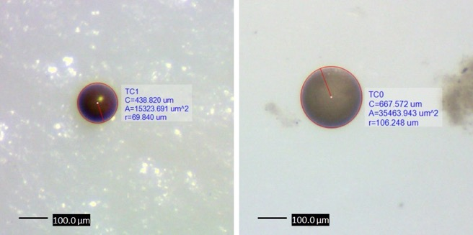
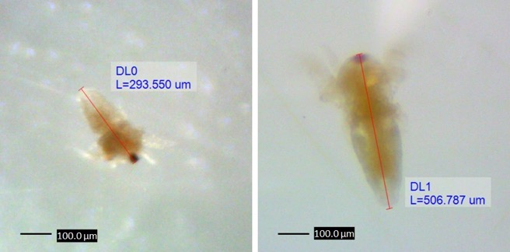
The 3 Pillars
Education & Training
Research & Innovation
Services to Communities & Industries
See website https://artemia.info/

Slide 20
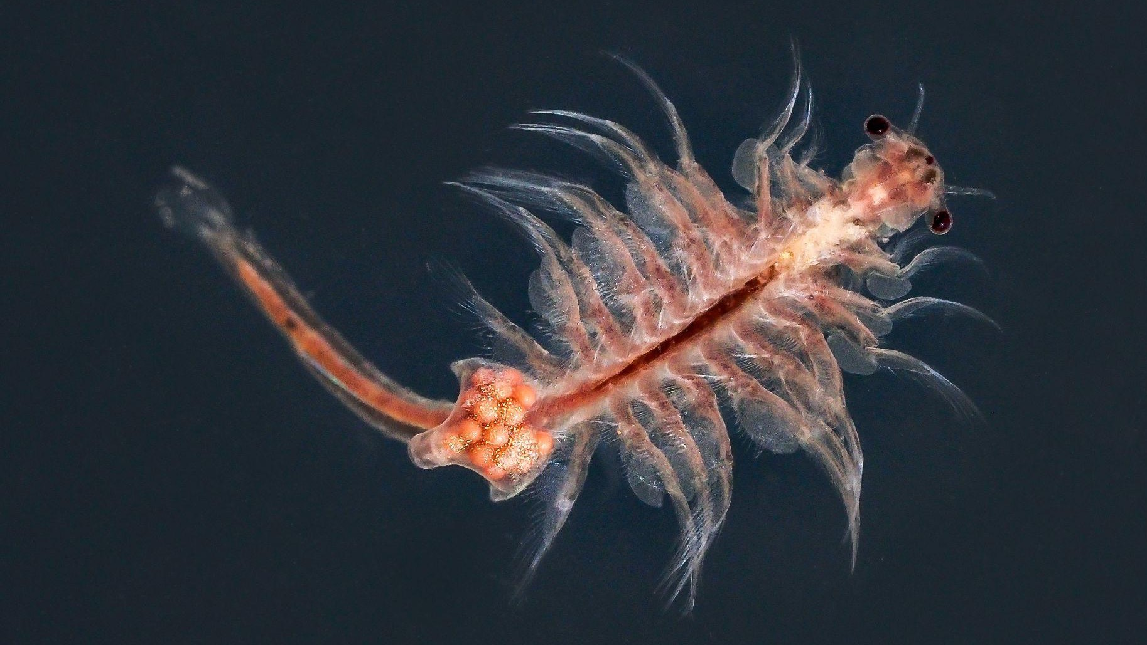
Thank you

