Slide 1
The Brine Shrimp Artemia in Animal Feeds: Opportunities in Africa and Abroad
Kartik Baruah, Stephanie De Vos, Parisa Norouzitallab
Aquaculture Nutraceuticals & Resilience Group Department of Applied Animal Science and Welfare
Swedish University of Agricultural Sciences, Uppsala, Sweden
Patrick Sorgeloos
Lab of Aquaculture & Artemia Reference Center
Department of Animal Sciences & Aquatic Ecology
Ghent University, Ghent, Belgium

Slide 2
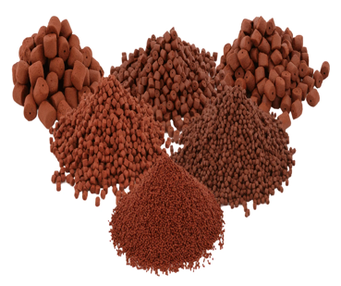
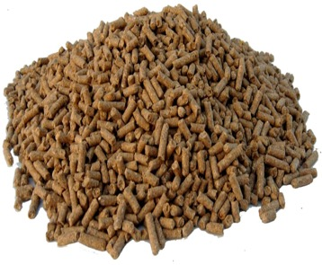
Feed and Feed Ingredients
Costs
1
Ecological
footprint
Quality
5
2
4
3
Sustainability
Regulatory
Compliance

Slide 3
Feed Ingredients – The 3 Generations
First Generation
Maize (corn)
Soybean meal
Wheat
Barley
Fishmeal & Fish oil
Second Generation
Rice bran
Palm kernel cake
Insect meal
Seaweed
Distillers dried grains with soluble
Third Generation
Lab-cultured proteins (e.g. single-cell proteins)
Precision-fermented feed ingredients
Genetically engineered crops for feed
Conventional feed sources directly derived from food crops, also consumed by humans.
Non-food or by-product sources not directly competing with human food, derived from non-conventional crops (agricultural wastes, forest wastes).
Conventional feed sources directly derived from food crops that are also consumed by humans.

Slide 4
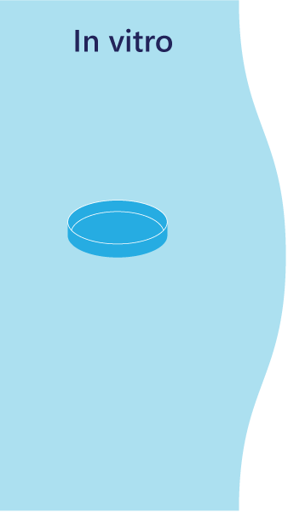
Quest for (Novel) Feed Ingredients
Non-conventional
Ingredients
Artemia

Slide 5
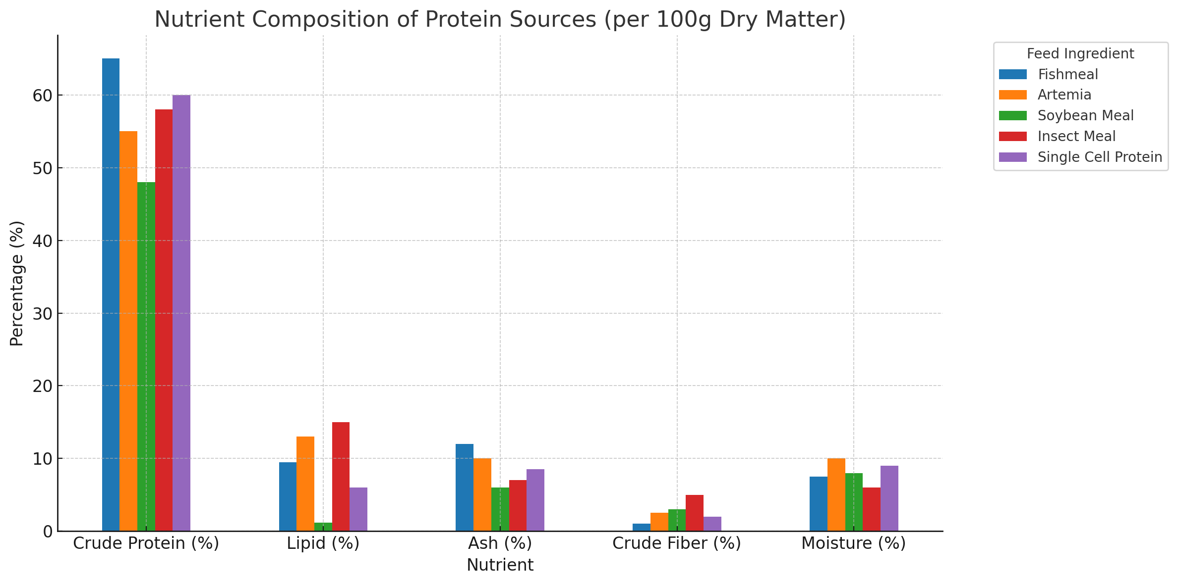
Feed and Feed Ingredients: Nutrient Comparison
Nutritional Composition Comparison of Different Generations Feed Ingredients
Nutritients

Slide 6
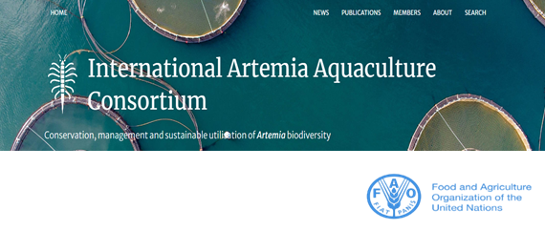
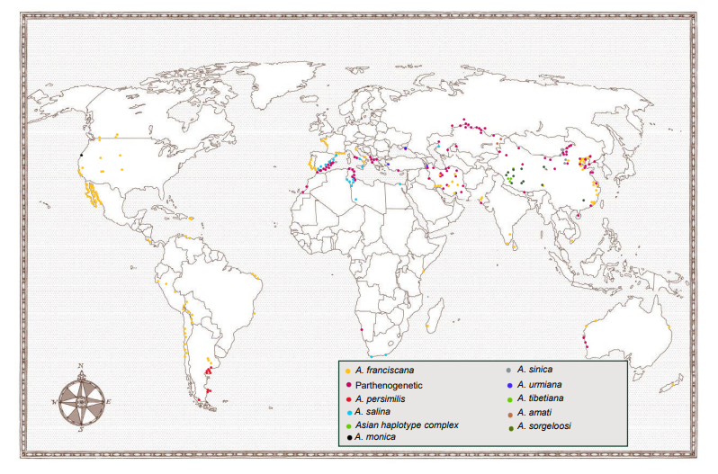
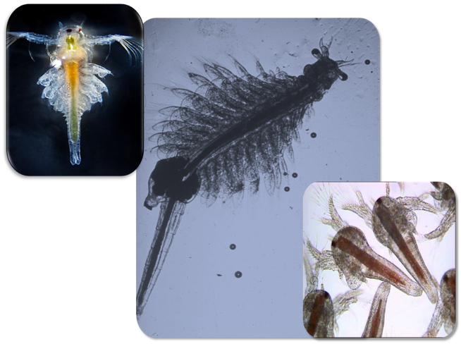
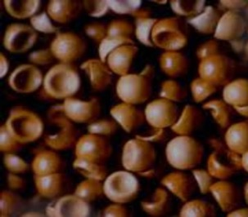
Global Distribution of Artemia

Slide 7
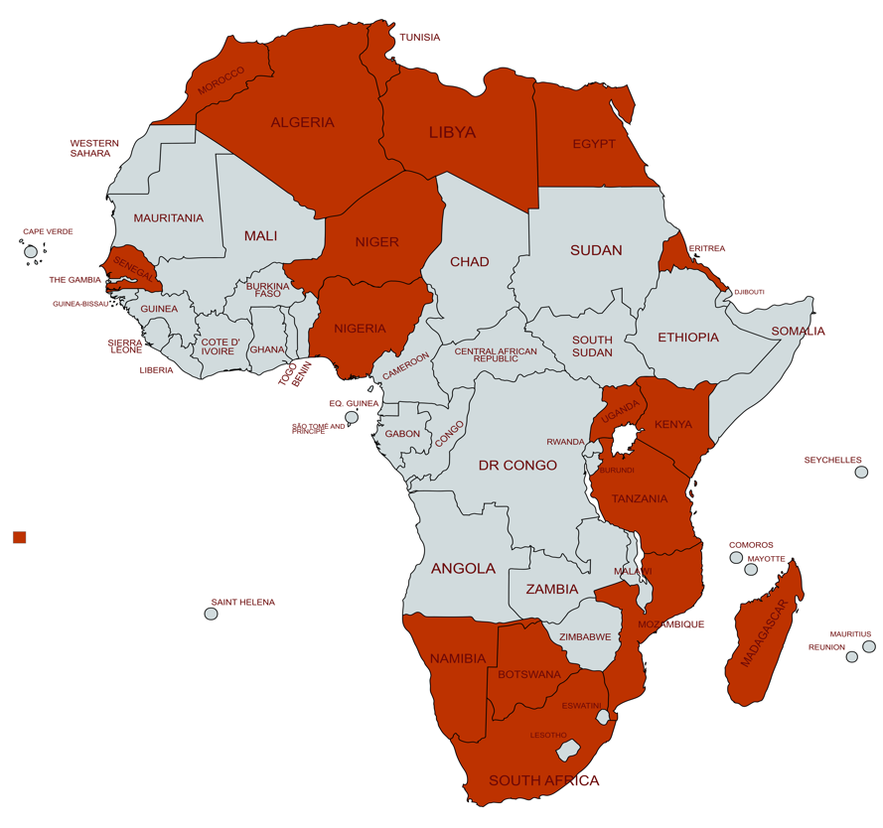
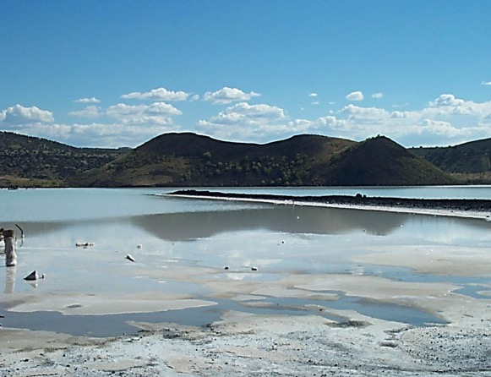
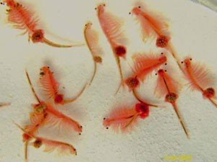
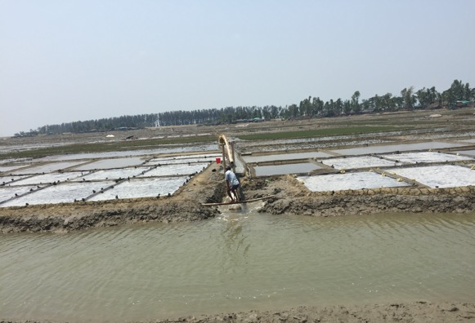
Distribution/Activities of Artemia in Africa

Slide 8
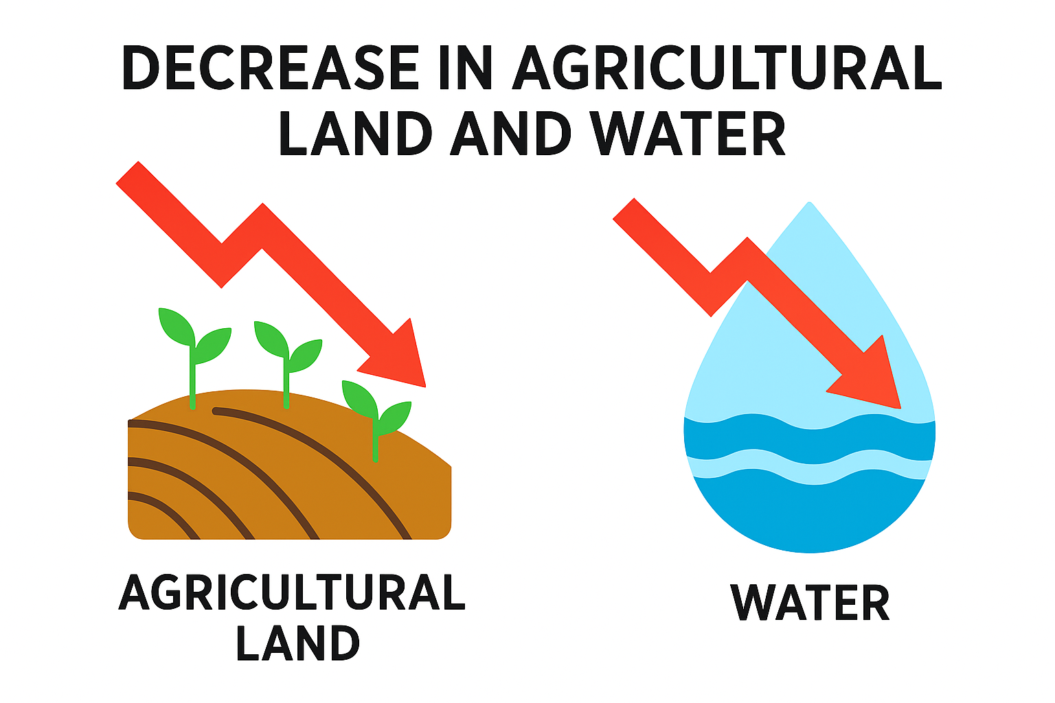
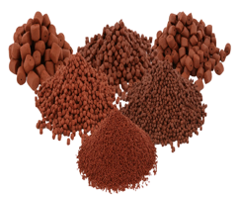
Feed and Feed Ingredients
Costs
1
Ecological
footprint
Quality
5
2
4
3
Sustainability
Regulatory
Compliance

Slide 9
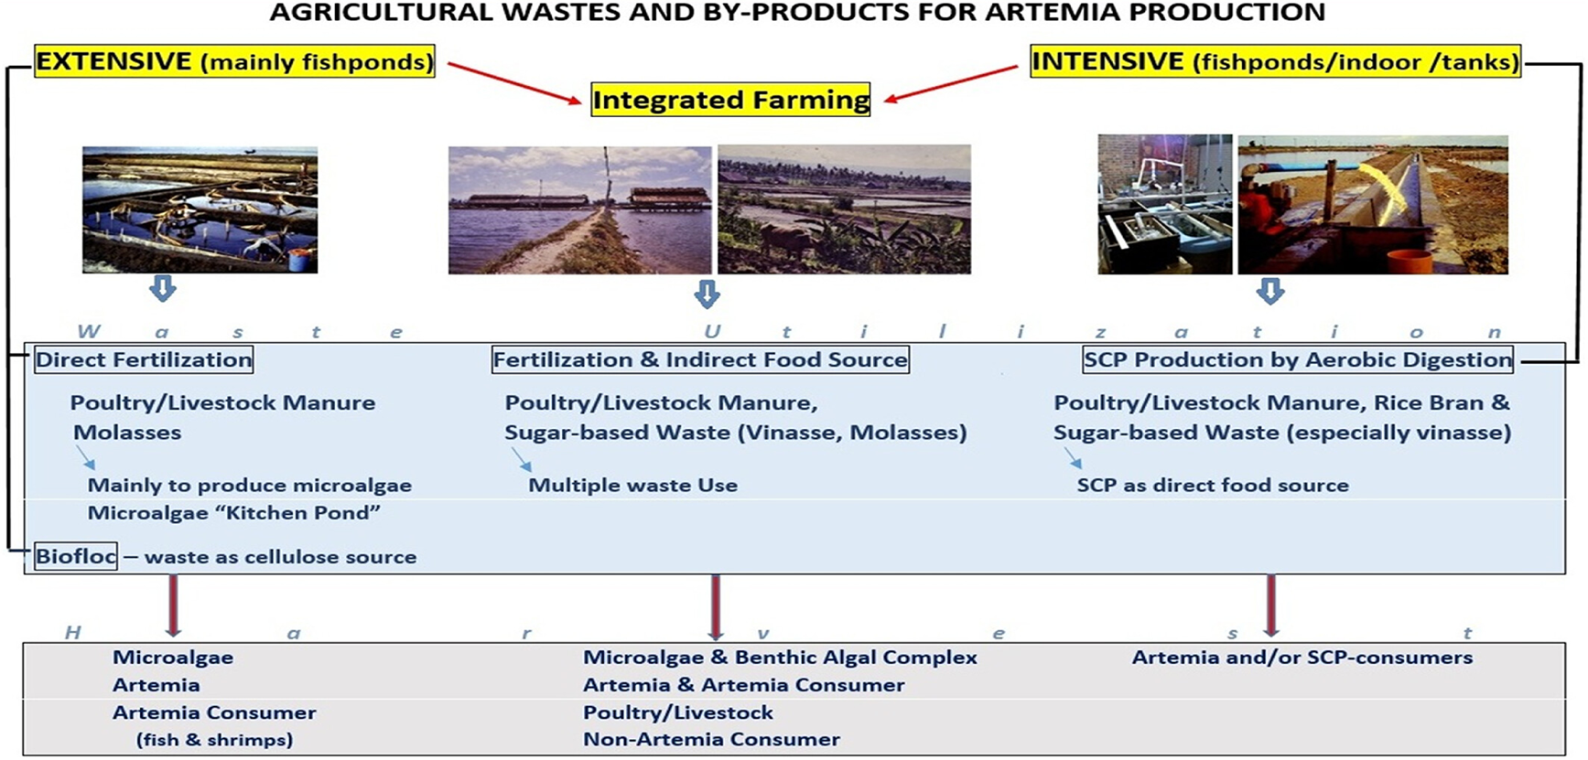
Bioconversion of Waste to Feed Ingredients

Slide 10
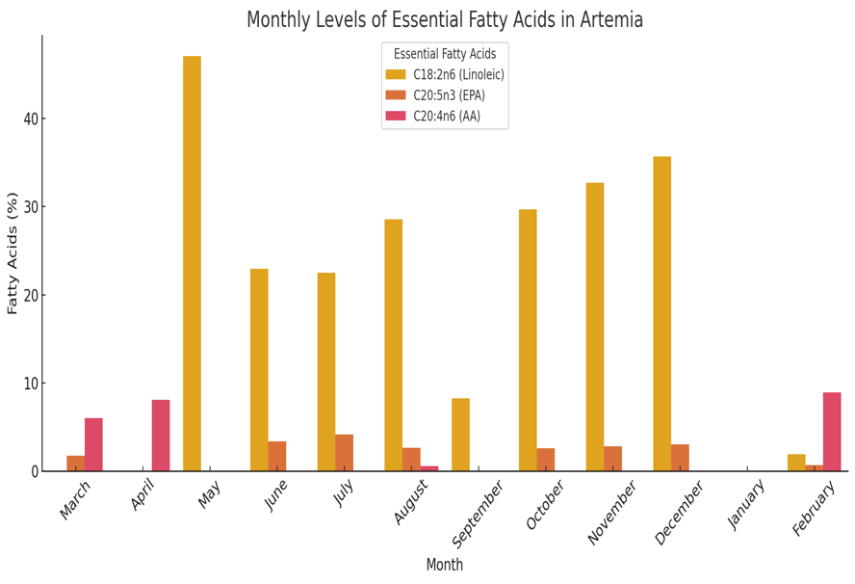
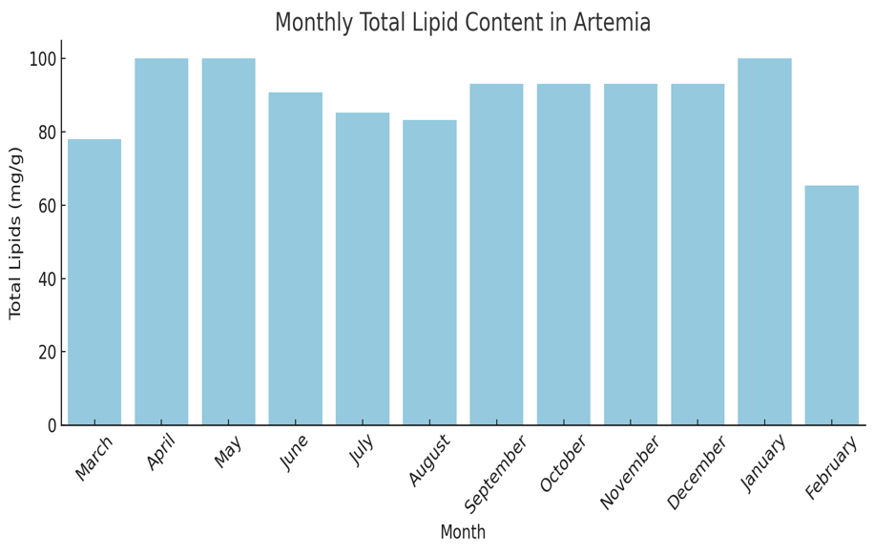
Feed and Feed Ingredients

Slide 11
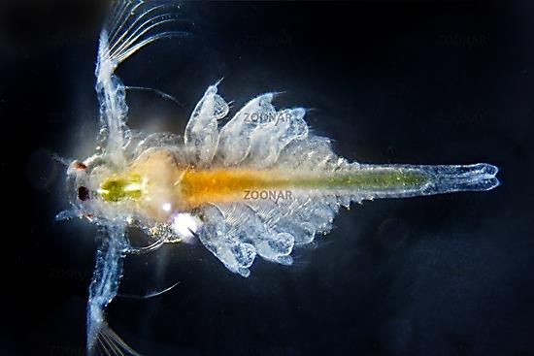
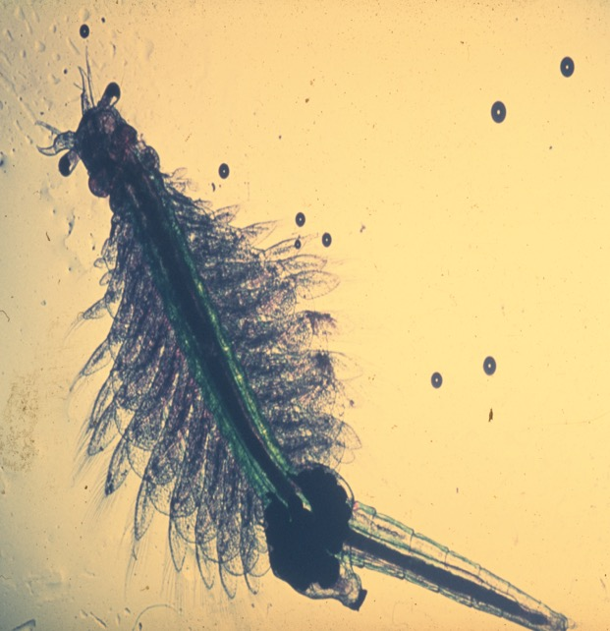
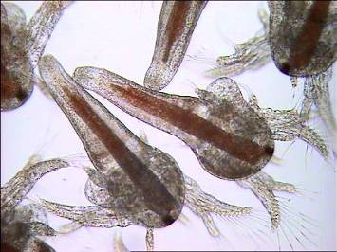
Feed and Feed Ingredients
(Digestible) Chitin

Slide 12
Artemia: More than a Feed Ingredients
Non-conventional
Ingredients
Nutraceutical
Ingredient
Conventional
Ingredients

Slide 13
Artemia as Feed Ingredients
- CASE STUDIES – Artemia Meal as Aquafeed

Slide 14
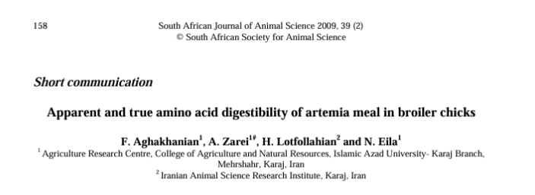
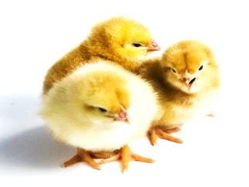
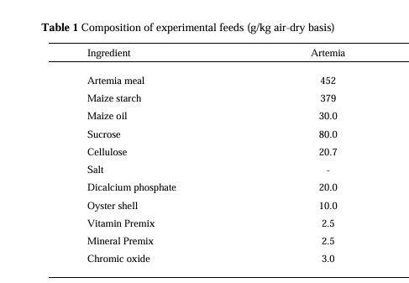
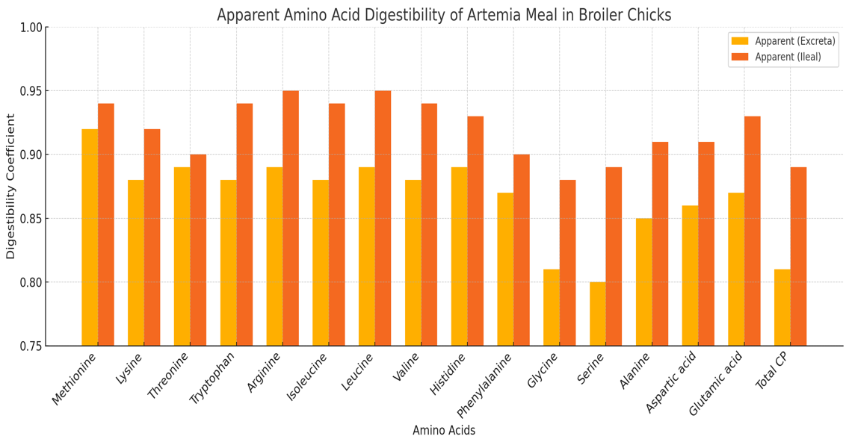
Feed and Feed Ingredients

Slide 15
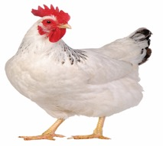
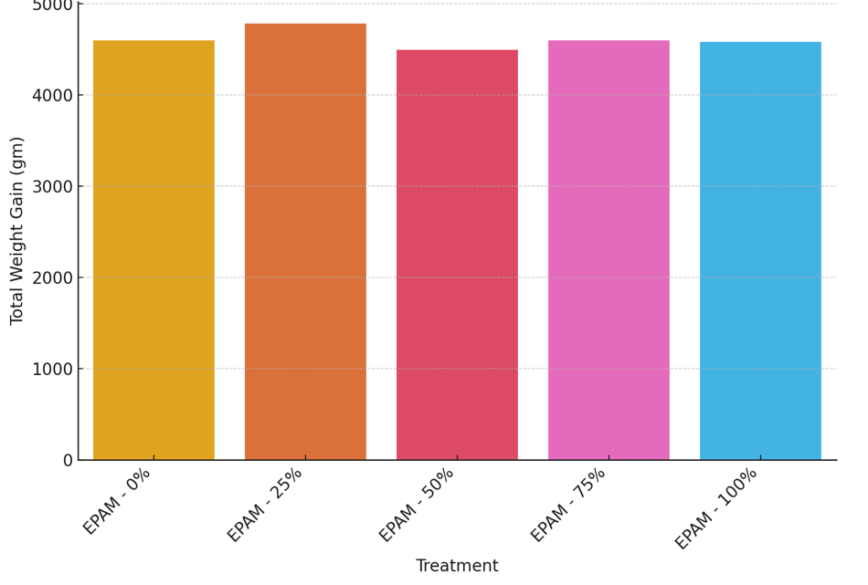
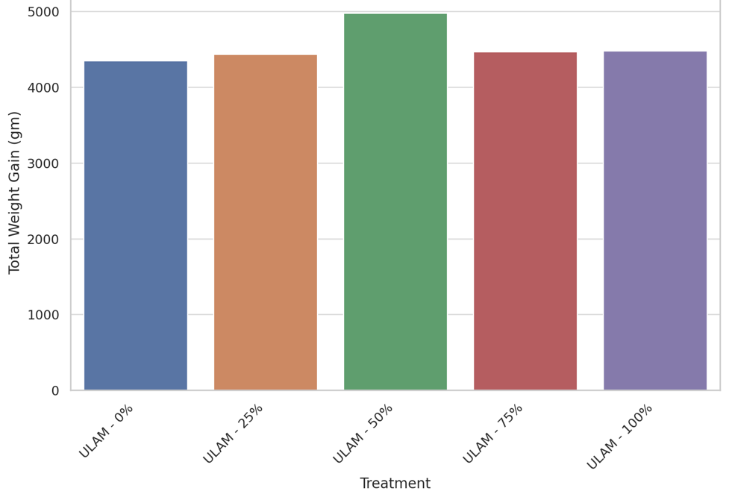
Impact of Artemia meal on the growth of Poultry
ULAM: Urmia Lake Artemia Meal; EPAM: Earth Pond Artemia Meal

Slide 16
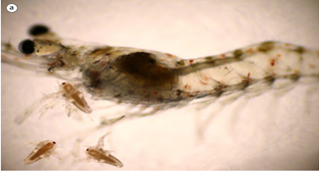
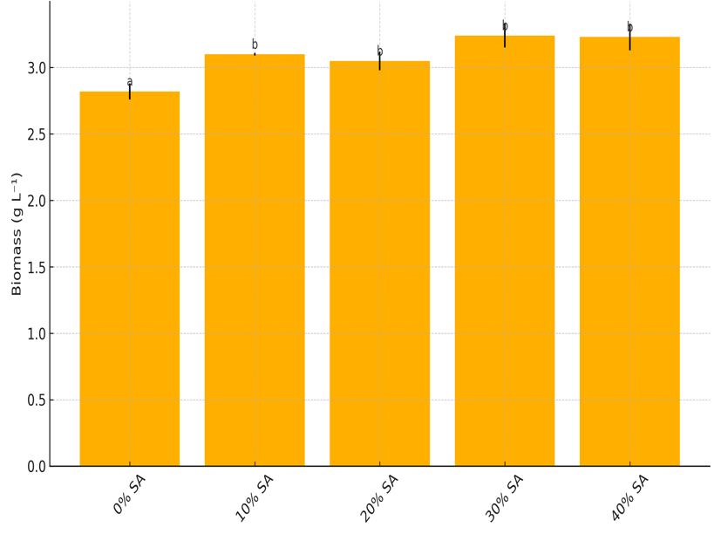
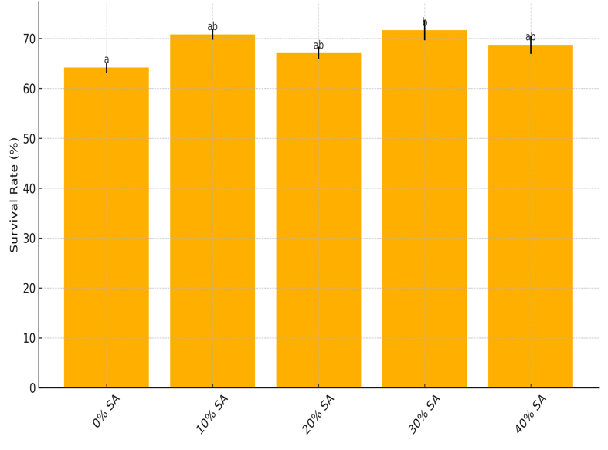
Feed and Feed Ingredients
AACL Bioflux, 2024, Volume 17, Issue 5.
Survival
Biomass

Slide 17
Cost-Benefit Analysis: A Snapshot
Fish meal vs Artemia meal (USD/kg, dry weight): ~ 1.6 vs ~ 1.0 USD
Costs
 | Feed components
Major Ingredients | Protein source
 | Energy source
 | Lipid (fat) source
 | Fiber source
Minor Ingredients | Mineral & Vitamin Premixes
 | Additives
1
Ecological
footprint
Quality
5
2
Carbon-neutral
Nutraceutical Ingredient
4
3
Sustainability
Regulatory
Compliance

Slide 18
Feed and Feed Ingredients
Linear economy
Circular economy
Production
Consumption
Waste management
Waste to resource
1
Resource
2
Products
3
Waste
Source: https://www.sustainableanimalnutrition.com/2020/12/01/sustain-circular-economy-keeping-nutrients-in-the-food-chain/

Slide 19
Feed and Feed Ingredients
Bioconversion of non-Food Bioresources to Novel Nutraceutical Ingredients
Yohanes Pamungkas Bawono

Slide 20
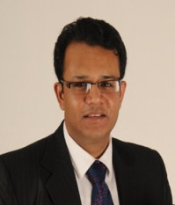
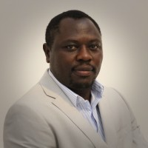
Feed and Feed Ingredients
SLU-WorldFish Project on Aquafeed
Assoc. Prof. Kartik Baruah
Research Group Leader
SLU, Sweden
Dr. Rodrigue Yossa, Director
Aquatic Foods Biosciences
WorldFish, Malaysia

Slide 21
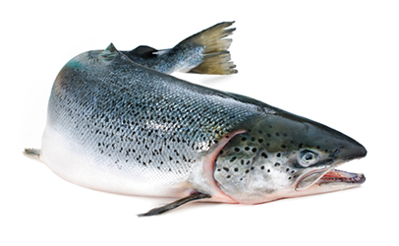
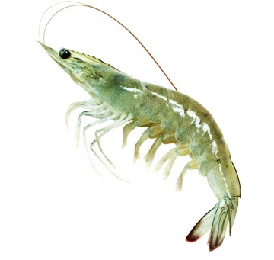
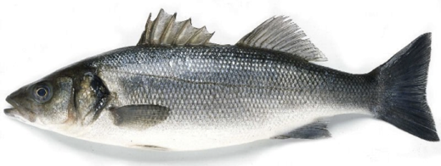
Feed and Feed Ingredients
Circular economy
Production
Consumption
Waste management
Waste to resource
INGREDIENTS
(microbial protein)
Source: https://www.sustainableanimalnutrition.com/2020/12/01/sustain-circular-economy-keeping-nutrients-in-the-food-chain/

Slide 22
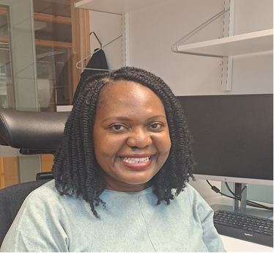
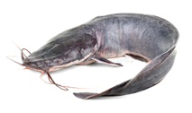
WorldFish-SLU: Waste to Feed Ongoing Projects
Sustainable Feed
for
Sustainable Aquaculture
Nigeria
Catfish
Zambia
Tilapia
Patience Chungu; PhD Student
Arnold Ebuka Irabor; PhD Student

Slide 23
WorldFish-SLU: Waste to Feed Ongoing Projects
Agricultural industry
Waste
Artemia Biomass
Artemia Nutraceutical Ingredients
Patience Chungu; PhD Student
Arnold Ebuka Irabor; PhD Student

Slide 24
Take Away Message

Slide 25
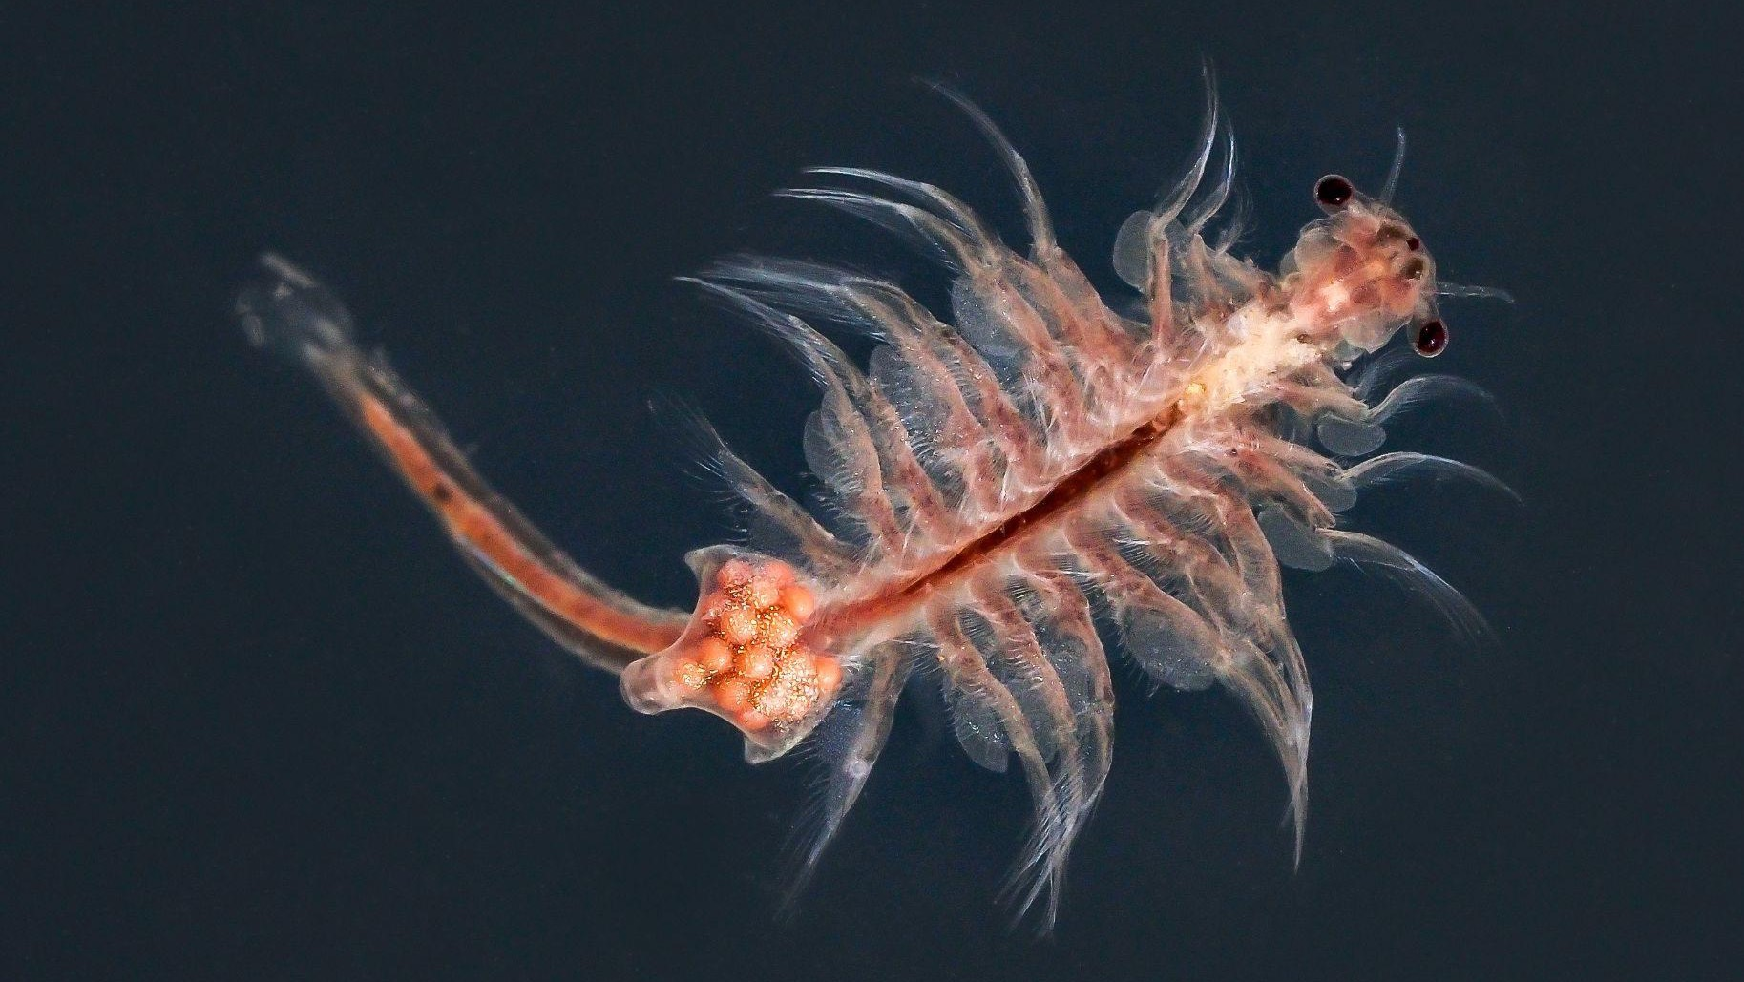
Thank you

