Slide 1
Artemia Potential For Human Food: A Cost-Effective Nutrition-Sensitive Innovation & Business Model For Food, Nutrition And Economic Security
Dr Manika Saha
Monash University, Australia
Global Artemia Summit
World Aquaculture Society (WAS) Safari Conference 2025
Uganda - June, 2025

Slide 2
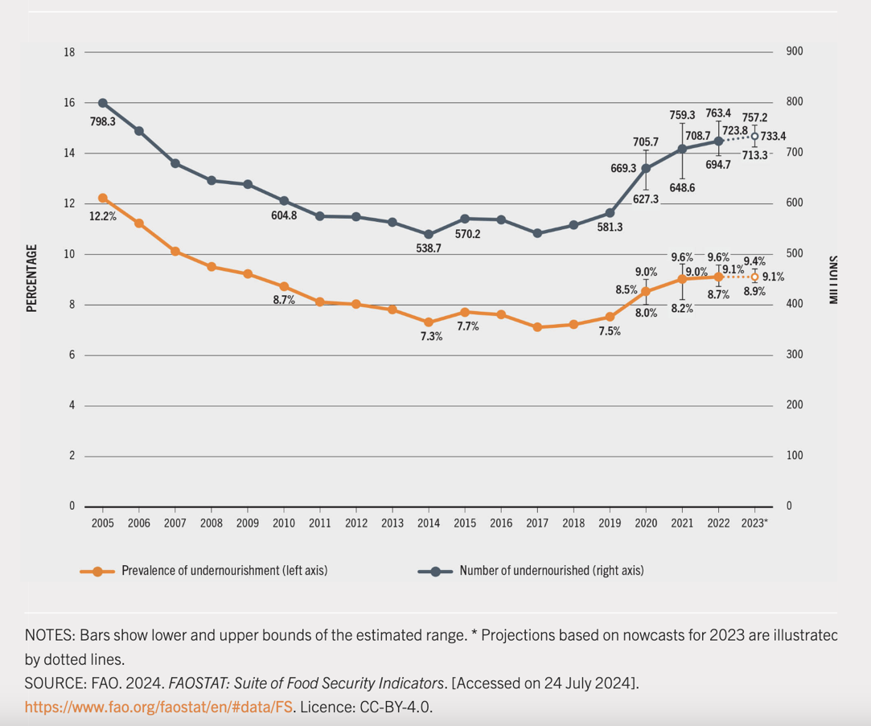
OUTLOOK ON GLOBAL FOOD AND NUTRITION SECURITY
Global hunger rose sharply from 2019 to 2021 and persisted at the same level to 2024

Slide 3
THE GROWING GLOBAL FOOD INSECURITY CRISIS: WHY WE NEED NEW SOLUTIONS
Global hunger affects ~733 million people in 2023 (9.1% of world population), up by 152 million since 2019.
Africa faces the highest hunger burden: 20.4% of its population is undernourished (~300 million people).
Severe food insecurity affects 864 million people worldwide (10.7%).
Moderate or severe food insecurity touches 2.33 billion people – 28.9% of the global population.
**58% of people in Africa are food insecure – double the global average.
Food insecurity is worse for women and rural populations.
Little progress toward SDG 2 (Zero Hunger); ongoing conflicts, wars, inflation, climate change and pandemic effects are worsening the situation.
The current scenario shows that 582 million people, or 6.8 percent of the global population, will be chronically undernourished in 2030, pointing to the immense challenge of achieving SDG 2 (Zero Hunger). This is about 130 million more undernourished people than in the “projections before COVID-19 pandemic” scenario.

Slide 4
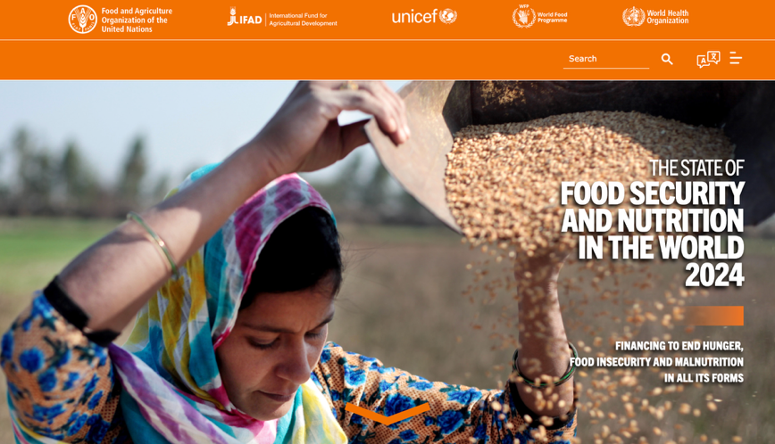
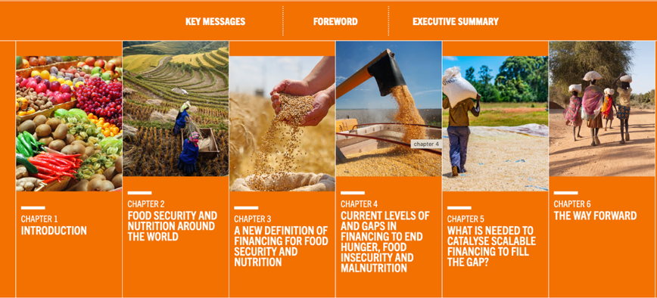
A COMPREHENSIVE APPROACH TO FINANCING FOOD SECURITY AND NUTRITION
A new definition of financing for food security and nutrition:
“Financing for food security and nutrition refers to the public and private financial resources, both domestic and foreign, that are directed towards eradicating hunger, food insecurity and all forms of malnutrition. They are targeted to ensure the availability, access, utilization and stability of nutritious and safe foods, and practices that favour healthy diets, as well as health, education and social protection services that enable these, and include the financial resources that are directed towards strengthening the resilience of agrifood systems to the major drivers and underlying structural factors of hunger, food insecurity and malnutrition.”

Slide 5
ARTEMIA: COST-EFFECTIVE, SCALABLE, AND CLIMATE-RESILIENT NUTRITION SOLUTIONS
SUPERFOOD
High protein content (40-60%)
Rich in omega-3s (PUFAS like EPA and DHA)
Adaptable to many different recipes
Ease of processing, storage and transport
COST-EFFECTIVE
Grows in saline, non-arable lands — no competition with crops.
Production costs as low as $1 per kg of Artemia biomass.
50g of Artemia can produce high-protein meals (kebabs, omelets) for under $0.05 per serving.
SCALABLE
A 1-hectare Artemia pond can produce up to 2 tons per month.
Rapid growth cycle: full maturity in ~2 weeks (vs. 6 months for shrimp, 12–18 months for cattle).
Scalable for smallholder farmers, salt farmers, and women-led businesses.
CLIMATE-RESILIENT
Thrives in hypersaline, climate-stressed environments unsuitable for most crops or fish.
Requires minimal freshwater, low inputs, and produces low GHG emissions.
Offers a sustainable livelihood option in coastal and drought-prone regions.

Slide 6
NUTRITIONAL COMPOSITION OF ARTEMIA
Nutrient Category | Nutrient | Content | Unit
Macronutrients | Protein | 30–65 | % dry weight
 | Lipids | 10–20 | % dry weight
 | Carbohydrates | 15–25 | % dry weight
Minerals | Calcium | 0.2–4.8 | mg/g
 | Iron | 269–2946 | µg/g
 | Zinc | 75–241 | µg/g
Vitamins | Vitamin B-Complex | Rich (qualitative) | -
 | Vitamin E | Rich (qualitative, antioxidant) | -
Fatty Acids | Palmitic Acid (16:0) | 5.74% – 26.6% | % of total fatty acids
 | Palmitoleic Acid (16:1) | 3.12% – 30.6% | % of total fatty acids
 | Oleic Acid (18:1, n-9) | 14.0% – 37.5% | % of total fatty acids
 | Linoleic Acid (18:2, n-6) | 1.6% – 11.8% | % of total fatty acids
 | Linolenic Acid (18:3, n-3) | 0.4% – 33.6% | % of total fatty acids
 | Eicosapentaenoic Acid (EPA) | 0.2% – 20.5% | % of total fatty acids
 | Docosahexaenoic Acid (DHA) | 0.1% – 1.5% | % of total fatty acids
Léger, P., Bengtson, D. A., Sorgeloos, P., Simpson, K. L., & Beck, A. D. (1987). The nutritional value of Artemia: a review. Artemia research and its applications, 3, 357-372.

Slide 7
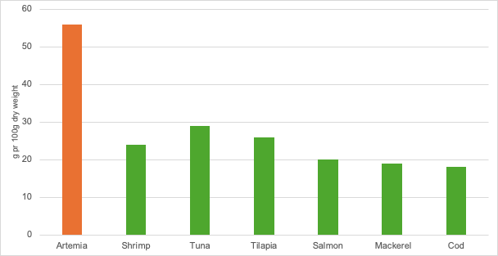
PROTEIN CONTENT COMPARISON (average)

Slide 8
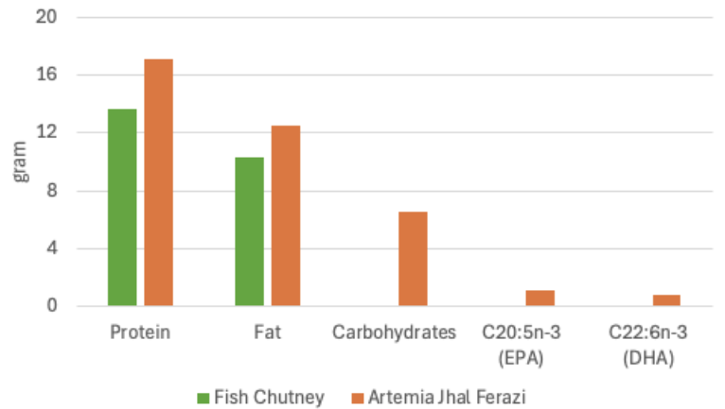
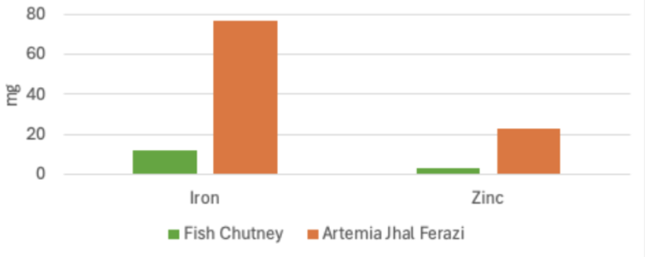
NUTRITIONAL COMPARISON: FISH CHUTNEY vs ARTEMIA JHAL FERAZI

Slide 9
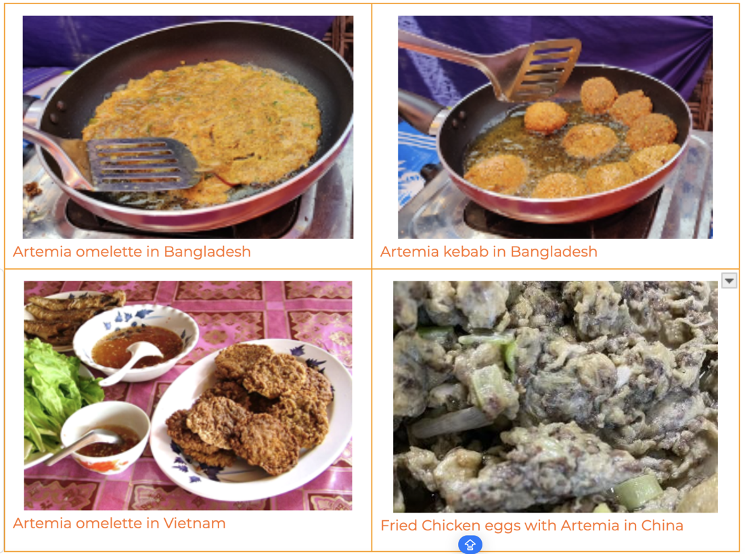
ARTEMIA BIOMASS IN LOCAL HUMAN FOOD RECIPES IN VIETNAM, BANGLADESH, AND CHINA
“Artemia is an osmoregulator”
Artemia seasoning powder product in Vietnam

Slide 10
ARTEMIA FOR WOMEN AND CHILDREN IN FIRST 1000 DAYS OF LIFE
 | (% of Recommended Daily Intake (RDI) Met by 50g of Artemia) |  |  | (% of Recommended Daily Intake (RDI) Met by 30g of Artemia)
Group | Protein (%) | Lipids (%) | Carbohydrates (%) | Protein (%) | Lipids (%) | Carbohydrates (%)
Pregnant women | 35 | 9.6 | 3.8 | 21.1 | 5.6 | 2.3
Lactating women | 35 | 8.9 | 3.5 | 21.1 | 5.6 | 2.1
Infants (6-12 months) | 227 | 17.9 | 6.7 | 136.4 | 10.7 | 4.0
Children (1-2 years) | 192 | 15.6 | 5.8 | 115.4 | 9.4 | 3.5

Slide 11
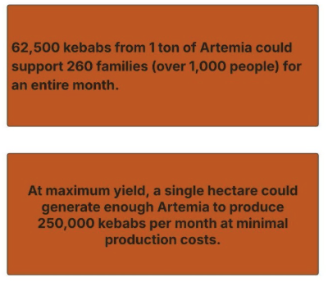
RAPID NUTRITION SOLUTION: ARTEMIA FOR HUMAN FOOD

Slide 12
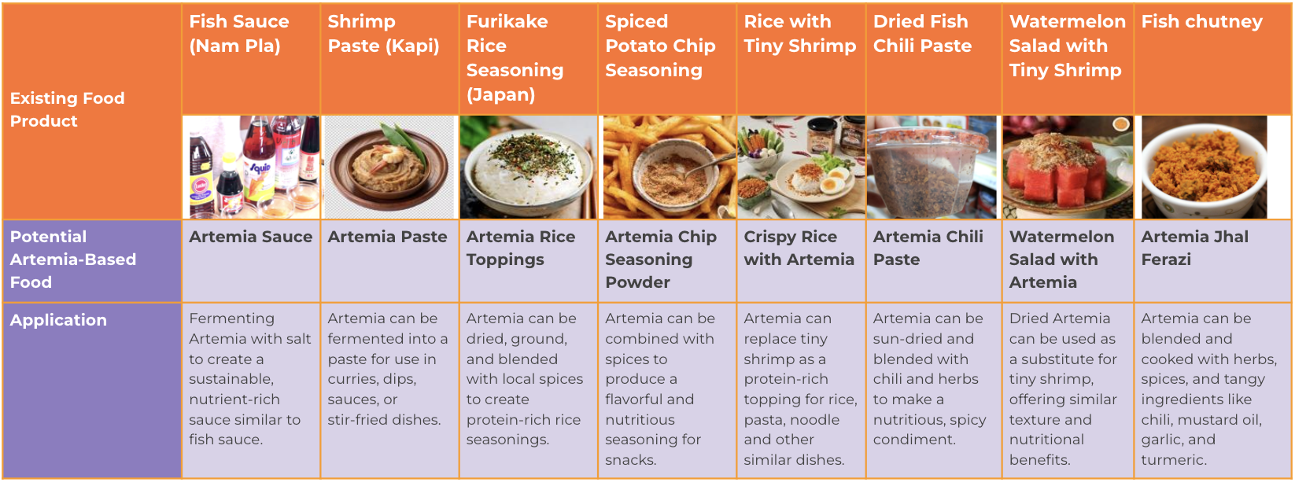
EXISTING ASIA-BASED FOOD PRODUCTS AND POTENTIAL FUTURE ARTEMIA-BASED ALTERNATIVES

Slide 13
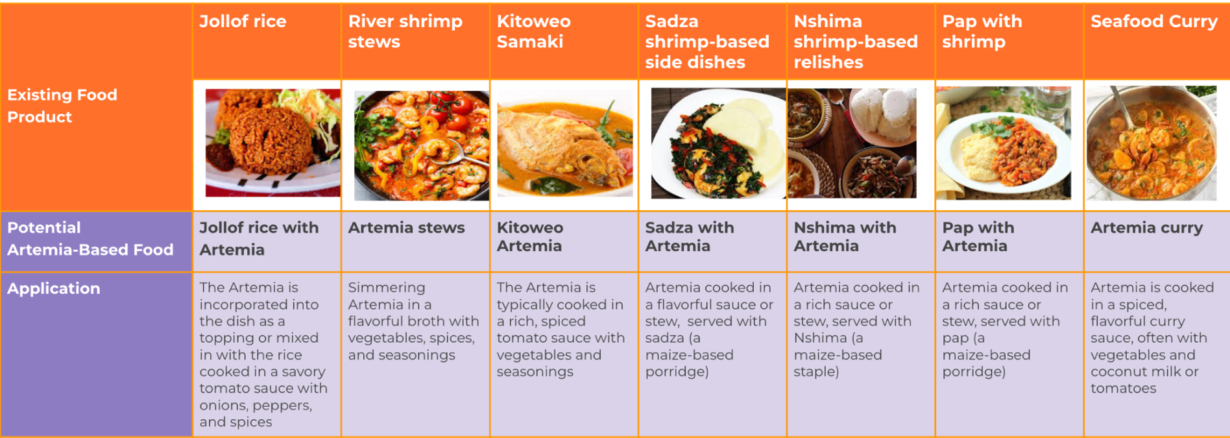
EXISTING AFRICAN-BASED FOOD PRODUCTS AND POTENTIAL FUTURE ARTEMIA-BASED ALTERNATIVES

Slide 14
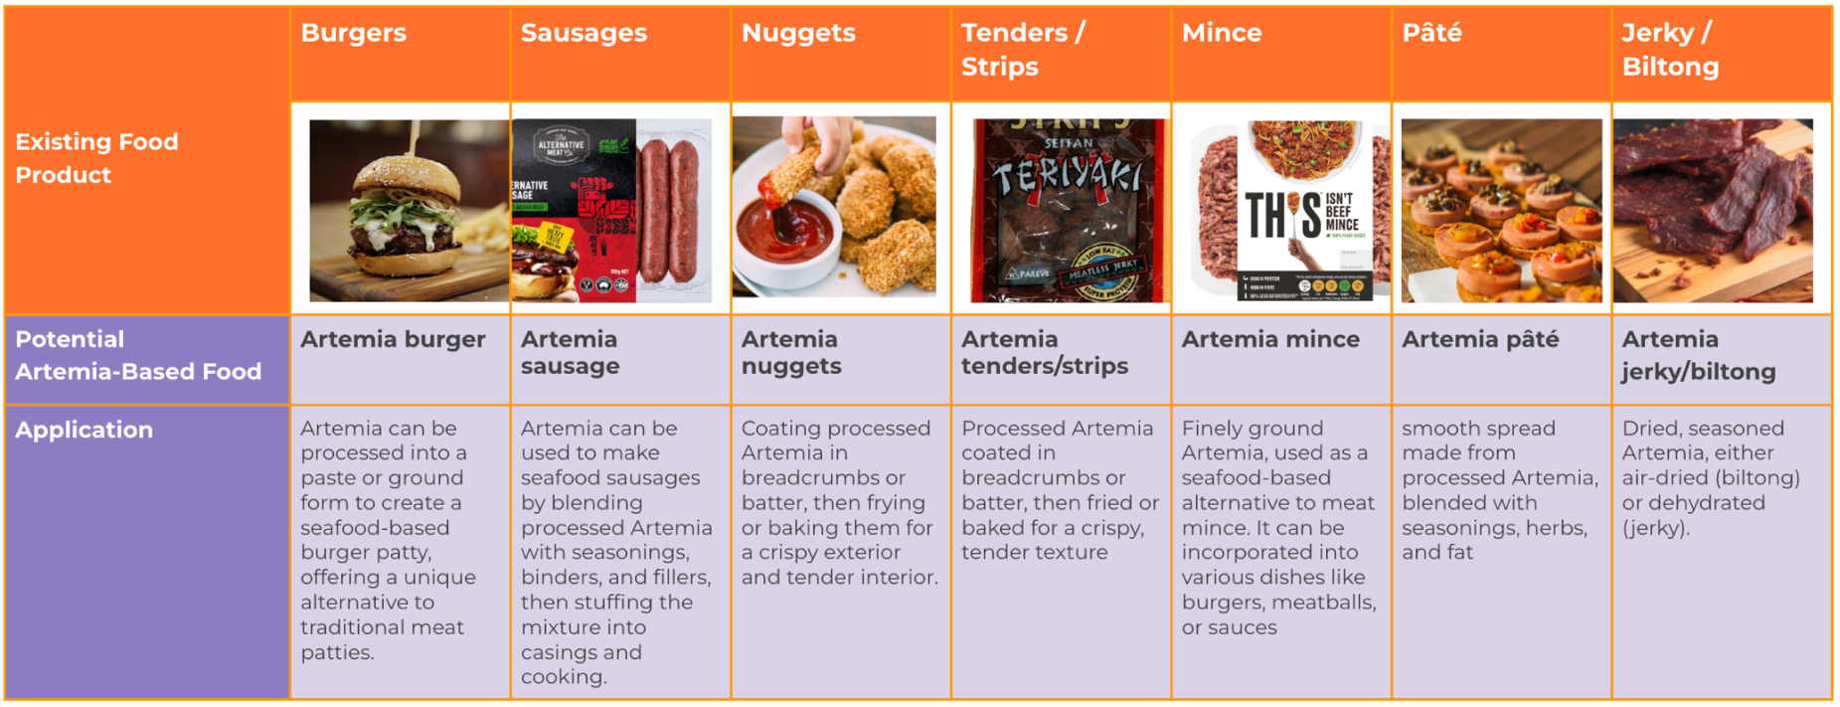
EXISTING WESTERN-BASED FOOD PRODUCTS AND POTENTIAL FUTURE ARTEMIA-BASED ALTERNATIVES

Slide 15
KEY OPPORTUNITIES FOR ARTEMIA INTEGRATION IN AFRICA
Women-Led Artemia-Based Food Production for Income Generation
1. Artemia-Based Food Products for Local and Export Markets Women-led businesses can develop and commercialize Artemia-based food products such as: Artemia Omelet & Kebab – High-protein, affordable street food and household meal alternatives. Artemia Fish Sauce & Powder – A sustainable alternative to traditional fish sauce, reducing pressure on wild fish stocks. Artemia Seasoning & Soup – Ready-to-use, fortified spice blends and protein-rich soup bases. Artemia Sausage & Meat Substitutes – Plant-based and seafood-flavored Artemia sausages for vegan/alternative protein markets. 2. Employment and Economic Empowerment for Women in Artemia Farming Women play a central role in food production and processing but often lack access to financial resources, training, and market integration. Artemia farming and food processing present a high-impact opportunity for women-led entrepreneurship and local food businesses. Earn stable incomes through Artemia food processing businesses. Reduce dependency on fluctuating fish stocks and high-cost protein sources. Improve household nutrition by incorporating Artemia into family meals.
Hot School Meals and World Food Programme (WFP) Initiatives
Malnutrition in School-Aged Children: Over 32 million African children suffer from stunted growth due to poor nutrition. School meal programs play a crucial role in improving education outcomes, cognitive development, and long-term health. Artemia-Enhanced School Meals: Integrating Artemia-based foods (omelets, kebabs, fish cakes, seasoning, soup) into school feeding programs can significantly enhance the protein and micronutrient intake of children. Alignment with WFP Goals: The World Food Programme (WFP) already supports school feeding programs in Africa. Artemia-based meals can be incorporated into existing WFP-supported initiatives to improve diet quality, meal affordability, and sustainability.

Slide 16
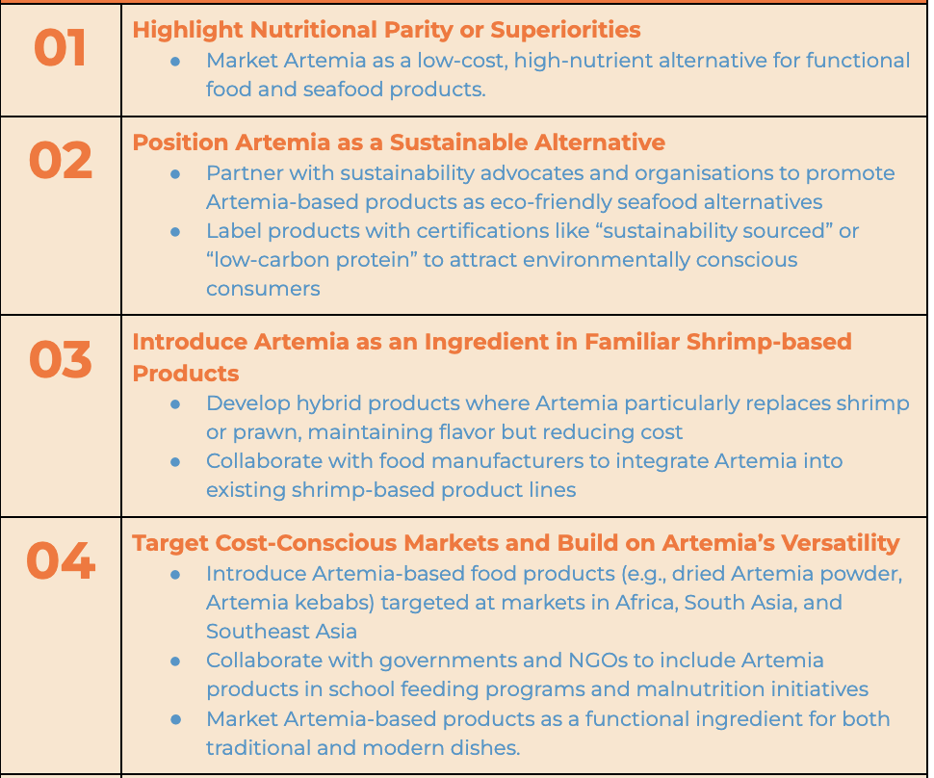
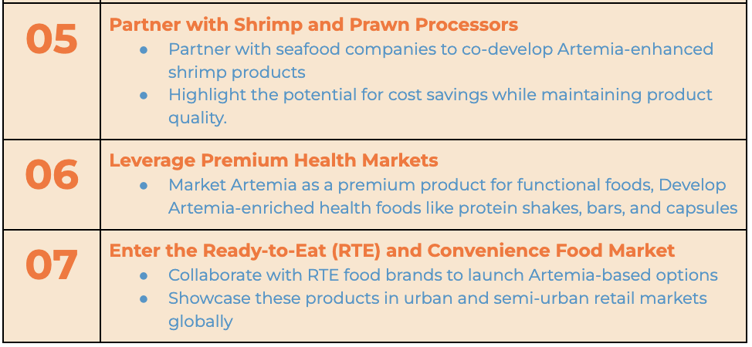
MARKET GROWTH STRATEGY (Unlock Business Insights with effective Market Research Strategies)

Slide 17
RECOMMENDATIONS FOR INVESTMENT IN ARTEMIA-BASED SOLUTIONS FOR HUMAN
Nutritional Research
Comprehensive Nutritional Profiling
Bioavailability of Nutrients
Anti-Nutritional Factors
Nutritional Optimization
Food Safety and Toxicology
Safety Assessments
Shelf-Life Studies
Regulatory Compliance
Product Development
Innovative Food Products
Cultural Integration
Fortified Foods
Consumer Acceptance and Market Research
Behavioral Studies
Market Positioning
Culinary Innovations
Awareness and Education
Environmental and Economic Feasibility
Sustainable Production
Adaptation to Climate Change
Cost Analysis
Community-Based Farming/ Livelihoods
Public Health and Policy Integration
Policy Advocacy
Global Partnerships
Empowering Women and Families
Awareness Campaigns
Research Funding and Collaboration
Interdisciplinary Studies
Pilot Projects
Comparative Studies
Regional Adaptation
Targeted Pilots in Food-Insecure Areas

Slide 18
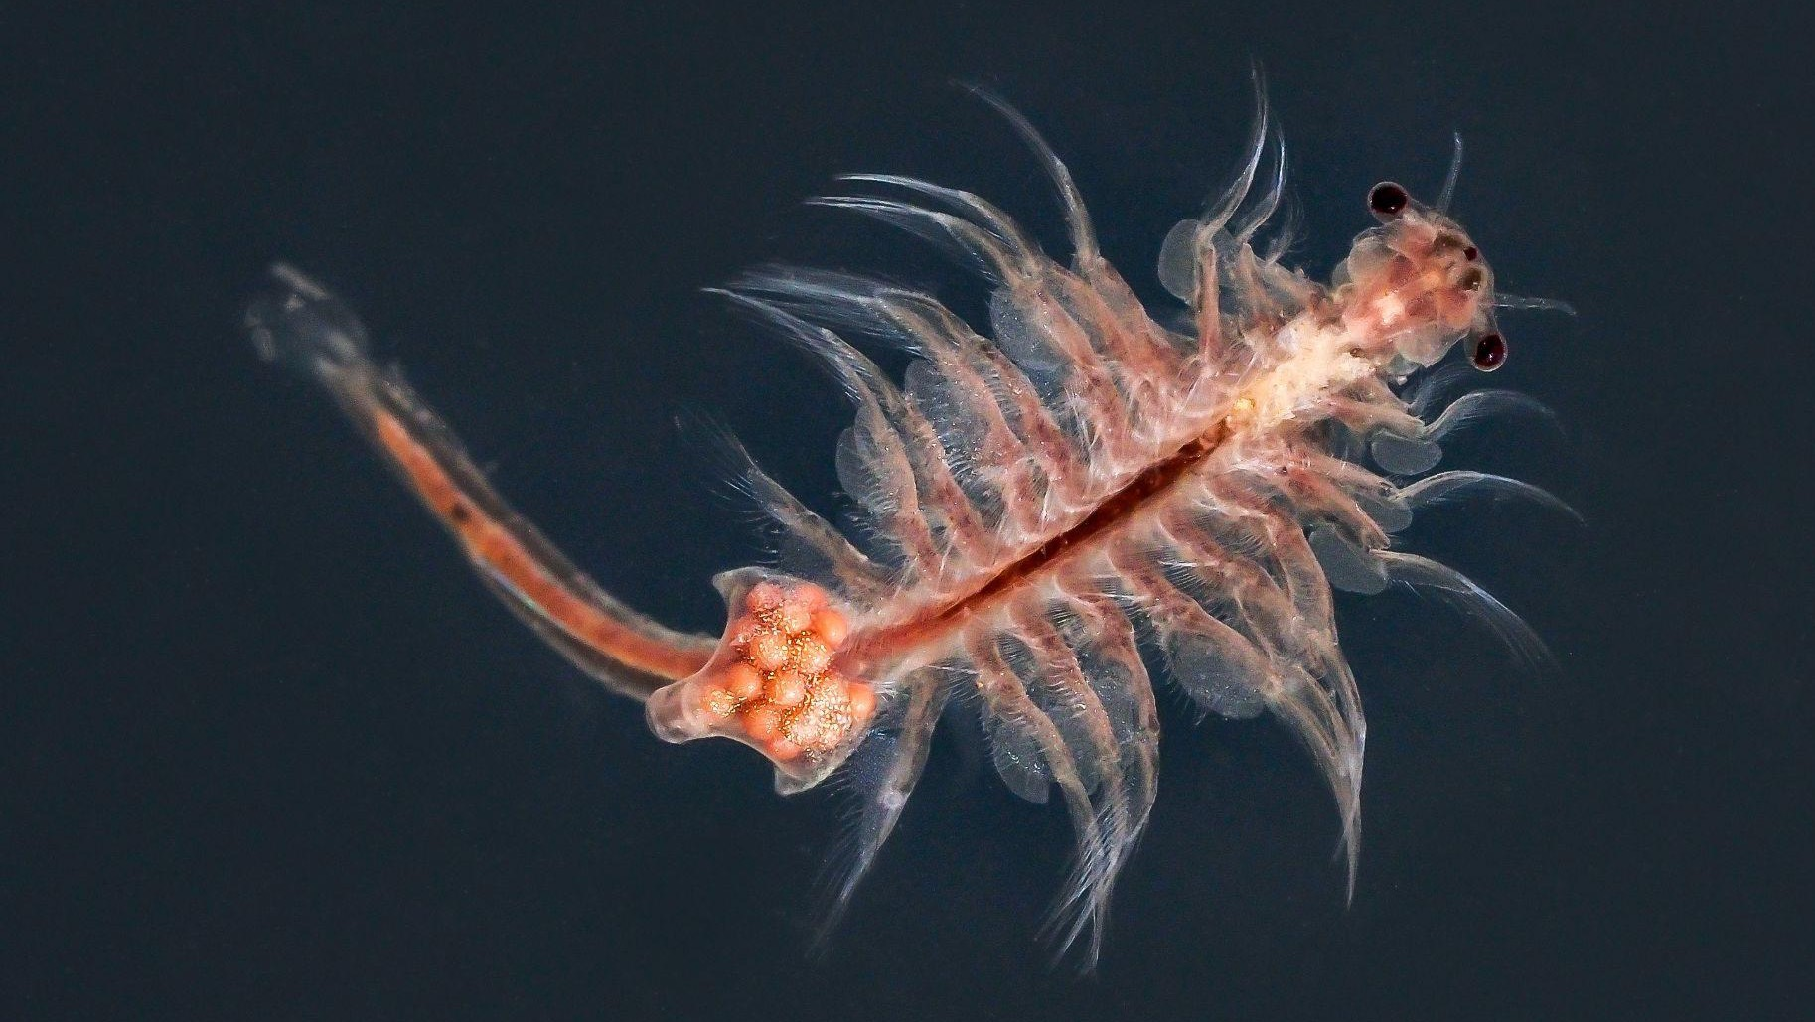
Thank you

