Slide 1
Crucial role of Artemia in solar salt production. Opportunity for new integrated Artemia-Salt farming business model
Hector Teruel (UNIDO) and Patrick Sorgeloos (UGent)
Global Artemia Summit
World Aquaculture Society (WAS) Safari Conference 2025
Uganda, June, 2025

Slide 2
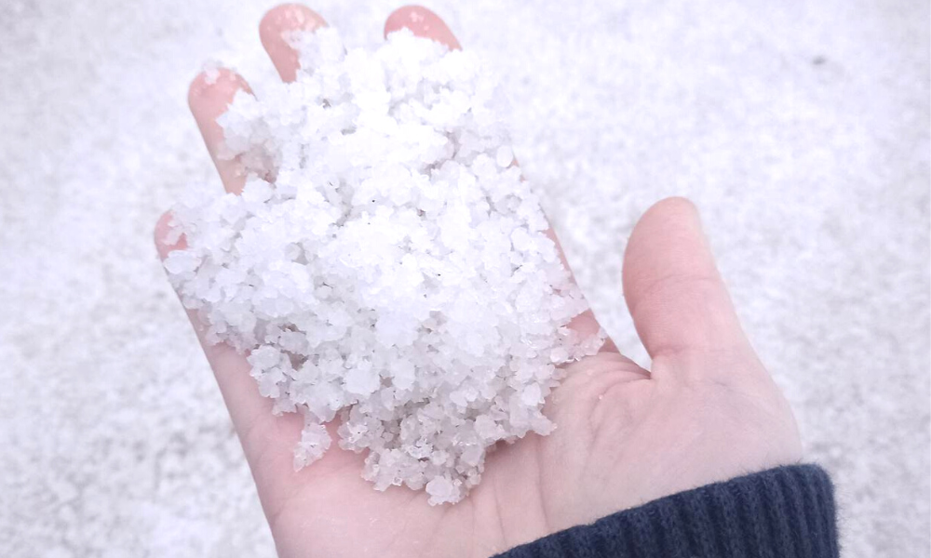
solar salt production
270 million tons a year
40% of all salt production
most sustainable system

Slide 3
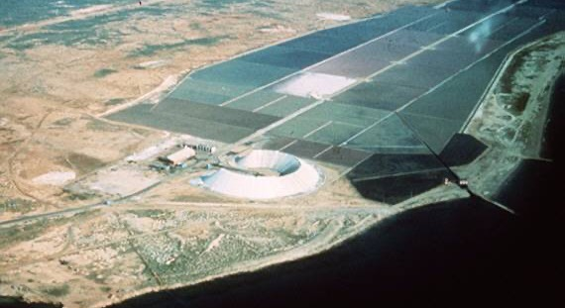

Slide 4
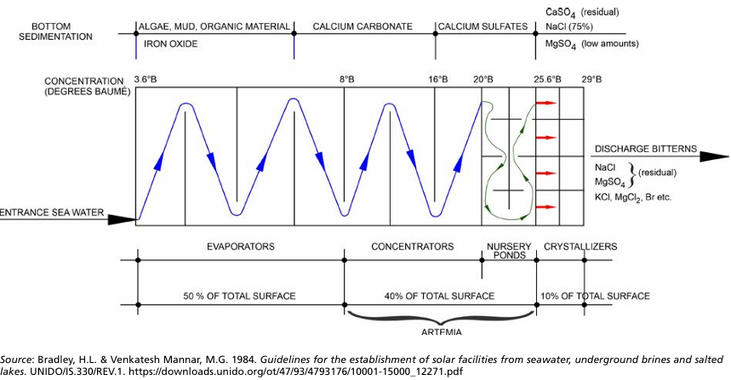
General Layout of solar saltworks

Slide 5
Solar salt operation with natural occurrence of Artemia
Seawater intake
50g salt/l
100g/l
150g/l
wind direction
ovoviviparous
Artemia
(continuous recruitment)
ovoviviparous
Artemia
gravitary flow
salt precipation
dying Artemia
oviparous Artemia
(no more recruitment)
crystallisation
250g/l
200g/l
cyst accumulation

Slide 6
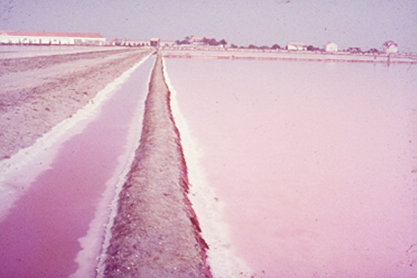
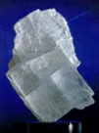
Integrated Artemia Farming: A Path to Improved Salt Production
Elimination of micro algae : dissolved organic excretion and decomposition products increase water viscosity
late precipitation of gypsum
no precipitation at all – floating salt
small crystals
Dying algae contaminate NaCl and result in small crystals
Decaying Artemia substrate for Halobacterium:
red coloration of crystallizers
enhances heat absorption
reduces dissolved organic matter

Slide 7
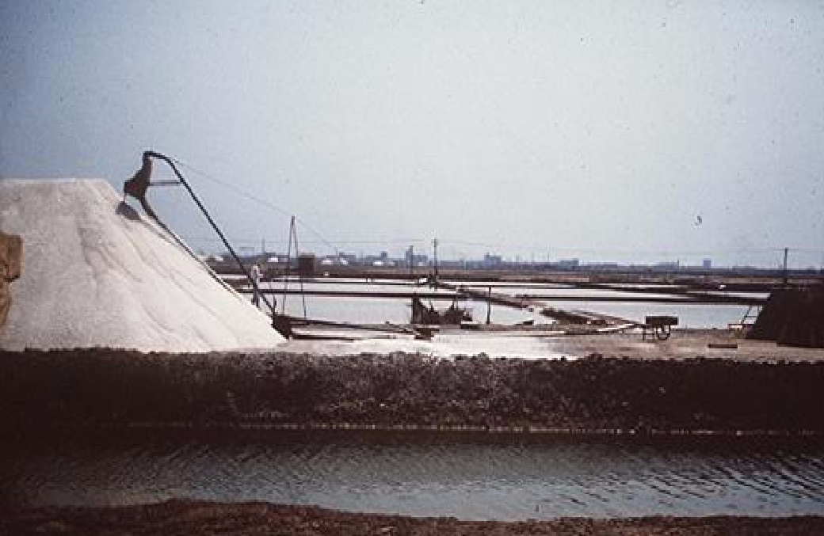
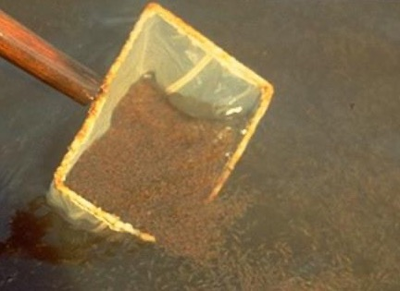
extractive aquaculture: Artemia cysts and biomass

Slide 8
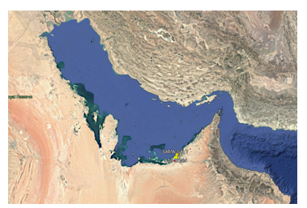
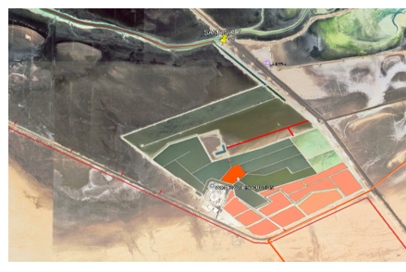
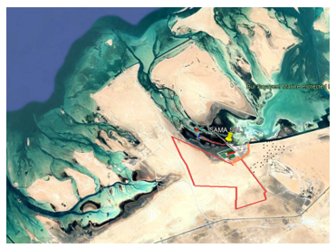
Example of new salt work in United Arab Emirates
need for hydrobiological management because of low nutrient level in intake water

Slide 9
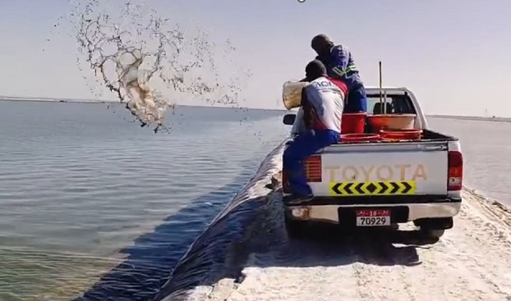
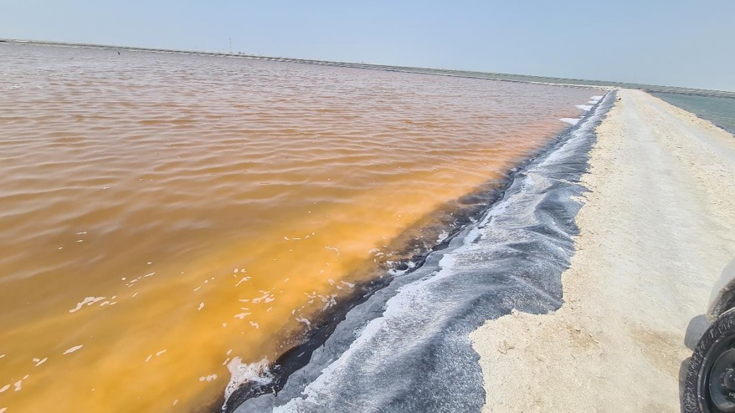
Fertilization of evaporation ponds to stimulate algae bloom

Slide 10
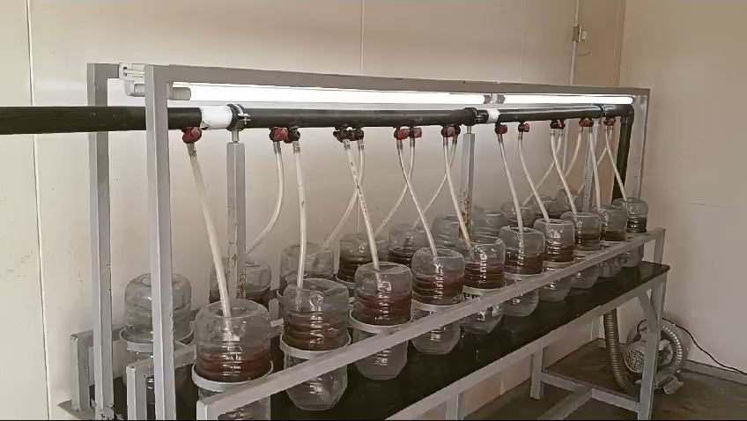
Inoculate Artemia to control algae bloom
Selection of high-temperature tolerant strain (Artemia franciscana) from Vietnam

Slide 12
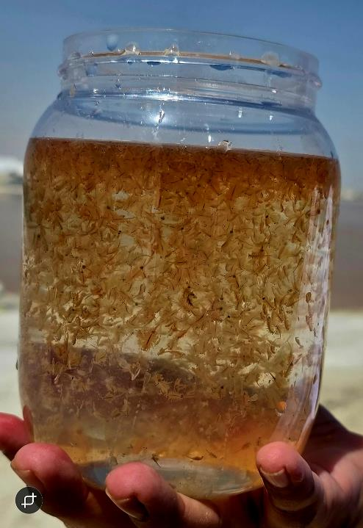

Slide 13
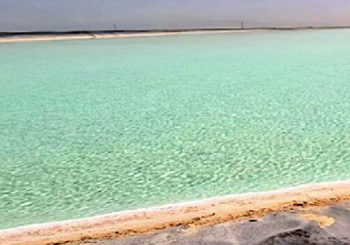
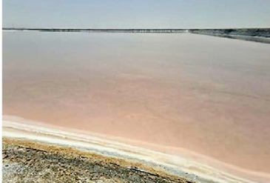
Sama Salt Company salt ponds, Abu Dabi, United Arab Emirates
Before and after biological management

Slide 14
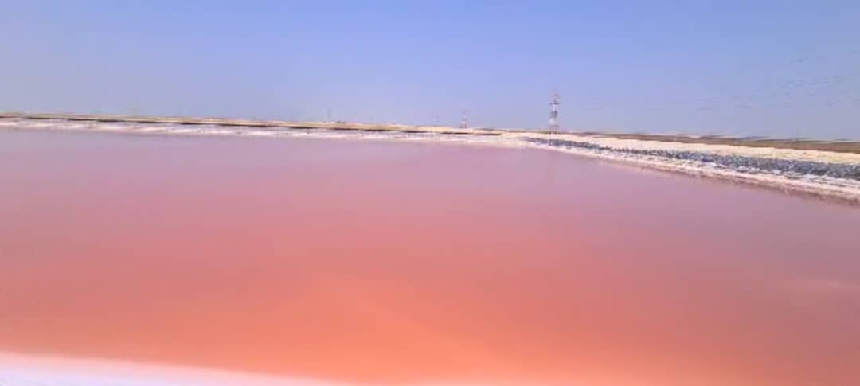
Thanks to earlier presence of Artemia:
bloom of Halobacterium in crystallizers,
more heat absorption, faster evaporation,
lower viscosity levels,
bigger salt crystals,
higher salt purity

Slide 15
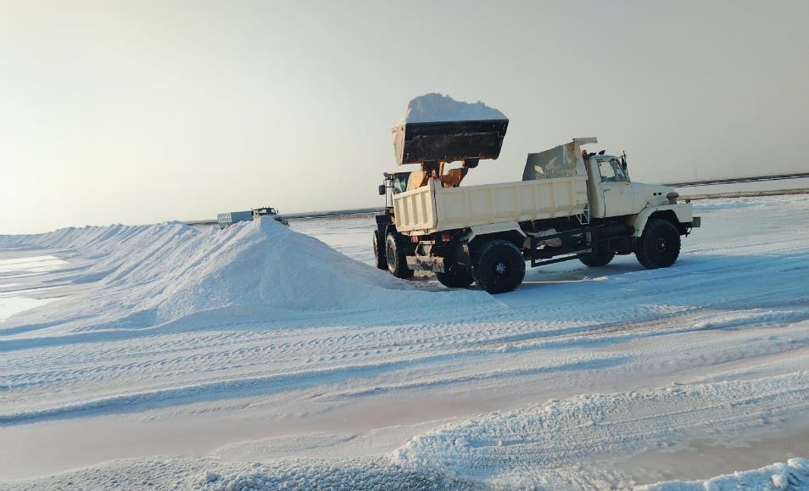

Slide 16
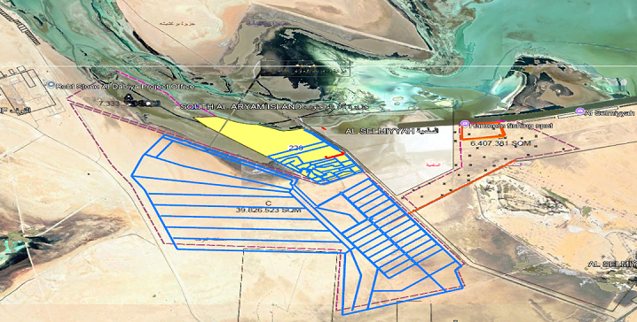
Extension of present salt farm in UAE new unit of 4000 Hectares for the production of an additional 1.8 million tons of high-quality salt
Option to build extra ponds for Artemia production: - deeper to optimize for Artemia production (biomass and/or cysts) - intake and outlet water from salt farm

Slide 17
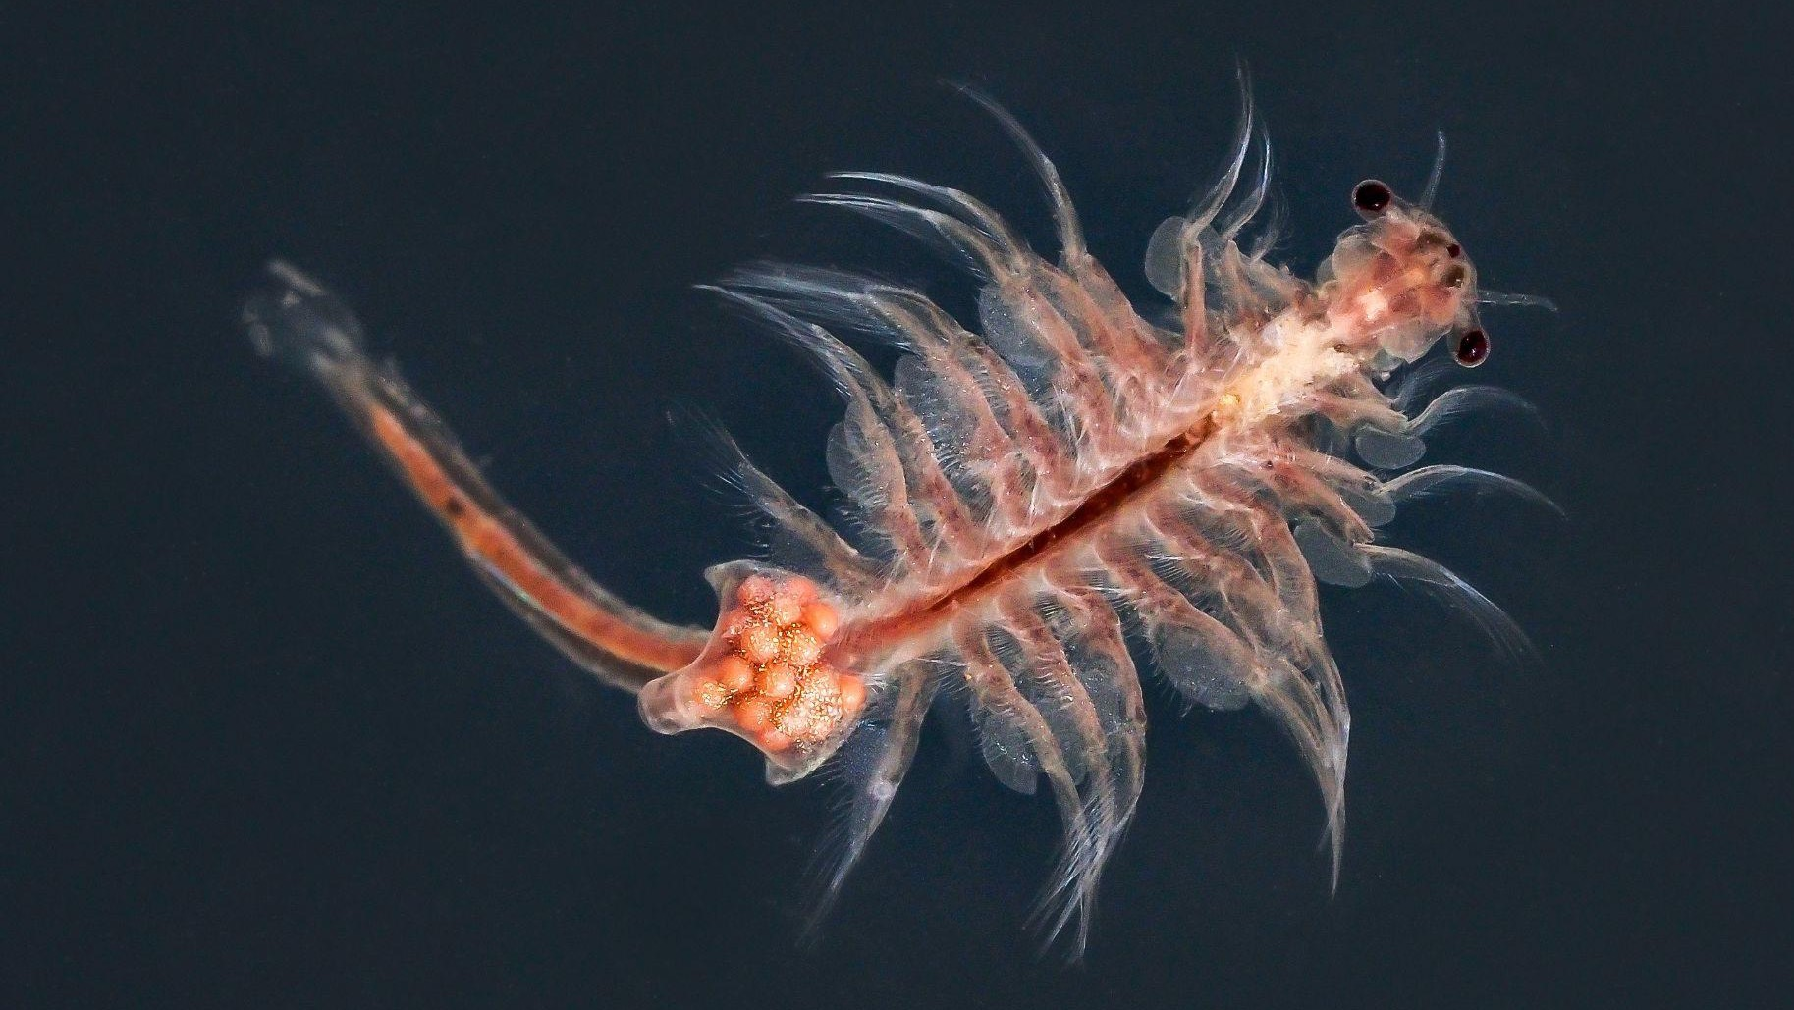
Thank you

