Slide 1
ARTEMIA AQUACULTURE IN AFRICA: OPPORTUNITIES AND CONSTRAINTS IN KENYA
Authors:
Morine M. Ngarari*, Betty M. Nyonje, James M. Mwaluma, Sheban M. Hinzano, Mary A. Opiyo, Anthony M. Nzioka, Derrick G. Rugendo and David Midumbi
Affiliation*:
Kenya Marine and Fisheries Research Institute, Mombasa

Slide 2
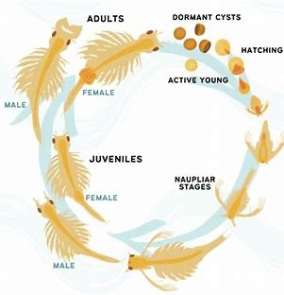
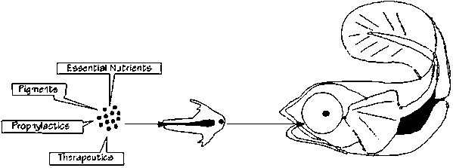
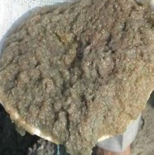
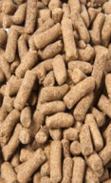
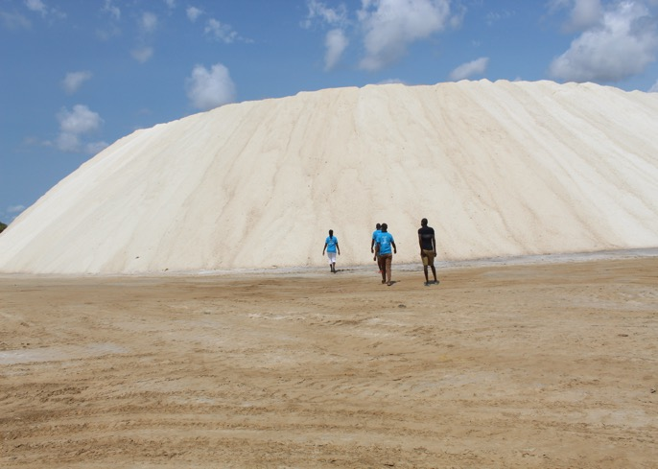
ARTEMIA AQUACULTURE IN AFRICA: OPPORTUNITIES AND CONSTRAINTS IN KENYA
Introduction
Artemia (brine shrimp) is essential in aquaculture as live feed or fish feed ingredient.
Introduced in Kenya in the 1980s via the Kenya-Belgium Project – same time with Vietnam
It was integrated into saltworks to test for feasibility and improved salt production
The salt quality and quantity has increased over the years due to presence of Artemia in saltworks

Slide 3
ARTEMIA AQUACULTURE IN AFRICA: OPPORTUNITIES AND CONSTRAINTS IN KENYA
Artemia Research and Development Interventions
- Feasibility of Artemia farming was done
- Potential of Artemia farming demonstrated
- Establishment of Biomass in saltworks
- Improved salt quality in saltworks
Kenya–Belgium project
KMFRI vs ARC Gent
1984 - 1986
Community livelihoods improvement project
KMFRI, Ghent & CTU
- Improved skills and knowledge in Artemia production to scientists and the local communities
- Commercialize Artemia farming in Artisanal salt farms – This triggered the support by KCDP Project
2010 - 2015
- Improve Artemia production via biofloc
- Artemia biomass- tilapia feed ingredient - Artemia sun-drying equipment (netting)
2020 - 2022
MASMA Project
Kenya,Tz & Sweden
Kenya supporting Mozambique in an Artemia farming project funded by IRD
2024
Artemia IRD Project

Slide 4
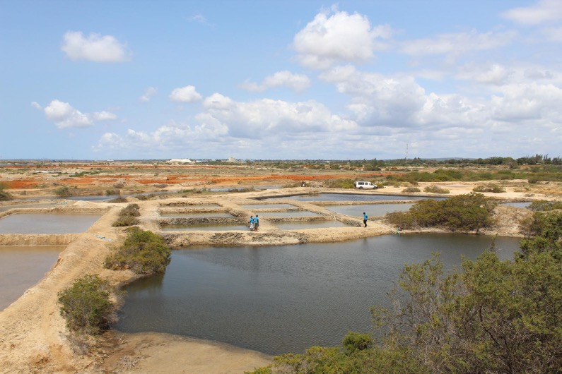
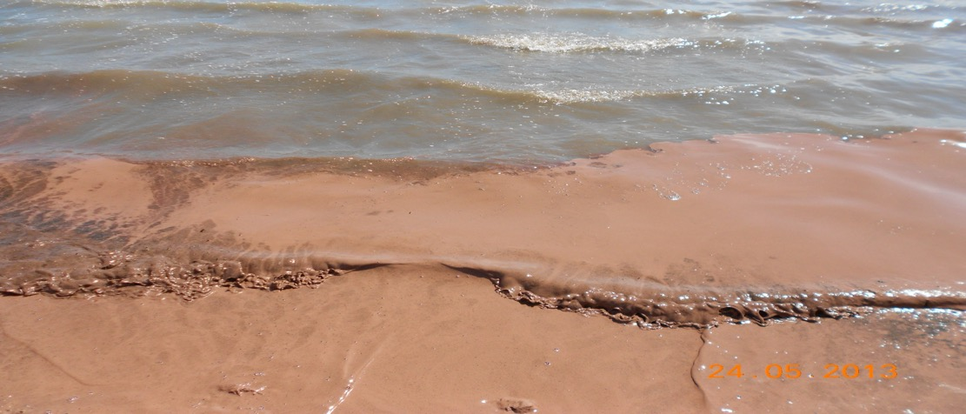
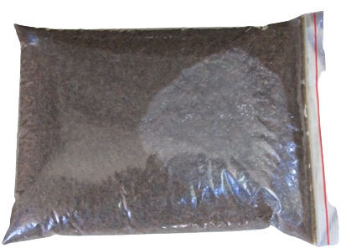
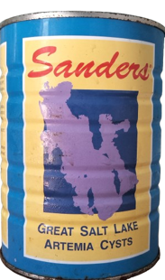
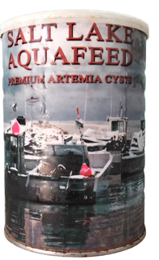
ARTEMIA AQUACULTURE IN AFRICA: OPPORTUNITIES AND CONSTRAINTS IN KENYA
Current Artemia Production in Kenya
Production is tied to artisanal and commercial saltworks at different scale, ownership and management.
Artemia cysts - a minimum of 3 kgs/ha/month to 33 kg/ha per season are produced
Artemia biomass – a minimum of 3.8 kgs/ha/month and 250 kg/ha per season
Kenyan-produced Artemia biomass
Imported Artemia cysts

Slide 5
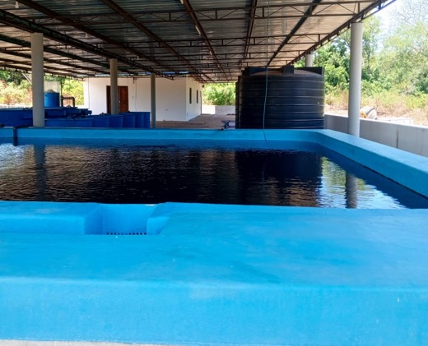
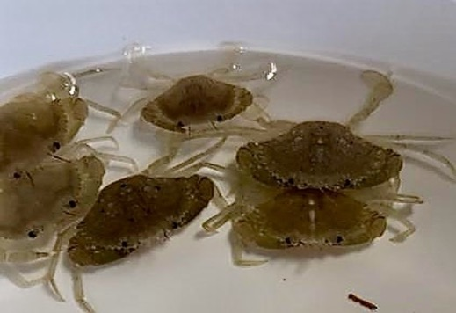
ARTEMIA AQUACULTURE IN AFRICA: OPPORTUNITIES AND CONSTRAINTS IN KENYA
Growing Artemia Demand in Kenya
Kenya still heavily relies on imported cysts, with demand exceeding 200 kg dry weight.
World Bank under the KEMFSED project is constructing 4 marine fish hatcheries
New private marine hatcheries e.g. Crab Alive (Cheshale) & Aquavista prawn farms
Public and private freshwater hatcheries require Artemia – Over 100 hatcheries
Expanding demand from marine fish, shrimp and ornamental aquaculture.
With this demand, there’s need to enhance domestic production of Artemia.
KMFRI Shimoni prawn hatchery
Crablets at Cheshale Crab Farm

Slide 6
ARTEMIA AQUACULTURE IN AFRICA: OPPORTUNITIES AND CONSTRAINTS IN KENYA
Artemia presence and scenario in Africa
Other countries in Africa that are reported to have Artemia include Libya, Morocco, Algeria, Egypt, Madagascar, Tunisia, Tanzania, Uganda, and Mozambique
Salt-producing African countries include Ghana, Tunisia, Senegal, Algeria, South Africa, Namibia, Botswana, Mozambique, Kenya and Tanzania – farming potential.
There is also lack of information regarding the species of Artemia found in the African continent – No collaborative research
Lack of commercial Artemia producing nation in Africa
Convincing the African investor about producing Artemia profitably requires a success story to learn from which is still lacking – No known demonstration site for Artemia farming.

Slide 7
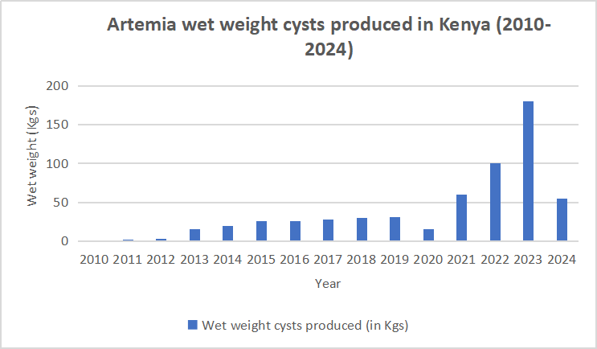
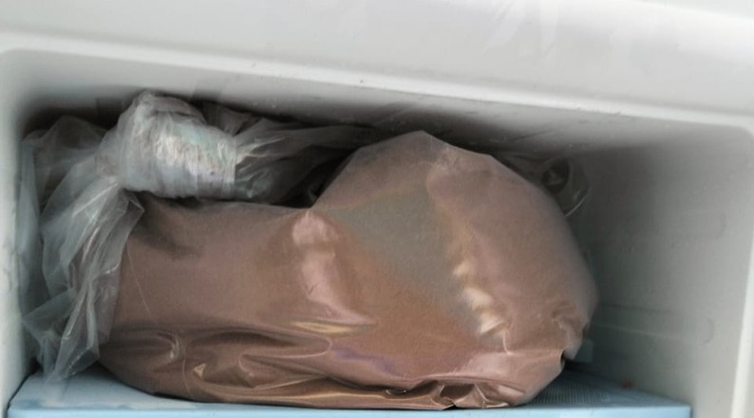
ARTEMIA AQUACULTURE IN AFRICA: OPPORTUNITIES AND CONSTRAINTS IN KENYA
Why has it taken so long for Artemia to establish in Kenya?
Low production levels despite over four decades of operations – No record keeping for 25 years
Early focus was on salt quality and not on Artemia commercialization
Use of outdated harvesting methods reducing efficiency and quality.
Genetic dilution in Artemia strains affecting productivity and resilience
Inadequate access to specialized equipment for Artemia initiatives and absence of national quality standards for Kenyan produced Artemia.
Limited access to markets, policy gaps and limited Artemia recognition as a viable value chain
Lack of consistent funding, trained personnel, fragmented pilot projects & limited follow-ups
Limited cold storage space

Slide 8
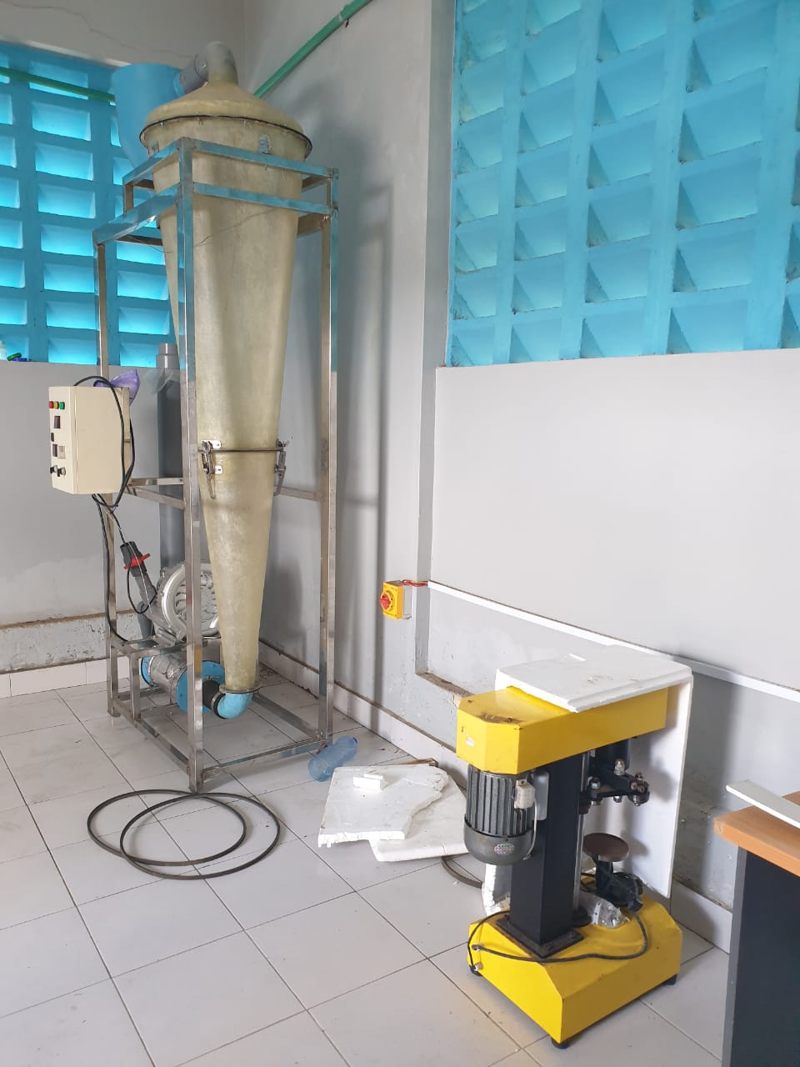
ARTEMIA AQUACULTURE IN AFRICA: OPPORTUNITIES AND CONSTRAINTS IN KENYA
Opportunities for Kenya
Strong government support driving aquaculture – BE, BUA
Favorable climatic conditions and availability of saline ponds
Ample production space (>8,000 ha)
Continued investment in fish farming
Potential to meet growing local and regional demand for Artemia.
Existing retail market infrastructure sustained by imported Artemia products
Presence of an Artemia laboratory with an Artemia processing facility at KMFRI
A tech-savvy youth population ready to innovative and modernize the sector

Slide 9
ARTEMIA AQUACULTURE IN AFRICA: OPPORTUNITIES AND CONSTRAINTS IN KENYA
Opportunities for Africa
Many African Countries have saline environments and saltworks suitable for Artemia farming – untapped potential
Aquaculture is growing very fast in Africa hence the demand for quality live feed will increase
There is no commercial-scale Artemia producer in Africa yet – Can Kenya, Tanzania, Mozambique, Egypt be the pioneer?
There is immense regional trade potential for regionally produced Artemia cysts and biomass
Most of the African population comprises of youth who can provide cheap but impactful labour in the Artemia sector

Slide 10
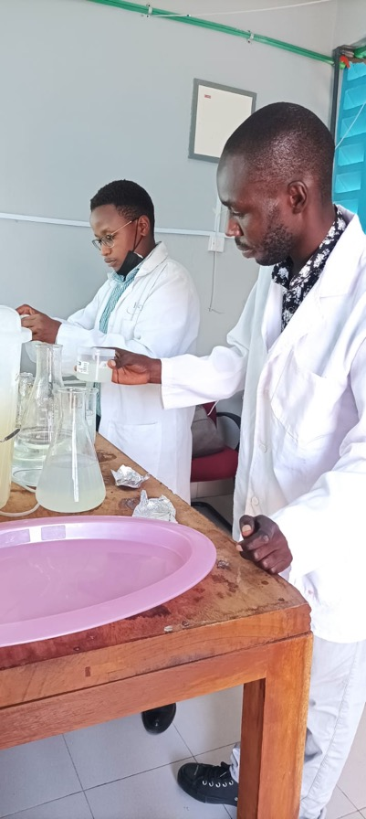
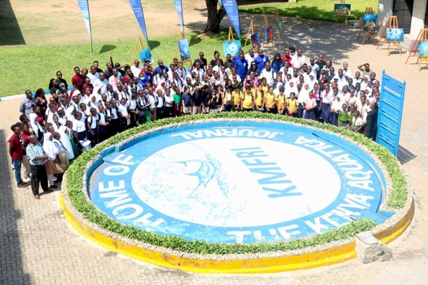
ARTEMIA AQUACULTURE IN AFRICA: OPPORTUNITIES AND CONSTRAINTS IN KENYA
Future Plans
Create an African artemia Research Working Group to build shared technical capacity (Kenya, Tanzania and Mozambique)
Set-up an African Artemia Reference Centre that will serve as a hands-on demonstration hub for students, producers, researchers and regulators
Develop an Artemia Cyst Bank to conserve genetic resources and ensure strain purity for future breeding and research programmes
Deepen Artemia-salt farm integration by introducing improved farm management protocols

Slide 11
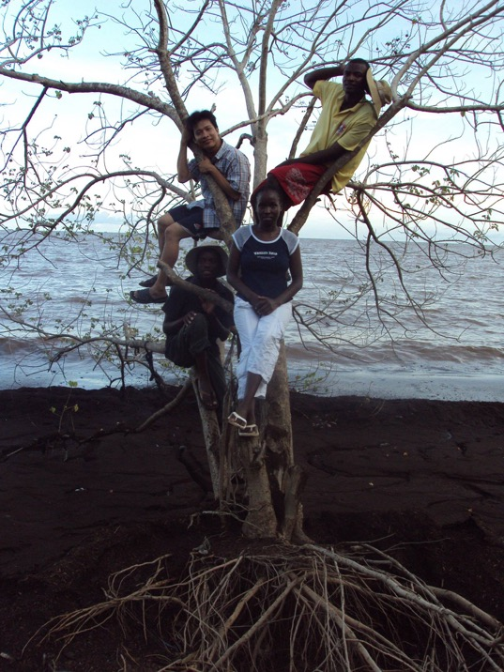
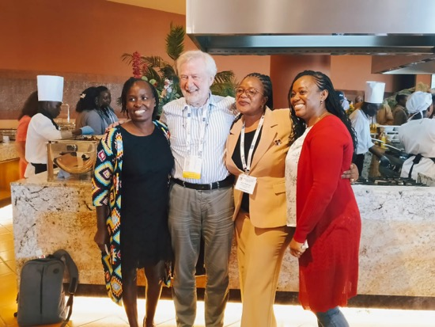
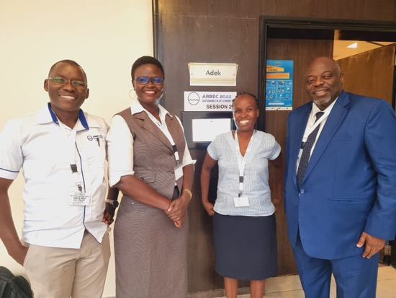
ARTEMIA AQUACULTURE IN AFRICA: OPPORTUNITIES AND CONSTRAINTS IN KENYA
Recommendations
Undertake collaborative research with Artemia researchers from more advanced regions to accelerate knowledge transfer
Modernize harvesting and processing systems with efficient and scalable technologies.
Strengthen market linkages and substitute imports by connecting producers and buyers
Advocate for robust policy frameworks that recognise Artemia’s value chain and provide clear quality standards, incentives, and export guidelines.

Slide 12
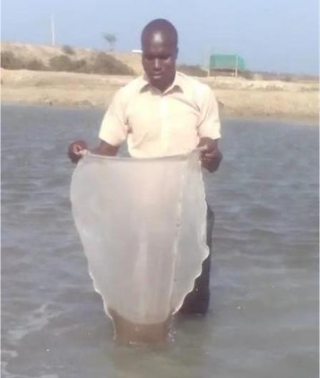
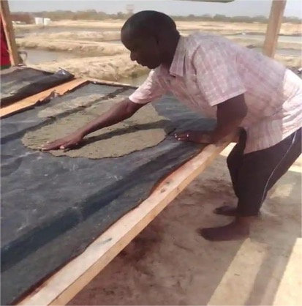
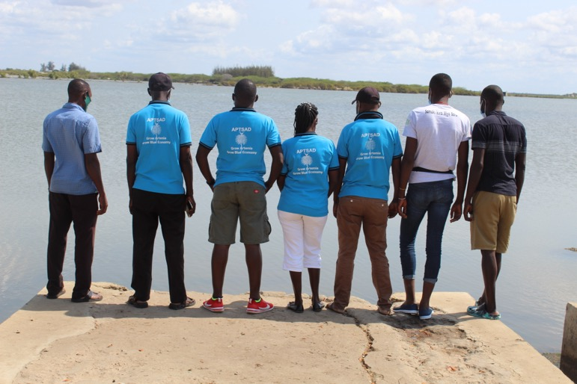
ARTEMIA AQUACULTURE IN AFRICA: OPPORTUNITIES AND CONSTRAINTS IN KENYA
Conclusion
Artemia farming holds a great promise for advancing aquaculture in Africa.
Unlocking this potential requires targeted investments and technological innovations
Engaging the youth is critical to driving future growth and sustainability of the sector
Kenya has the capacity to take a leading role in Artemia production in Africa – expertise
Strengthening research collaborations will be key to improving Artemia farming practices in Africa
Harvesting net
Biomass drying rack

Slide 13
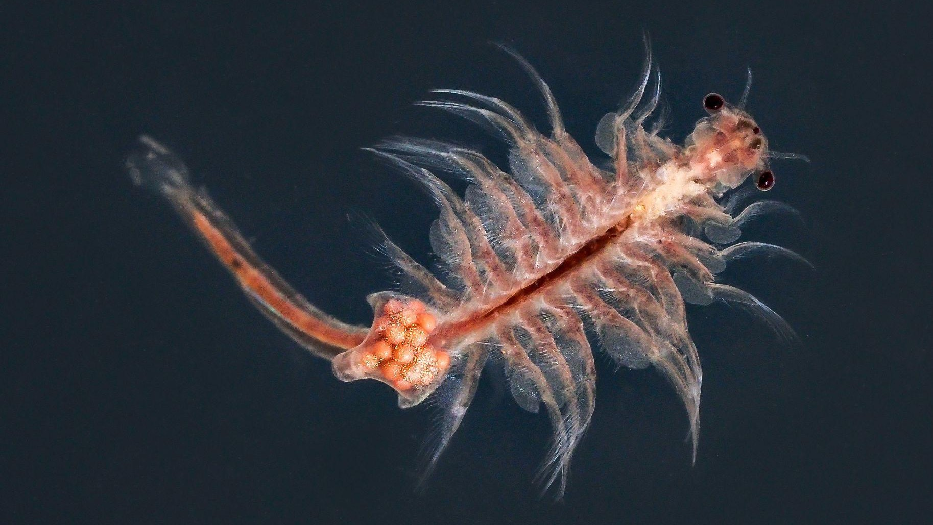
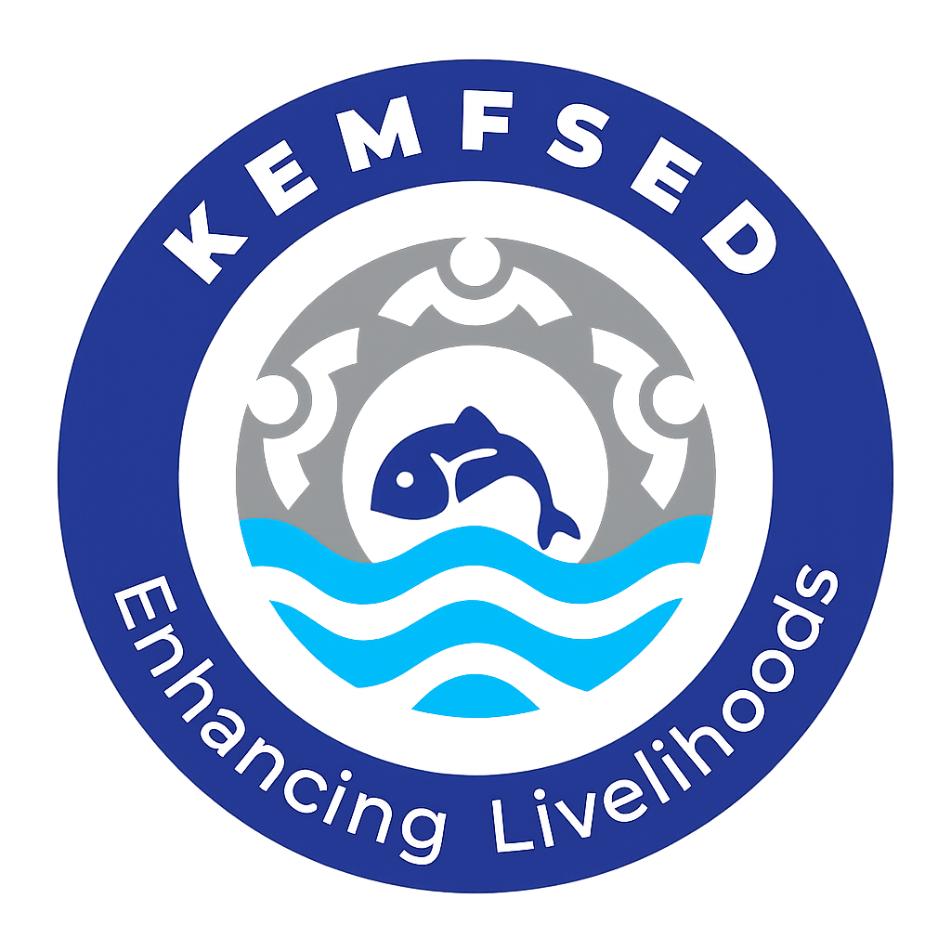
Thank you
Research, communities and field teams involved in Artemia initiatives

