Slide 1
Global market trends and investment opportunities
Olek Kaminski
FUTUREFISH
Global Artemia Summit
World Aquaculture Society (WAS) Safari Conference 2025
Uganda, June, 2025

Slide 2
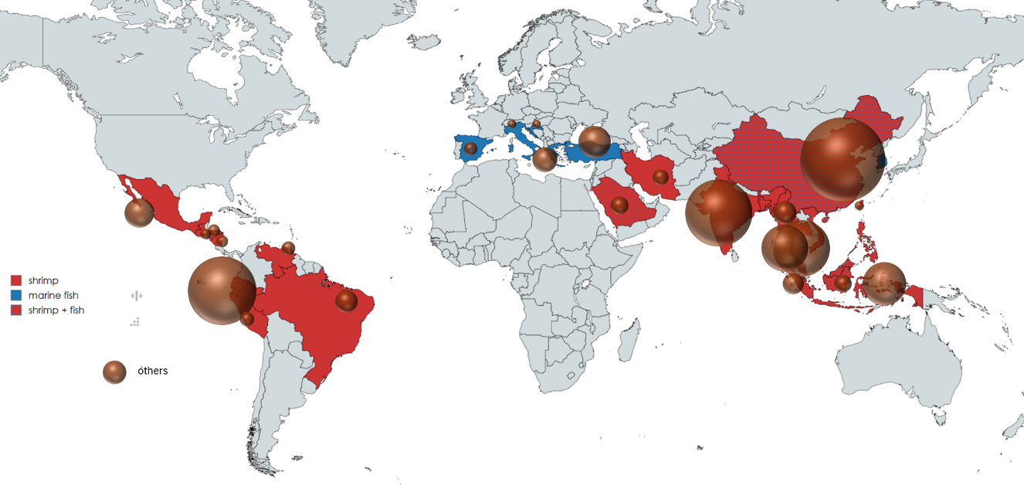
Global demand and market share of Artemia cysts
Size of market share
Main markets for artemia cysts in 2022, with size of sphere representing the size of market share

Slide 3
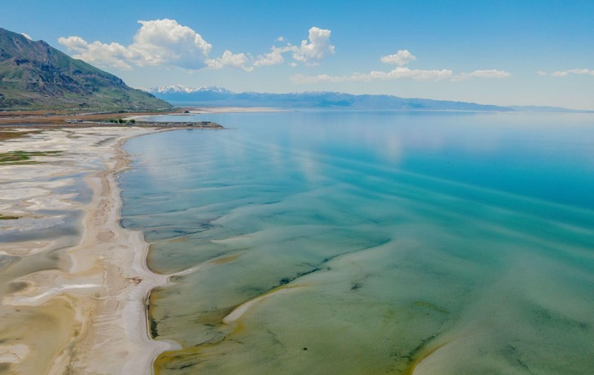
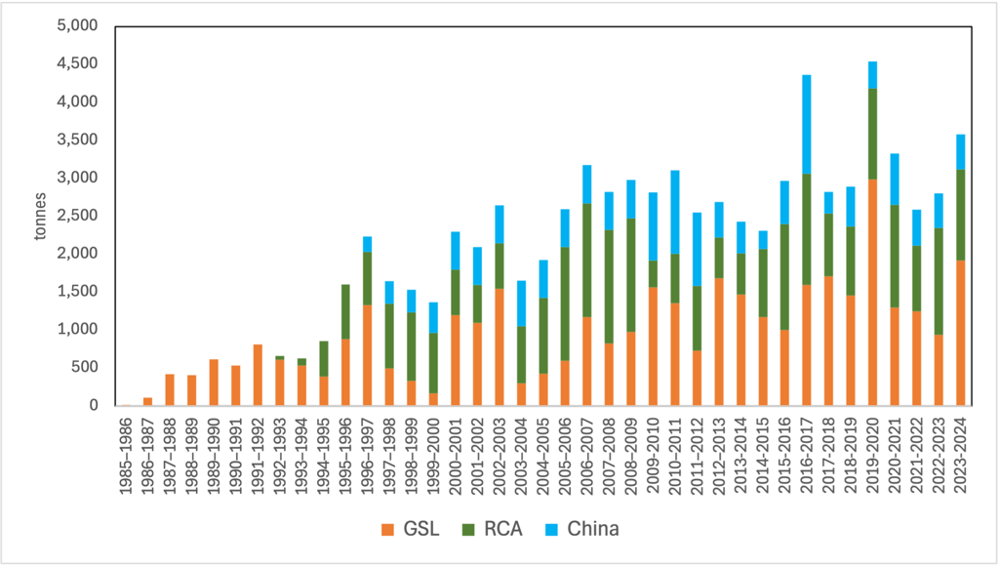
Wild Harvesting: A Stagnating Resource
Global Artemia cyst production is around 3,500 tonnes annually, with the Great Salt Lake contributing over 40%. By 2035, demand is projected to exceed 5,000 tonnes, needing the equivalent of another GSL, which does not exist.
Wild populations have stagnated
Stricter regulations are curbing overharvesting
Wild artemia affected by weather variability and therefore price volatility
No wild artemia sources of sufficient size to meet global demand
Global artemia harvest from 1895 to 2024

Slide 4
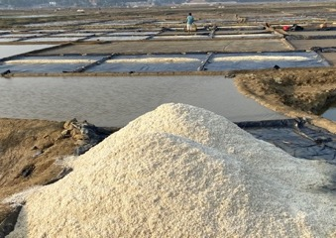
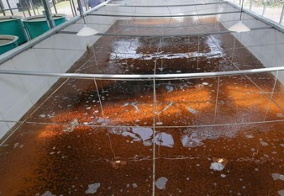
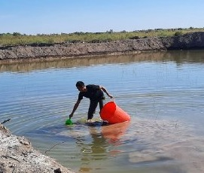
Artemia Farming as the New Frontier
Traceability & Biosecurity
Farming systems Farmed Artemia systems vary in design, with opportunities for efficiency gains and rapid scaling using existing technology.
produced in controlled environments: consistent quality & less contamination risks
Product Customization
biofortify cysts - added nutrients for improved hatchery outcomes.
Integrated Salt-Artemia Systems
Cyst-Focused Farming
Biomass-Focused Systems
Year-Round Production
continuous, reliable supply, addressing seasonal and geographic gaps.
Repurposes brine from salt production for Artemia cultivation; promotes circular use of resources.
Optimized for cyst yield through controlled salinity and strategic harvesting.
Produces live or processed Artemia biomass for markets like ornamental fish, and aquatic animal feed.

Slide 5
Country case studies

Slide 6
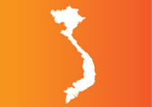
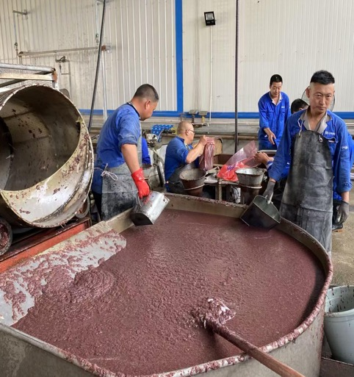
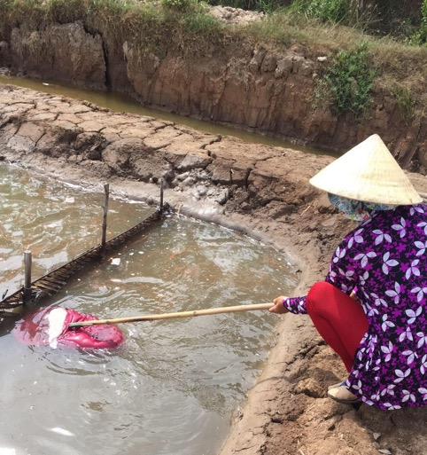
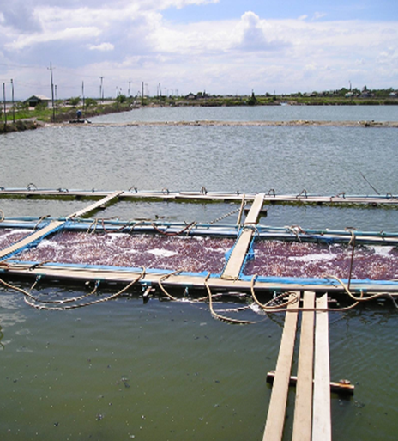
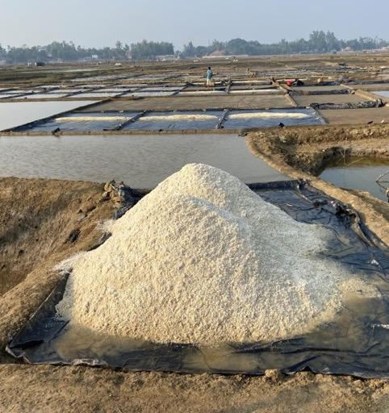
Scalable Business Models:
China
Vietnam
Thailand
Bangladesh
1000’s of jobs
500-600 tons of cysts
100,000 tons of biomass
20-30 tons (dry weight)
2000 jobs
2/3 workers p/ha
20 Intensive ponds
Direct sale to hatchery
250 t of biomass
54 farmers - 6.7 of biomass, 8kg of cysts, 35 t of tilapia
$1300 extra p/farmer
144 seasonal workers
Notes:
All figures need to be checked

Slide 7
Scalable business models
 | China | Thailand | Vietnam | Bangladesh
Business Model | Artemia Biomass & Cysts in Large Solar Saltworks Model | Artemia Biomass Pond Farming | Artemia Cysts and Salt Pond Farming | Year-round Integrated Artemia Salt Farming
Cycle Time | April to November | Year-round operation | 4-5 months | January - May or year round
Tons per ha per Cycle | Cysts: Large salt ponds (30-60 ha per pond) Biomass: High-yield, large-scale collection | Biomass: 2-4 tons per ha per cycle | Cysts: 50-70 kg/ha (150-200 kg in intensive systems) Biomass: 4-5 tons | Cysts: ~17 kg/ha Biomass: 1.3 - 1.4 tons/ha
Cost per kg | Biomass: $0.30/kg | $0.15 - $0.50/kg | $15-20/kg | Cyst: $36/kg - Biomass: $1.4/kg
Selling Price ($/kg) | Cysts: Premium price (150% higher than inland cysts Live biomass: $1-$2/kg | Live biomass: $1.75 - $1.78/kg Frozen biomass: $1.50 - $1.63/kg | Cysts: $200/kg (high-quality Vietnam cysts) Imports: $50-$100/kg | Cysts: $50 - $100/kg Live biomass: $4.0 - $5.0/kg
Revenue per ha | $6,000 - $30,000 per year | Up to $38,000 per farm per year | Cysts: $10,000 per ha per season Biomass: Additional revenue stream | Estimated $8,000 per ha per season
Profit Margin | 30-50%, Stable due to high demand | Profit until end-user can be 50-90%, with processors taking 30-40% | 30-50% for farmers but processors take a further 60%, meaning total margin is over 90% | 40-50% but Variable and dependent on local demand and production efficiency

Slide 8
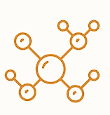
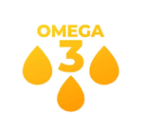
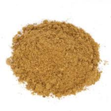
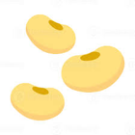
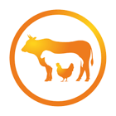
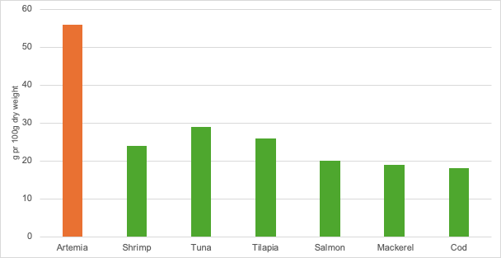
Emerging applications: animal feeds
The global aquatic feed market, valued at USD 28.72 billion in 2022, is projected to reach USD 40 billion by 2032.
Artemia biomass is a viable, underutilized protein source for feed systems, particularly in salt-affected and import-dependent regions, aligning with sustainable protein, feed resilience, and land rehabilitation goals.
Essential Amino Acids
Contains a favorable profile of essential amino acids
Omega-3 Fatty Acids
Rich in omega-3 fatty acids
Digestibility
Easy digestible for young animals
Protein Content
High protein level ranging from 45-65%
Alternative to Fishmeal
Serves as a substitute for fishmeal
Alternative to Soy
Offers a replacement for soy-based feeds
Alternative to Terrestrial Proteins
Provides an alternative to terrestrial proteins
In Africa, where aquaculture and livestock production are growing fast, Artemia biomass offers an untapped and sustainable alternative to fishmeal, in aquaculture and terrestrial animal feeds
Protein content comparison of Artemia vs. fish species (g per 100g dry weight)

Slide 9
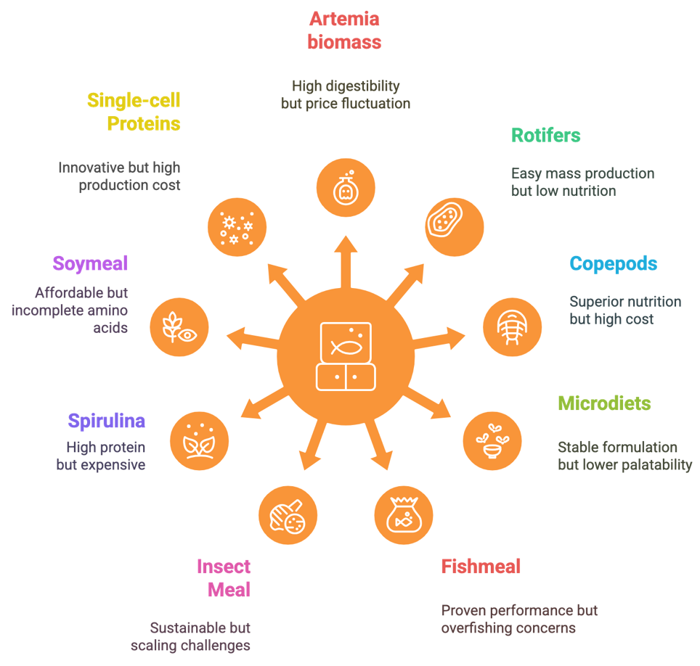
Competition and risks
Barriers to the Competitiveness of Artemia Farming
Environmental Vulnerability
Artemia systems are sensitive to shifting salinity, irregular rainfall, and evaporation, with disruptions already seen in the Great Salt Lake.
Biosecurity Risks
Poor management can lead to contamination by pathogens or predators, affecting cyst viability and productivity.
Market Volatility
Prices for wild-harvested cysts can fluctuate by over 50% depending on supply disruptions, weather, and global shrimp hatchery demand.

Slide 10
Investment criteria and scaling conditions
Key Investment criteria
Scaling conditions
Saline Land Availability: Access to coastal or inland saline environments with stable salinity levels above 60 ppt.
Low Entry Barriers: Simplicity and affordability of technologies suited to smallholder adoption (e.g., drying beds, paddle harvesters).
Water and Brine Management: Reliable saline water sources and systems for seasonal or year-round brine control.
Public–Private Support: Involvement of R&D institutions, NGOs, agribusinesses, or feed manufacturers in pilot deployment.
Locally available Artemia nutrient resource: organic substrates, waste/by-products of local agriculture products
Extension and Training: Availability of technical assistance in pond management, seed quality, harvesting, and biosecurity.
Market Demand: Existing or emerging hatchery, feed, or food markets that can absorb Artemia cysts or biomass.
Certification and Quality Standards: Systems for grading, labeling, and traceability—especially for cysts and enriched biomass.
Labor Supply and Inclusivity: Availability of artisanal labor, interest from women's groups or youth, and potential for cooperative engagement.
Climate Resilience and Circularity: Integration into climate-smart farming, including salt reuse, wastewater recirculation, or solar drying.
Infrastructure and Logistics: Access to roads, drying or processing infrastructure, and cold chain (for biomass).
Access to Finance: Microfinance, concessional loans, or blended finance mechanisms for producers and SMEs.
Policy and Regulatory Frameworks: Supportive aquaculture, salt, or food safety regulations enabling Artemia production and trade

Slide 11
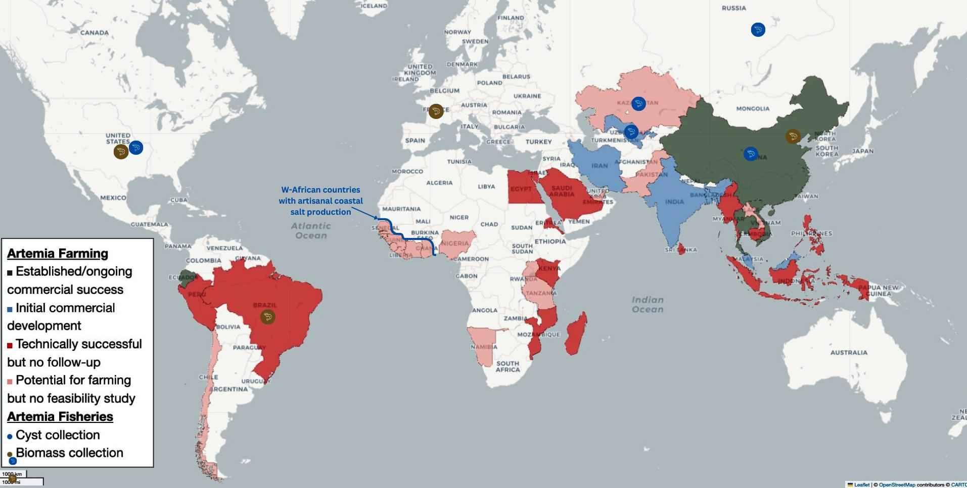
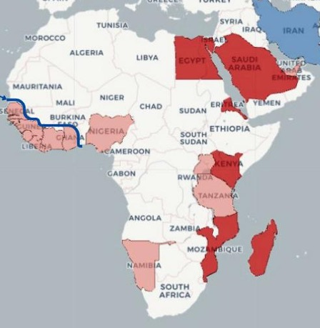
Artemia farming status and investment opportunities

Slide 12
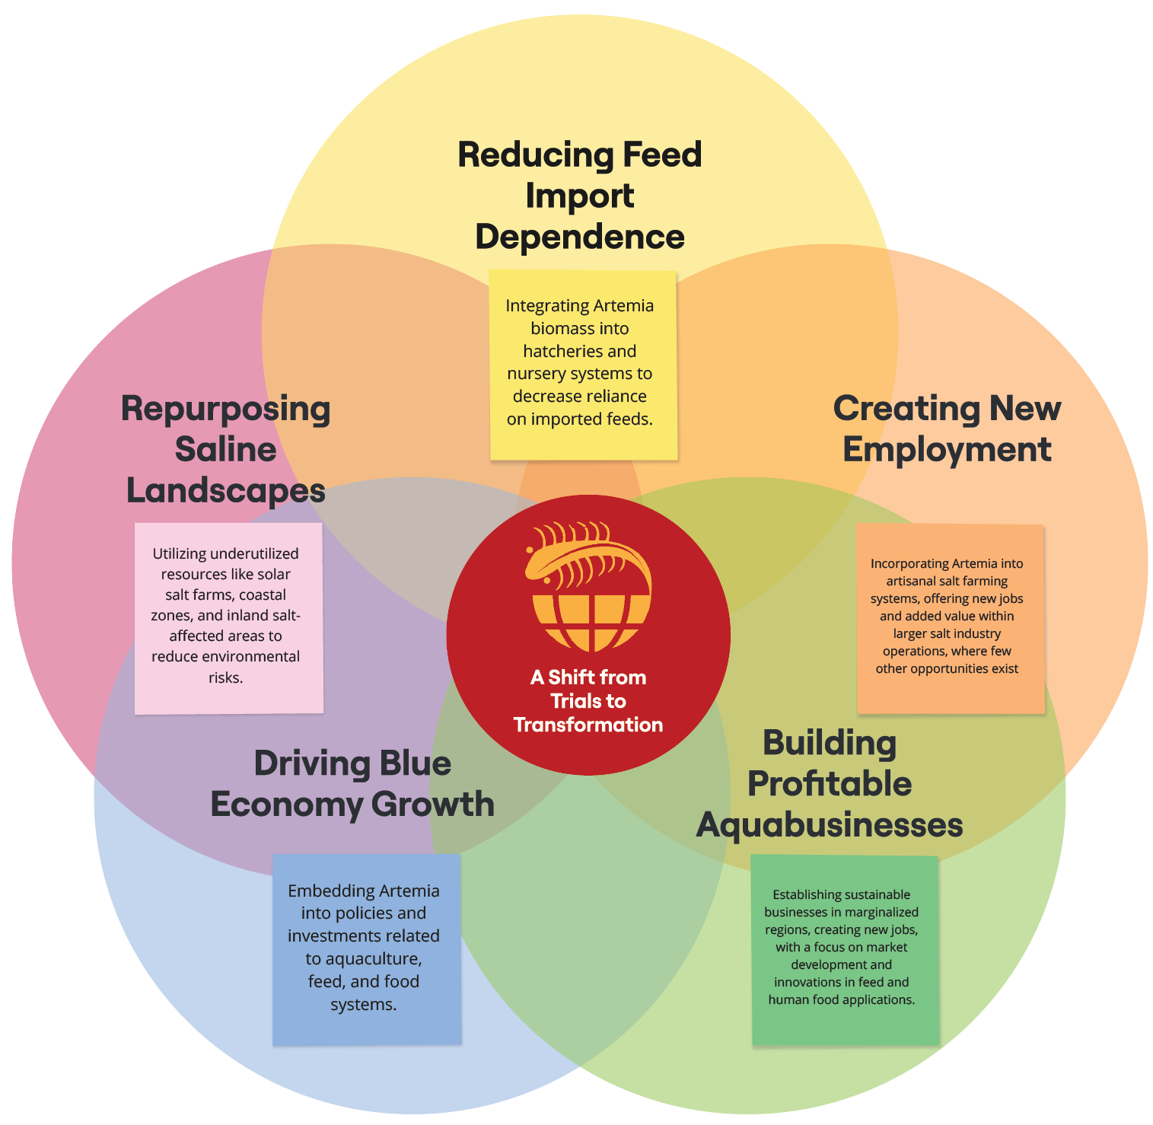
Roadmap
This roadmap presents a strategic, forward-thinking approach to Artemia investment, building on country case studies, investment criteria, and market dynamics.
The strategy focuses on aligning with World Bank investment priorities: inclusivity, scalability, and climate resilience.
A Shift from Trials to Transformation Artemia farming should be viewed not just as a technical solution, but as an investment opportunity for governments and private sector to drive broader impacts and enter new markets.

Slide 13
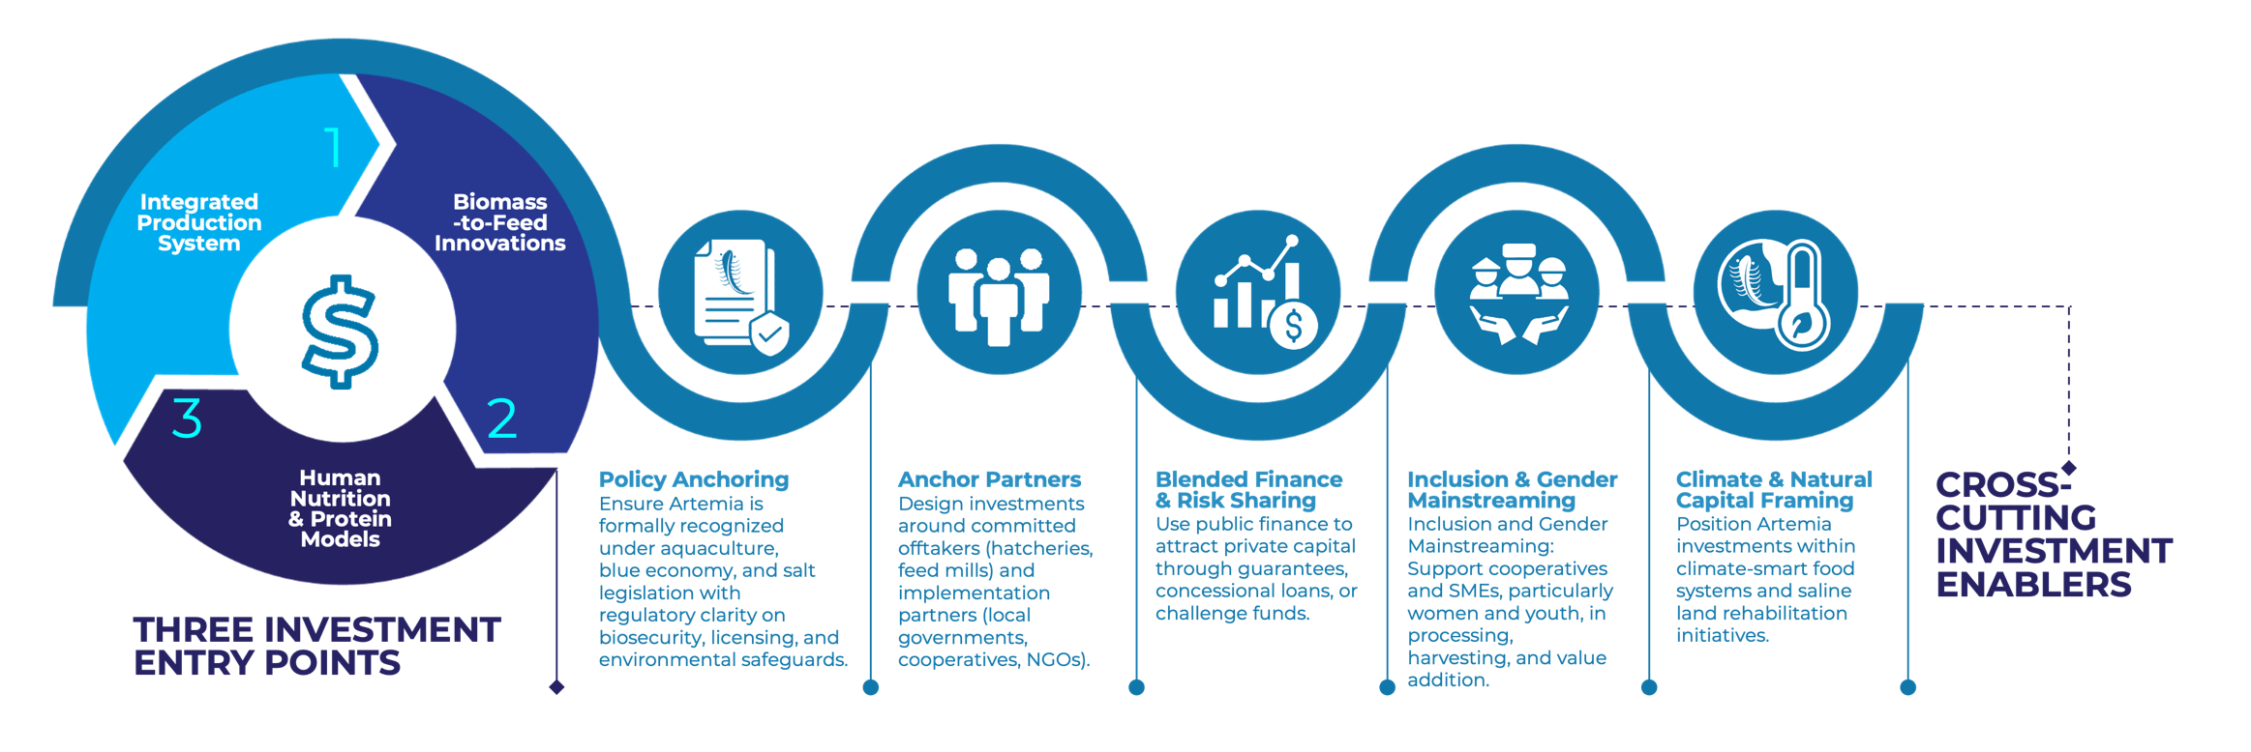
Investment Roadmap
Scoping & Stakeholder Engagement
Platform and Model Design
Capital Structuring
Inclusive Rollout
Policy and Scale

Slide 14
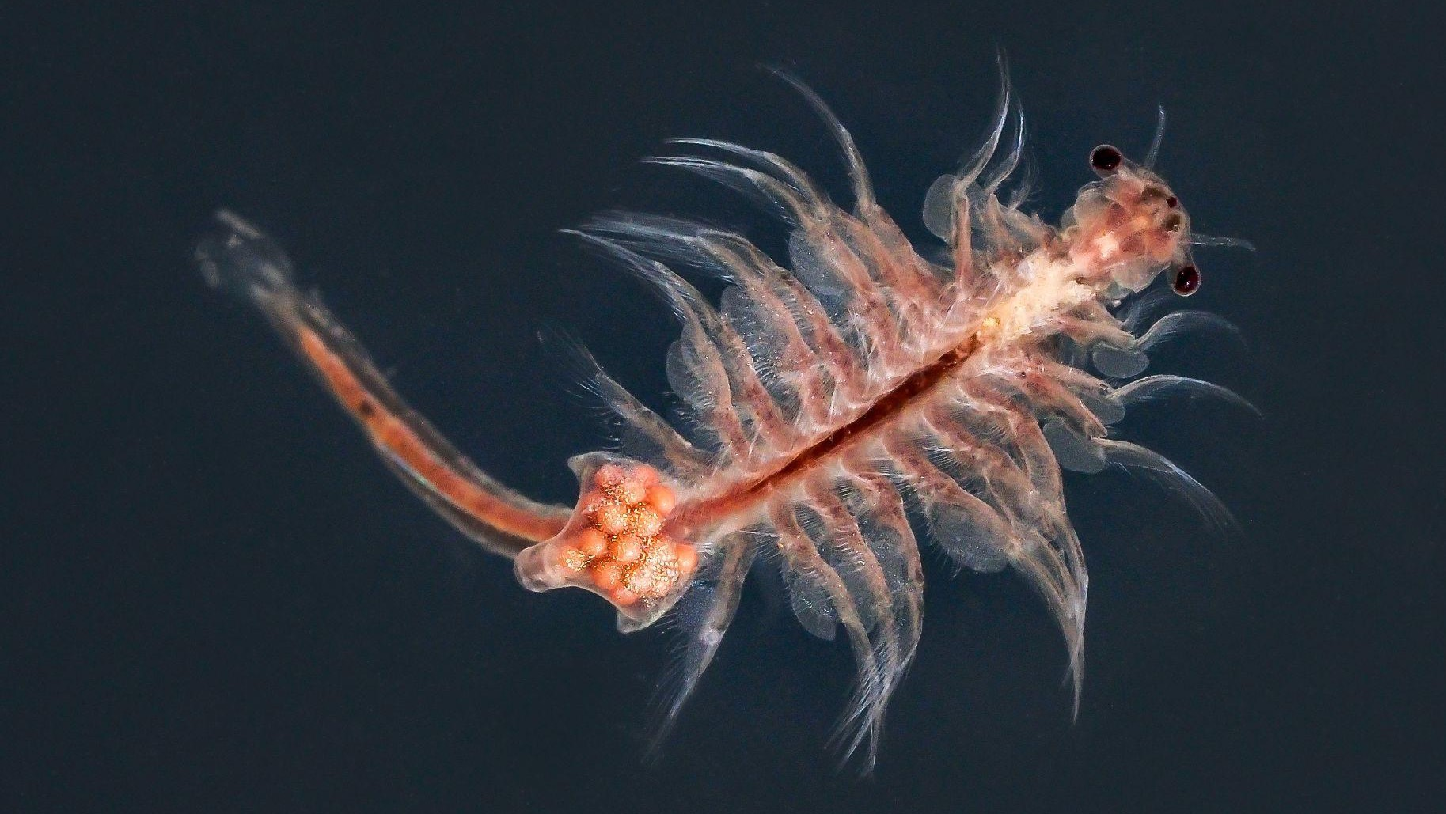
Thank you

