Slide 1
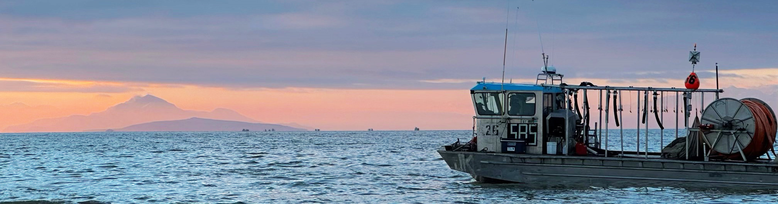
Supporting natural Artemia resources and man-made Artemia production
Thomas Bosteels
Vice Chairman Great Salt Lake Brine Shrimp Cooperative, Inc.
COMMITTED TO SUSTAINABILITY

Slide 2
AGENDA SLIDE
Growth aquaculture
Importance of Artemia in support of marine Aquaculture
Management of natural resources
Importance of man-made Artemia production
COMMITTED TO SUSTAINABILITY

Slide 3
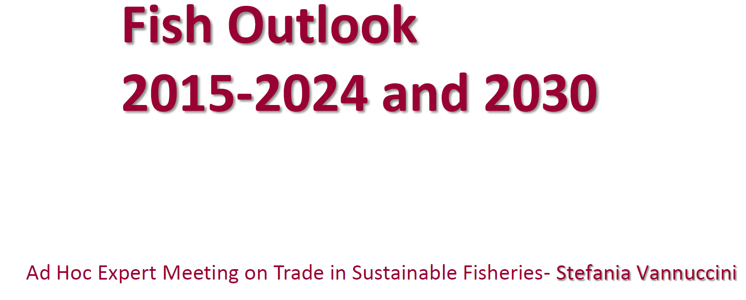
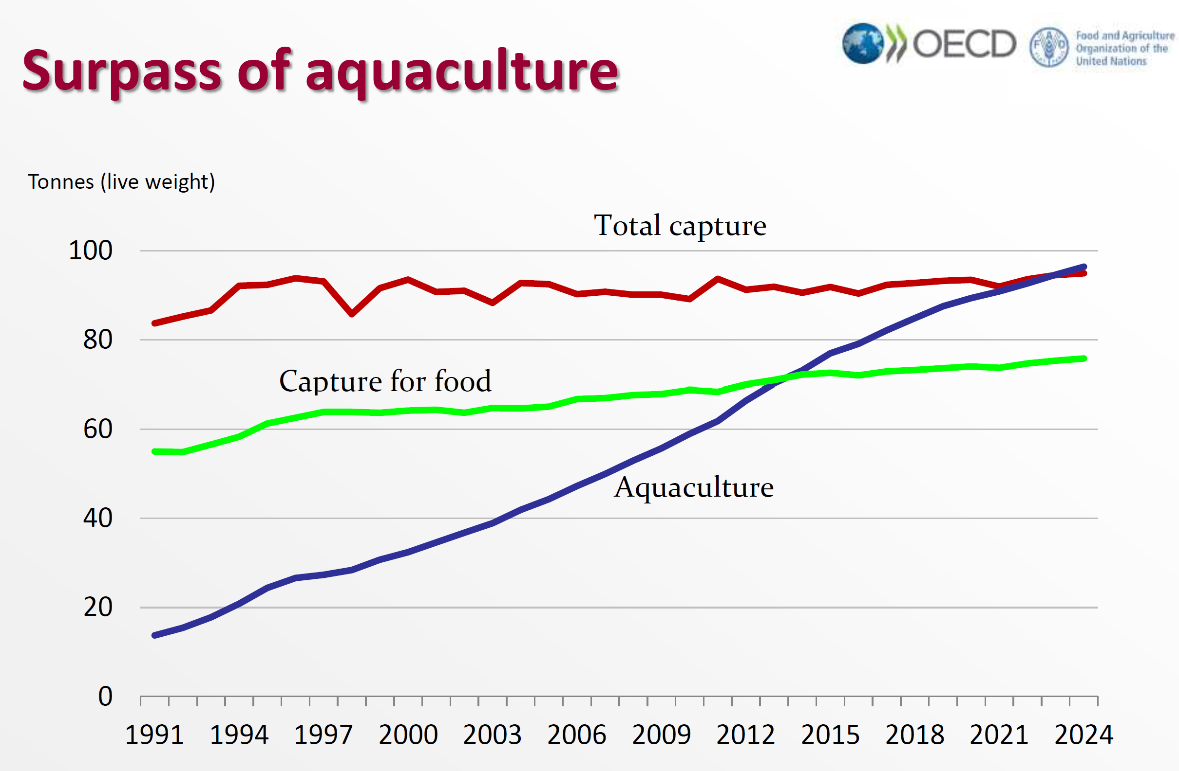
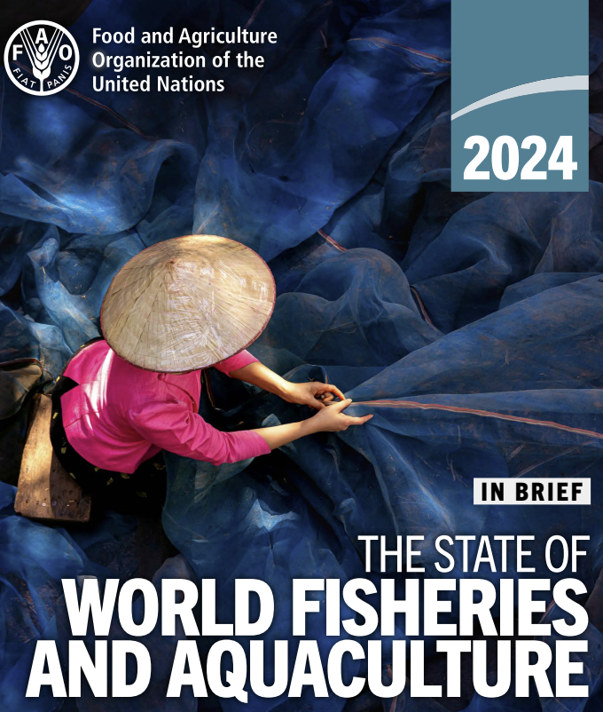
Aquaculture vs capture fisheries
Million
2022
2014
4.6% Compound annual growth rate (CAGR)
HIGH QUALITY ANIMAL PROTEIN – LOW FCR – PROJECT CONTINUED GROWTH OF AQUACULTURE

Slide 4
Why live feeds, why Artemia?
Larvae commercial marine species:
Small Carnivores with an underdeveloped digestive system that benefit from the predator prey reflex when fed live feeds
Artemia is:
Small
Highly digestible
Can be enriched to tailor the nutritional composition
Can be hatched on demand (convenient)
Beyond nutrition “ARTEMIA (live feed) factor”
Artemia supports
11 million Ton
(>900 billion fry)
18% of fish & shrimp produced from aquaculture
> 400 micron
COMMITTED TO SUSTAINABILITY

Slide 5
L.Vannamei
hatchery
L. Vannamei
Field trial hatchery
Artemia (live feed) factor
Optimal 6 kg per million fry produced
Increased Artemia → increased stress resistance
Heat shock proteins could be a contributing factor
L.Vannamei
Nursery
L.Vannamei
Field trial grow out
L.Vannamei
Optimal feeding ratio
Optimal 3 to 6 kg per million fry produced
Increased Artemia → increased pond production
6 to 9 kg
per million
fry produced
optimal co-feeding ratios - The Artemia factor – beyond nutrition

Slide 6
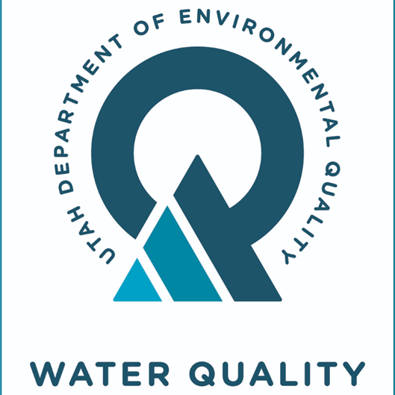
>270 ppt
100-160 ppt
Harvest management
Salinity management
Salinity management
nutrients management
Water management
25 years
Escapement stock of 21 cysts/liter
North >270 ppt
South 100-160 ppt ideal for artemia
Move water
North to South
South to North
Nutrient criteria and other solutions
Protect fresh water resources
Maintaining nutrient inflow to Great Salt Lake
$750 million water conservation 2022 to 2020
10’s of millions every year to lease conserved water when is needed
Optimizing artemia resources through Sustainable resource management

Slide 7
Sustainable harvest management
1,274 MT AVG
1,469 MT AVG
Sustainable harvest management implemented in 1996 has resulted in a stable Artemia population on Great Salt Lake
_______ 5 Y trailing standard deviation
Notes:
As a result of this management cyst production on great salt lake has become more stable as shown by the trailing 5 year standard deviation. Additionally, production has increased as can be seen in the yellow trend line

Slide 8
Worldwide Artemia cyst production reaching maximum carrying capacity
exploration
optimization
3791 MT
2,773 MT
Notes:
We are not the only group working on sustainable management of hypersaline resources and when looking at the world production, we can see that there was about 15 years of exploration followed by 25 years of optimization of resources. Some further optimization is likely possible, but regardless, natural production systems either will or may already have reached their maximum carrying capacity

Slide 9
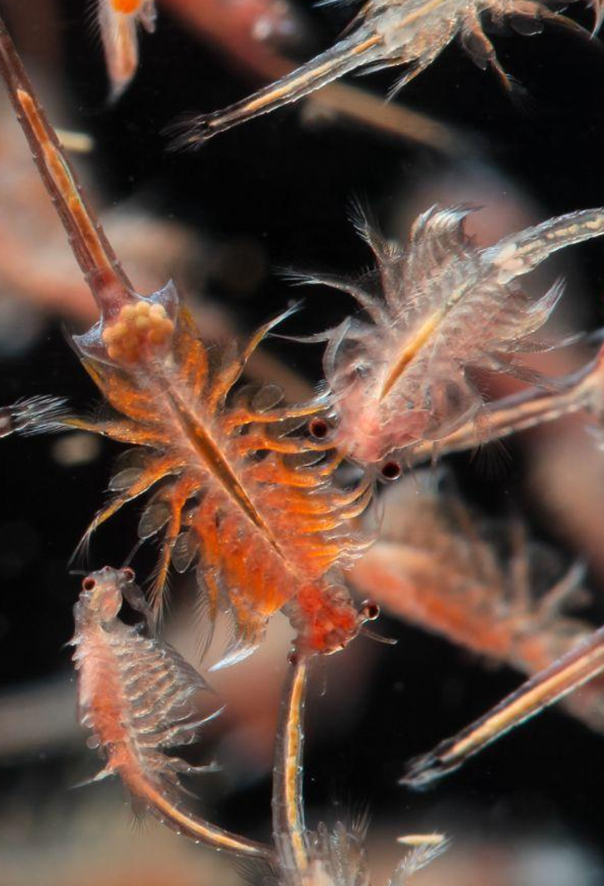
Bringing it all together
Artemia is essential to marine aquaculture
> 11 million MT of marine species rely on Artemia
Beyond nutrition
Improved survival growth and stress resistance
Optimize use of scarce resources (feeds, marine ingredients – land used for aquaculture…)
Optimal usage rate of Artemia required to optimize aquaculture production
Marine Aquaculture continues to grow
High quality protein produced at low FCR
Natural Artemia resources, even when sustainably managed will reach their carrying capacity
→ Logical that we have to rely on both the optimization of natural resources through sustainable management as well as the growth in man-made Artemia production
gsla.us
COMMITTED TO SUSTAINABILITY

