Slide 1
Artemia farming in different regions/conditions in Iran
Prof. Naser Agh Artemia & Aquaculture Research Institute, Urmia University, Iran

Slide 2
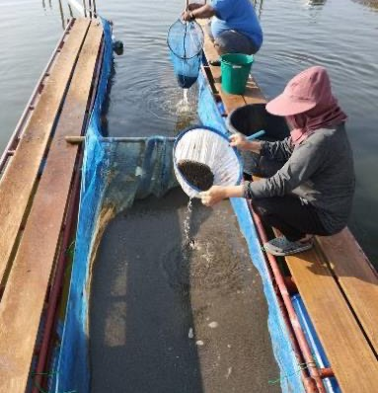
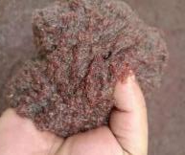
Artemia farming in different regions/conditions in Iran
Naser Agh Artemia & Aquaculture Research Institute
Urmia University, Iran

Slide 3
Potentials of Iran for aquaculture development
2026 | Metric tons
Capture | 750,000
Aquaculture | 1,000,000
Shrimp Culture: 40,000 h
Sturgeon Fish Culture in 22 provinces
Marine Fish culture
In 3 provinces

Slide 4
Need for Artemia cyst
 | 2022
Shrimp Hatcheries | 25 tons
Sturgeon Fish Hatcheries | 7 tons
Marine Fish Hatcheries | 5 tons
Aquarium Fish | 5 tons
 | 2025
Shrimp Hatcheries | 35 tons
Sturgeon Fish Hatcheries | 10 tons
Marine Fish Hatcheries | 5 tons
Aquarium Fish | 5 tons

Slide 5
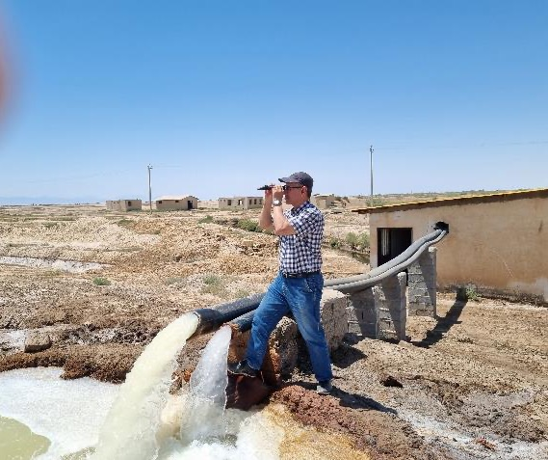
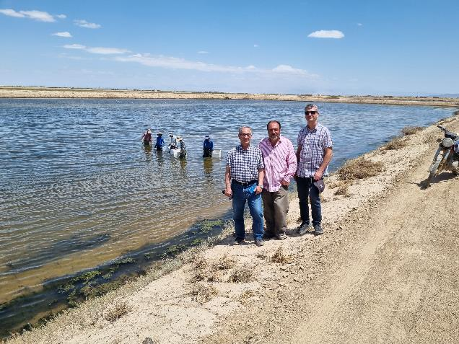
Parthenogenetic Artemia Culture
North-West of Iran Water Source: Salty Ground Water & Agricultural Drains
Area: 25 Hectare
Salinity: 60-80 ppt – Feed: Algae + Wheat bran
Seasonal Production: 20 Tons Biomass

Slide 6
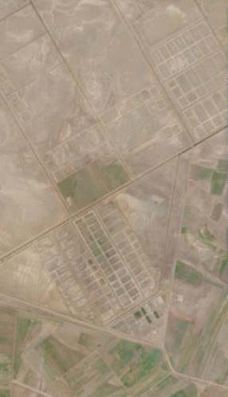
New Artemia Production Site South of Lake Urmia
Species: Parthenogenetic Artemia Water Source: Agricultural Drains and Salty Groundwater
Area: 200 Hectare
Currently Active: 60 Ha
Seasonal Production: 60 Tons Biomass

Slide 7
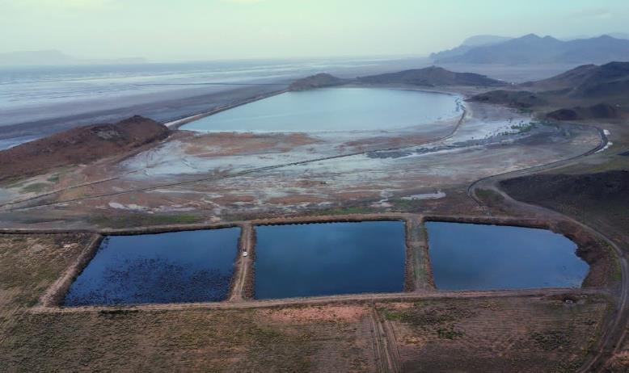
Parthenogenetic Artemia culture project at East of Lake Urmia 55 ha large Artemia pond + 5 ha Algae ponds Water source: effluent from urban sewage treatment plant + salty ground water, salinity 25-40 ppt Feed: algae + powdered wheat bran + beetroot molasses Seasonal Production: 50 tons biomass

Slide 8
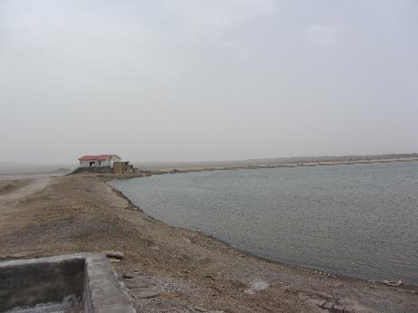
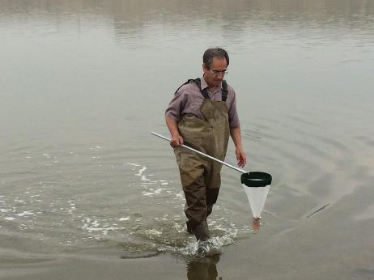
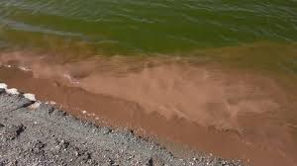
Kerman Province
Artemia franciscana culture – Area 25 ha
Water Source: brackish ground water and agricultural wastewater
Salinity: 50 ppt
Feed: wheat bran + beetroot molasses
Seasonal Production:
- 20 tons biomass - 2 tons wet cyst

Slide 9
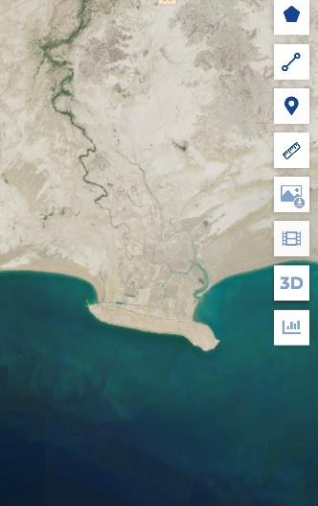
New Artemia culture Site in South of Iran
Sistan & Baluchestan Province
Artemia franciscana culture – area 80 ha
Water Source: Oman Sea and effluent from desalination plant
Salinity: 70 ppt
Feed: algae + wheat bran + beetroot molasses
Started recently

Slide 10
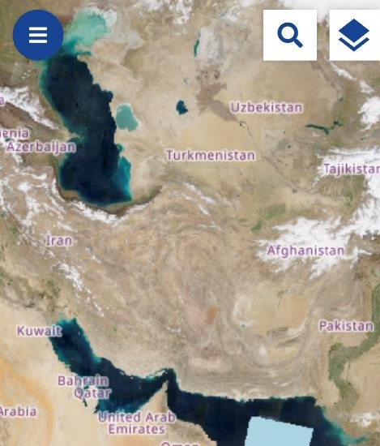
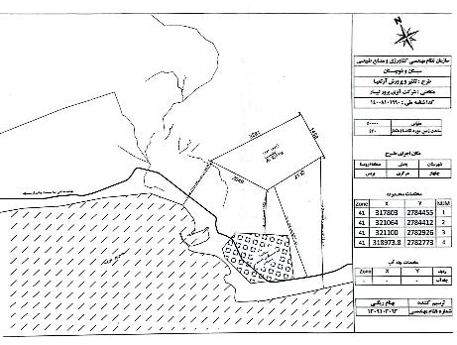
Sistan and Baluchestan Province (South-East Iran) Coast of Oman Sea near Chabahar Port Area: 6500 ha allocated for Artemia franciscana culture Water source: Oman Sea + desalination plant effluent 35-80 ppt
First Project 430 ha Construction of large ponds (20-50 ha) Will begin soon
6500 h

Slide 11
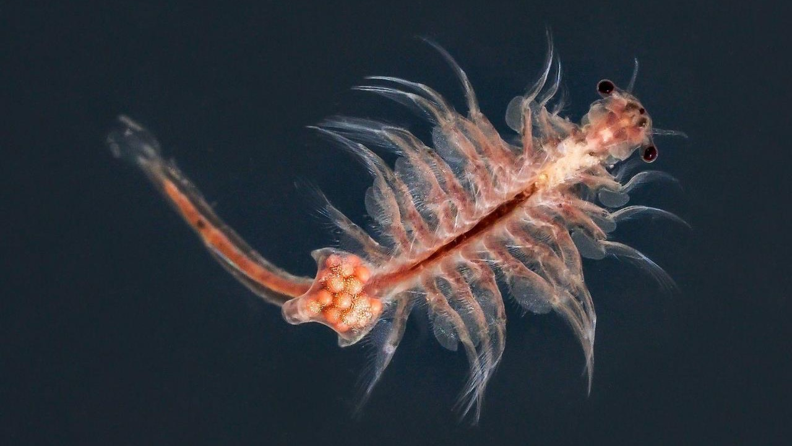
Thank you

