Slide 1
The role of Artemia in Resilient Aquaculture
Patrick Sorgeloos
Artemia Reference Center
Ghent University, Belgium
Global Artemia Summit
World Aquaculture Society (WAS) Safari Conference 2025
Uganda, June, 2025

Slide 2

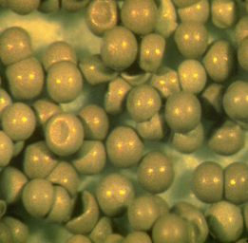
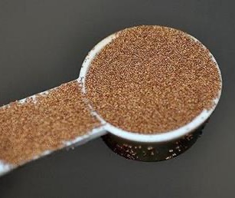
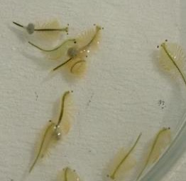
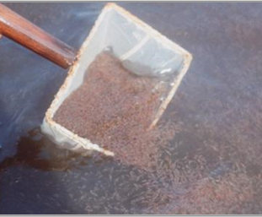
What is Artemia aka “Brine Shrimp”?
Cornerstone
of aquaculture
hatchery production
Unique biological characteristics: extremophile
Unique
reproductive cycle
Unique salinity
resilience
Exceptional
nutritional value
Artemia
Cysts
0.5 mm
Artemia
Biomass
1 cm

Slide 3

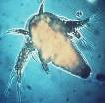
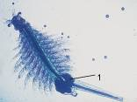

Life cycle of Artemia
100-200 nauplii every 4-5 days during several months
OVOVIVIPAROUS REPRODUCTION
(under optimal conditions)
adults
dry
cysts
±14 days
24h
nauplii
500 times weight increase
0.4mm
10mm
OVIPAROUS REPRODUCTION
(under sub-optimal conditions)
100-200 cysts every 4-5 days
Notes:
<culture-aspects, life-stage, life-cycle>

Slide 4
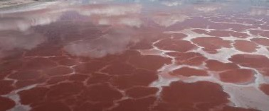
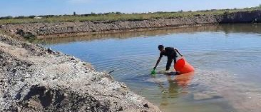
Artemia history: wild fishery, moving to farming
Fisheries supply 90% of global supply of cysts
Farms supply 10% of global supply of cysts
1940-1970
1970-1980
1990-2000
2000-2010
2010-present
Wild
fishery
Commercial harvesting of Artemia cysts begins in San Francisco Bay and Great Salt Lake (GSL), Utah.
Early
farming
GSL harvests grow, but San Francisco Bay harvesting ceases by the mid-1980s.
Early farming of Artemia cysts begins in Asia (China, Thailand, Philippines, Vietnam, and India) and America (Brazil)
Supply
volatility
GSL harvests become volatile; Artemia Task Force (ATF-IAQ) is created to find new sources.
Kara Bogaz Gol and Siberian lakes are used for harvesting.
China, Russia, and Kazakhstan begin exporting Artemia, and hatching enhancers are developed for non-GSL cysts.
Global
expansion
China, Russia, and Kazakhstan begin exporting Artemia cysts.
Hatching enhancers are developed for non-GSL Artemia.
Artemia Task Force (ATF-IAQ) explores new sources and production innovations.
Intensification & sustainability
Southeast & East Asia adopts more intensive farming.
Brazil uses Artemia
in solar salt farms.
Climate change impacts supply, and focus is shifting to sustainable farming to meet growing demand.

Slide 5





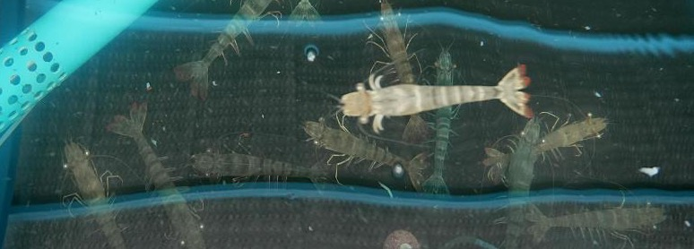


What is Artemia used for? Aquaculture mainly, but multiple applications
Artemia is valued as a highly nutritious feed for early stage
shrimp and fish production, supporting >10 million tonnes
of aquaculture production
Aquarium
& pet trade
Research
& education
Aquaculture
Pharmaceutical
& biotech applications
Human
food
Feast time!
A giant tiger prawn
devours free-swimming
adult Artemia (see white dots)
Ecosystem
services, solar salt
Other emerging
products & innovations

Slide 6
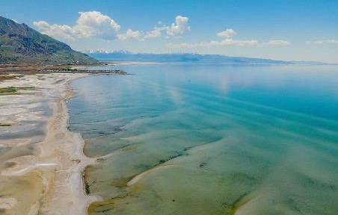
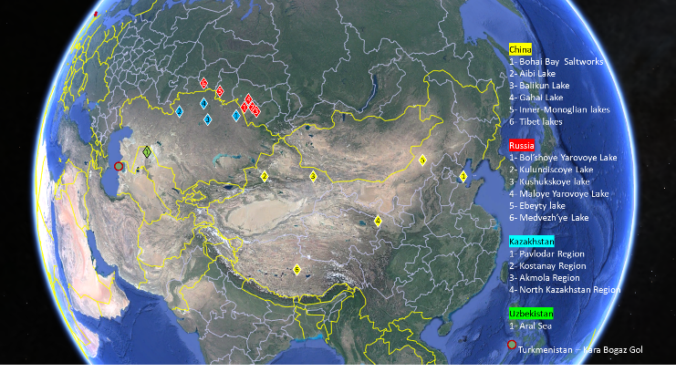
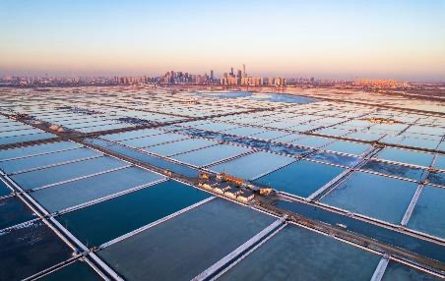
Artemia sources: wild fisheries supply >90% of cysts
Great Salt Lake, USA
Large Solar Salt Works, China

Slide 7
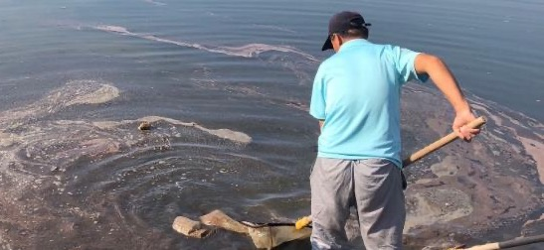
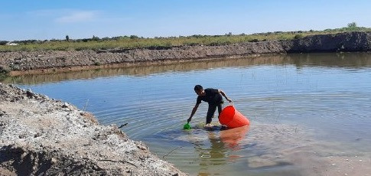
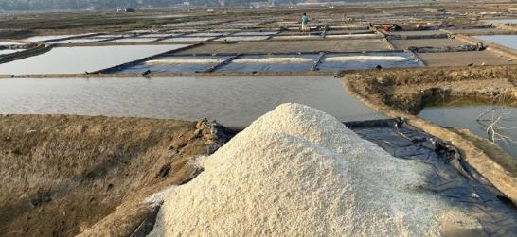
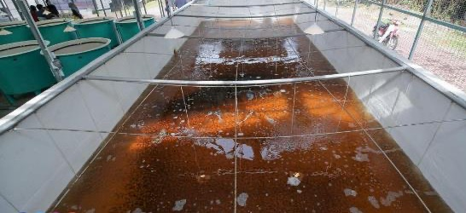
Artemia sources: farming is increasing, in diverse systems
Solar salt works
Pond farming
Artisanal salt farms
Tank systems

Slide 8
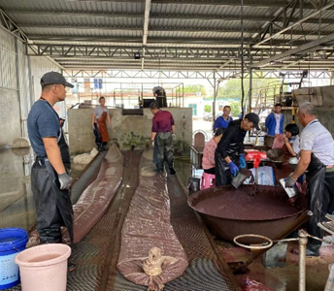

Artemia: its economic value and impacts
Economic
Impacts
Market Growth: USD 144M (2022) → USD 295M (2030), supporting a USD 250B aquaculture sector.
Higher Incomes: Artemia farming doubles/triples earnings for salt farmers (for cysts: 60–100 kg/ha, USD 40–50/kg).
New Revenue: Brine water & Artemia biomass create alternative income streams.
Jobs & Cooperatives: Supports value chains, cooperatives, and women in processing.
Global Demand: 80% artemia cyst supplies to major shrimp markets (China, Vietnam, Ecuador, India)
Innovation: integrated farming boost efficiency and resilience.

Slide 9
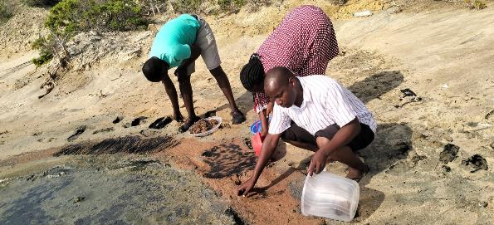
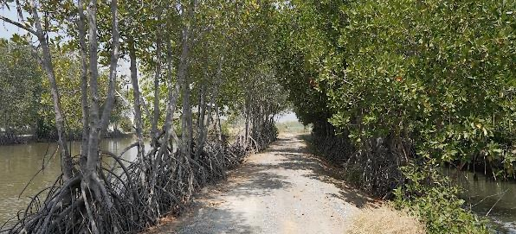
Artemia farming: its social and ecological values and impacts
Social Benefits
Environment and Climate
Targets very impoverished regions with few alternatives.
Empowering Women Through Livelihood Diversification
Attracting Youth to Aquaculture
Strengthening Community Cohesion
Enhanced incomes in poor salt impacted regions
Evidence of Strong Cooperatives
Artemia production in diverse hypersaline agro-ecologies,
with few alternatives
Climate resilience in hypersaline, salt impacted coastal
and inland region
Biomass production based on agro-processing waste streams - low environmental and GHG footprint
Biodiversity of Artemia

Slide 10
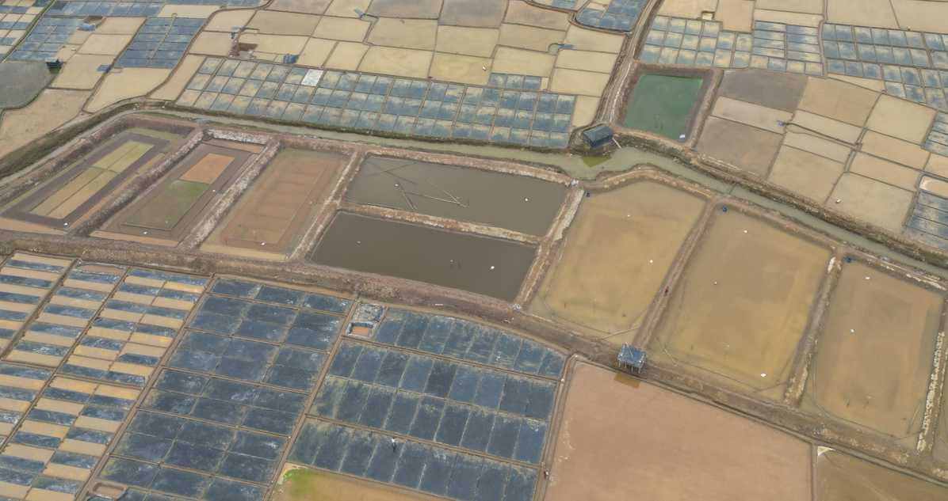
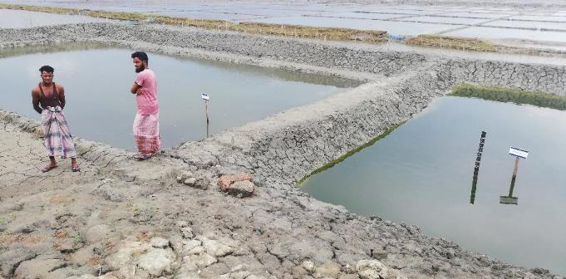

Slide 11
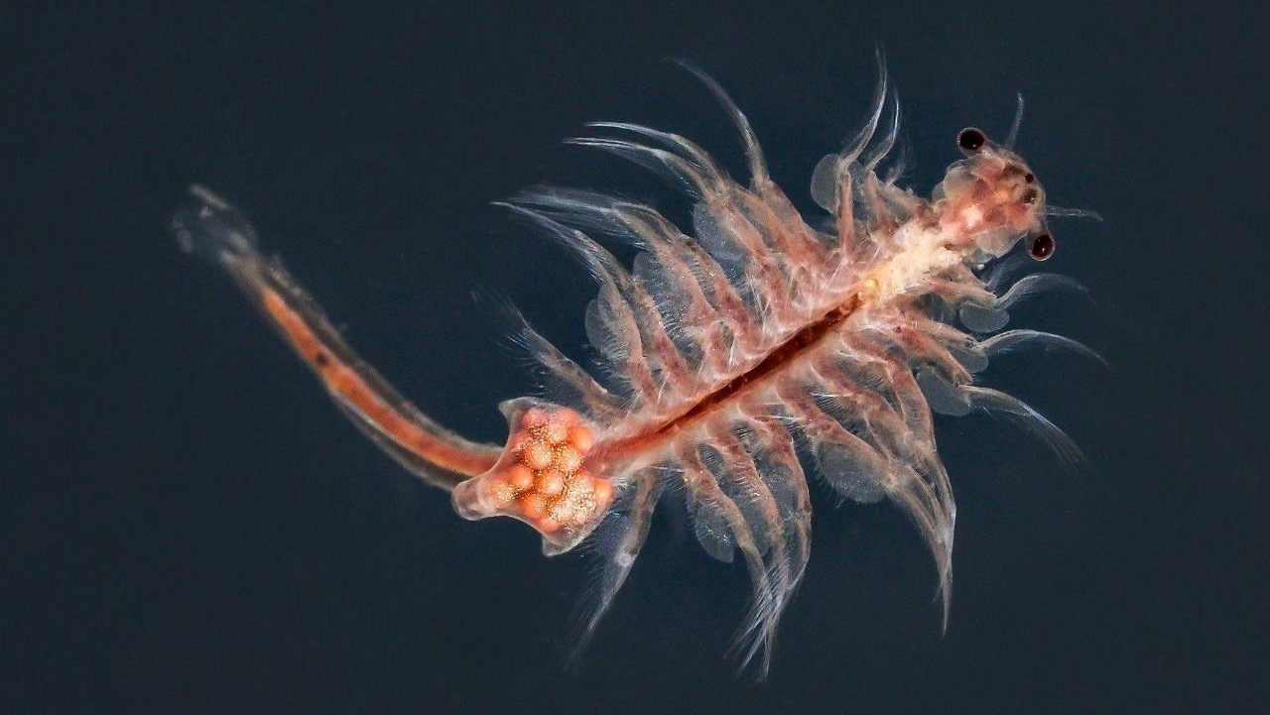

Thank you

