Slide 1








Yeong Yik Sung, Sui Liying & Patrick Sorgeloos
亚洲区域卤虫参考中心
Asian Regional Artemia Reference Center

Slide 2
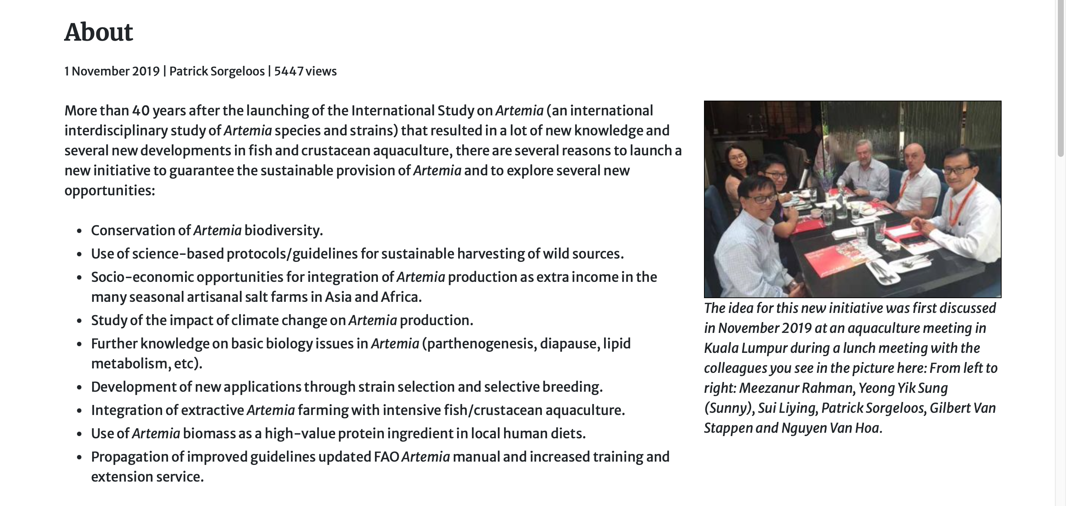
Background

Slide 3
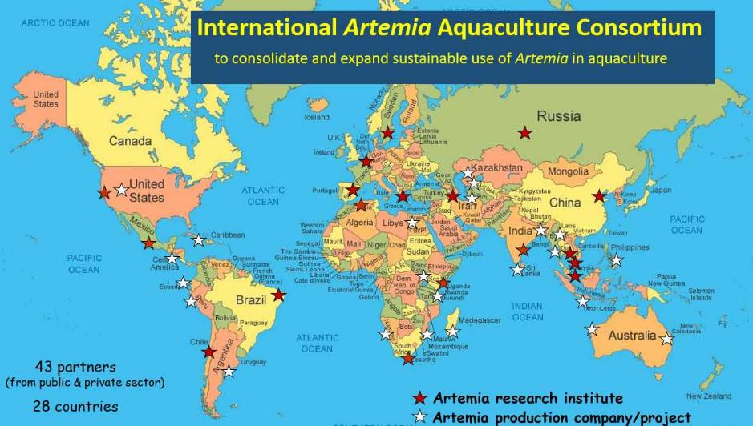
IAAC

Slide 4
Steering and Advisory Committee Members
Steering Committee
Yeong Yik Sung, Universiti Malaysia Terengganu, (Chair)
Sui Liying, Asia Regional Artemia Reference Center, Tianjin University of Science & Technology, China (Co-chair)
Simon Wilkinson, Network of Aquaculture Centres for Asia and Pacific (Secretariat / IAAC host institution)
Nguyen Van Hoa, Can Tho University, Vietnam
Meezanur Rahman, WorldFish, Bangladesh
Betty Nyonje, Kenya Marine Fisheries Research Institute, Kenya
Gonzalo Gajardo, Los Lagos University, Osorno, Chile
Annelies Declercq, Artemia Reference Center, Ghent University, Belgium
Parisa Norouzitallab, SLU, Sweden
Naser Agh, Urmia University, Iran
Advisory Committee
Patrick Sorgeloos (Chair)
Representing the FAO
Matthias Halwart
Representing the academic sector
John Beardmore, honorary member
Theodore Abatzopoulos
Representing the private sector
Philippe Léger
David Christopher Garriques

Slide 5

16. The Sub-Committee appreciated the work on Artemia and supported FAO efforts to explore development of technologies and sustainable management of Artemia resources.
63. The Sub-Committee noted with appreciation new examples of international cooperation such as the International Artemia Aquaculture Consortium and the Center for Ecological Aquaculture. In this regard, the Sub-Committee encouraged FAO to work in partnership with national, regional and international initiatives to promote sustainable aquaculture, such as the Global Sustainable Aquaculture Advancement Partnership (GSAAP).
66. The Sub-Committee welcomed the Artemia workshop held in association with GCA +20 and stressed the value of Artemia as an important aquaculture species and noted concern over the dependence on wild resources. The Sub-Committee further supported proposals for future workshops and recommended development of related guidelines on sustainable development of Artemia aquaculture, including capacity building.
NACA to host and coordinate the International Artemia Aquaculture Consortium

Slide 6
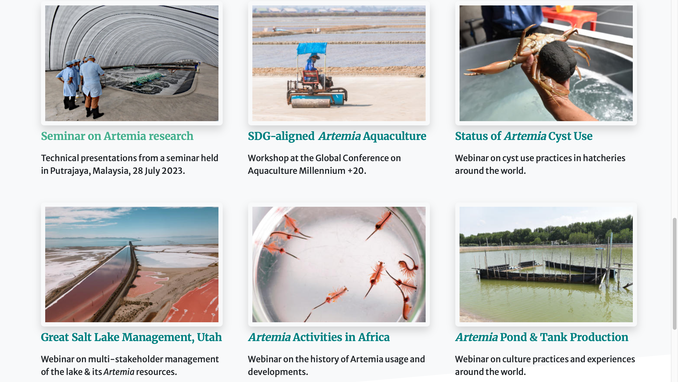
Recent Activities

Slide 7
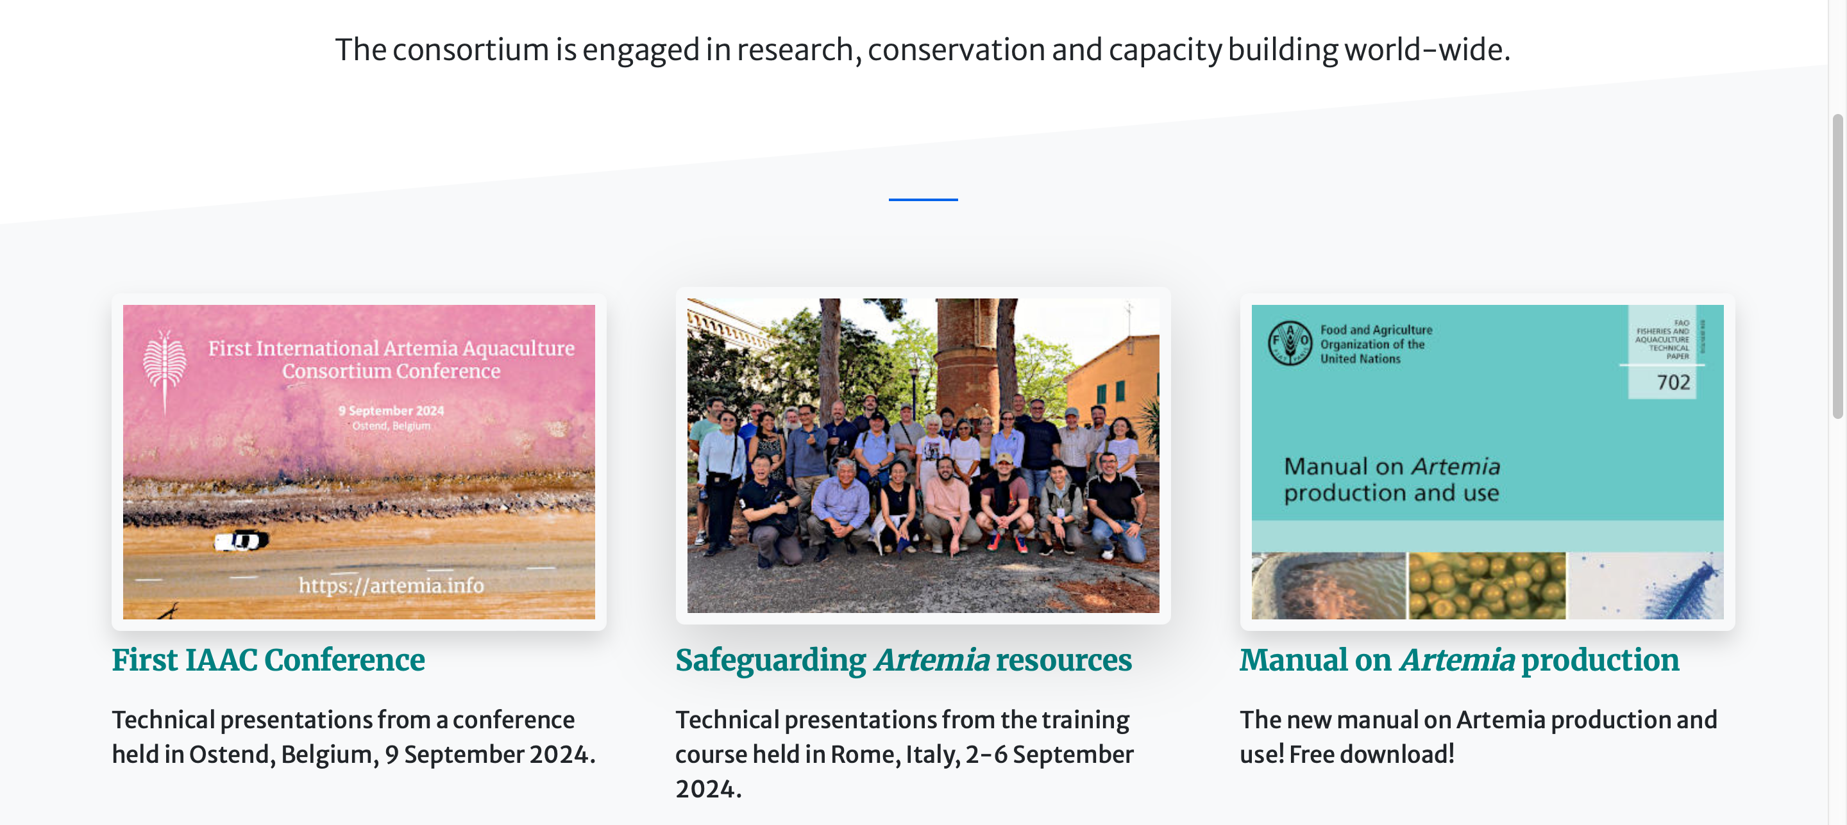
Recent Activities

Slide 8
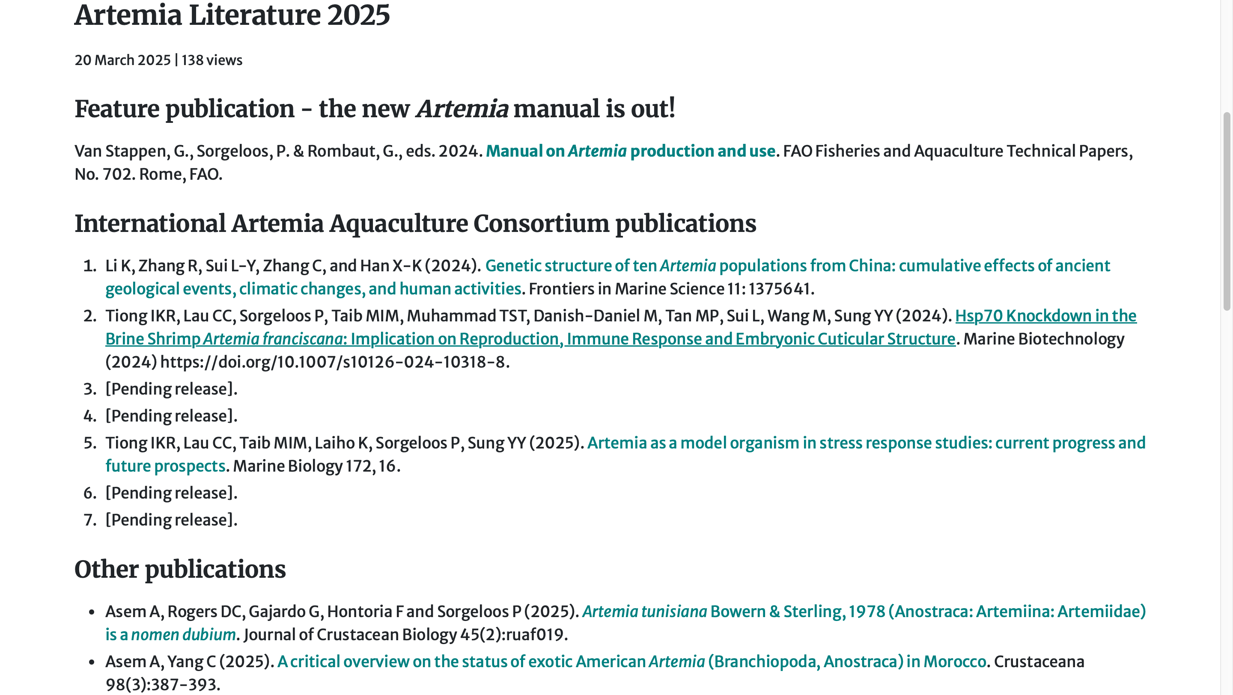
Publications

Slide 9

IAAC – Global Artemia Project

Slide 10




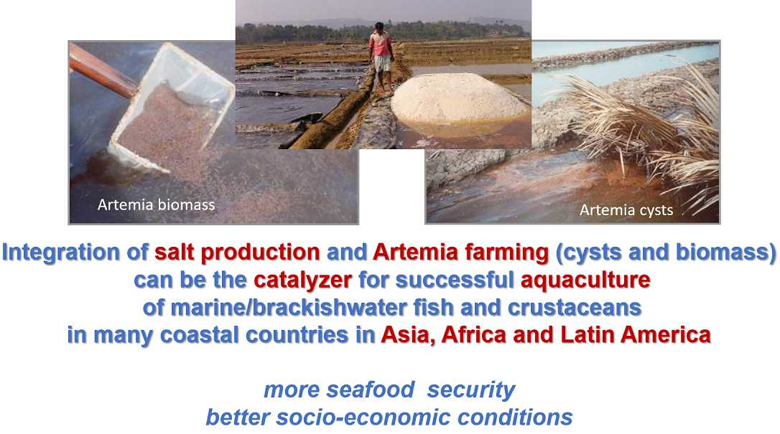
BANGLADESH & GLOBAL PERSPECTIVE

Slide 11
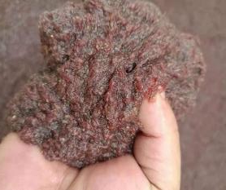
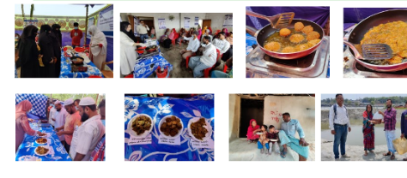
BANGLADESH & GLOBAL PERSPECTIVE
Artemia biomass as human food

Slide 12
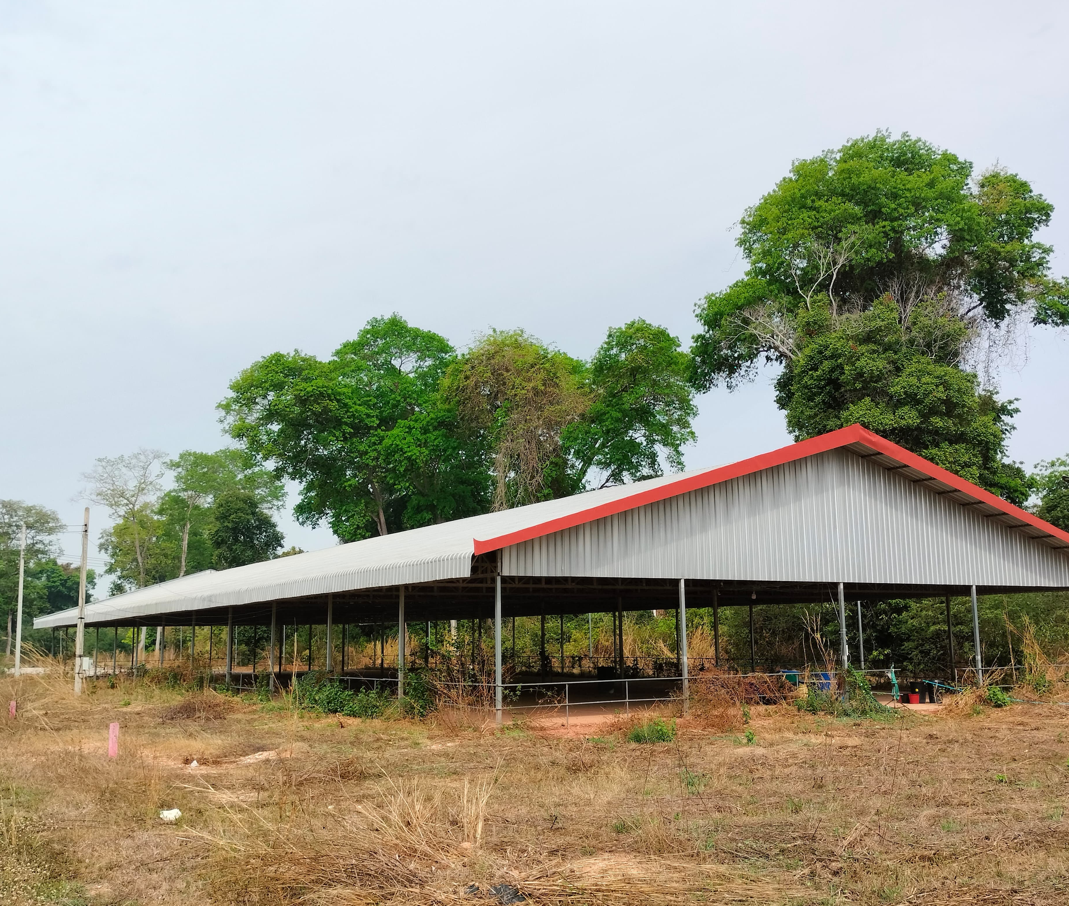
FAO Artemia Laos

Slide 13
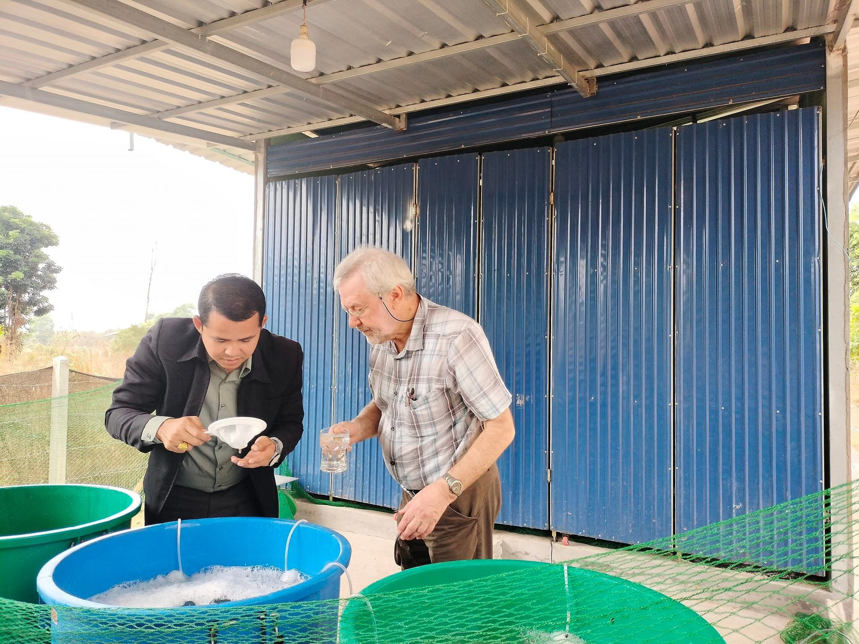
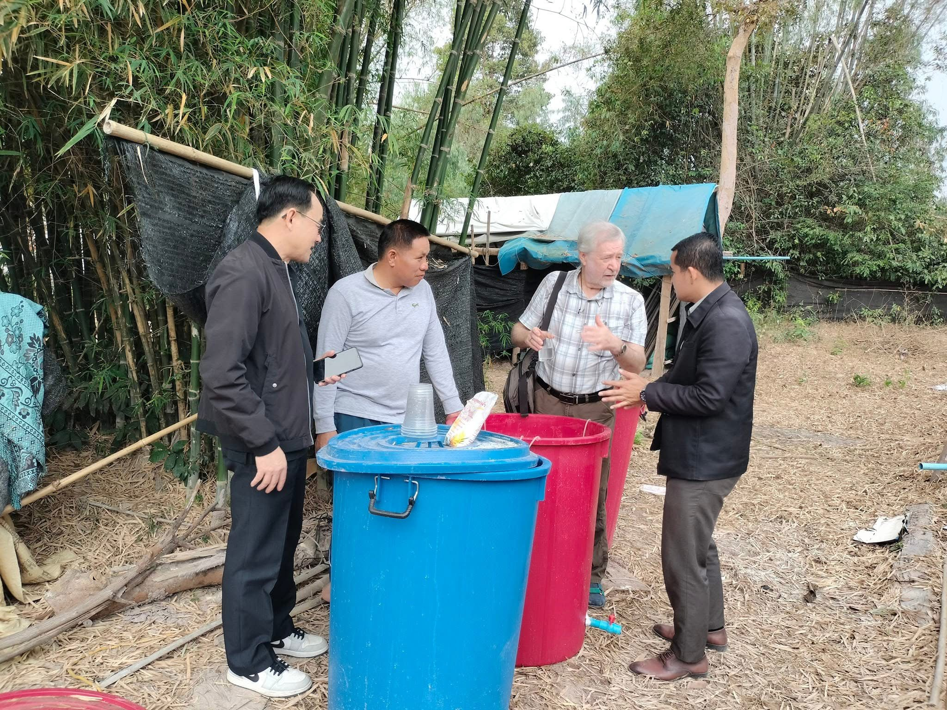
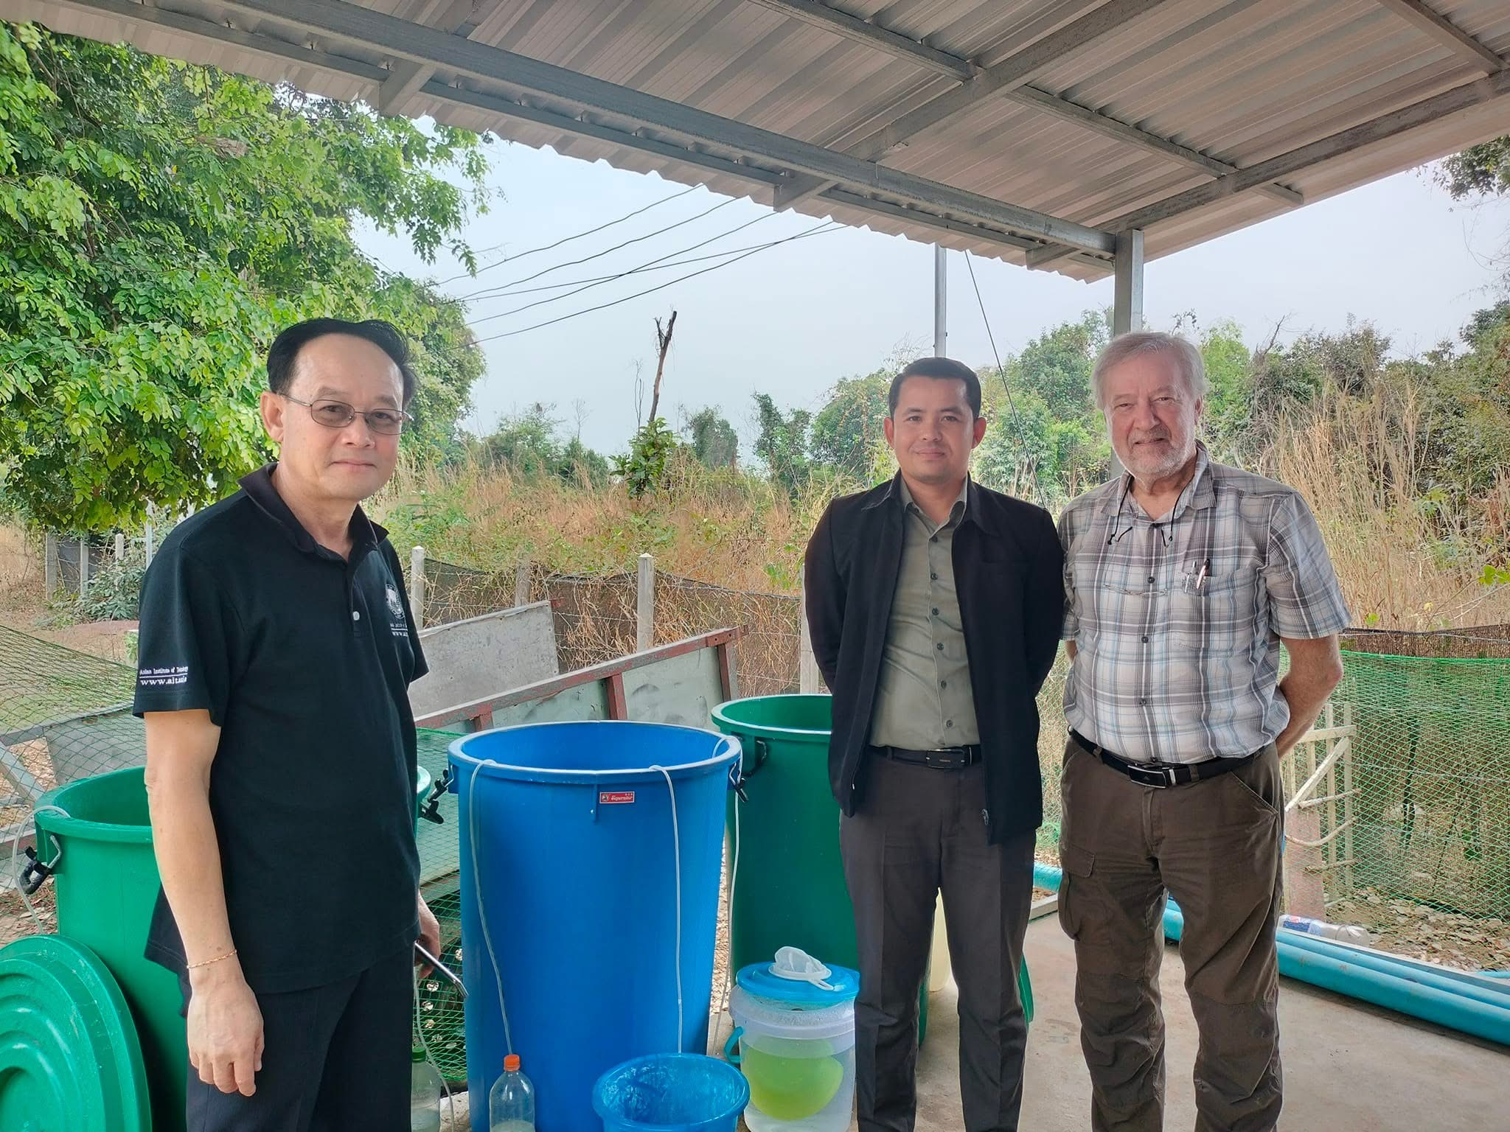
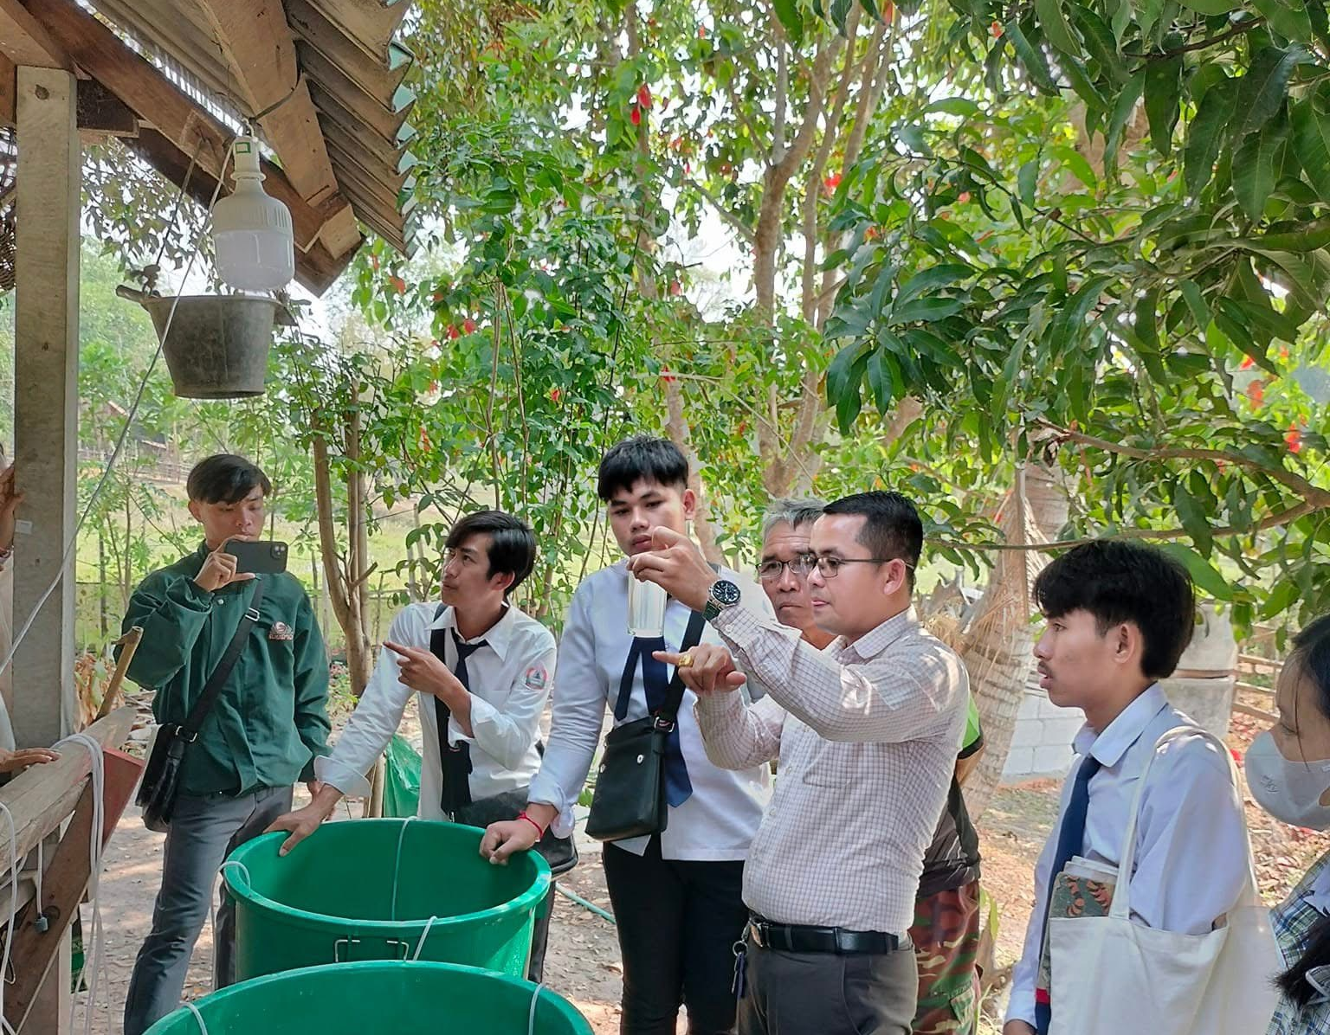
From backyard culture with water buckets….

Slide 14
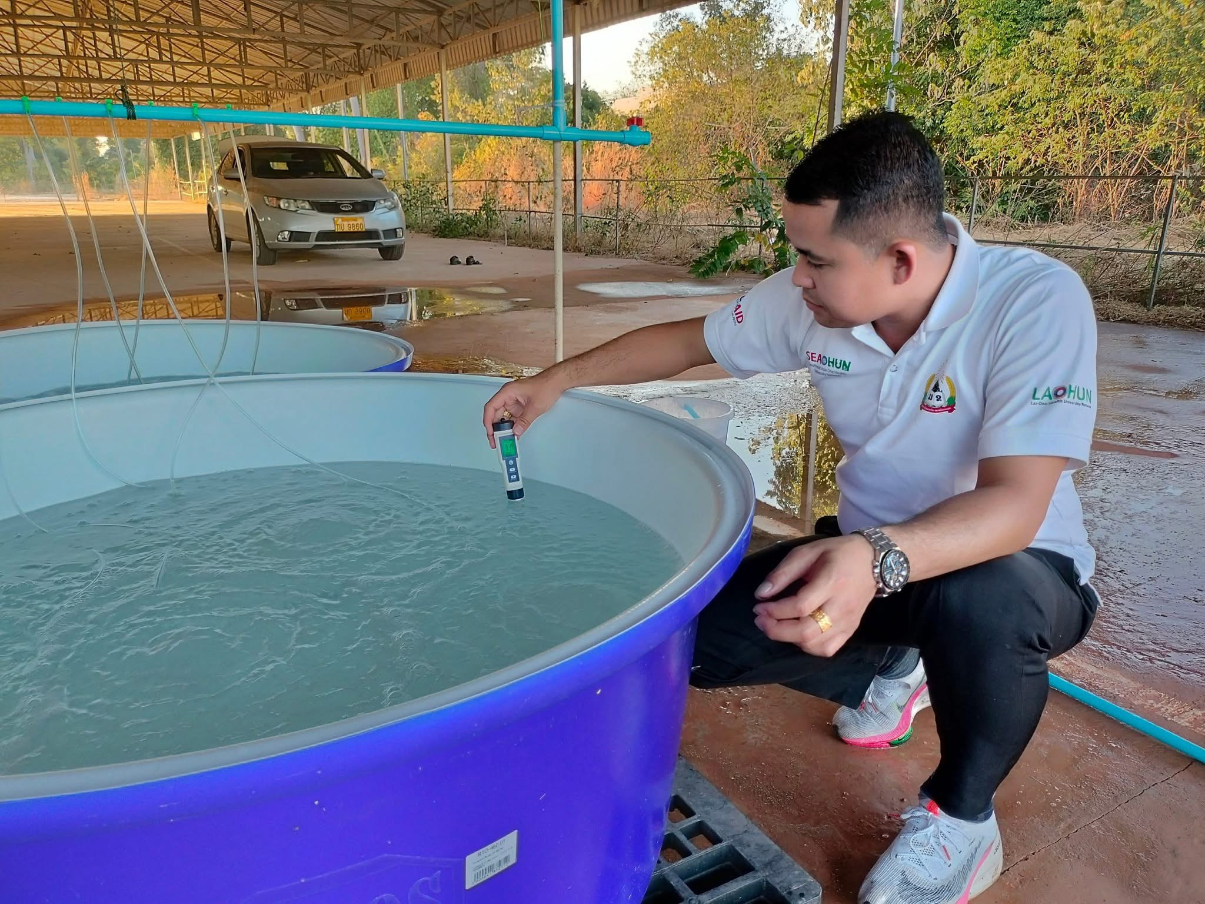
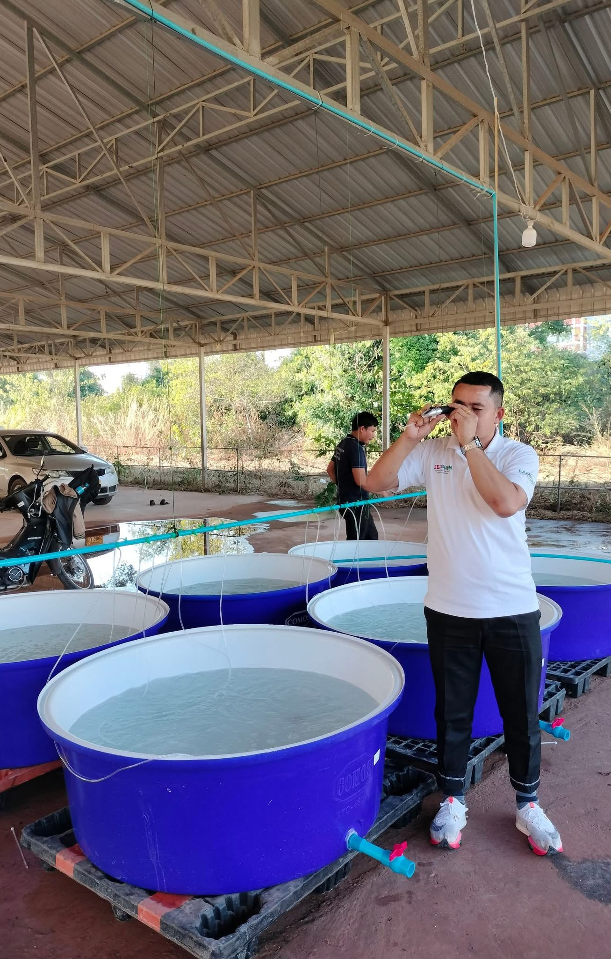
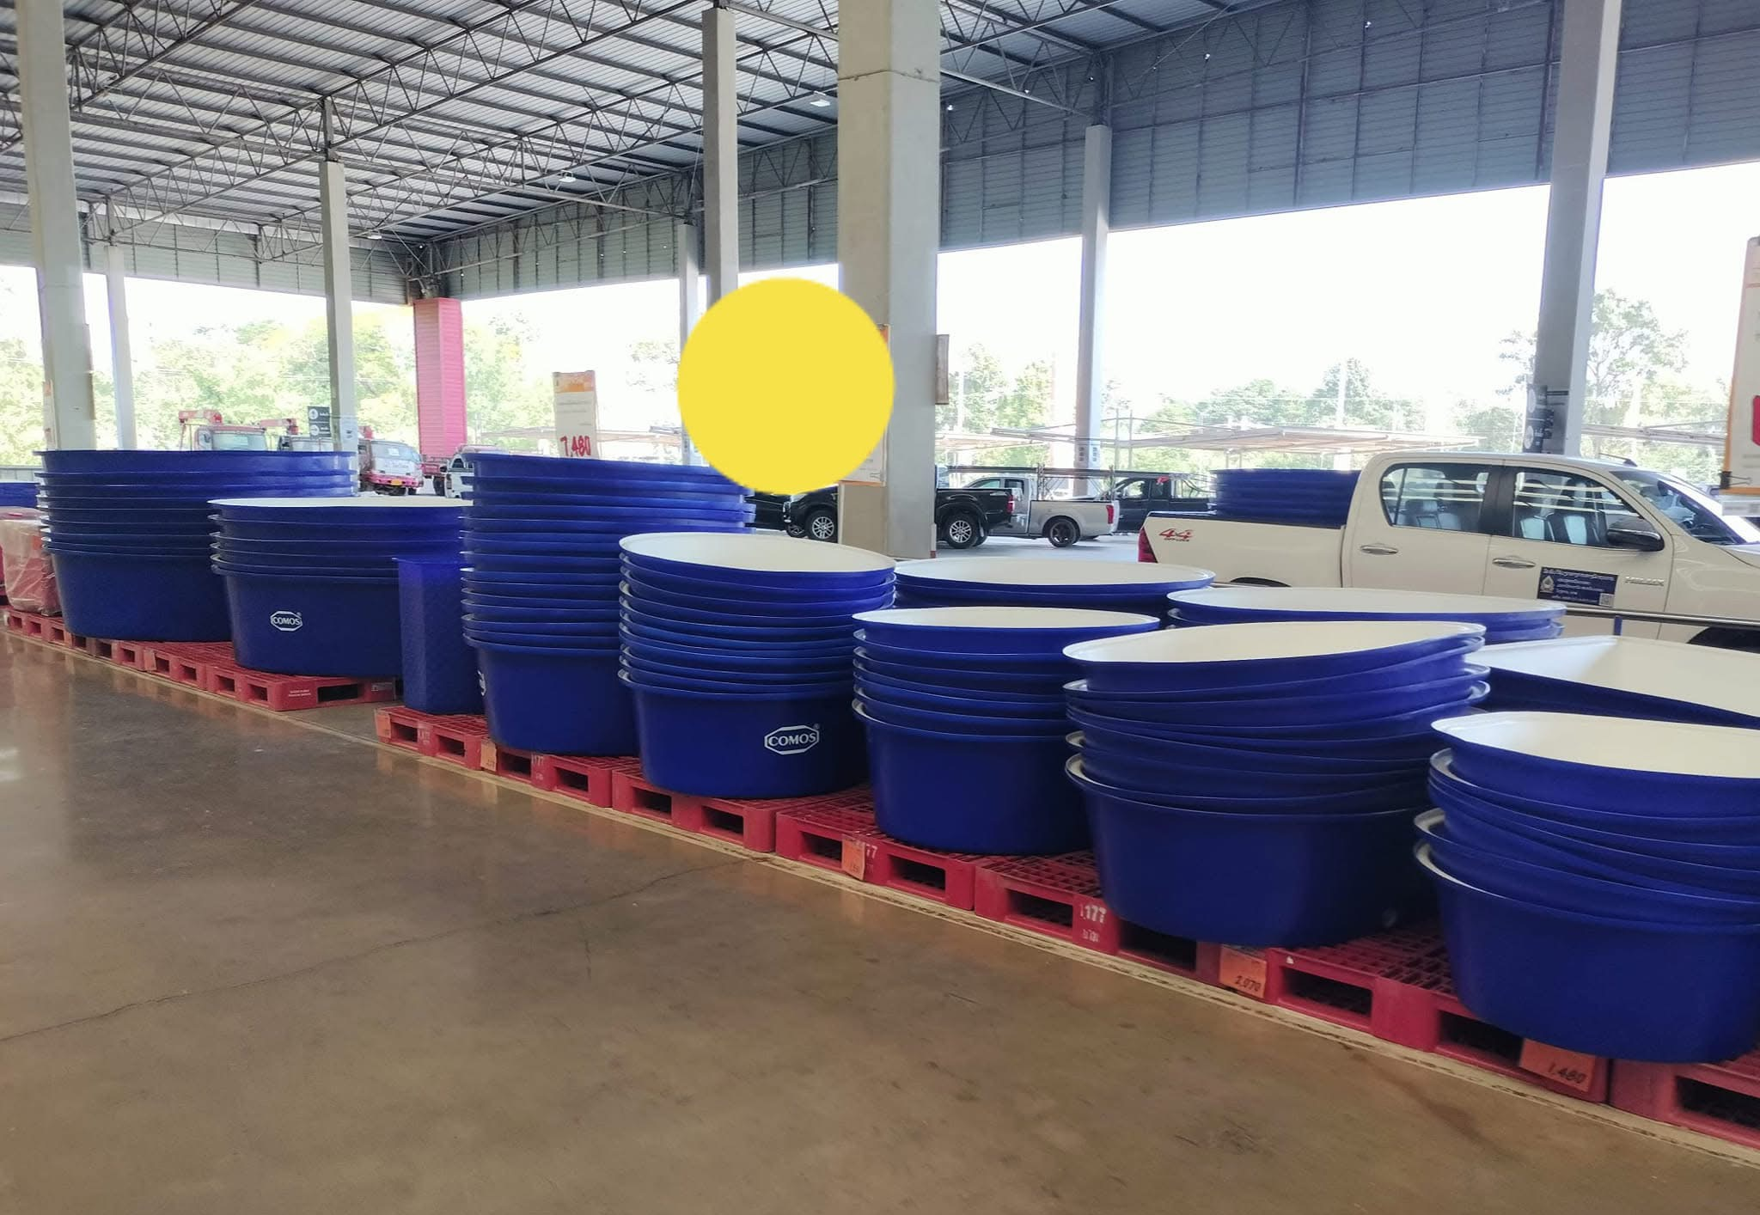
To Artemia Hatchery @ Savannakhet University

Slide 15
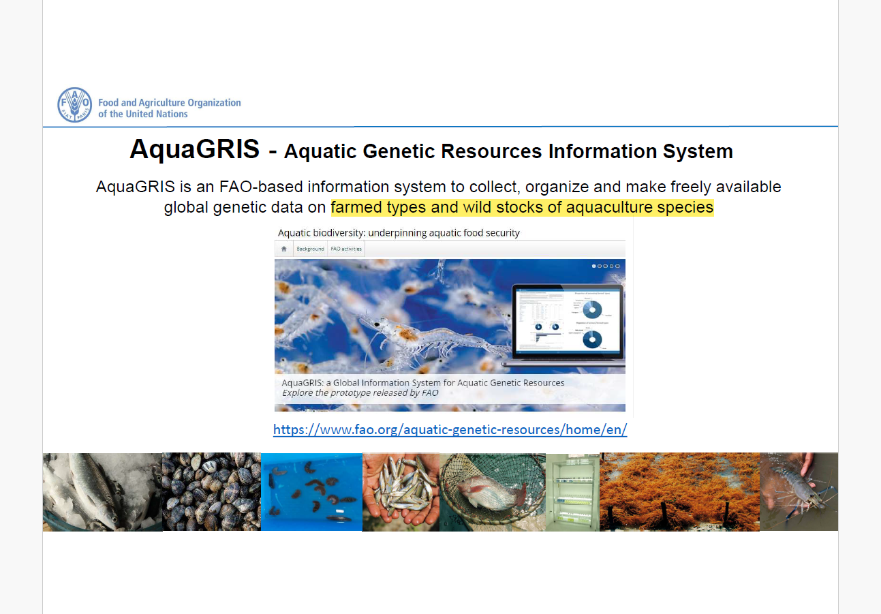

Slide 16
Information input
11 genetic stocks/salt lakes with commercial harvest:
- 3 Artemia species：A. sinica, A. tibetiana, A. franciscana
- several parthenogenetic linages
Types of Information/data:
- Species: species name, impact of climate change, etc.
- Wild stocks/farmed species: total wild catch production, trend of harvest,
habitat status, management or assessment, etc.
- Genetic stocks
  evidence and criteria for identification: COI/ITS/SNP, genome, adult morphology
  biological characteristics and geological distribution: nutritional profile, size of cysts and instar I nauplii, morphometrics of adults
  taxonomic status: description in literatures
  conservation measure: ex-situ cryopreservation
  …..

Slide 17
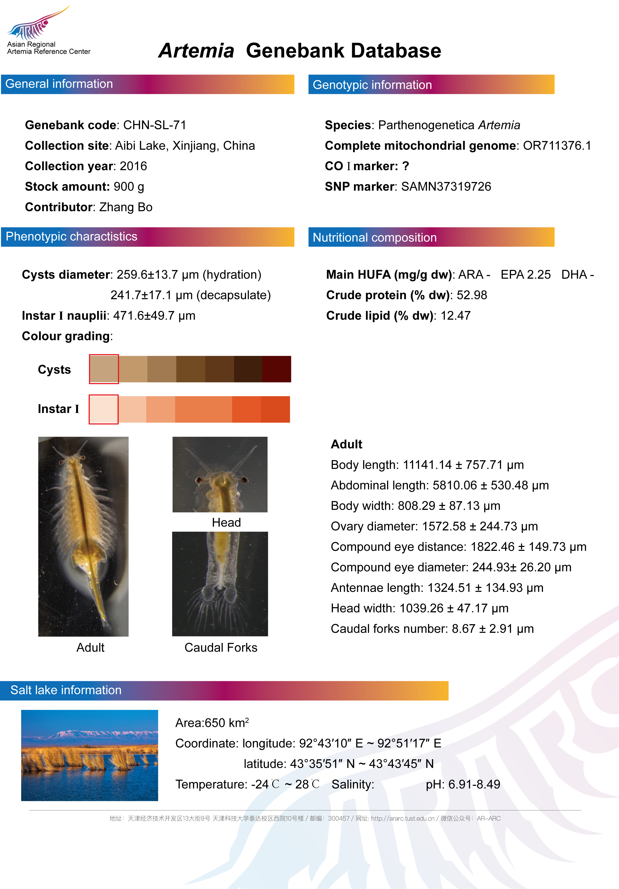

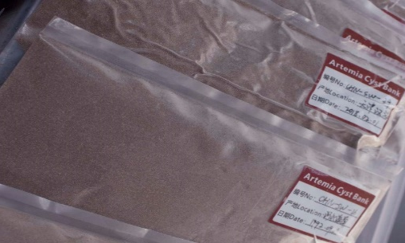
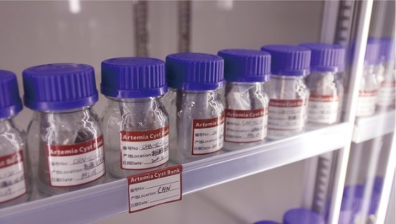
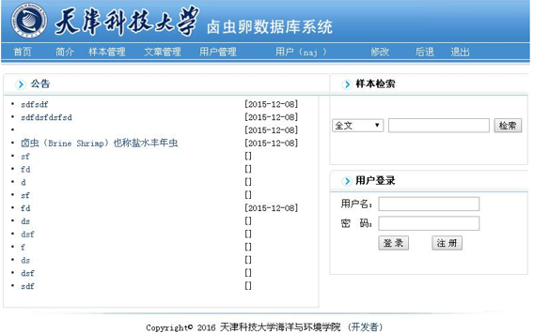

ARARC Artemia Cysts Bank

Slide 18
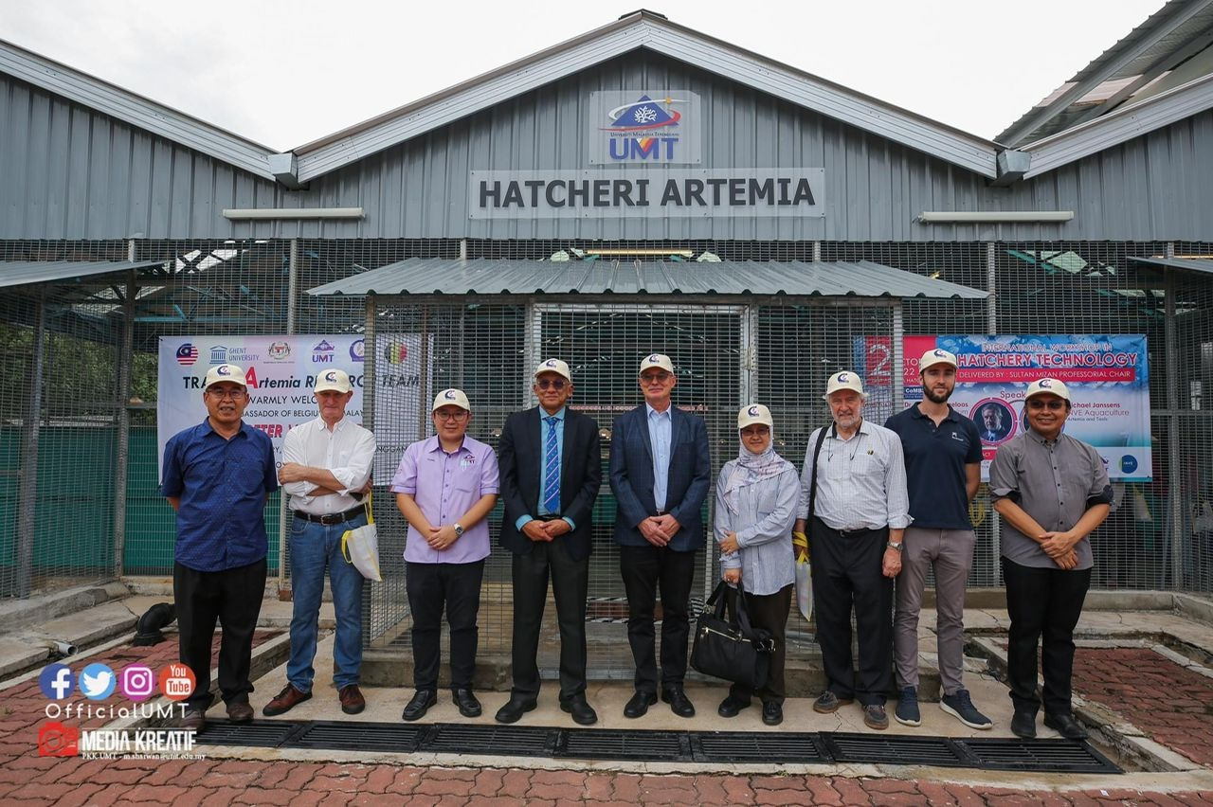
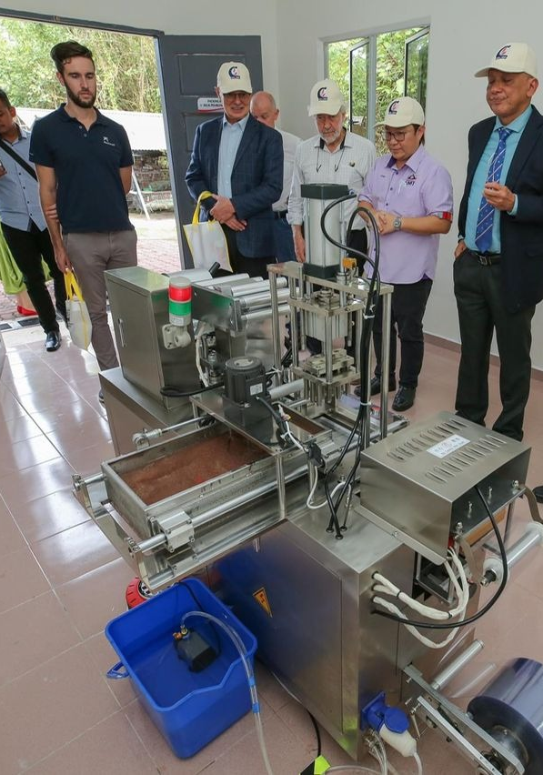
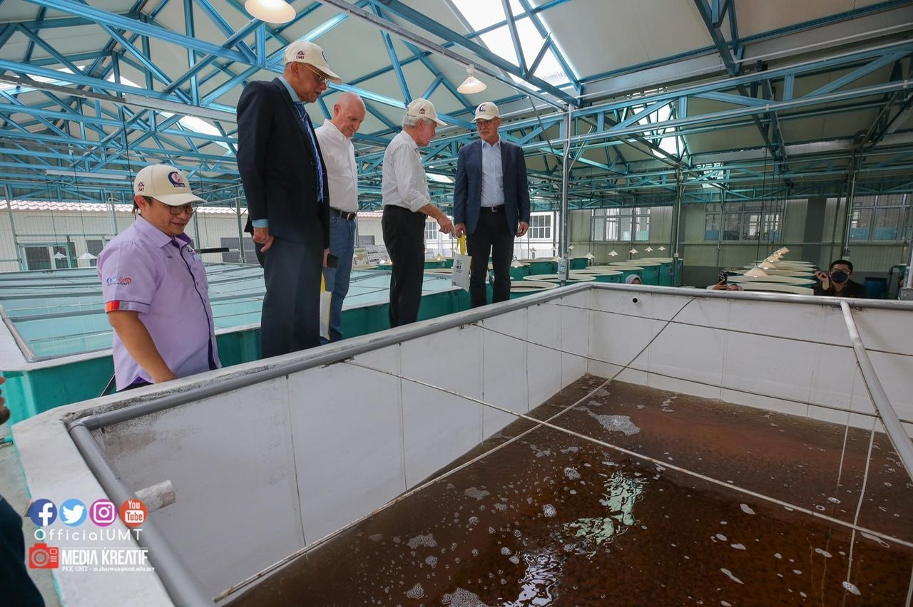
Artemia Production Facilities @ UMT
Artemia culture Facilities
Artemia Food Preparation Facilities
Artemia Depuration & Sterilization Facilities
Artemia Packaging Facilities
Artemia QC Laboratory
Artemia cysts production tank

Slide 19
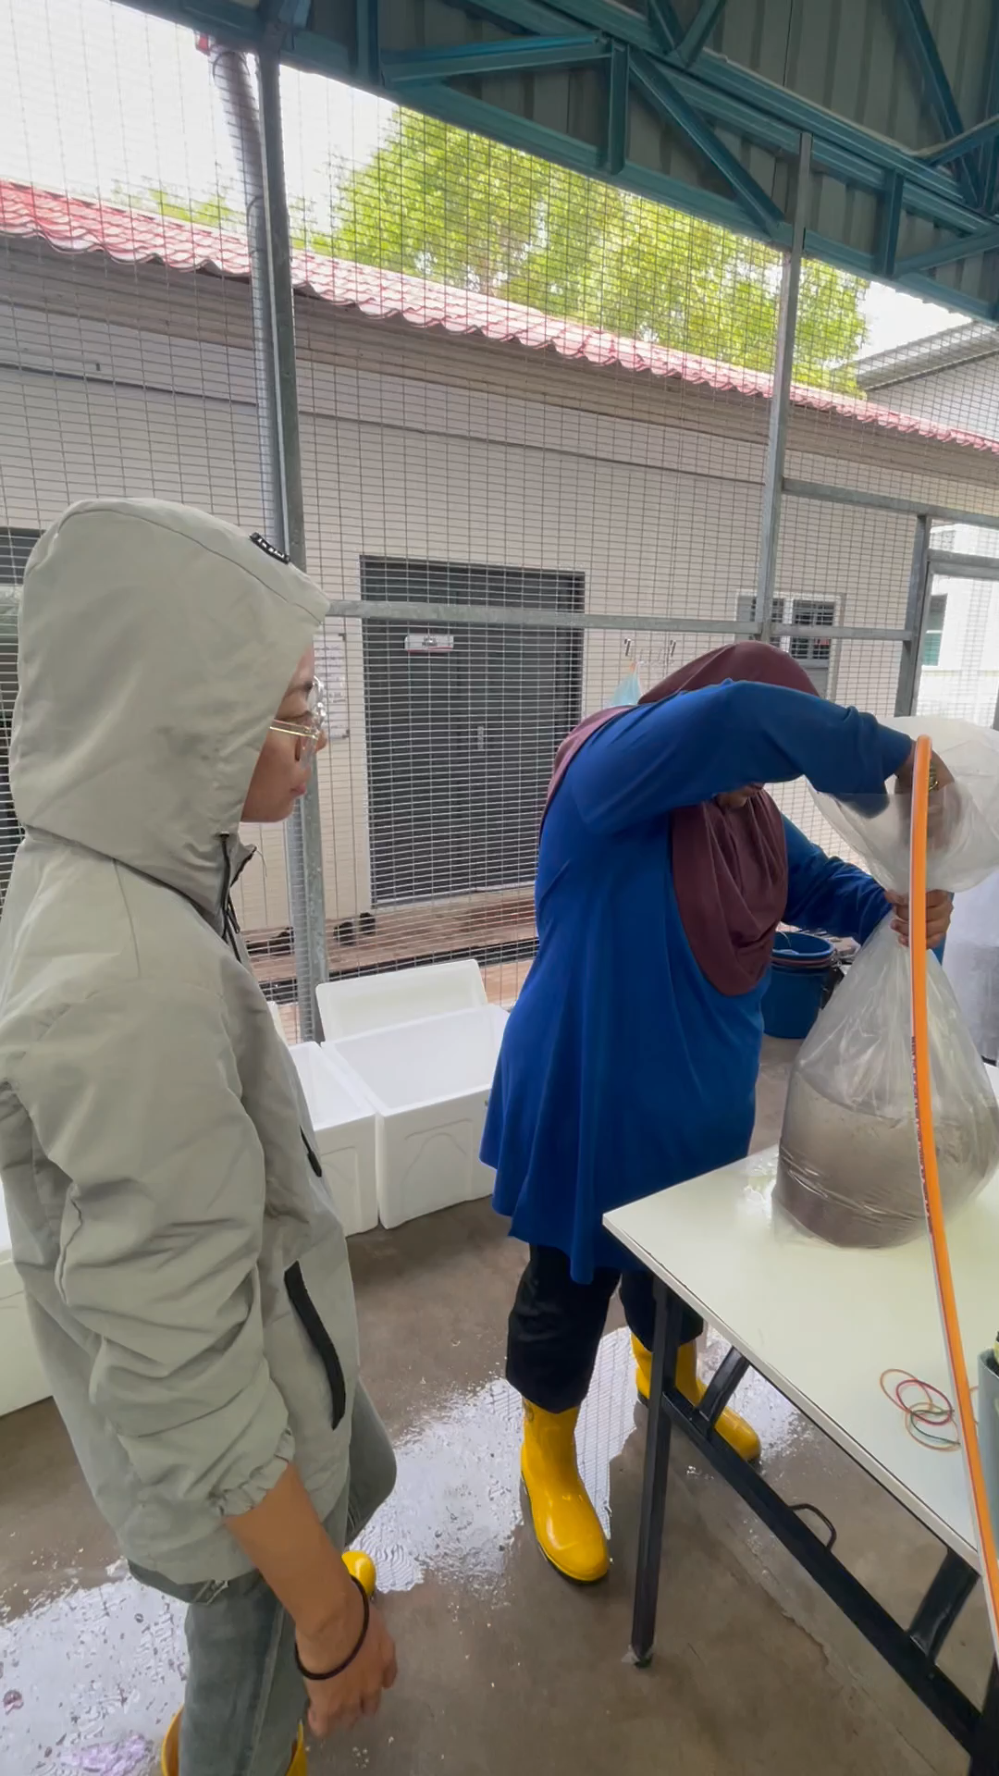
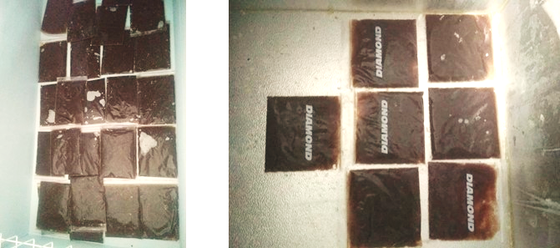
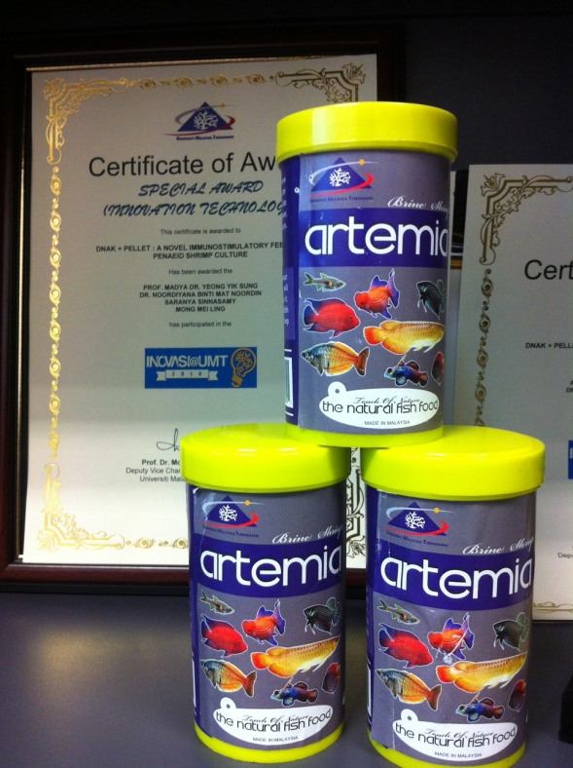
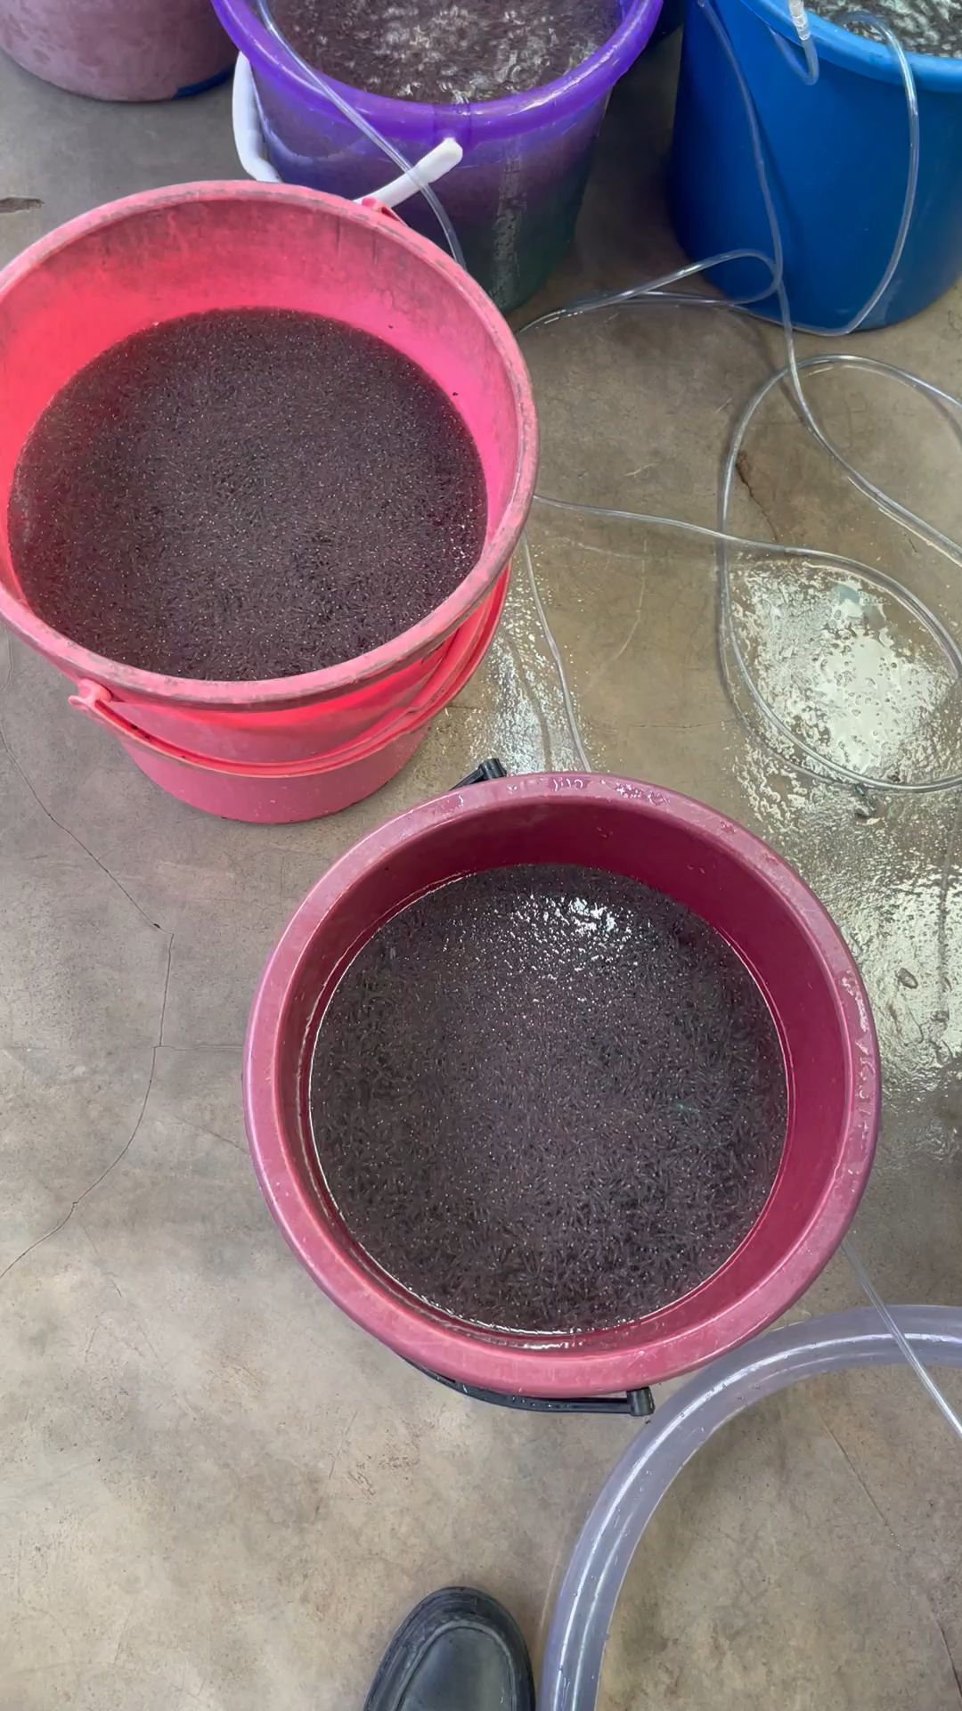
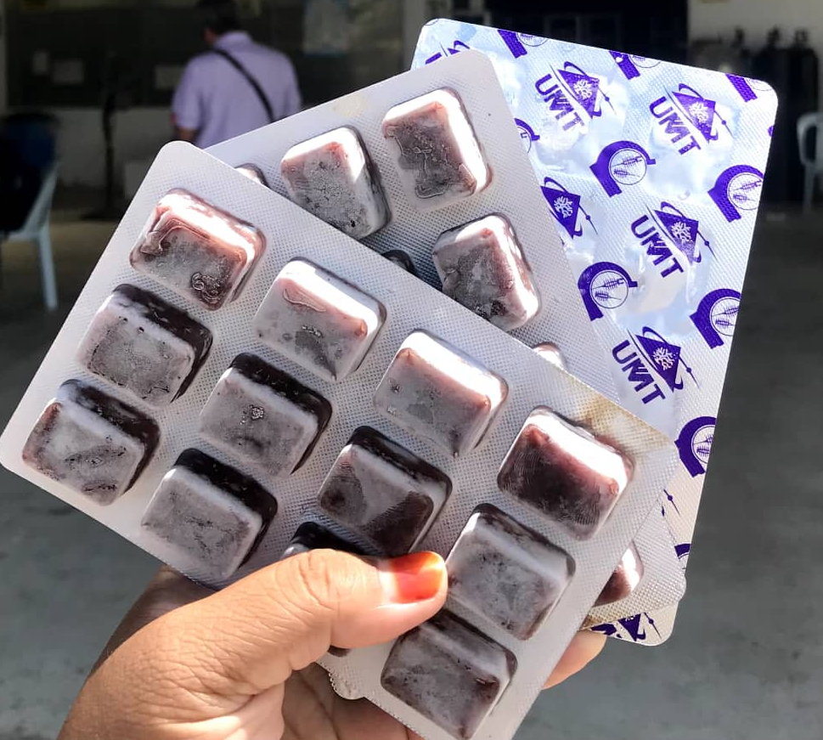
Live, freeze-dried and Frozen Artemia Biomass

Slide 20
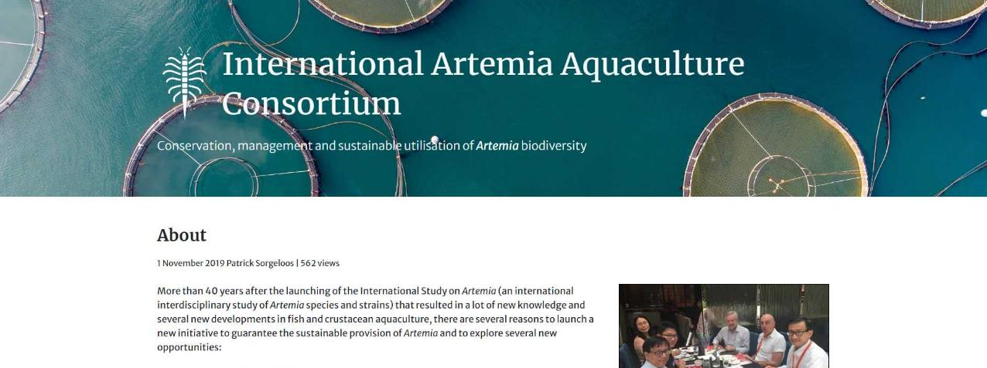
See website https://artemia.info/
NACA is hosting the IAAC which is now managed by an international working committee and advisory council members.

Slide 21


Thank you

