Slide 1
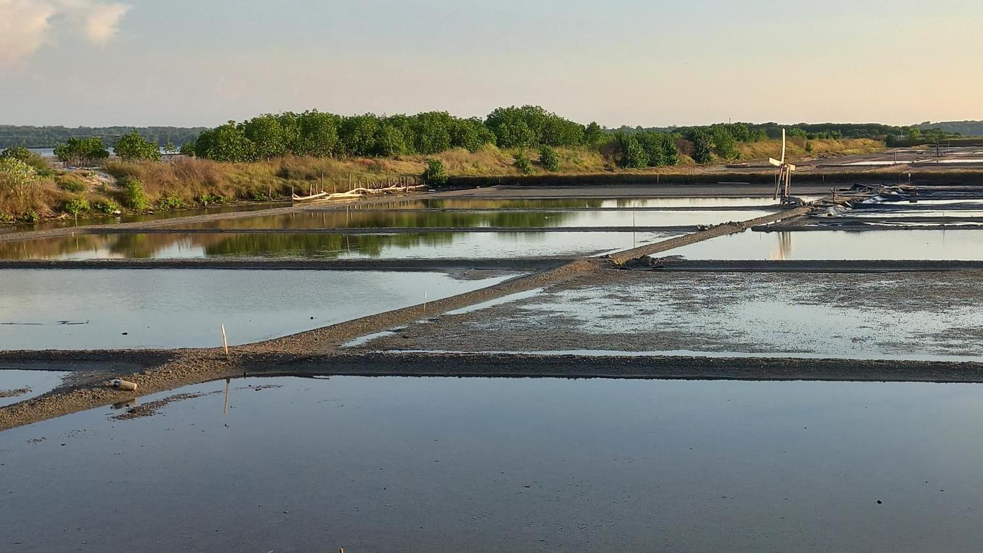

TECHNICAL FEASIBILITY
ARTEMIA CYST PRODUCTION IN SOLAR SALT PONDS,
MADURA, EAST JAVA, INDONESIA
Gede Suantika
Puspitaningasih Sutrisno
Indah Puspitasari
School of Life Science and Technology
Institut Teknologi Bandung
WORLD AQUACULTURE SOCIETY CONFERENCE
SINGAPORE, 2-5 JUNE 2026

Slide 2
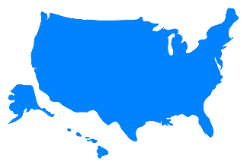
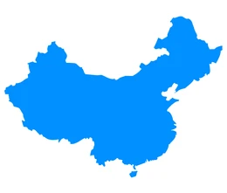
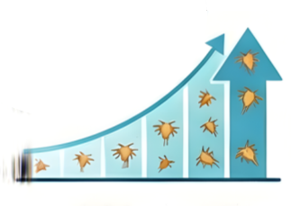
Introduction
Artemia Supply and Dependency in Indonesia
Current Condition
Indonesia shrimp production 786,382 ton, 4rd Global
Demand is expected to continue increasing following efforts to expand shrimp production
High reliance on imports raises long-term sustainability concerns for nursery systems
The estimated national Artemiacycst requirement in 2024
USA 1,012 thousand tons
176 Tons
Implication
Strategic Need
Strengthened domestic supply and improved aquaculture resilience
China 74,1 million metric tons
Local Artemia production initiatives needed
Target area: Solar salt ponds in Madura
Indonesia relies predominantly
on imported Artemia cysts
Sources: https://portaldata.kkp.go.id/portals/data-statistik/prod-ikan/summary,
Notes:
https://portaldata.kkp.go.id/portals/data-statistik/prod-ikan/summary
https://www.imarcgroup.com/united-states-shrimp-market
https://apps.fas.usda.gov/newgainapi/api/Report/DownloadReportByFileName?fileName=2025%20China%20Fishery%20Products%20Report_Beijing_China%20-%20People%27s%20Republic%20of_CH2025-0057.pdf

Slide 3
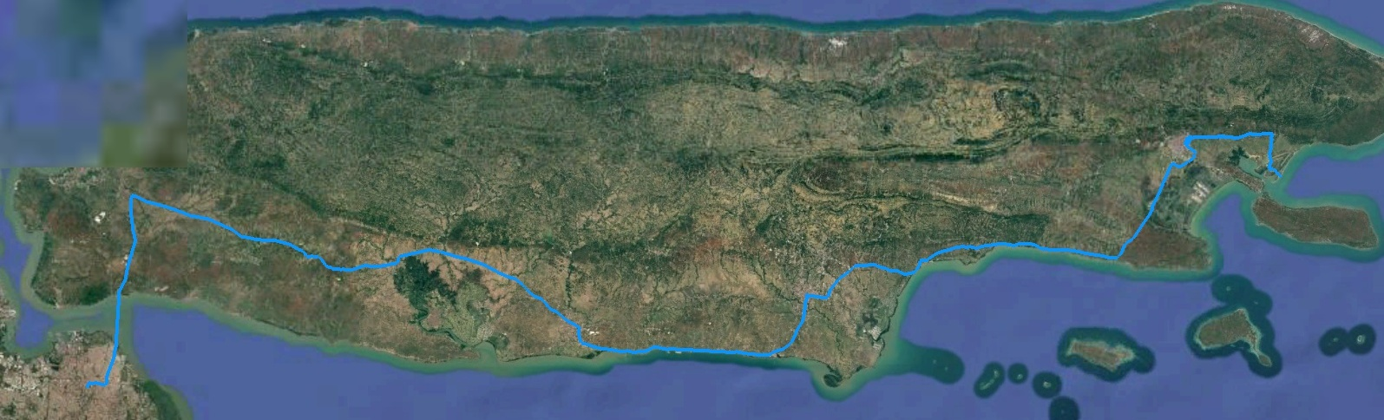


Connectivity
Transportation Network
Sumenep
Kalianget
Port
Suramadu Bridge
Pamekasan
Surabaya
The sea-salt farming area is in Sumenep Regency, eastern Madura Island, East Java Indonesia
Primary hub: Surabaya (Tanjung Perak Port) serves as the primary transportation gateway of East Java
Land routes: Suramadu bridge and national provincial roads (Bangkalan, Sampang, Pamekasan, Sumenep).
Distance & travel time from Surabaya to Sumenep: approx. 168 – 175 km, with 4.5-6 hours by car.
Road condition: continuous network of national and provincial roads, generally paved and in good condition.
Air routes: Trunojoyo Airport, Sumenep with small aircraft only and limited regional flights)
Sea routes: Kalianget & Gersik Putih Port limited to small inter-island connectivity (Sapudi, Raas, Kangean, Masalembu)

Slide 4
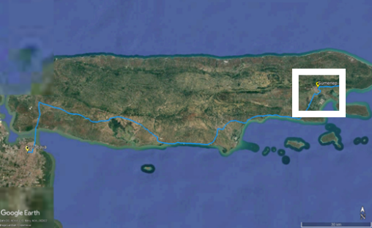
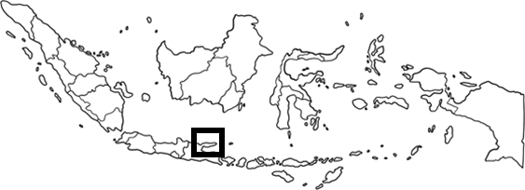
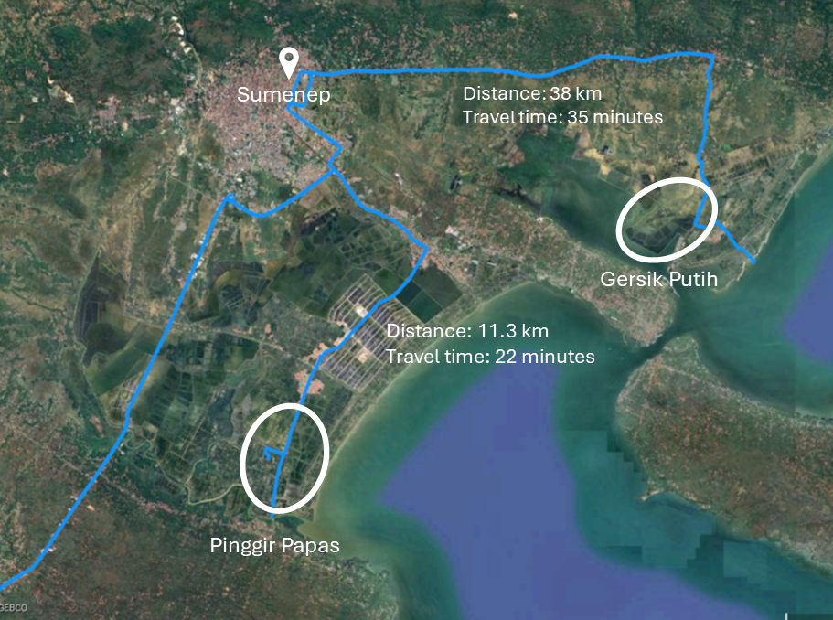
Condition overview of Sea salt ponds in Sumenep area;
1. Gersik Putih (GP)
2. Pinggir Papas (PP)
Gersik Putih (GP) and Pinggir Papas (PP) are well-established salt-producing areas in Sumenep Regency
Physicocemical conditions are favorable for high-quality raw salt production
Proximity to Sumenep town:
GP is located approximately 36-38 km from Sumenep town (30-40 minutes by road), adjacent to Gersik Putih Port, road access limited, salt transported by boat to wider road areas.
PP is located about 11-13 km from Sumenep town (20-30 minutes by road), inland with estuarine water source, moderate road networks to Gersik Putih Port .

Slide 5
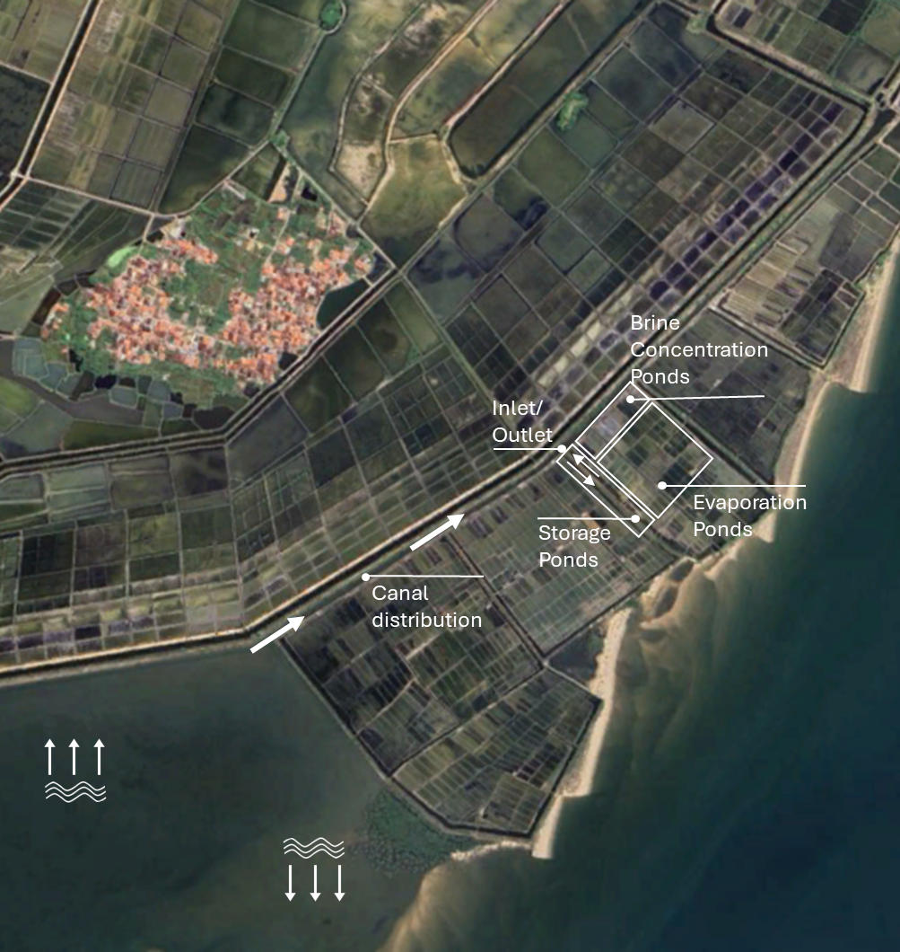
Salt pond Structure
at Gersik Putih (GP)
Salt pond layout: inlet/outlet canal, storage ponds, evaporation ponds, brine concentration ponds, canal distribution, and pond bunds.
Direct seawater intake: water enters from canal distribution through inlet/outlet without sluice gate control, relying on tidal flow
Water flow system: seawater enters via inlet, stored in storage ponds, distributed through canal, processed in evaporation ponds, concentrated in brine ponds, crystallization
Functional roles:
Storage ponds: initial seawater reservoir
Evaporation ponds: gradually salinity increase
Brine concentration ponds: final stage before crystallization
Canal distribution: regulates water flow from source to storage ponds
Sea dike: embarkment protection against wave intrusion

Slide 6
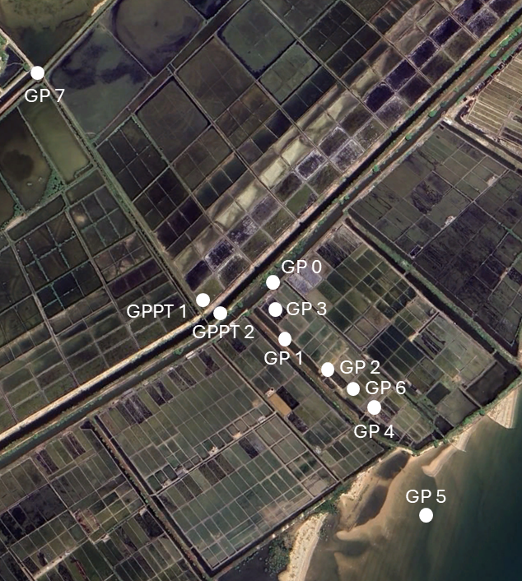
Sampling Points at Gersik Putih (GP)
(Physicochemical water parameters)
Sampling site: GP0 – GP7 and GPPT1-GPPT2
Condition of site: salt production has not yet started, so sampling focused on raw seawater inflow.
Coverage of production stage (baseline only) :
GP0 – GP7: canal distribution and storage pond (inlet/outlet, direct tidal inflow without sluice gate)
GP2, GP4, GP6: evaporation ponds (currently inactive, only filled with incoming water)
GP3: brine concentration pond (baseline water condition only)
GP5: seawater source and sea dike
GP7: canal distribution
GPPT1: brine concentration ponds
GPPT2: additional canal distribution
Purpose of sampling: to measure salinity and water quality of incoming seawater under non-operational conditions; provides baseline physicochemical data before salt production cycle begins.
GPPT 2
GP 0
GPPT 1
GP 3
GP 1
GP 2
GP 6
GP 4
GP 5

Slide 7
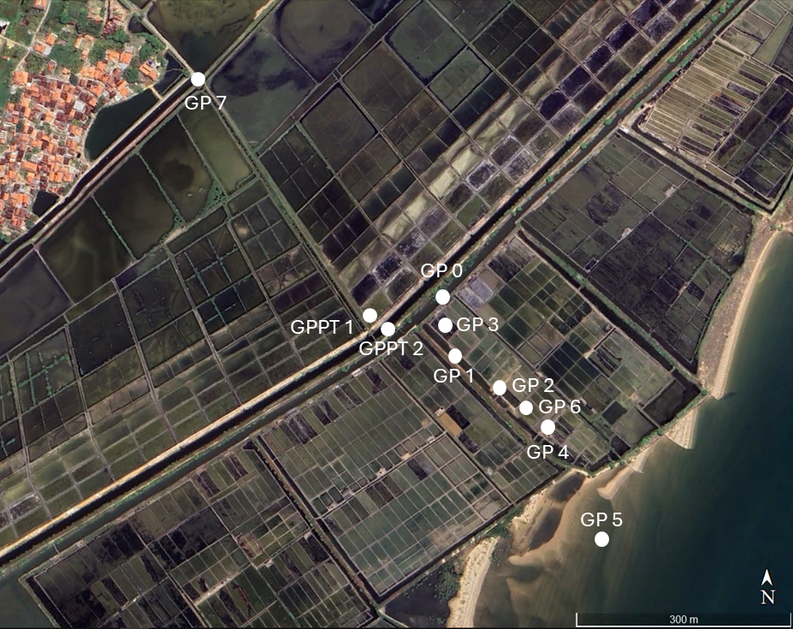
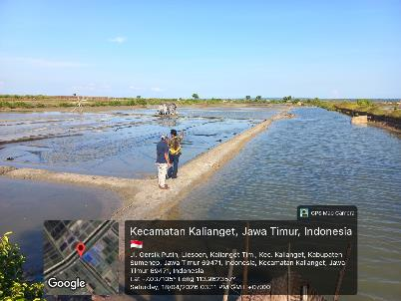
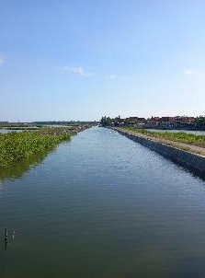
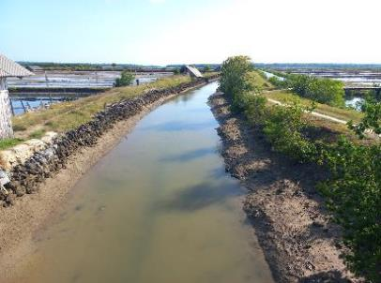
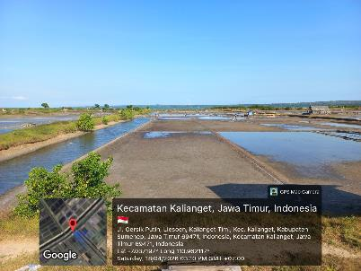
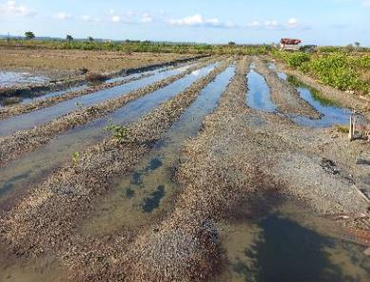
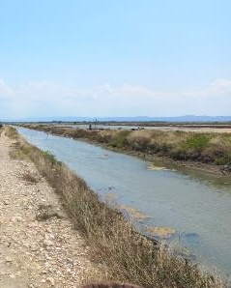
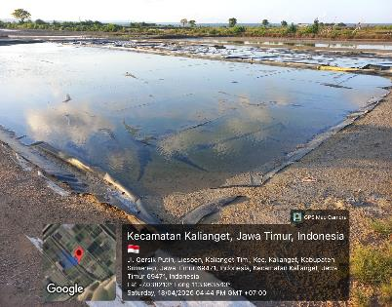
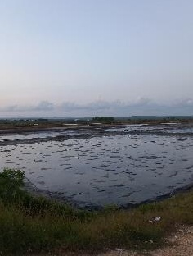
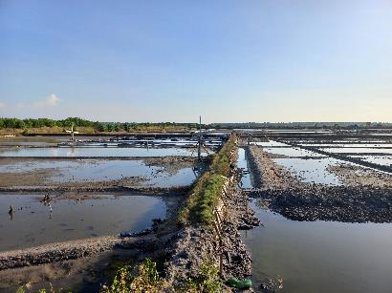
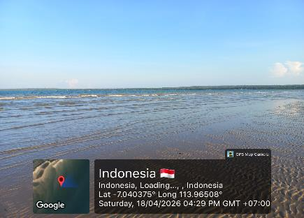
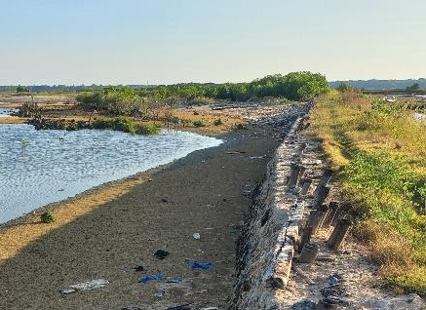
Salt Ponds at Sumenep
Gersik Putih (GP)
GP 1
Storage Pond – Inlet/Outlet
GP 7
Canal Distribution
GP 0
Canal Distribution
GP 2
Evaporation Pond
GP 4
Evaporation Pond
GPPT 1
Canal Distribution
GP 3
Brine Conentration Pond
GPPT 2
Brine Pond
GP 6
Evaporation Pond
GP 5
Source – Open Water (Sea)
GP 5
Sea Dike

Slide 8
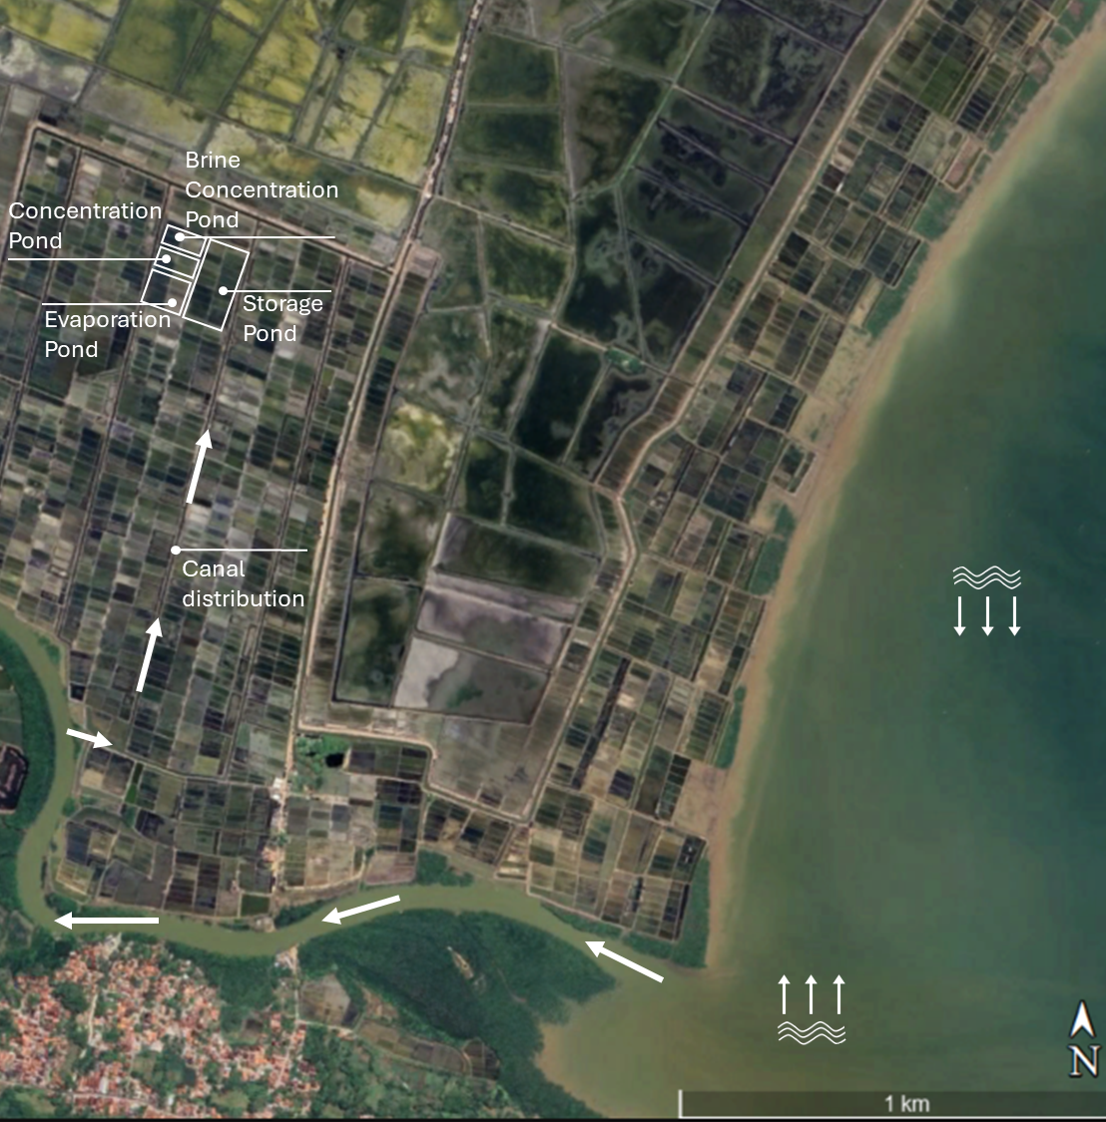
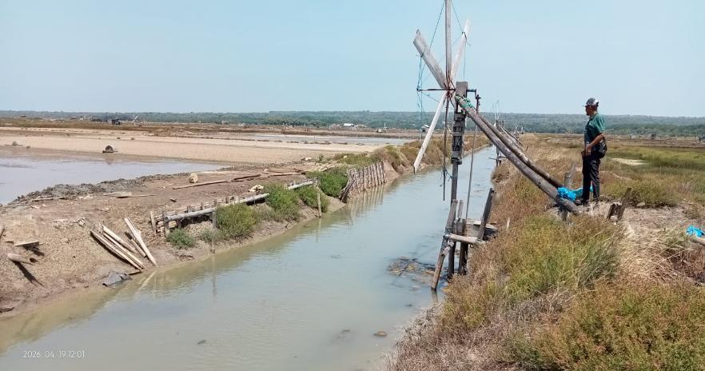
Salt Ponds Structure
at Pinggir Papas (PP) Sumenep
Inland salt-farming site relying on estuarine-mangrove water sources.
Layout includes canal distribution, inlet channel, storage ponds, evaporation ponds, and brine concentration ponds
Water intake controlled by tidal flow and canal systems, assisted by windmill pumps.
Adapted to inland estuarine condition, unlike GP’s direct coastal intake.
Estuarine inlet channel at PP, windmill pump supporting canal distribution

Slide 9
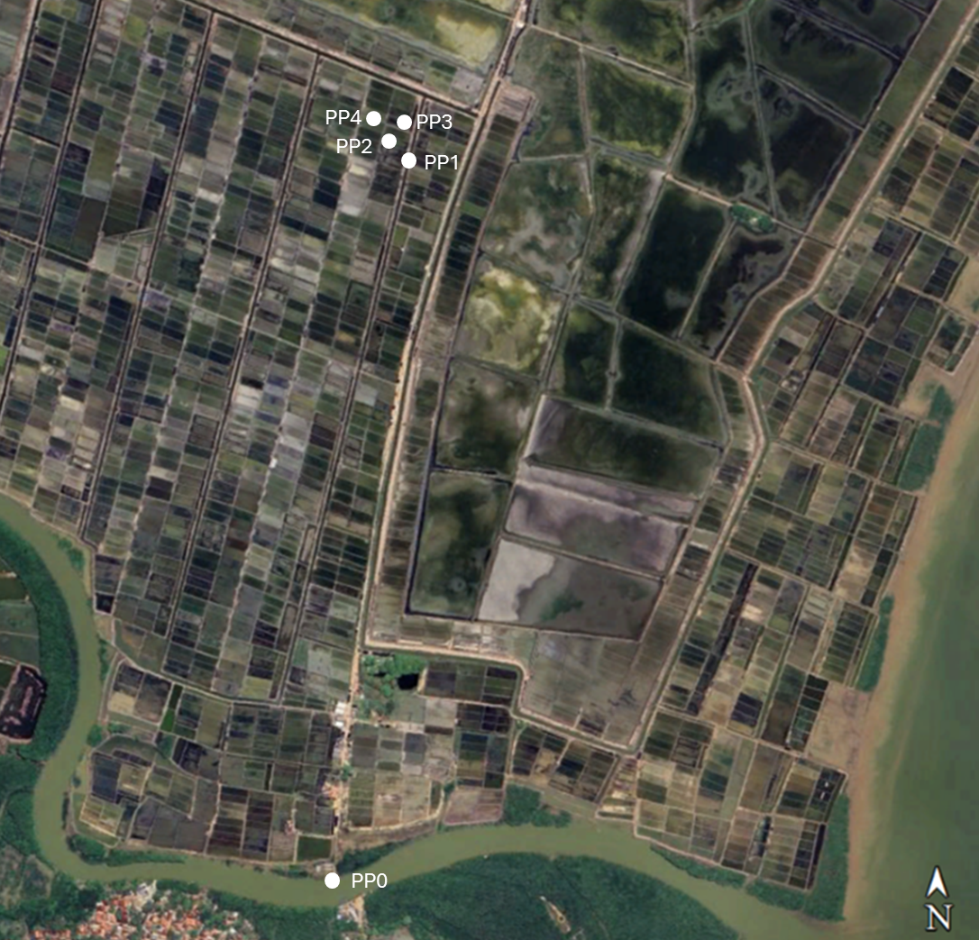
Sampling Points at Pinggir Papas (PP)
(Physicochemical water parameters)
Sampling site: PP0 – PP4
Coverage of production stage (baseline only)
PP0: estuarine inlet channel (tidal inflow)
PP1: canal distribution
PP2: storage pond
PP3: evaporation pond
PP4: brine concentration pond
Condition of site: salt production has not yet started, so sampling reflects raw estuarine water inflow without operational pond cycles.
Purpose of sampling: to measure salinity, water quality, and physicochemical parameters under non-operational conditions

Slide 10
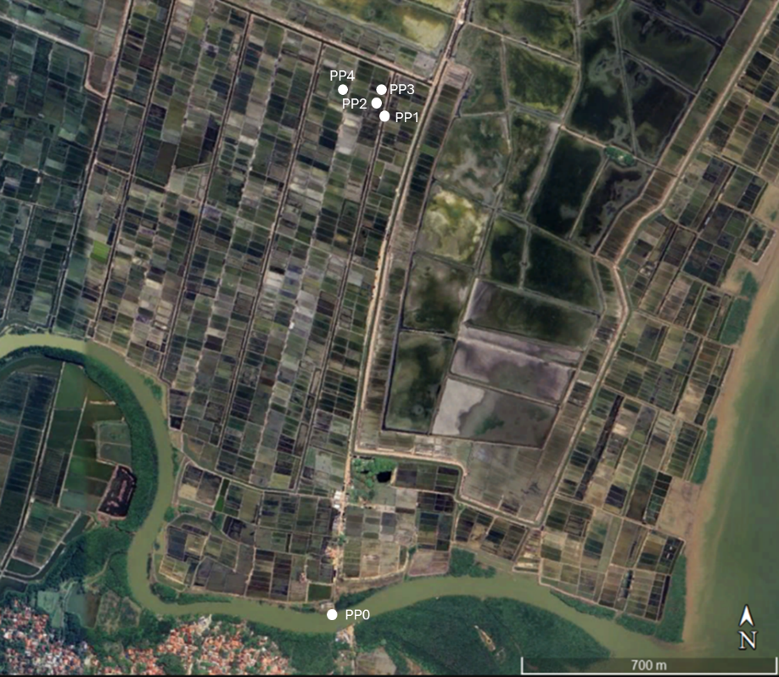
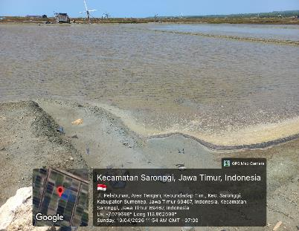
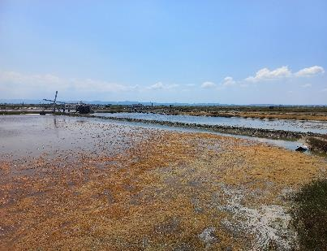
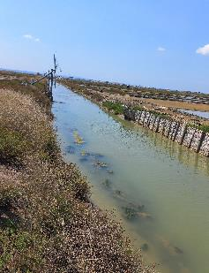
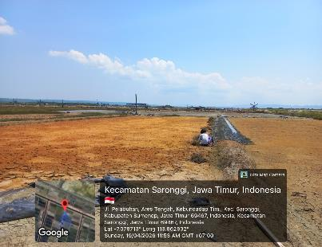
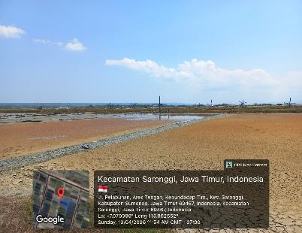
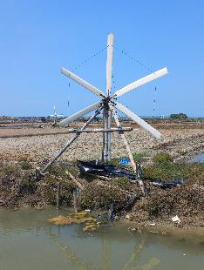
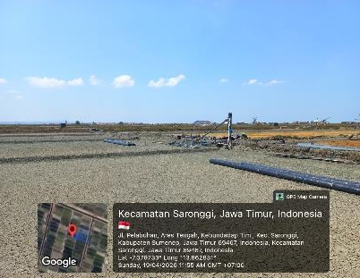
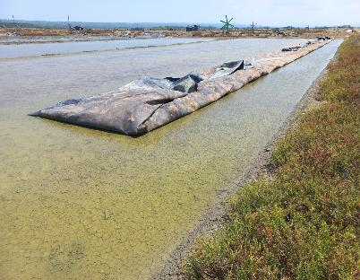
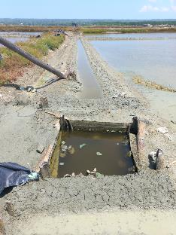
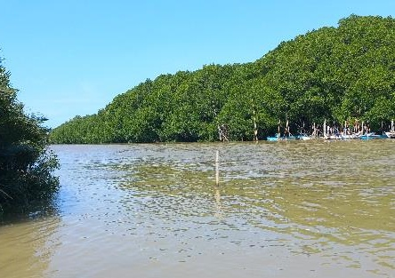
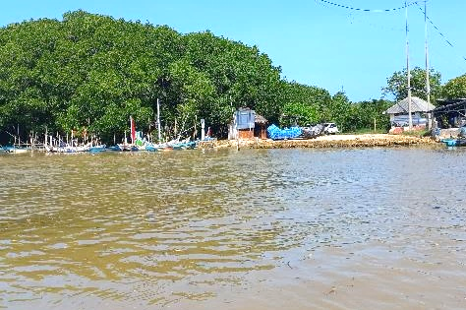
Salt Ponds at Sumenep
Pinggir Papas (PP)
PP2
Storage Pond – Inlet/Outlet
PP3
Storage Pond
PP1
Canal Distribution
Evaporation Pond
Concentration Pond
Windmill Pump
PP 4
Brine Concentration Pond
PP 4
Brine Concentration Pond
Sea-salt farm
Canal Distribution
PP 0
Source – Open Water (Estuarine - Mangrove)

Slide 11
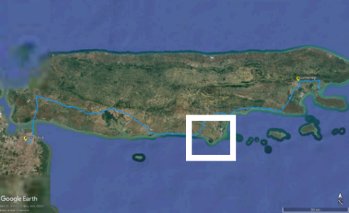
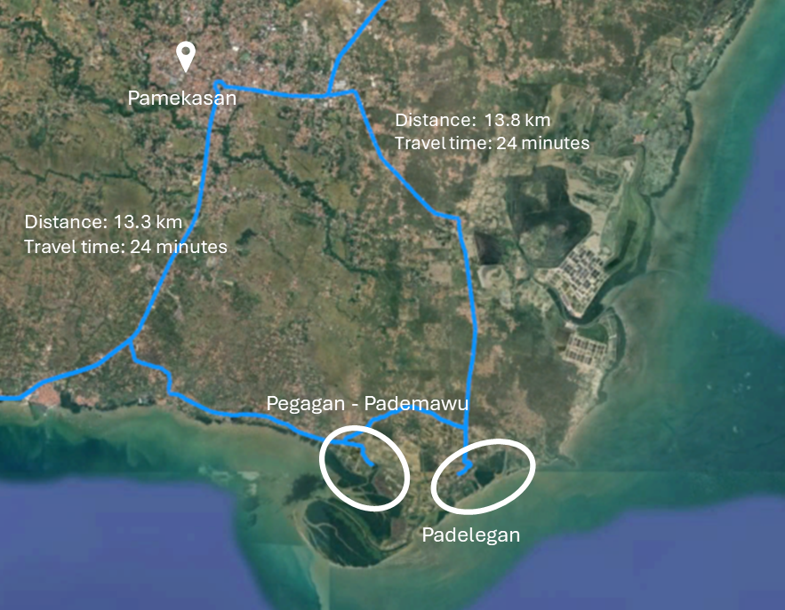
Condition Overview of Pamekasan area
1. Pegagan-Pademawu (PM)
2. Padelegan (PD)
Pegagan–Pademawu (PM) and Padelegan (PD) are coastal traditional salt-farming areas in Pamekasan Regency.
Characterized by mangrove buffers and estuarine/riparian settings.
Proximity to Pamekasan town:
PM is located approximately 13.3 km (20 – 24 minutes by road)
PD is located approximately 13.8 km (20 – 26 minutes by road)
Baseline physicochemical measurement was conducted, with fewer points compared to Sumenep, due to non-operational status and ongoing pond renovation
Selected as comparative sites to Sumenep

Slide 12
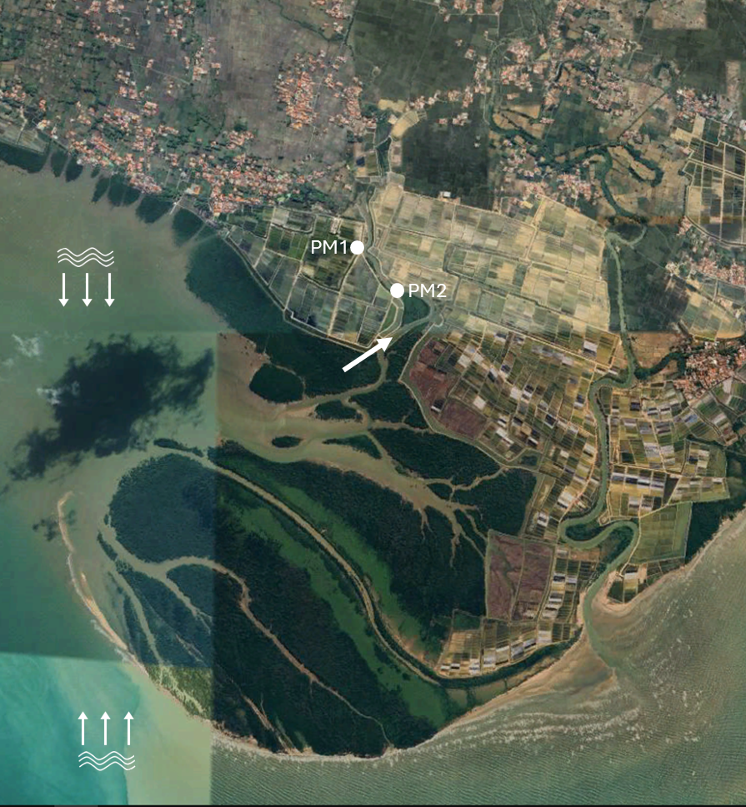
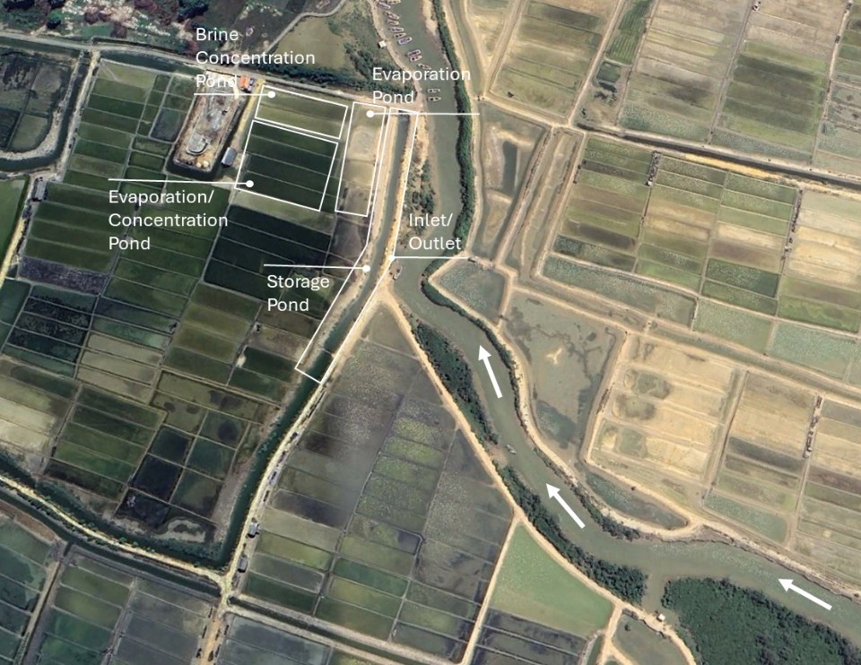
Salt Ponds at Pegagan/Pademawu (PM)
(Pamekasan)
PM site structure consists of storage, evaporation, and brine concentration ponds, with mangrove buffers influencing water intake.

Slide 13
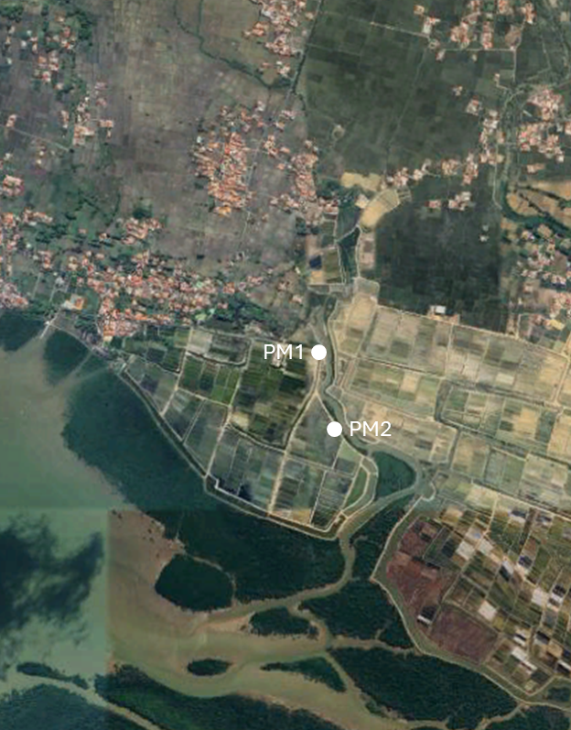
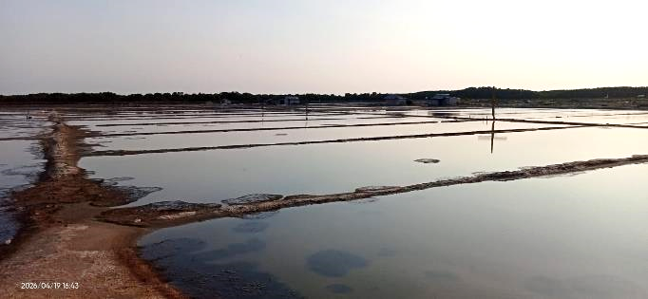
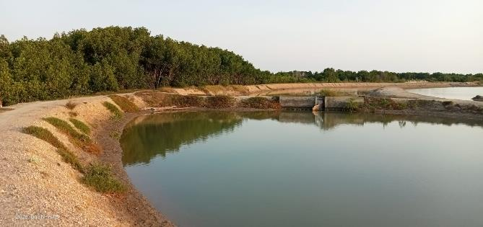
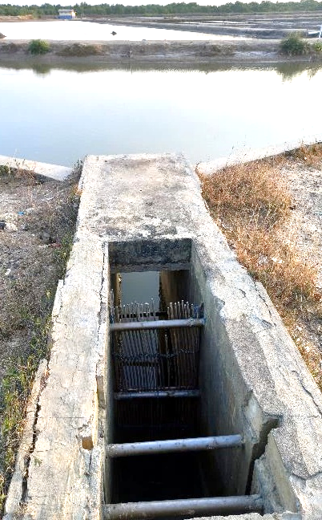
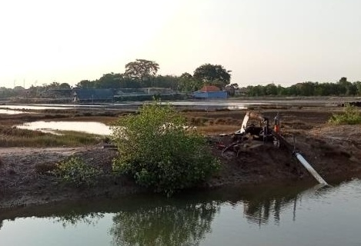
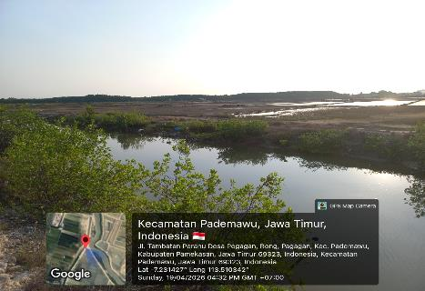
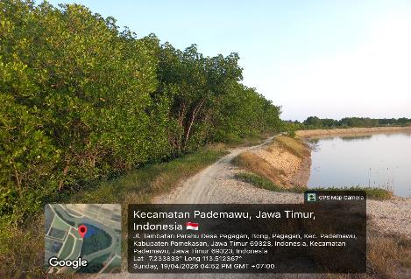
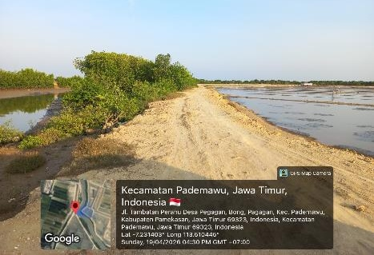
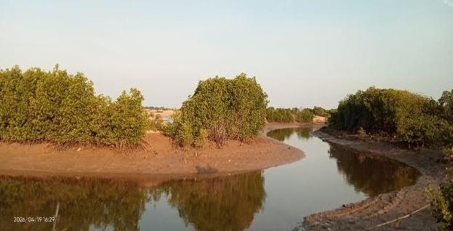
Salt Ponds at Pegagan/Pademawu (PM) Pamekasan
Evaporation Pond Area
Storage Pond Area
PM1
Storage Pond Area
PM1
PM2
Water Control Gate
Storage Pond – Water Intake Pump
PM1
Storage Pond
Sea-salt Pond Bund
Protective Pond Bund
with Mangrove Buffer
PM2
Water Source

Slide 14






Salt Ponds at Padelegan (PD) - Pamekasan
PD water distribution includes canal distribution, storage, evaporation, and brine concentration ponds, reflecting coastal estuarine settings.
Sea-salt Pond Area
PD1
Evaporation Pond Area
Brine Concentration
Pond
Concentration Pond
Evaporation
Pond
Storage Pond
Canal
Distribution
Brine Concentration Pond Area

Slide 15
Biophysical Baseline (Technical Aspect)
Topography, Hidro-Oceanography, Climatology, Soil/Sediment, Natural Hazard
Parameter | Sumenep |  | Pamekasan
 | Gersik Putih (PP) | Pinggir Papas (PP) | Pademawu (PM) | Padelegan (PD)
Topography | Sandy coastal plain, adjacent to port; gentle slope (<3%) with thin mangrove fringe at shoreline associated with coastal vegetation. | Inland estuarine setting, sea-salt farming area located farther from open water, gentle slope typical of estuarine plains. | Coastal plains with mangrove buffers and canal distribution system; generally flat terrain with gentle slope.
Hydro-Oceanography | Direct seawater intake via tidal canals, limited mangrove buffer, far from settlements. | Water sourced from estuarine river flow, tidal-influenced, passing through settlement areas before discharging to the sea. | Mangrove-riparian buffers influence water intake. | Canal distribution regulates seawater flow.
Climatology | Tropical monsoon climate; high solar radiation and seasonal wind favor evaporation. |  | Similar tropical monsoon climate; slightly less wind exposure but comparable solar radiation.
Soil/Sediment | Sandy soils with high permeability, low organic matter; mangrove fringe adds minor organic input. | Sandy-clay soils with estuarine influence. | Sandy-clay coastal soils; mangrove influence adds organic matter, affecting bund stability.
Natural Hazard | Vulnerable to erosion and tidal flooding due to open coastal setting | Risk of estuarine flooding and potential domestic waste input via intake channel. | Coastal flooding and mangrove derived organic enrichment. | Canal overflow during storms.
 | Severe local convective storm (tornado events)

Slide 16





Field Measurement
Water Quality
Parameter | Unit | Sumenep |  | Pamekasan | Artemia requirement (FAO, 2024)
 |  | Gersik Putih | Pinggir Papas | Pademawu
VISUAL
Color |  | Clear, Turbid Green | brown- turbid | Turbid
Odor |  | Neutral - Fishy (1 site) | neutral | Neutral
Foam presence |  | None | none - present | None
Surface film/Algal bloom |  | None - Thin Film | present | Present
INSITU
Salinity | ppt | 23.7 - 33.6 | 28.9 - 65.5 | 30.2 - 31.2 | 30 - 120 (60-80 for cyst)
Temperature | ºC | 29.4 - 35.1 | 31.7 35.9 | 31 - 32.1 | 25-30oC
Dissolved Oxygen/DO | mg/L | 2.5 - 6.1 | 5.3 - 6.5 | 6 - 6.2 | >4-5 mg/L
pH |  | 7.58 - 8.91 | 7.98 - 8.87 | 7.94 - 8.05 | 7.5-8.5
Conductivity | mS/cm | 36.3 - 49.6 | 41.3 - 88.1 | 45.4 - 46.6 | stable
TDS | ppt | 18.2 - 24.8 | 20.7 - 44.1 | 22.8 - 23.4 | consistent
Turbidity | NTU | 2.56 - 53 | 2.46 - 118 | 29.5 - 32.5 | low-moderate
NUTRIENT
Ammonium | mg/L | 0.2 - 1.6 | 0.2 - 0.2 | 0.025 - 0.025 | <0.1 mg/L
Nitrite | mg/L | 0.05 - 0.05 | 0.05 - 0.05 | 0.05 - 0.05 | <0.05 mg/L
Nitrate | mg/L | 2.3 - 5.6 | 2.3 - 5.6 | 2.3 - 2.3 | <10 mg/L
Phosphate | mg/L | 0.25 - 0.25 | 0.25 - 0.25 | 0.25 - 0.25 | <0.1 mg/L

Slide 17


Microclimate & Evaporation
Sumenep – Gresik Putih (GP)
Temperature: 32–36 °C, rising steadily in the afternoon.
Relative Humidity (RH): ranged 30–80%, dropping sharply during peak temperature.
Microclimate Pattern: coastal site with strong afternoon heating and humidity decline.
Average Evaporation: 0.72 mm/h; critical evaporation period in Gersik Putih occurs in the early afternoon (14:46–15:56); peak evaporation coincides with highest temperature and lowest RH, typical of coastal salt pond sites; Gersik Putih shows early afternoon stress.

Slide 18


Microclimate & Evaporation
Sumenep – Pinggir Papas (PP)
Temperature: 33–38 °C, peaking around midday (11:46–13:23).
Relative Humidity (RH): fluctuated between 28–60%, dropping sharply during peak temperature.
Microclimate Pattern: inland estuarine site, showing strong midday heating and humidity decline.
Average Evaporation: 0.79 mm/h; critical evaporation period in Pinggir Papas occurs at midday (11:46–13:23); evaporation peak coincides with highest temperature and lowest RH, typical of inland estuarine conditions; Pinggir Papas shows classic inland midday stress.

Slide 19


Microclimate & Evaporation
Pamekasan – Pademawu (PM)
Temperature ranged 23–31 °C, peaking around 16:36–16:56.
Relative Humidity (RH) fluctuated: high (78–81%) early afternoon, then dropped sharply to 50% at 17:06.
Microclimate pattern: moderate temperature but rapid humidity changes in late afternoon.
Average Evaporation: 0.67 mm/h; critical evaporation period in Pademawu occurs in the late afternoon; Unlike Gersik Putih (midday peak) and Pinggir Papas (late morning peak), Pademawu’s maximum evaporation is shifted to the evening.

Slide 20










Infrastructure
Access and Supporting Facilities
Parameter | Sumenep |  | Pamekasan
 | Gersik Putih (PP) | Pinggir Papas (PP) | Pegagan – Pademawu (PM) | Padelegan (PD)
Road Access | Coastal road near port, relatively good but limited shoreline routes. | Estuarine village roads, intake channel passes settlement areas. | Village roads connected to main routes, close to settlements. | Road access adequate, main transport via land routes.
Port/Harbor | Proximity to Kalianget Port (small inter-island connectivity). | No direct port access, relies on land routes. | No major port, distribution remains local.
Airport Access | Near Trunojoyo Airport, small aircraft only, limited regional flights. |  | Farther from airport, not significant for salt distribution.
Access to Gersik Putih (GP)
Access to Pinggir Papas (PP)

Slide 21






Infrastructure
Access and Supporting Facilities
Parameter | Sumenep |  | Pamekasan
 | Gersik Putih (PP) | Pinggir Papas (PP) | Pegagan – Pademawu (PM) | Padelegan (PD)
Settlement Proximity | Ponds distant from settlements, open coastal environment. | Intake channel crosses settlements. | Ponds close to settlements, high community interaction.
Storage Facilities | On-site salt storage. | Small storage units near pond sites. | Village-level storage facilities, often linked to cooperatives.
Logistics/Distribution | Inter-island via local port and land routes to Surabaya. | Local distribution through village roads and markets. | Long-distance trade via land routes to Surabaya.
Access to Pademawun (PM) and Padelegan (PD)
On-site Salt Storage
Communal Storage Facility

Slide 22



Community Voices & Practices (Interview)
Regarding Salt ponds production for Artemia Cyst production Considerations
Respondents: salt farmer (inherited practice), village head, female pond owner, salt collector/trader.
Production Practices: multi-stage evaporation system with seasonal cycle (May – August); annual maintenance,( March – April) for bund, ponds, and infrastructure, constraints (geomembrane lifespan, weather dependency, extreme events).
Environmental Perceptions: salinity range 15-20 ppt (using manual salinometer), higher salinity reduces quality; no algal bloom observed, water quality judged visually, historical conversion from mangroves to salt ponds.
Socioeconomic aspect: gender roles, labor division, profit-sharing, price fluctuation, secondary income from milkfish culture during off-season.

Slide 23







Ecological – Sosioeconomic Baseline
Biological Environmental & Land-use/Human Activities
Location | Biological Environment | Land-use & Human Activities
Gersik Putih Sumenep | Salt ponds located on a mud sandy beach fringe with thin coastal vegetation and mangrove; more exposed and vulnerable to erosion and seawater intrusion. | Community‑based ownership through inheritance or land purchase. Average pond size 1 – 5 hectare. Geomembrane lifespan approximately 3 years . Seasonal activity (halted during rainy season). Labor division: men handling water management and production, women cleaning and harvest. Profit sharing system between landowner and manager (2:1). Diversification through milkfish cultivation in off-season.
Pinggir Papas Sumenep | Salt ponds situated around mangrove–estuarine systems with canal water intake; mangrove buffer provides partial protection against flooding.
Pademawu Pamekasan | Salt ponds adjacent to mangrove buffers and influenced by river/estuarine flows; socio‑ecological adaptation evident.
Coastal-mangrove transitional zone
(Gersik Putih – Sumenep)
Estuarine mangrove surrounding salt ponds
(Pademawu – Pamekasan)
Diverse mangrove species along salt pond margins (Rhizophora, Avicennia, Sonneratia)
Salt pond preparation before production season

Slide 24



Ecological – Sosioeconomic Baseline
Production Capacity & Supply Chain Dynamics
Production Capacity
Pond system: 1 hectares with around 7 ponds, including 1 brine concentration ponds.
Production cycle: 10–15 days per batch.
Seasonality: May–August, yielding approximately 6–10 cycles per season.
Salt quality: NaCl content ranges between 80–95%.
Land tenure: managed by farmer groups or individual
Production capacity: equivalent to around10–20 tons/ha/season
Supply Chain Dynamics
Price fluctuation: IDR 0.7 – 5.0 million per ton; average price IDR 2–3 million/ton: price variability is influenced by seasonality and salt quality.
Distribution routes: storage facilities, boat transport, truck delivery, local/regional markets.
Market actors: collectors, cooperatives, traders.
Trader destinations: Surabaya (national hub/export) and Bali (regional demand).
Constraints: road access, storage capacity, transport efficiency.

Slide 25
Feasibility Assessment For Artemia Culture – Salt Pond Integration
Site Selection (Suitability Matrix)
Primary Baseline Dataset
Criteria
Multi-Criteria Decision Analysis
Measures technical parameters directly at the site, technical data, quantitative – salinity , pH, Dissolved Oxygen (DO), TDS, turbidity, temperatures, nutrients (ammonium, nitrite, nitrate, phosphate), microclimate.
Water physicochemical suitability
Water nutrient profile
Microclimate and evaporation
Natural hazard
Structural suitability
Standardization
(Reclassification)
In-situ
Measurement
Biophysical (Technical aspects)
Determination of Rank and Weighted
Normalization and Aggregation
Interview and visual observation for socioeconomic and ecological aspect, qualitative or semi quantitative–infrastructure, labor and production system, pond structure, economic, risk perception.
Biological baseline
Infrastructure and logistic
Labor availability & system
Production capacity
Economic integration
Classification
Survey and Observation
Ecological
Sosioecomic
S1 Highly Suitable (≥80)
S2 Moderately Suitable (60-79)
S3 Marginally Suitable (40-59)
N Unsuitable (<40)

Slide 26
Feasibility Assessment For Artemia Culture – Salt Pond Integration
Site Selection based on Suitability Matrix
Criteria/Aspect |  | Sumenep |  | Pamekasan
 |  | Gersik Putih | Pinggir Papas | Pademawu
A. | Physicochemical suitability | 12.82 | 10.64 | 10.09
B. | Nutrient profile | 10.00 | 8.00 | 6.00
C. | Microclimate & evaporation | 7.33 | 7.33 | 6.00
D. | Biological baseline | 6.00 | 8.00 | 8.00
E. | Natural hazard | 6.00 | 6.67 | 7.33
F. | Structural suitability | 5.00 | 5.50 | 5.50
G. | Infrastructure & logistic | 3.33 | 4.67 | 4.00
H. | Labour availability & system | 4.80 | 4.80 | 4.80
I. | Production capacity | 7.33 | 7.33 | 7.33
J. | Economic integration | 4.20 | 3.27 | 3.27
Total Score |  | 66.82 | 66.20 | 62.32
Classification |  | Moderately Suitable | Moderately Suitable | Moderately Suitable
Location Ranking: All sites are Moderately Suitable with scores ranked from highest to lowest are Gersik Putih (66.82), Pinggir Papas (66.20), Pademawu (62.32).
Strengths: Physicochemical Suitability (soil and water conditions), Nutrient Profile (environmental quality sustains productivity, Microclimate & Evaporation (stable local climate favors evaporation processes).
Weakness: Infrastructure & Logistic (limited road access, canal systems, and utilities), Labor Availability & System (workforce is limited, organization remains informal), Economic Integration (weak market access and limited diversification).

Slide 27

Conclusions
Baseline multi‑criteria analysis confirms that Madura salt ponds are biophysically suitable for Artemia–salt pond integration, with physicochemical conditions, nutrient profiles, and evaporation regimes meeting key technical requirements.
All surveyed sites were classified as Moderately Suitable (S2), indicating that feasibility is primarily supported by environmental and climatic factors rather than marginal site conditions.
Physicochemical stability and climate‑driven evaporation constitute the main strengths, enabling effective salinity management during pre‑crystallization stages critical for Artemia development.
Primary constraints are non‑biophysical, including limited infrastructure and logistics, weak hydraulic control, exposure to natural hazards, and low economic integration within existing value chains.
Overall, Artemia integration in Madura is technically feasible but systems requiring targeted improvements in water control, infrastructure, and market linkage to enable scalable and stable production.

Slide 28

Thank you
Terima kasih
Gede Suantika, Puspitaningasih Sutrisno, Indah Puspitasari
School of Life Science and Technology
Institut Teknologi Bandung

