Slide 1

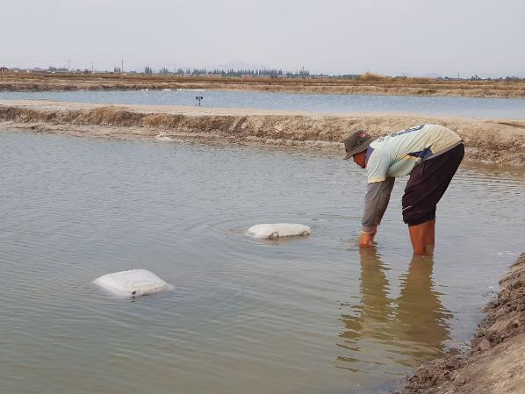
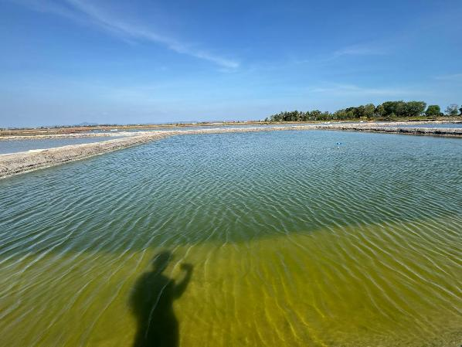
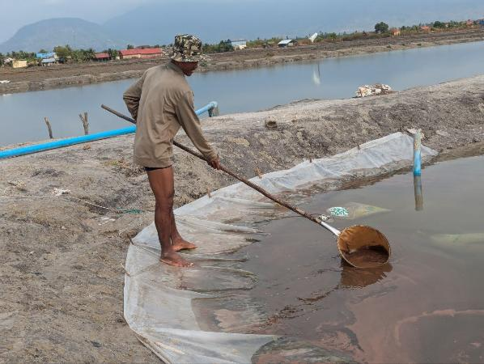
CLIMATE-RESILIENT ARTEMIA CYST PRODUCTION IN COASTAL SALT FIELDS OF CAMBODIA: A PILOT STUDY
Veasna Ao, Marine Aquaculture Research and Development Center
World Aquaculture Singapore June, 2026

Slide 2
Introduction of Artemia cyst production in Cambodia

Slide 3
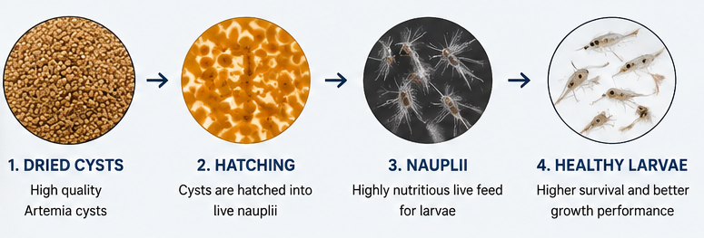


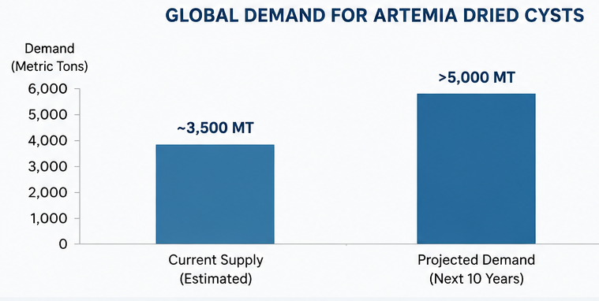


Global Artemia dried cyst demands for hatchery
Artemia dry cysts are an essential live feed that ensure high larval survival and healthy development in hatchery production of high-value aquatic species
Support more than 10 million MT of aquaculture production worldwide
Global demand in expected to exceed 5,000 MT in next 10 years
Secure and sustainable supply of Artemia cyst is critical for the growth of aquaculture
Artemia-Integrated Systems for Sustainable Coastal Aquaculture

Slide 4
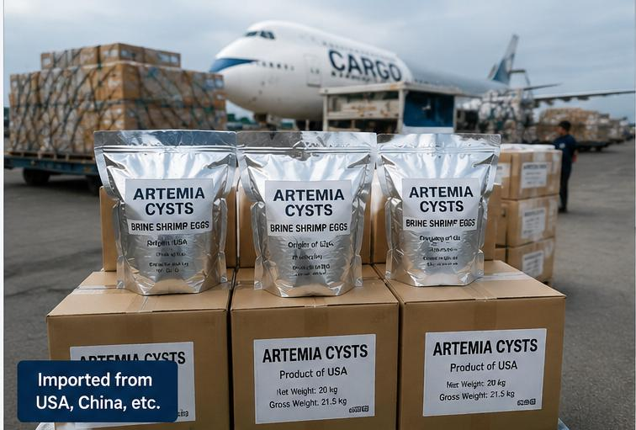
Cambodia Aspect of Artemia cyst
Cambodia currently depends on imported dried Artemia cyst
Depend on International Supply
Price fluctuation
Shipping delay and logistic risk
Global Crises, Pandemic, conflict, Weather

Slide 5
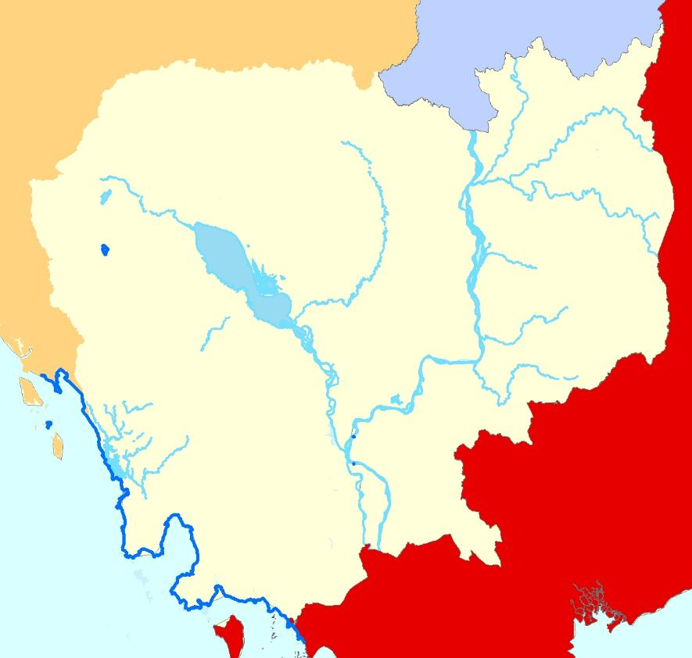
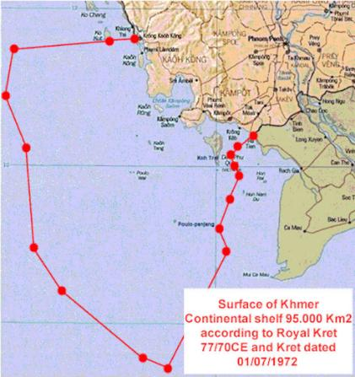
Cambodia Coastal line
Coastline of the country is 435 Km:
Koh Kong - 237 Km
Preah Sihanouk- 175.81 Km
Kampot- 67 Km
Kep- 26.50 Km
Exclusive Economic Zone (EEZ):
Extended from the shoreline to 200 nautical miles, covers 55,600 Km²

Slide 6
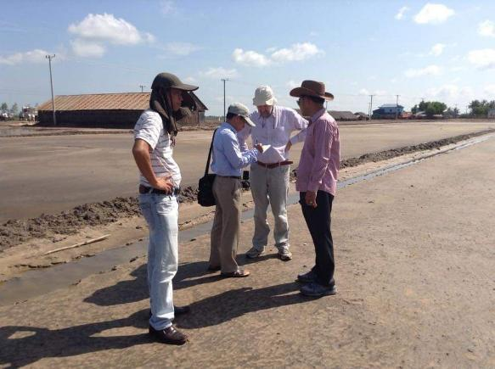
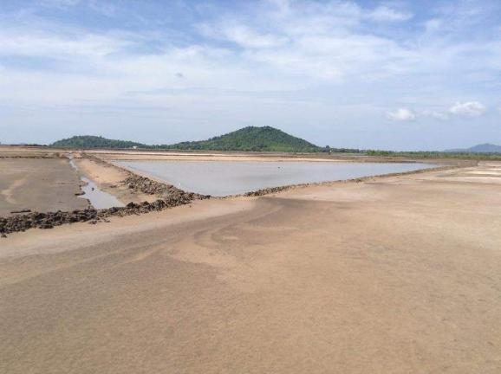
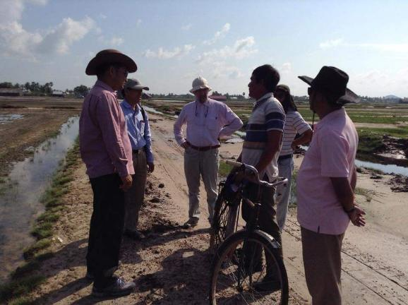
Visiting of Prof. Patrick Sorgeloos to Salt farm at Kep and Kampot provinces
In November 2014: Visiting of Patrick Sorgeloos at salt farms in Kep and Kampot provinces to assess the potential and feasibility of Artemia cyst production.

Slide 7
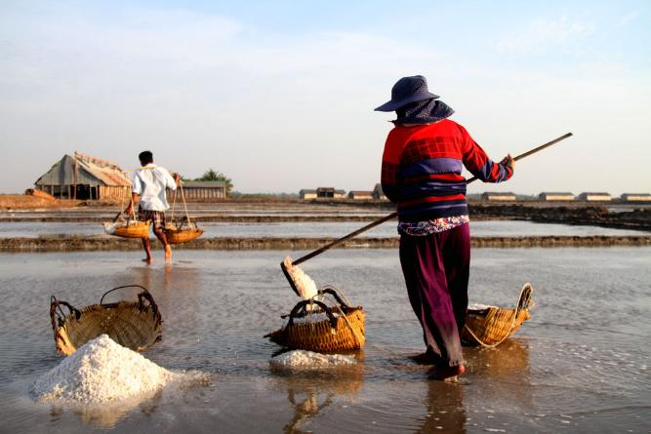
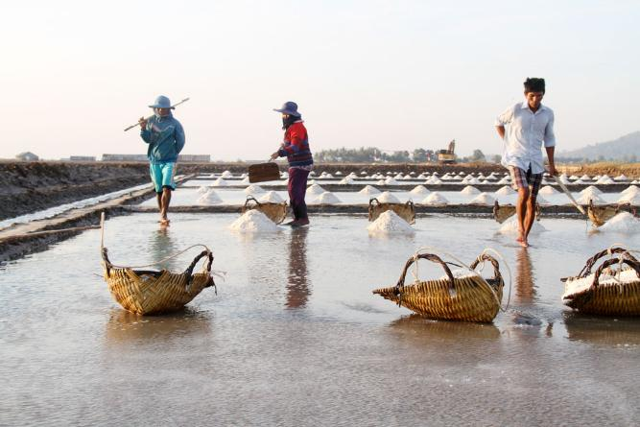
Possibility of Artemia culture in Cambodia
A total area of approximately 4,500 ha are utilized for salt farming in Kampot and Kep provinces (2016).
Cambodia’s geographical and climatic conditions are relatively similar to those of other Artemia-producing countries.
To support the development of marine hatcheries for fish, shrimp, and crab production, Artemia culture trials have been conducted in Cambodia’s solar salt farms.

Slide 8
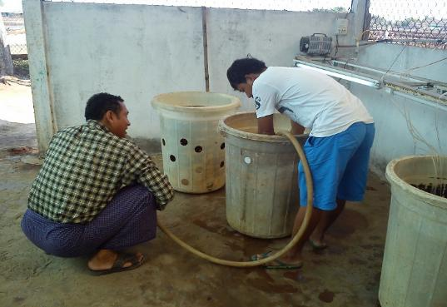
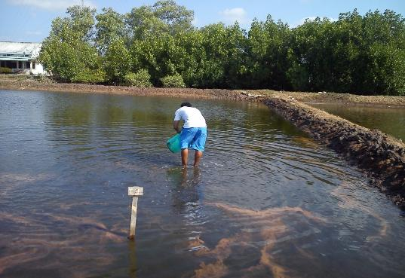
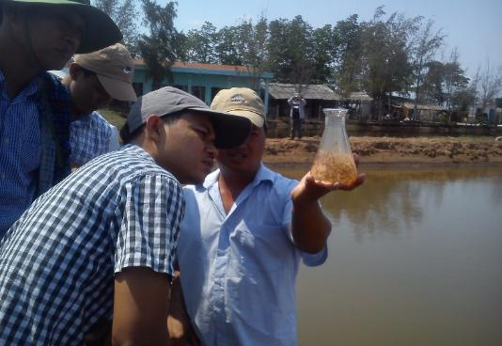
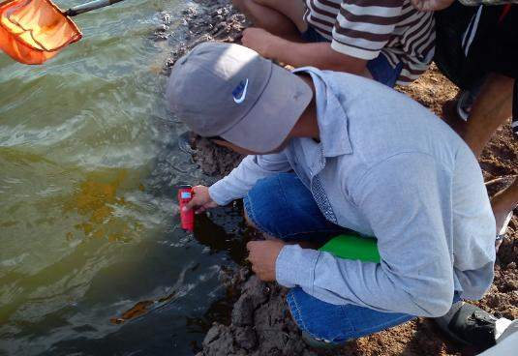
Training on Artemia cyst production at Vinh Chao station, Can Tho University (2015)
Two officers from the Fisheries Administration were assigned to receive training on the complete process of Artemia cyst production at the solar saltworks of Can Tho University in Vinh Chau Station under EU project.

Slide 9
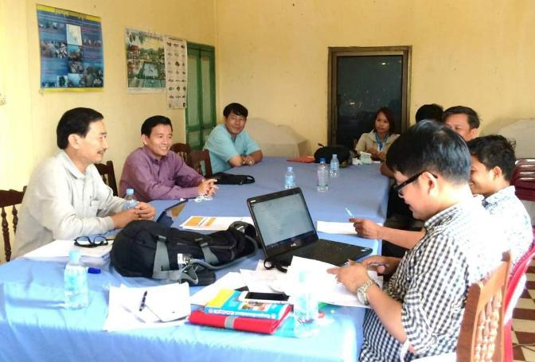
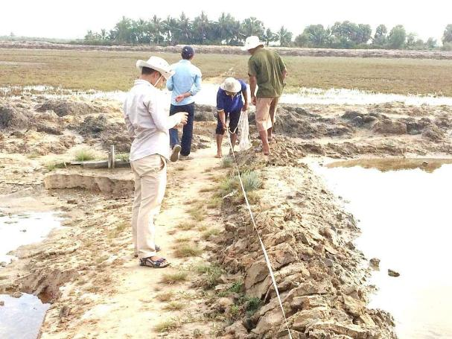
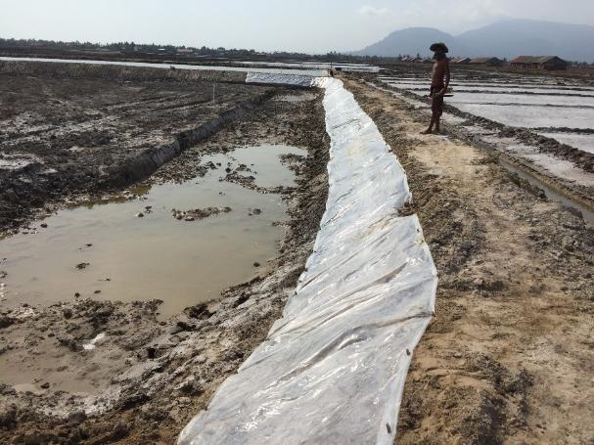
First Artemia cyst production introduced in Cambodia
The first Artemia cyst production trial at solar salt farms began in January 2016 in Kampot Province, technical support by CTU under EU project.
It was continued in 2017 by Fisheries Administration’s officers

Slide 10
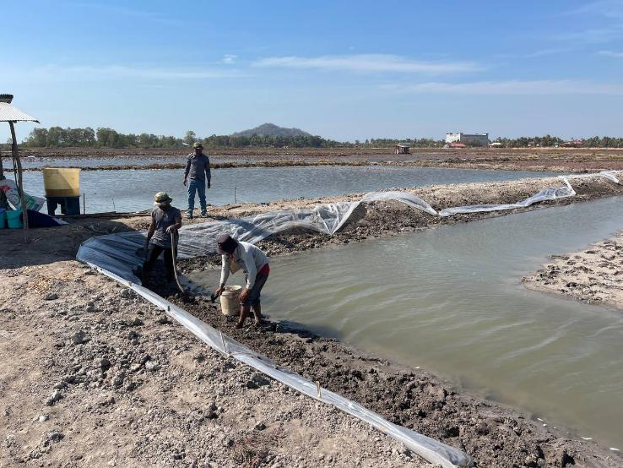
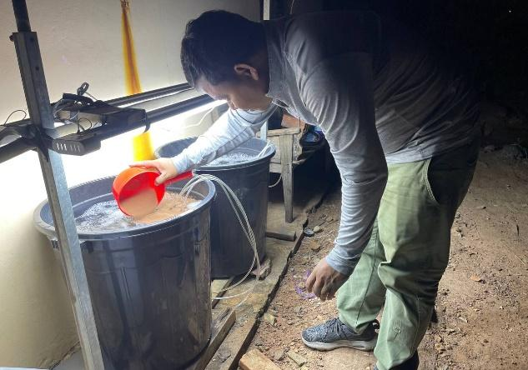
Re-trial Artemia cyst production in Cambodia
In January 2025, a re-trial of Artemia cyst production was carried out in salt fields covering an area of 1.33 hectares at Troey Koh Sangkat, Kampot City, Kampot Province.

Slide 11
Methods

Slide 12
Layout of Artemia Cyst Production Pond
S
Low Salinity Water Reservoir
E
W
F2: 1225 m²
N
A3: 2625 m²
35 m
75 m
F2: 1225 m²
A1: 2625 m²
A2: 2625 m²
75m
35 m

Slide 13
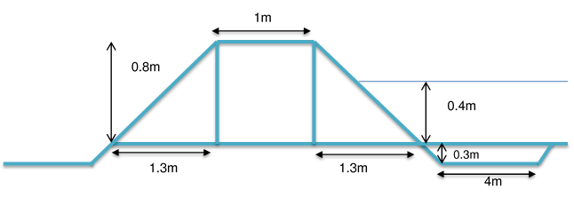
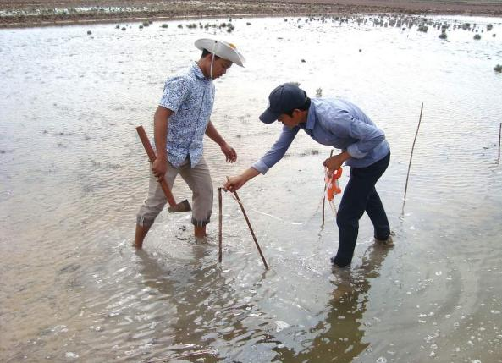
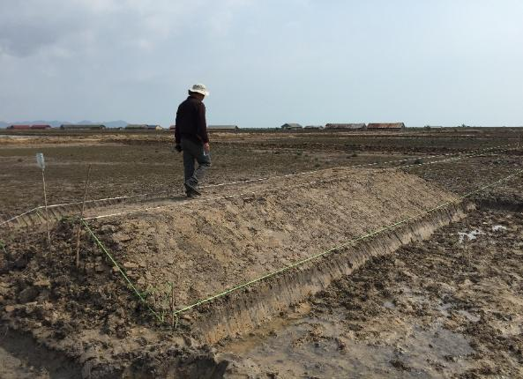
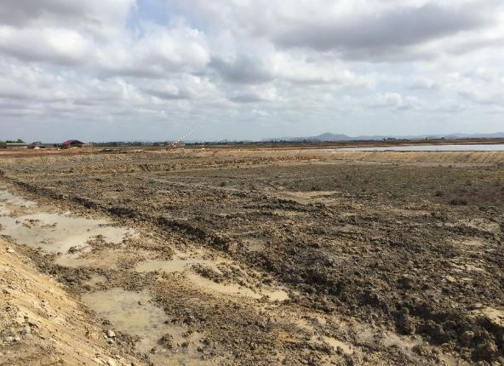
Dike Artemia Pond’s Structure

Slide 14
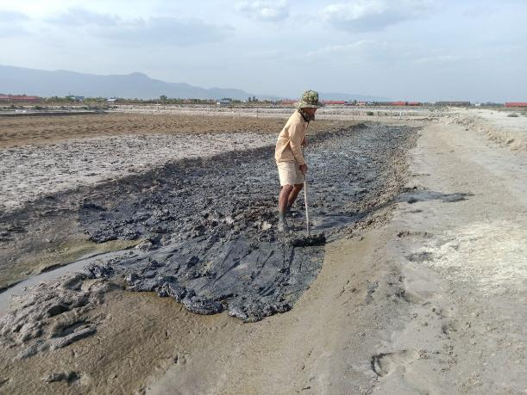
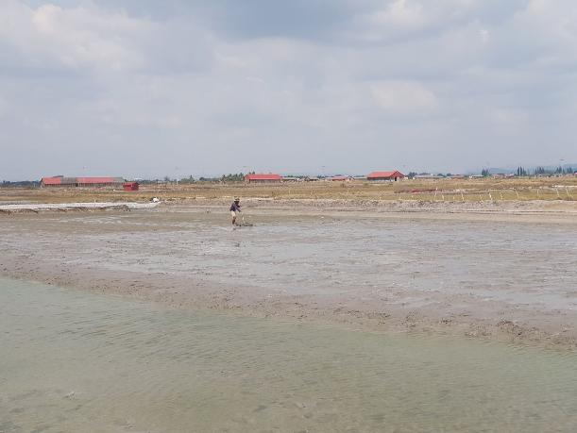
Artemia Culture Pond Preparation
Drain water out
Remove sludge from the ditch
Remove Lab-Lab
Apply quicklime
Dry pond bottom (5 days)

Slide 15
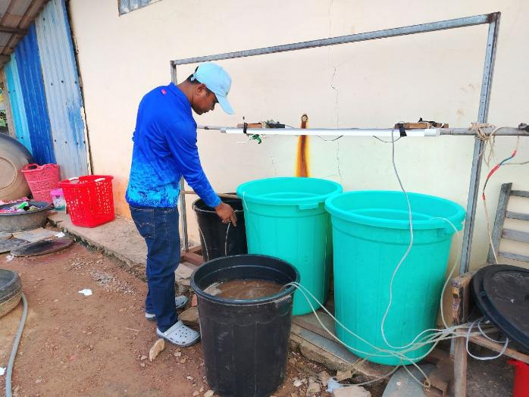
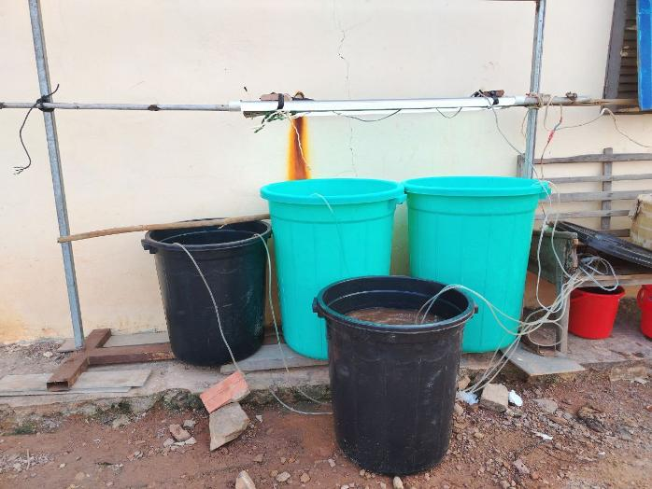
Incubation
Fill up the sea water in container
Weight dried cyst (1g/L)
Strong aeration
Light (2000lux)

Slide 16
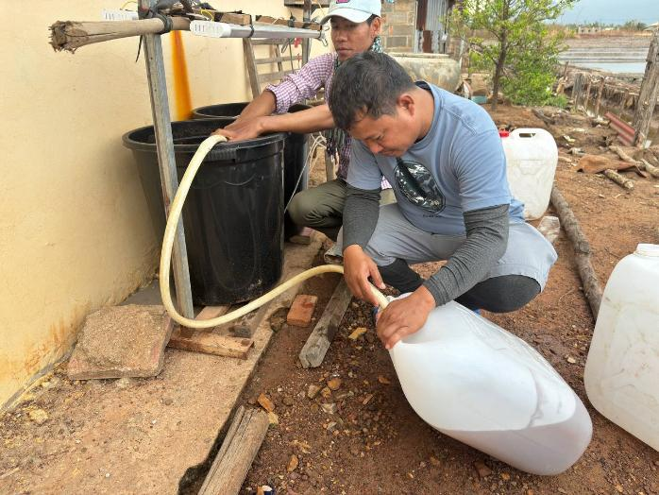
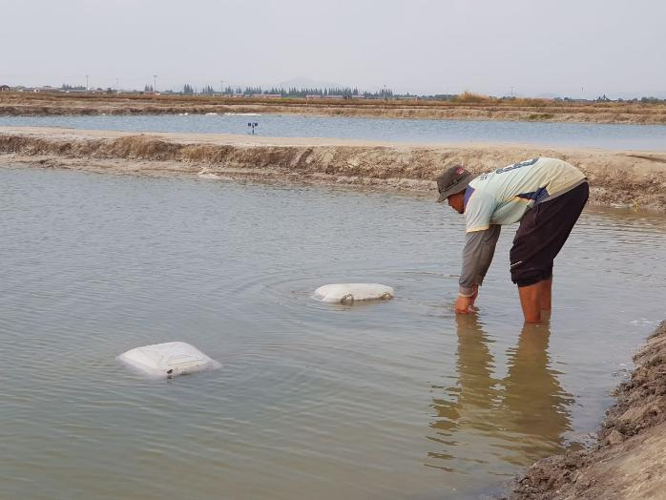
Inoculation
Collect nauplii ( instar I) after 24 hrs
Initial stocking density 100 nauplii/L
Turbidity level 30 cm
Water depth 10-15 cm

Slide 17
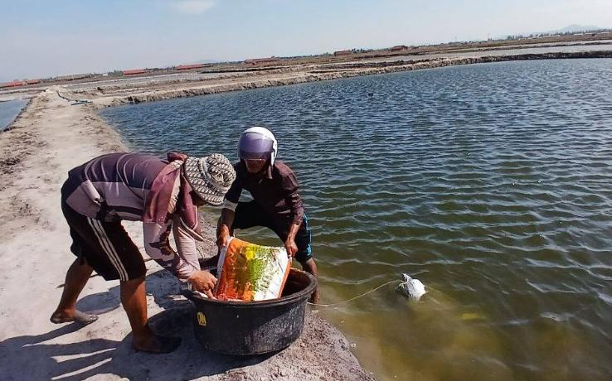
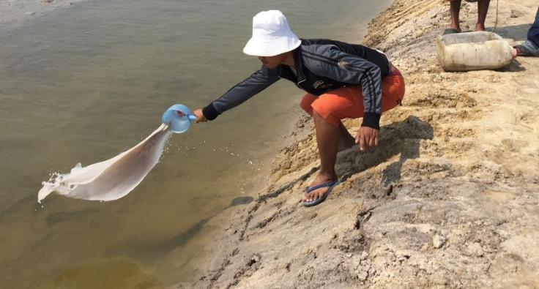
Fertilizer Pond Preparation
Drain water out
Remove Algal mats (Lab-Lab)
Dry pond bottom
Refill water(20-30cm at the beginning)
Fertilizers: Urea &DAP at ratio N:P (3:1, N:15g/m³), and chicken manual (1ton/ha)
Fertilizer pond was 25% of total production area.

Slide 18
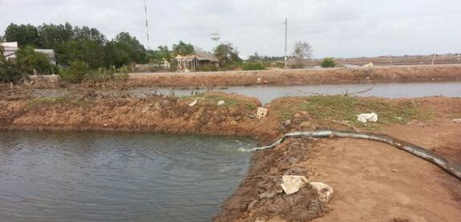
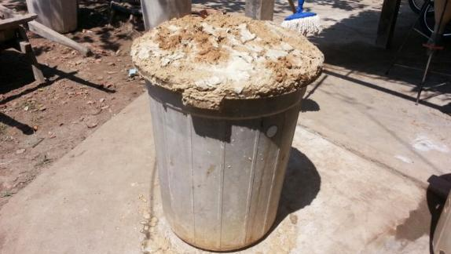
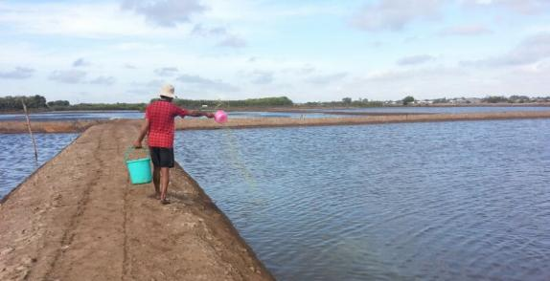

Feeding green water and supplementary feed
Maintain water productivity by supplying green water every 2 days to keep turbidity at 25–35 cm.
Provide supplementary feed (formulated feed or fermented rice bran) on alternate days between green water applications, beginning from Day 6–7.
Enhance pond nutrient availability by applying chicken manure using 2–3 suspended bags in the Artemia culture pond.

Slide 19
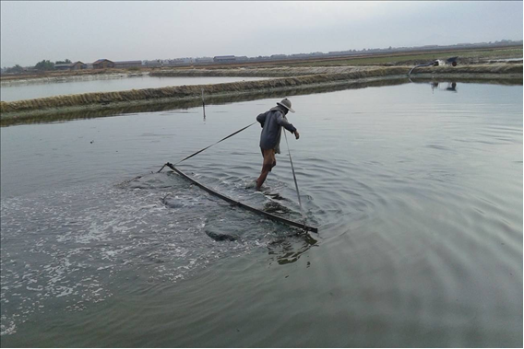
Pond raking
Raking at the platform twice per day early morning

Slide 20
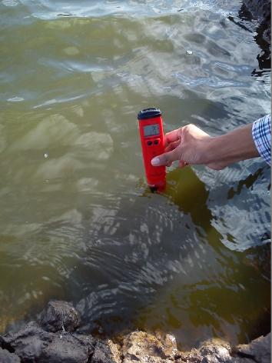
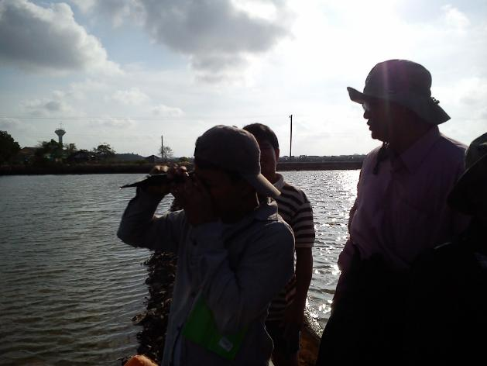
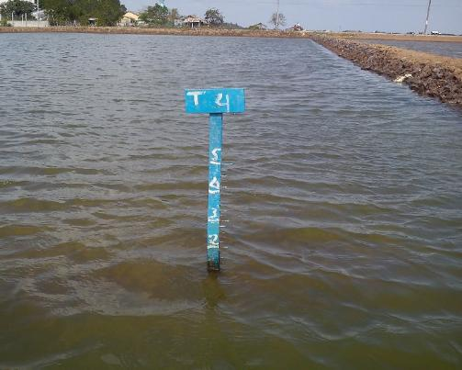
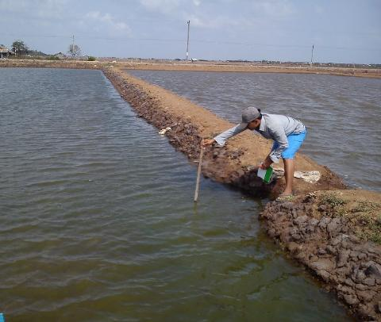
Water quality Monitoring
pH
Water temperature
Salinity
Turbidity level
Water level

Slide 21
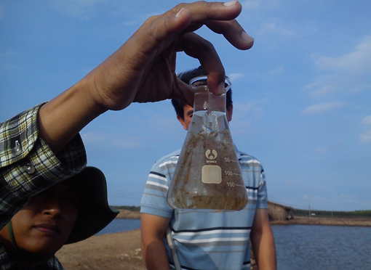
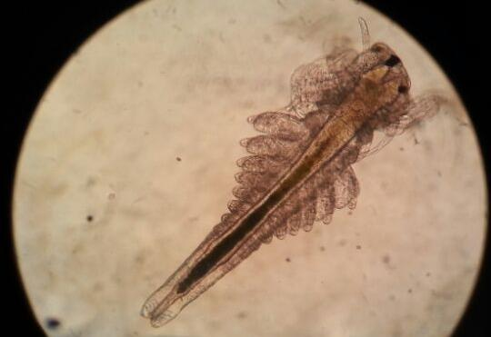
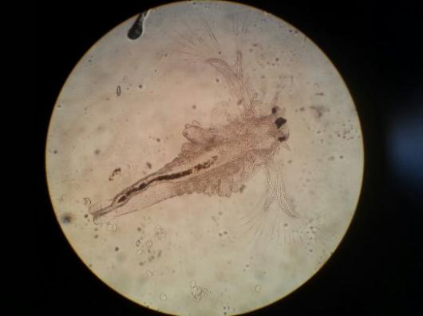
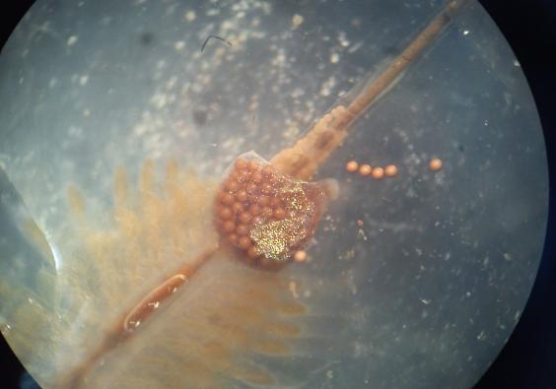
Artemia Condition Monitoring
Digestive tract
Activity
developmental Stage
Reproductive mode
Fecundity (cyst/brood)

Slide 22
Collecting and Preserving Storage of Cyst
Collecting cyst from pond under wind direction
Screening cyst by proper mesh size to remove impurity
Brine water separation to remove soil particles from cysts
Preserve cyst with salt (1:1) and well mix for 30 days
1
2
3
4

Slide 23
Results

Slide 24
Temperature
Results

Slide 25
Salinity

Slide 26
Turbidity

Slide 27
pH

Slide 28
Dissolved Oxygen

Slide 29
Artemia Density

Slide 30
Artemia growth in length by week

Slide 31
Egg fecundity

Slide 32
Wet cyst collection by week

Slide 33
Conclusion of Artemia production in 2025
Shallow fertilization pond
Low nutrition of supplementary feed ( rice bran + yest + Vitamin mix)
Present of Lab Lab fertilization pond
Contamination of Zooplanktons
Low production of Artemia cyst in 2025
Nutrition
(N:P ration)
Low density and stable of Micro-algae production
Low nutrition of introduced water
Low salinity of introduced water
Weather

Slide 34
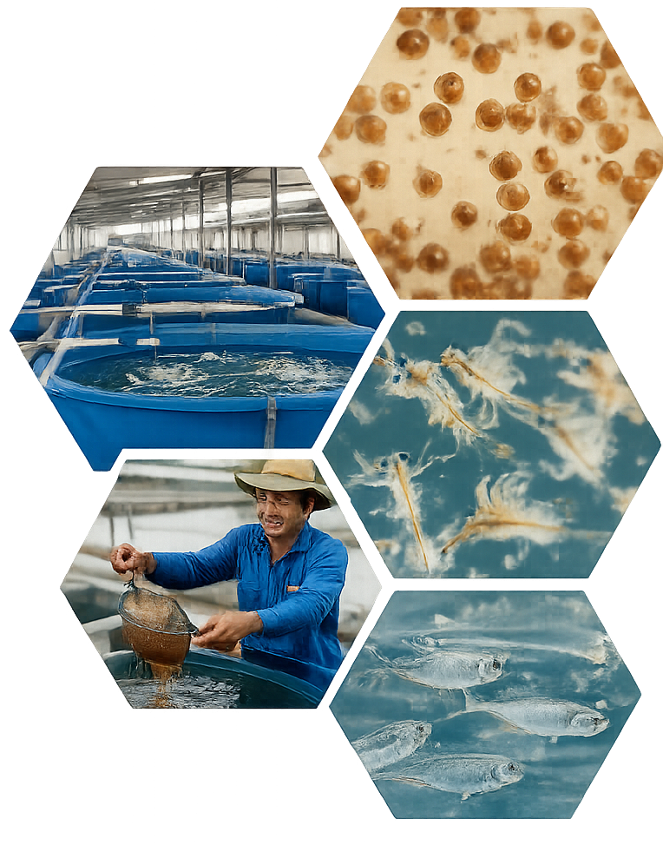
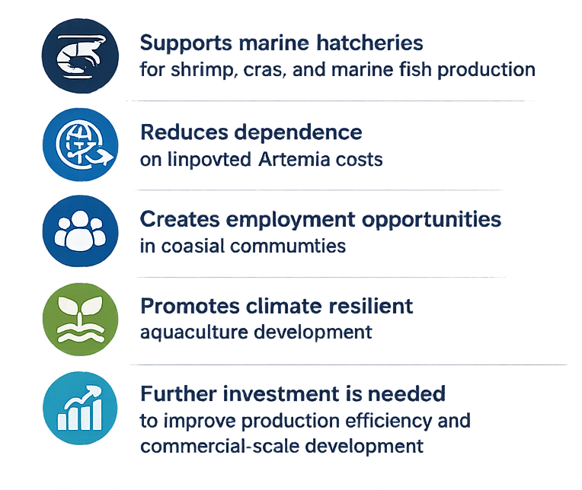
Contribution of Investment in Artemia Cyst Production in Cambodia

Slide 35
Thank You

