Slide 1





Status of Artemia production in the artisanal saltworks in the Mekong delta, Vietnam
VN Ut¹, LV Thong¹, Sorgeloos² and NV Hoa¹
¹Cantho University, Vietnam, ²Ghent University, Belgium
CTU
CAN THO UNIVERSITY
www.ctu.edu.vn
‹#›
Community - Totality - Uniqueness

Slide 2







Steps in the process of Artemia cultivating in salt ponds
1
Site selection
2
System design
3
Pond construction
4
Inoculation
5
Pond maintenance
6
Cyst/biomass collecting
7
Primary processing
8
Primary storage
CTU
CAN THO UNIVERSITY
www.ctu.edu.vn
‹#›
Community - Totality - Uniqueness

Slide 3
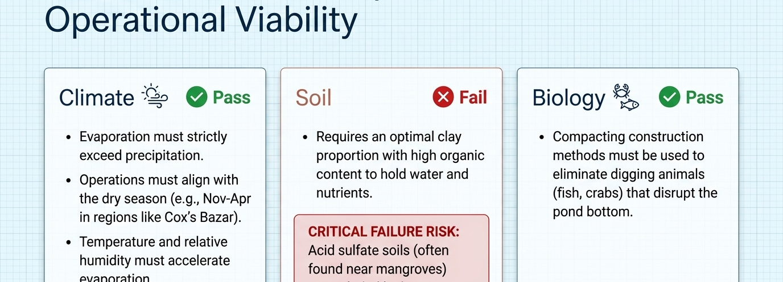
CRITERIA FOR SELECTING A SITE FOR ARTEMIA PRODUCTION AREAS
CTU
CAN THO UNIVERSITY
www.ctu.edu.vn
‹#›
Community - Totality - Uniqueness

Slide 4
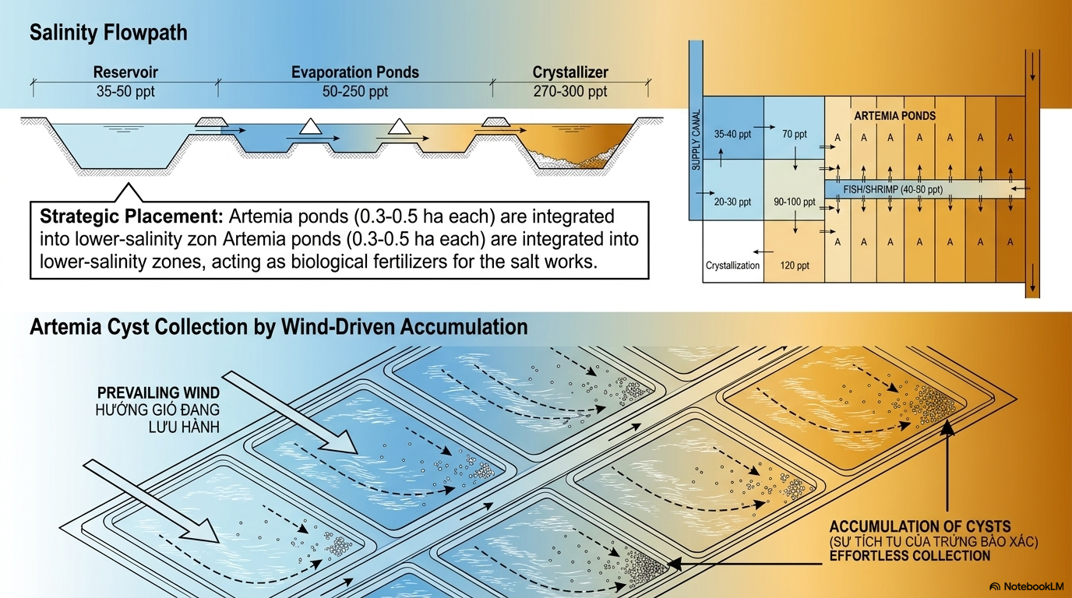
CTU
CAN THO UNIVERSITY
www.ctu.edu.vn
‹#›
Community - Totality - Uniqueness

Slide 5
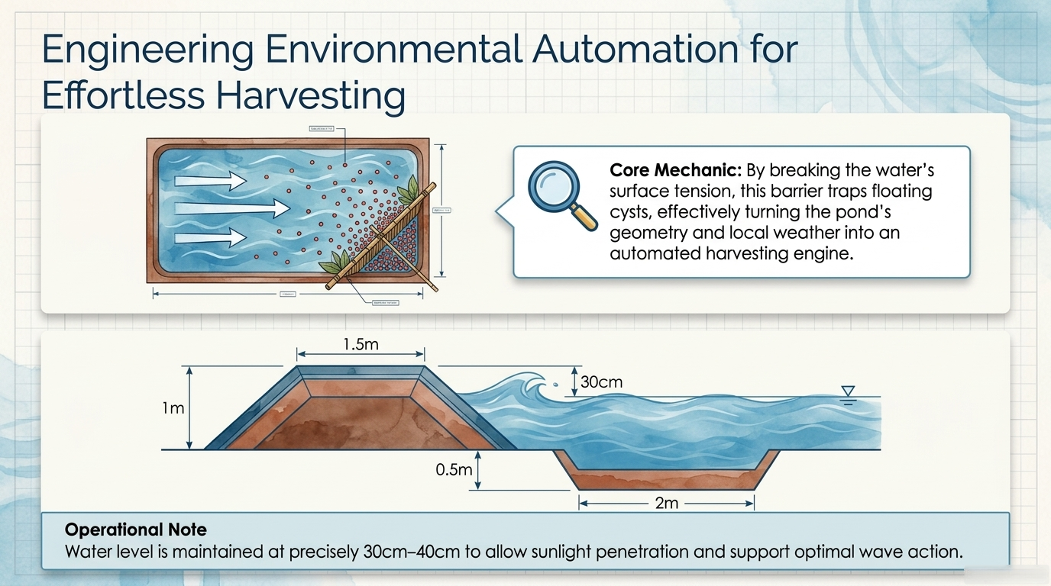
CTU
CAN THO UNIVERSITY
www.ctu.edu.vn
‹#›
Community - Totality - Uniqueness

Slide 6
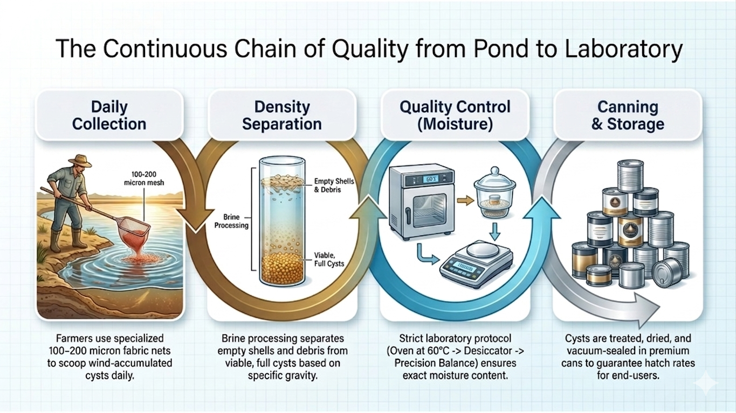
CTU
CAN THO UNIVERSITY
www.ctu.edu.vn
‹#›
Community - Totality - Uniqueness

Slide 7
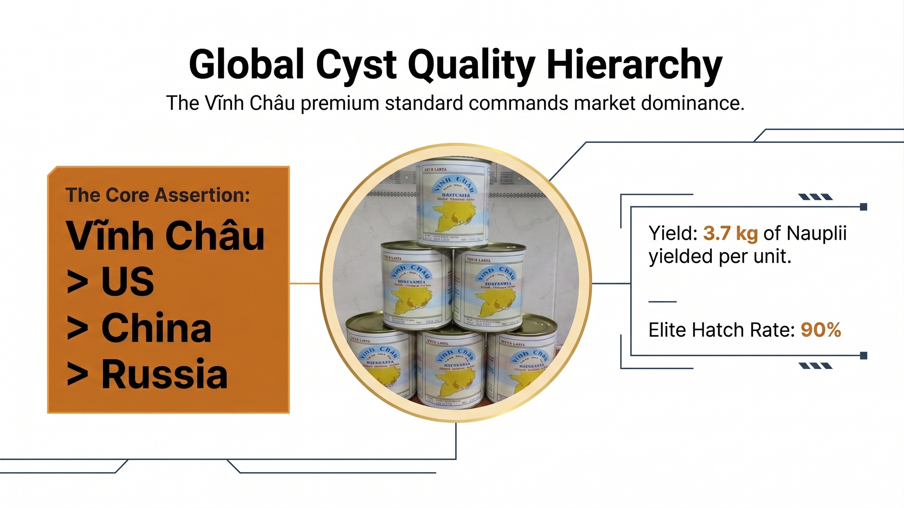
CTU
CAN THO UNIVERSITY
www.ctu.edu.vn
‹#›
Community - Totality - Uniqueness

Slide 8

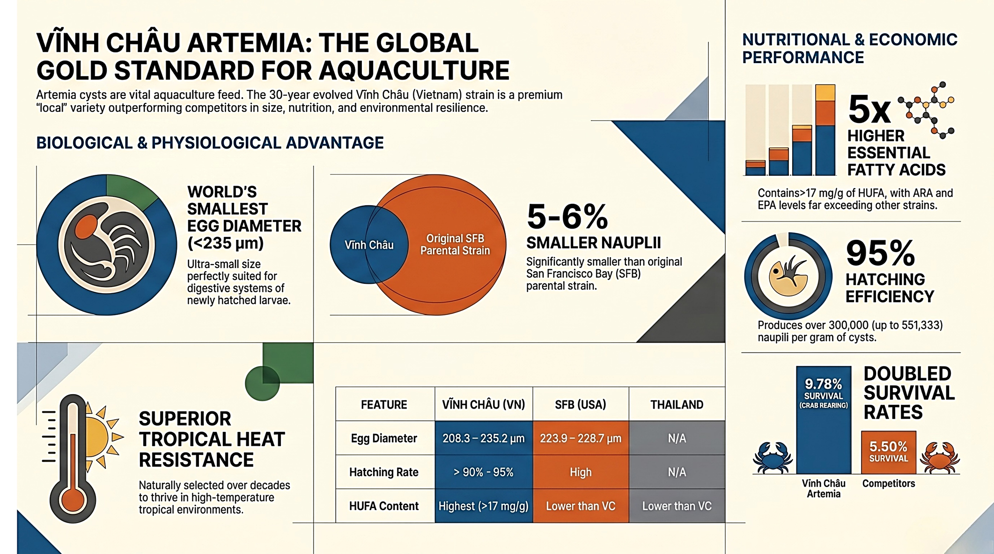
Vinh Chau Artemia: the global gold standard for aquaculture
CTU
CAN THO UNIVERSITY
www.ctu.edu.vn
‹#›
Community - Totality - Uniqueness

Slide 9
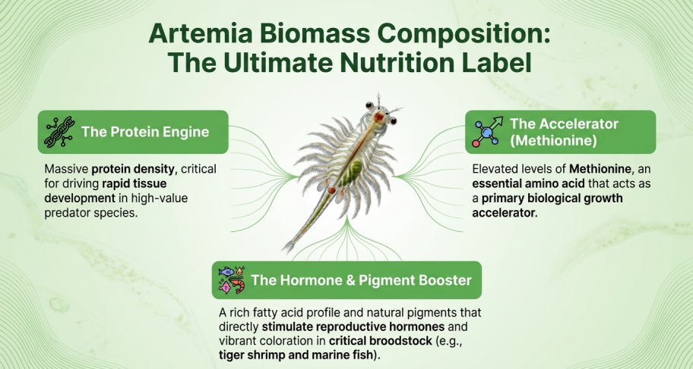


11
CAN THO UNIVERSITY
‹#›
CTU
www.ctu.edu.vn
Community - Totality - Uniqueness

Slide 10
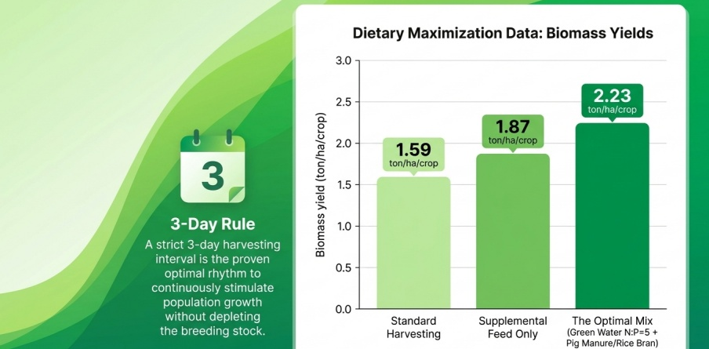
Maximizing biomass yields
CTU
CAN THO UNIVERSITY
www.ctu.edu.vn
‹#›
Community - Totality - Uniqueness

Slide 11


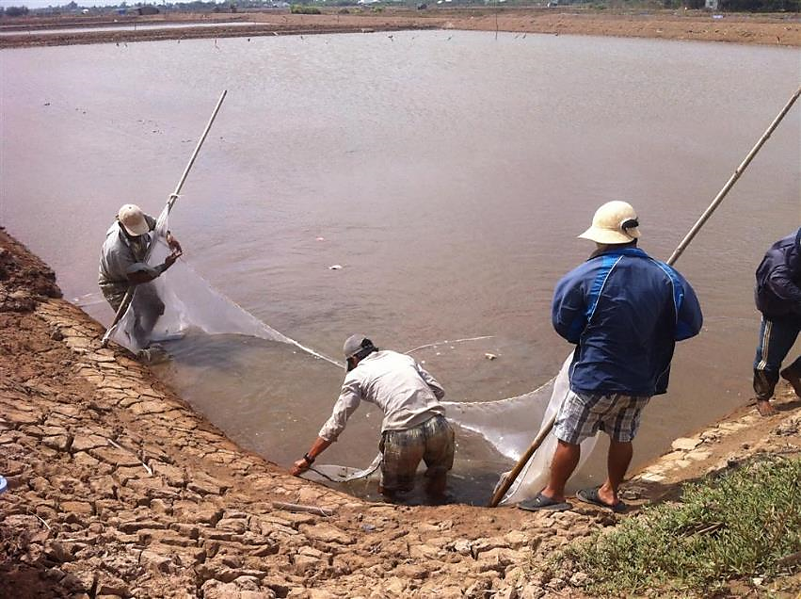
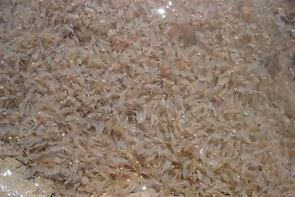
Biomass production
Artemia biomass
Manual biomass harvesting
CTU
CAN THO UNIVERSITY
www.ctu.edu.vn
‹#›
Community - Totality - Uniqueness

Slide 12
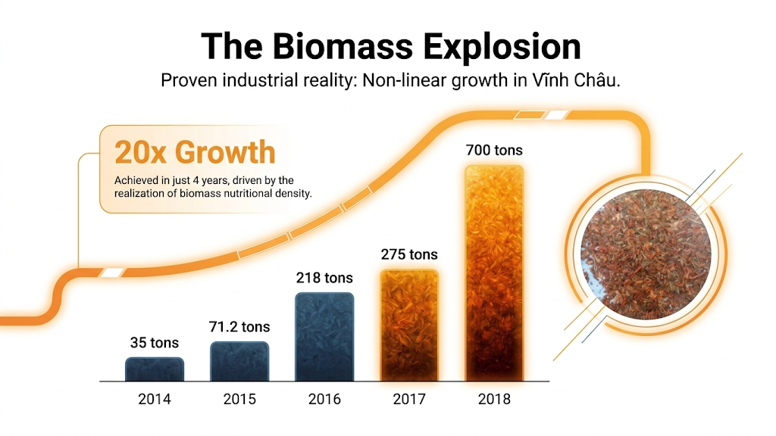
CTU
CAN THO UNIVERSITY
www.ctu.edu.vn
‹#›
Community - Totality - Uniqueness

Slide 13
Production scales / Families involved
2020
800 ha
500 fam
2015
app 1200 ha
> 1000 fam
2000
> 1000 ha
> 500 fam
90’s
200 ha
100 families
Artemia production scales in Vinhchau-Baclieu since 90’s
Converted to shrimp ponds ,wind farm project …
Abnormal weather has
negative impact on
Artemia farming
Families involved
in Artemia farming

Slide 14
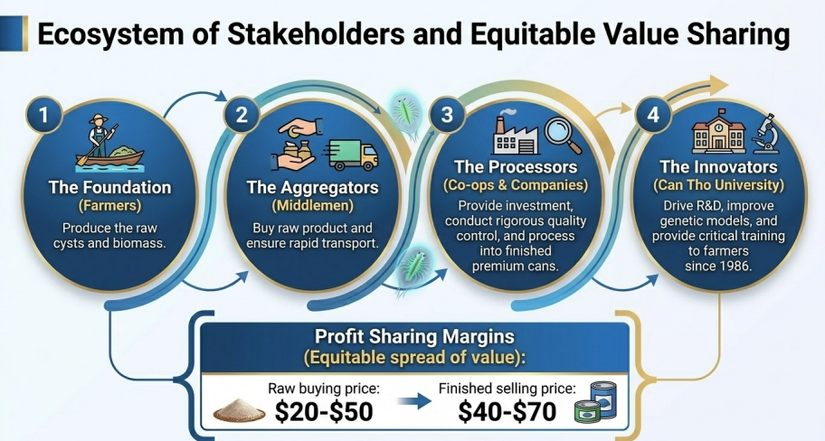
16
CAN THO UNIVERSITY
‹#›
CTU
www.ctu.edu.vn
Community - Totality - Uniqueness

Slide 15
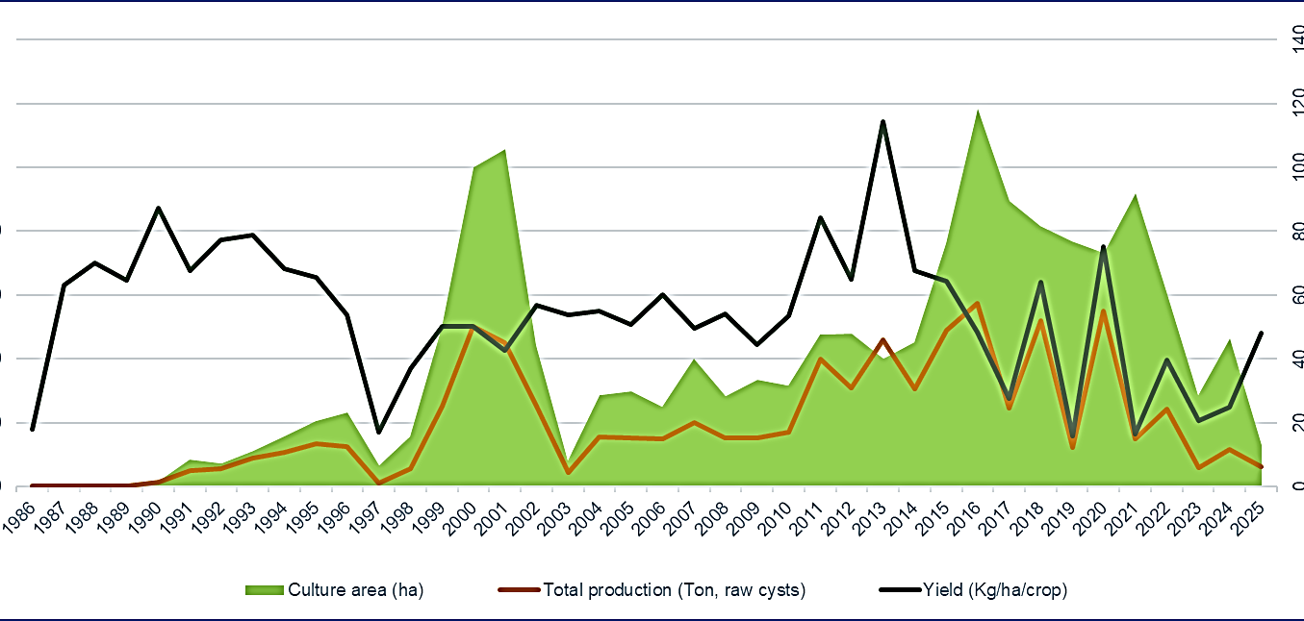
Statistics on area, yield, and production of Artemia cysts in Vinh Chau, Bac Lieu
17
CAN THO UNIVERSITY
‹#›
CTU
www.ctu.edu.vn
Community - Totality - Uniqueness

Slide 16

CTU
CAN THO UNIVERSITY
www.ctu.edu.vn
‹#›
Community - Totality - Uniqueness

Slide 17
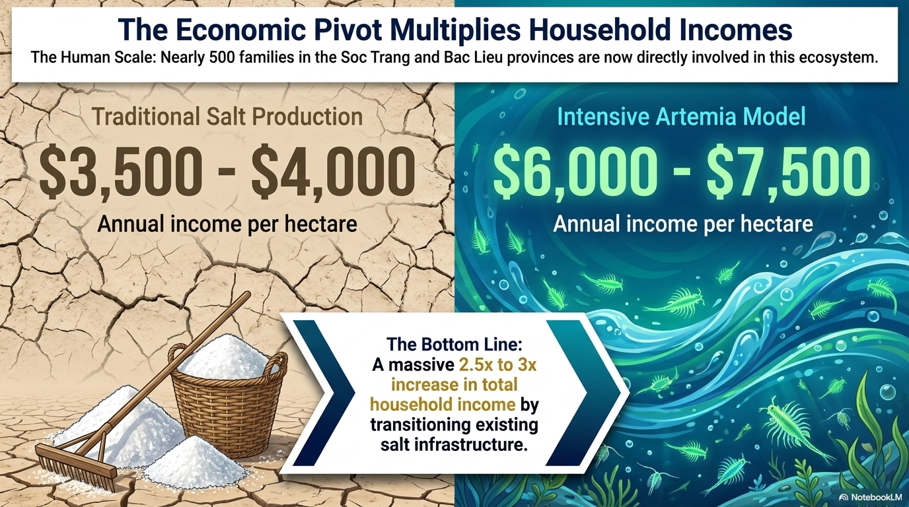
CTU
CAN THO UNIVERSITY
www.ctu.edu.vn
‹#›
Community - Totality - Uniqueness

Slide 18

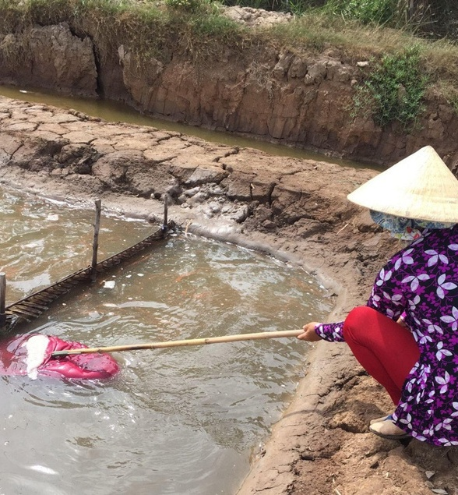
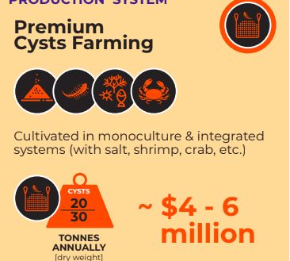
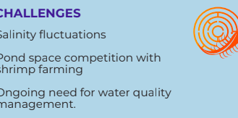
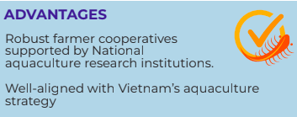
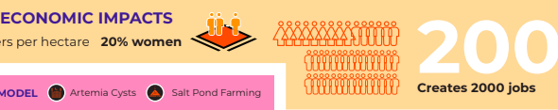
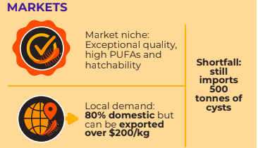
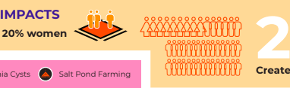


VIETNAM: premium cysts farming
20
CAN THO UNIVERSITY
‹#›
CTU
www.ctu.edu.vn
Community - Totality - Uniqueness
Notes:
1.7.2013
All figures need to be checked
‹#›

Slide 19


Thank you
CTU
CAN THO UNIVERSITY
www.ctu.edu.vn
‹#›
Community - Totality - Uniqueness

