Slide 1
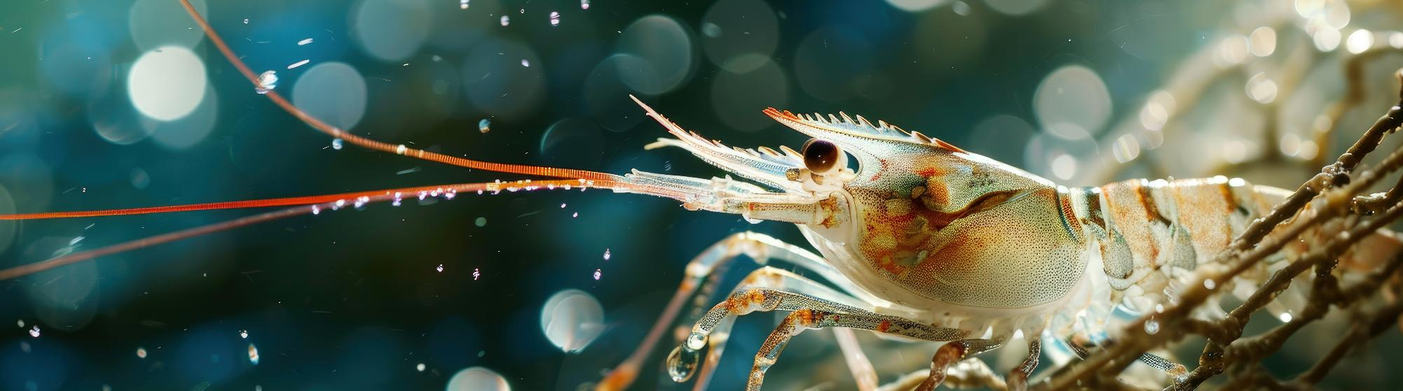

OPTIMIZATION OF ARTEMIA USE IN SHRIMP AQUACULTURE
a MULTI-YEAR EFFORT and a PRELIMINARY ECONOMIC ASSESSMENT
Erik Van Ballaer, Thomas Bosteels, Phil Brown, Yathish Ramena, Nguyen Van Hoa, Chau Tai Tao, and Mohamed Mohamed
GREAT SALT LAKE ARTEMIA

Slide 2
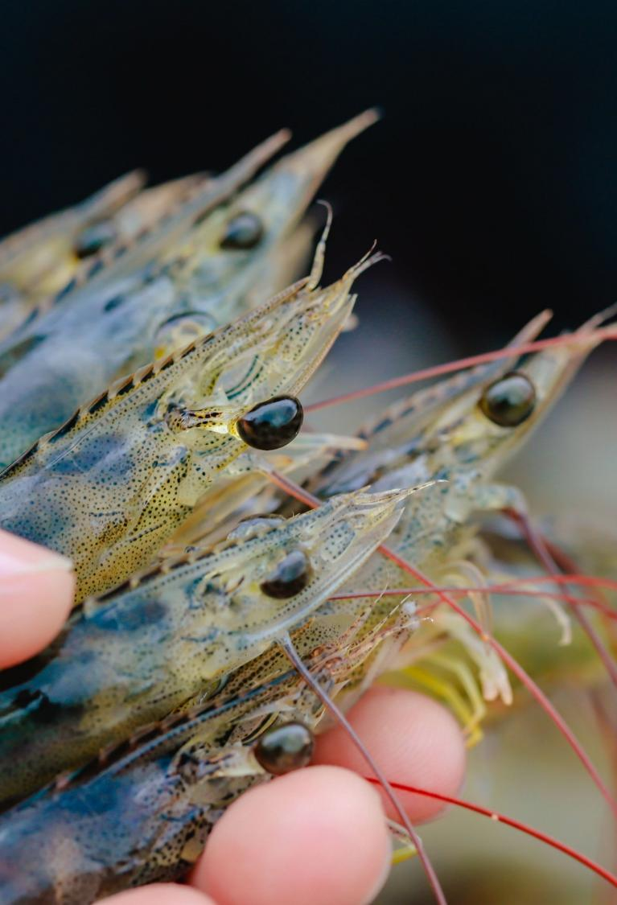
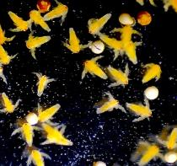
Increased artemia use
A series of trials
HATCHERY
NURSERY
GROWOUT
Research Facilities
USA: University of Arkansas
Vietnam: Can Tho University
  hatchery
  nursery
Commercial Production Facilities
  hatchery – Ecuador, Vietnam
  nursery – Vietnam
  legacy in grow-out – Mexico, Vietnam

Slide 3
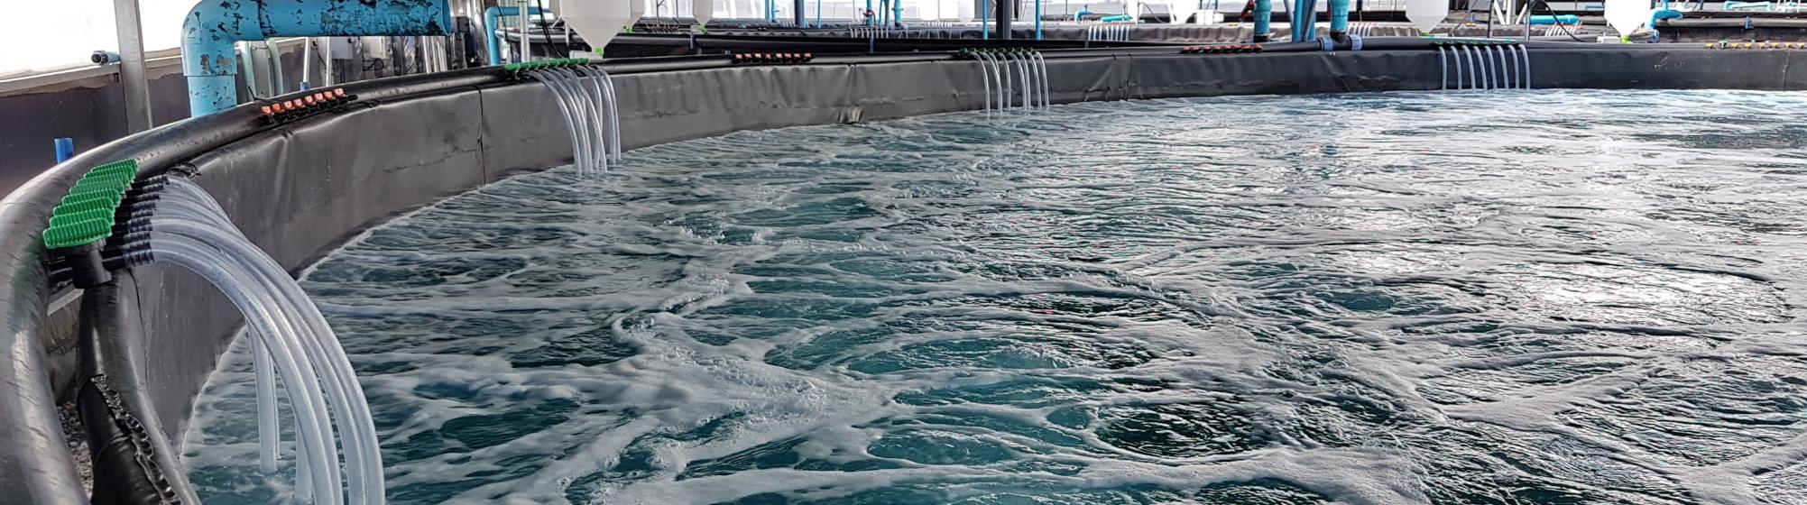
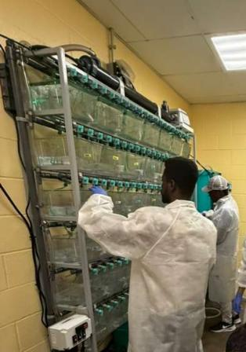
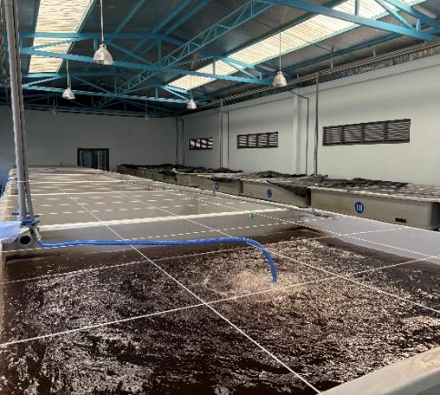
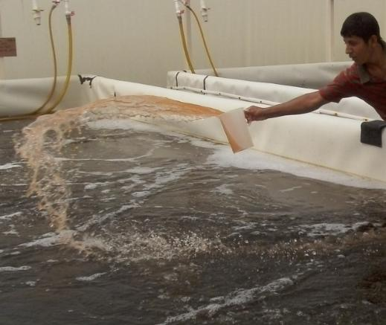
HATCHERY
USA, UAPB
VIETNAM, CTU
ECUADOR

Slide 4
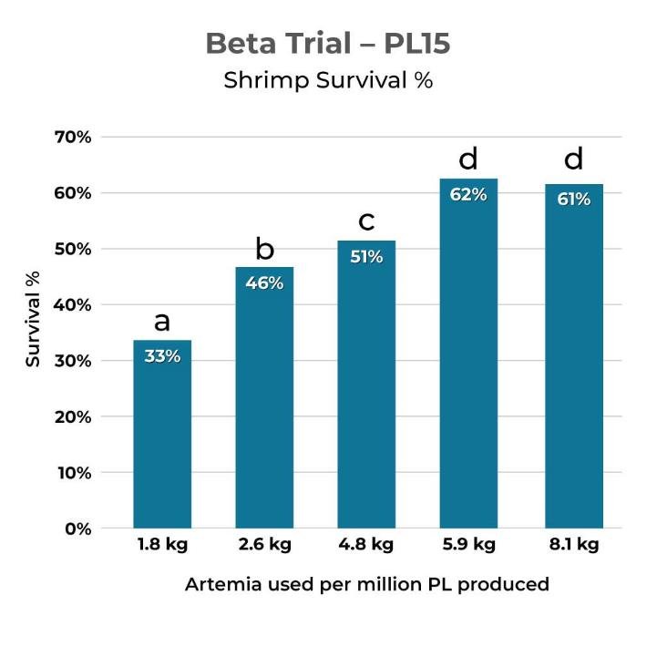

SCOPING TRIALS FOR HATCHERY CYCLE TESTS
HATCHERY
LRT = 10L
Treatments - kg Artemia cysts per million PL15
  2 – 3 – 5 – 6 - 8
Co-feeding with high quality PL diets, fed to satiation
Results:
Survival increases with Artemia use rate
Still very significant survival gains above 3kg per million PL
… and peaks at approximately 6kg
no further gains above this
GREAT SALT LAKE ARTEMIA

Slide 5

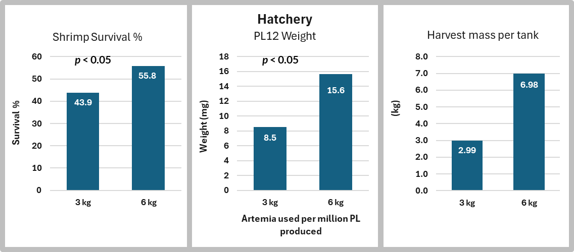
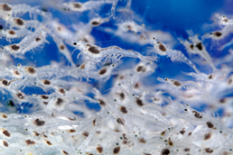


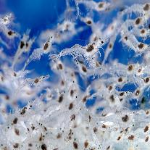
Vietnam commercial scale
TRIAL 1
HATCHERY
Vinh Chau Artemia
LRT = 7,000L – 3 replicates
Larval density 200 nauplii/L
Treatments - kg Artemia cysts per million PL12
  3 – 6
Co-feeding with high quality larval diet, fed to satiation
Results:
Survival +27%
PL weight +83%
Harvested biomass per tank +133%
3kg Artemia/mill
6kg Artemia/mill
3kg PL
biomass/tank
7kg PL
biomass/tank
GREAT SALT LAKE ARTEMIA

Slide 6
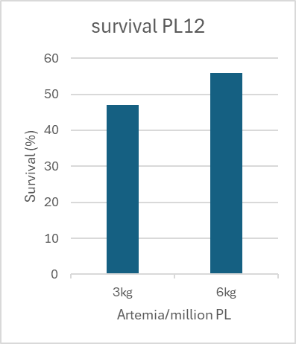
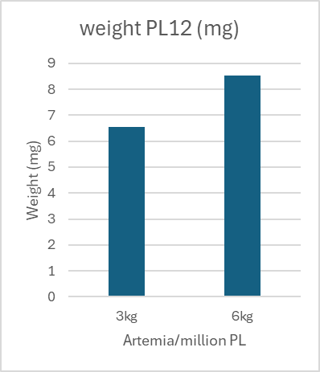
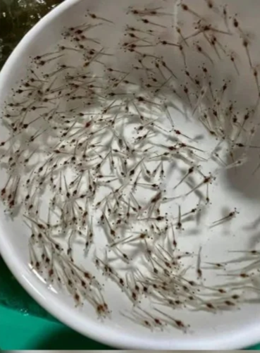
Vietnam commercial scale
TRIAL 2
HATCHERY
GSL Artemia
Results:
Survival +19%
PL weight +31%
GREAT SALT LAKE ARTEMIA

Slide 7
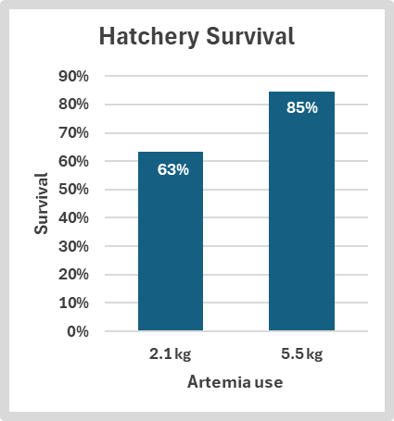
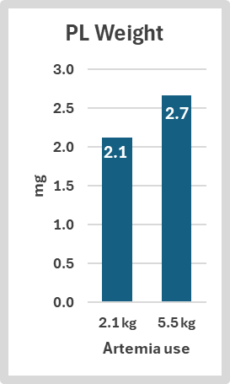
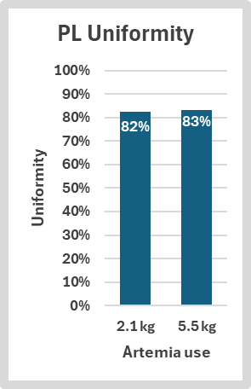
Ecuador commercial scale
TRIAL 1
HATCHERY
LRT = 20,000L – 6 replicates
Larval density 130 nauplii/L
Treatments - kg Artemia cysts per million PL12
  2 = 1kg fed as live nauplii [Z3-PL4] + 1kg fed as decapsulated cysts [PL1-PL8]
  5.5 = 4.5kg fed as live nauplii [Z3-PL6] + 1kg fed as decapsulated cysts [PL1-PL8]
Co-feeding with high quality larval diet, fed to satiation
Results:
Survival +35%
PL weight +29%
PL Uniformity was not compromised
+
p = 0.01
EARLIER HARVEST
Harvest could be done 2 days earlier for the 5.5kg Artemia group
GREAT SALT LAKE ARTEMIA

Slide 8
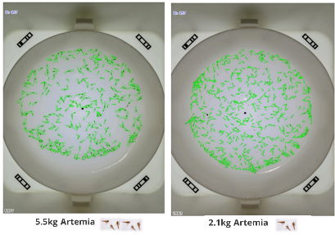

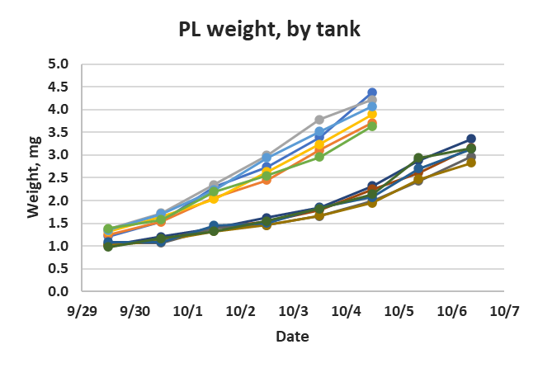



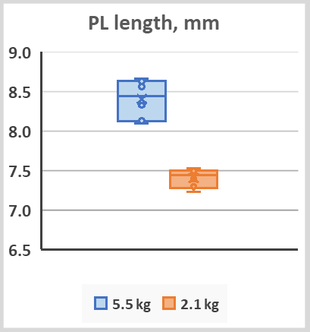
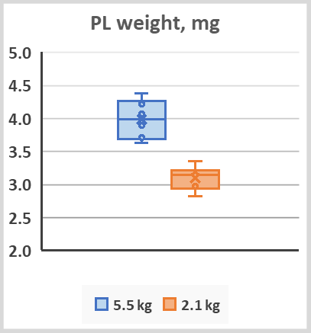
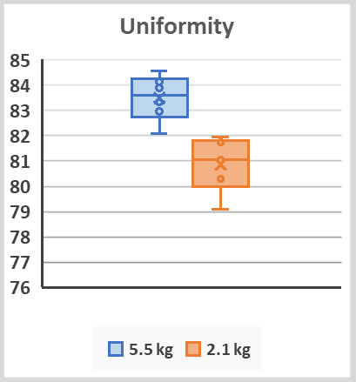


Ecuador commercial scale
TRIAL 2
HATCHERY
Survival +13% in the 5.5kg Artemia
PL size on same day
5.5 kg
At harvest
2.1 kg
Faster growth in all 6 Treatment tanks
At PL9: nearly twice as large with more Artemia
Harvest 3 days earlier than the 2.1kg
5.5kg Artemia PLs still nearly 30% larger at harvest, despite control group having another 3 days to grow
Uniformity slightly higher
GREAT SALT LAKE ARTEMIA

Slide 9
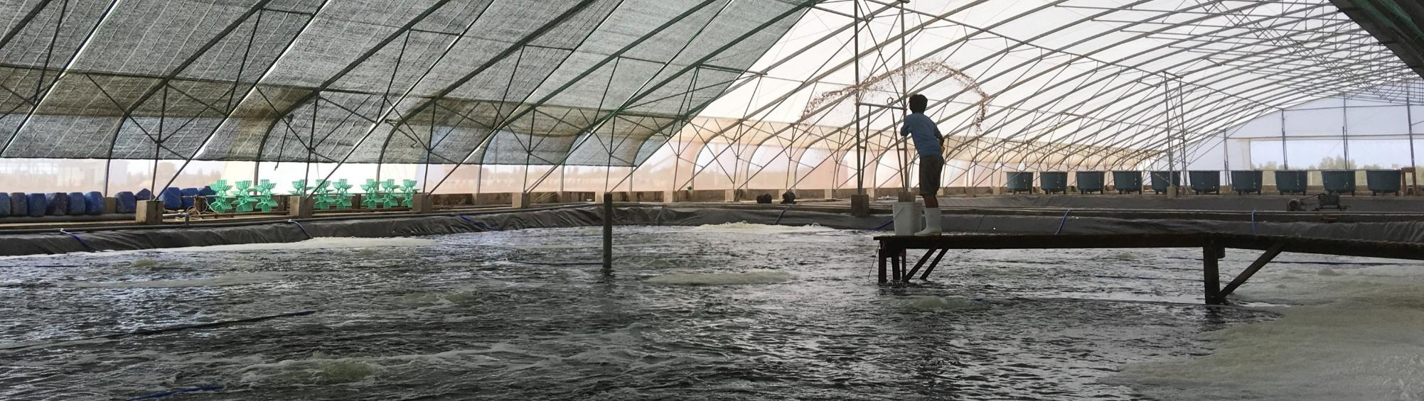
NURSERY
USA, UAPB
Vietnam

Slide 10
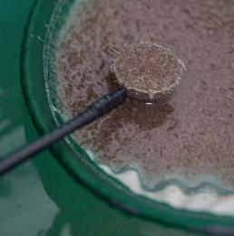
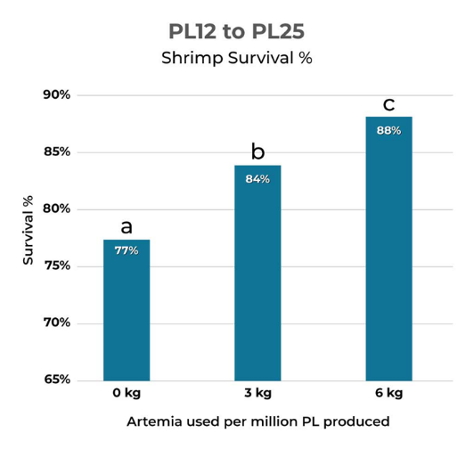
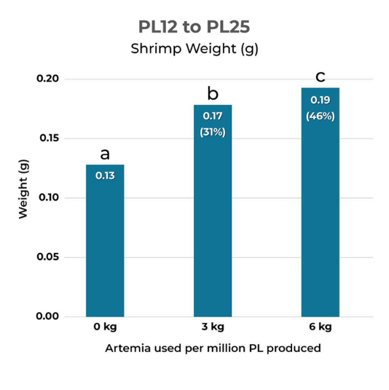
UNIVERSITY TRIALS
NURSERY
NURSERY
Larval density 18/L
Treatments - kg Artemia cysts per million PL25
  0 - 3 – 6
Co-feeding with high quality larval diet, fed to satiation
Results:
Survival
  3kg vs 0kg +7%
  6kg vs 0kg +11%
PL weight
  3kg vs 0kg +31%
  6kg vs 0kg +46%
  6kg vs 3kg +12%
Shrimp biomass at PL25
  6kg vs 0kg +60%
  6kg vs 3kg +17%

Slide 11
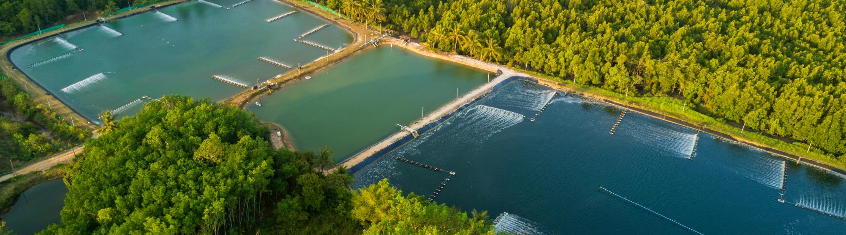
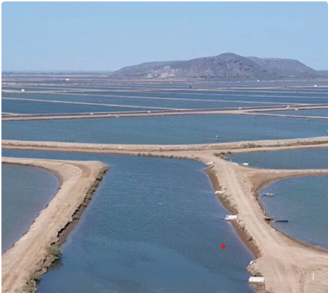
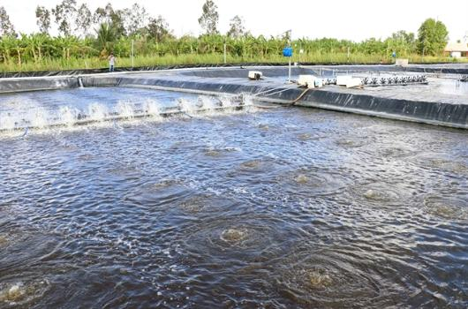
GROWOUT
Mexico
Vietnam
legacy ←
GREAT SALT LAKE ARTEMIA

Slide 12

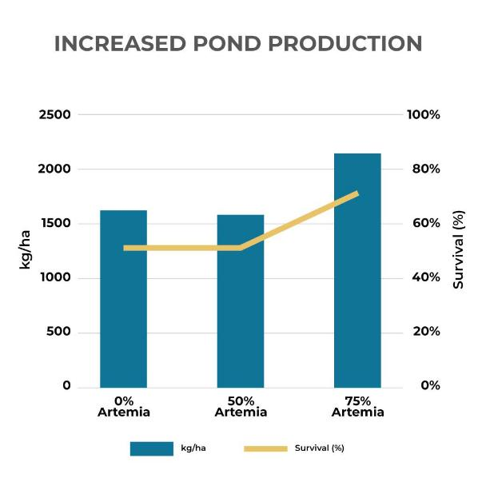
Mexico a preliminary trial on the legacy effect
GROWOUT
G/O ponds: 11 ponds ranging from 3 to 24 ha
Stocking density: 27 PL/m²
Semi-intensive production system
Results:
Survival improved from 50% to 70%
Pond production per unit area increased
Suggests a legacy effect of Artemia use in the hatchery

Slide 13
Vietnam commercial scale
NURSERY
GROWOUT
HATCHERY
NURSERY
GROWOUT
Control: 3kg in hatchery + 0kg nursery = 3kg total
Trial: 6kg in hatchery + 3kg nursery = 9kg total
Trial design
Hatchery
200 n/L
3 replicates
Quality diets
→ PL10
Nursery
1,000 PL12/m³
1 replicate
Nursery feed
3 weeks (PL31)
Growout
150 PL31/m³
3 replicates
G/O feed
9 weeks
4 ton
500 m²
500 m²
Control: 3 kg Artemia/mill PL
Trial: 6 kg Artemia/mill PL
Control: 0 kg Artemia/mill PL
Trial: 3 kg Artemia/mill PL
Control: 0 kg Artemia
Trial: 0 kg Artemia
Only G/O feed
Vinh Chau Artemia
Vinh Chau Artemia

Slide 14
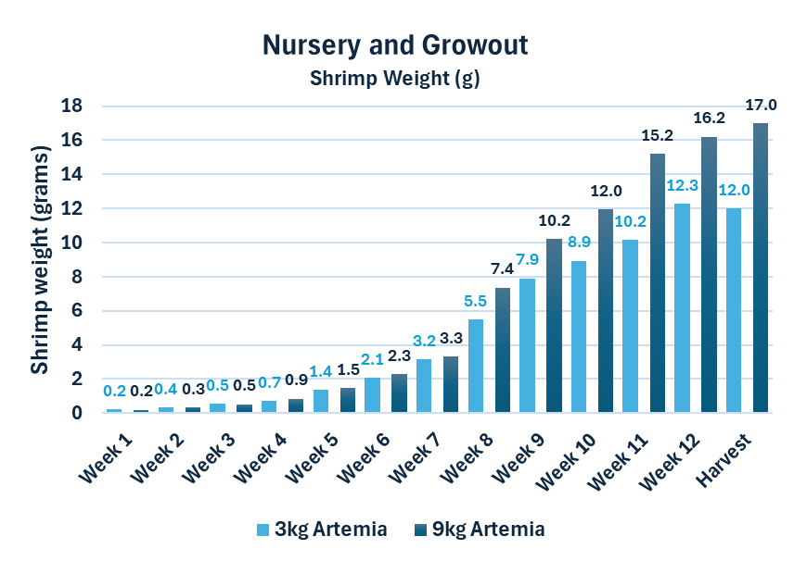

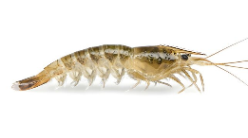
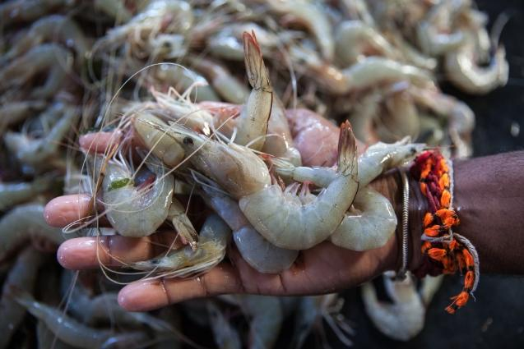


Vietnam
NURSERY
GROWOUT
HATCHERY
NURSERY
GROWOUT
Nursery (3 weeks)
0.85g per shrimp (9kg Artemia)
0.73g per shrimp (3kg Artemia)
Growout
Large differences start at week 8
Shrimp fed 9kg total Artemia are 42% larger at harvest
17g
12g
GREAT SALT LAKE ARTEMIA

Slide 15
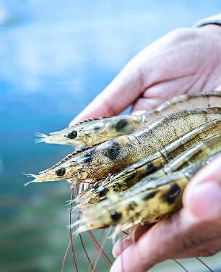
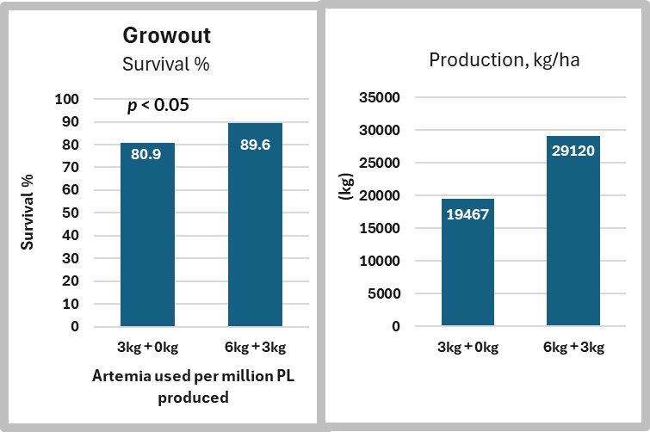
Vietnam
NURSERY
GROWOUT
HATCHERY
NURSERY
GROWOUT
Harvest results
Survival
8% higher survival
Growth
Much faster growth
Larger shrimp
  50% higher production per unit area
  LEGACY effect of Artemia
    ↓
    The benefit of Artemia in the hatchery and nursery continues through growout and to harvest for market

Slide 16
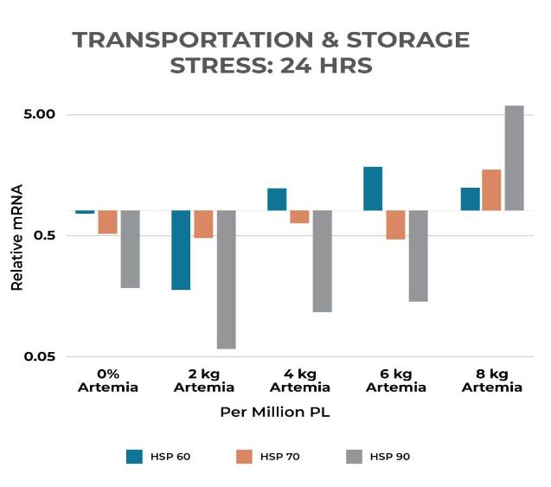
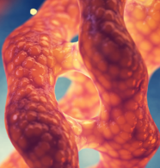

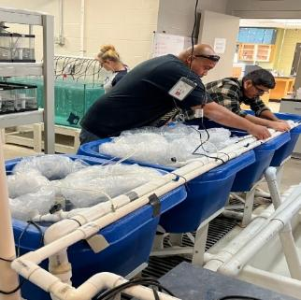
WHY?
2024 GSLA-UAPB, USA
2023 CP, Thailand
PL15
PL7 to 17 were fed different diets
Although growth and survival was similar, immune expression was significantly increased
more Artemia → pond production ↑
Courtesy Robins McIntosh, CPF Thailand
Positive correlation between Artemia feeding and the upregulation of mRNA expression of heat shock proteins
↑ HEAT SHOCK PROTEINS
↑ PROPHENOLOXIDASE
Notes:
Artemia: 8 kg per million PL17
Larval feed: 4 kg Artemia up to PL7 + larval diet
Growout feed: 4kg Artemia up to PL7 + grinded G/O feed

Slide 17
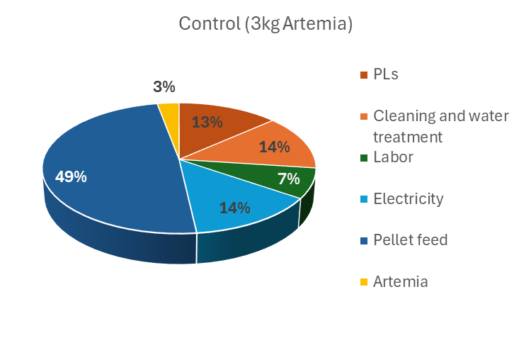
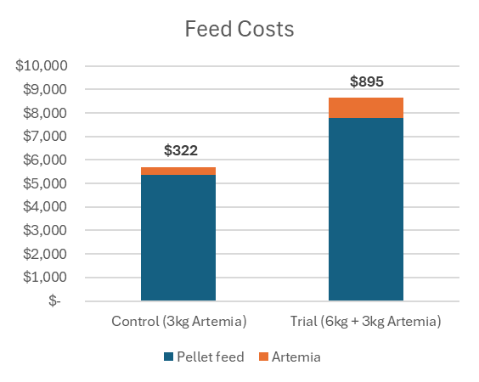

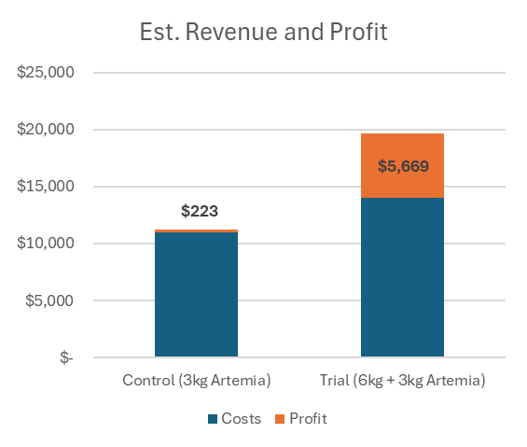
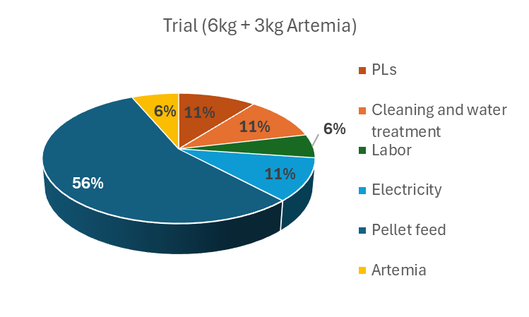
NURSERY & GROWOUT commercial SCALE VIETNAM
higher survival + faster growth
↓
more + larger shrimp
Artemia is 3% (Control), and 6% (Trial) of total production costs
Higher pellet feed costs in trial ponds
Profits $5,400 higher with more Artemia in this trial
$9 profit for every $1 spent on more Artemia
Preliminary Economics

Slide 18
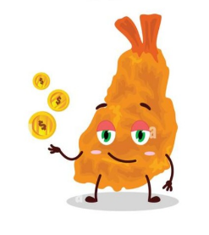
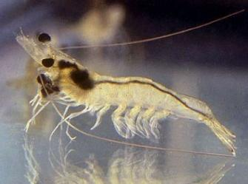
HATCHERY commercial SCALE Ecuador
TRIAL 1
TRIAL 2
Artemia cost $3900 more
Survival 35% higher = 3,400,000 more PL at harvest
$1.95/1000PL = $6,675 more revenue
Profit from using more Artemia: $2800
+ larger PL
+ earlier harvest = 2 days saved
Artemia cost $3900 more
Survival 13% higher- $3,944 more revenue → wash
But,
+ larger PL
+ earlier harvest = 3 days saved
Preliminary Economics

Slide 19
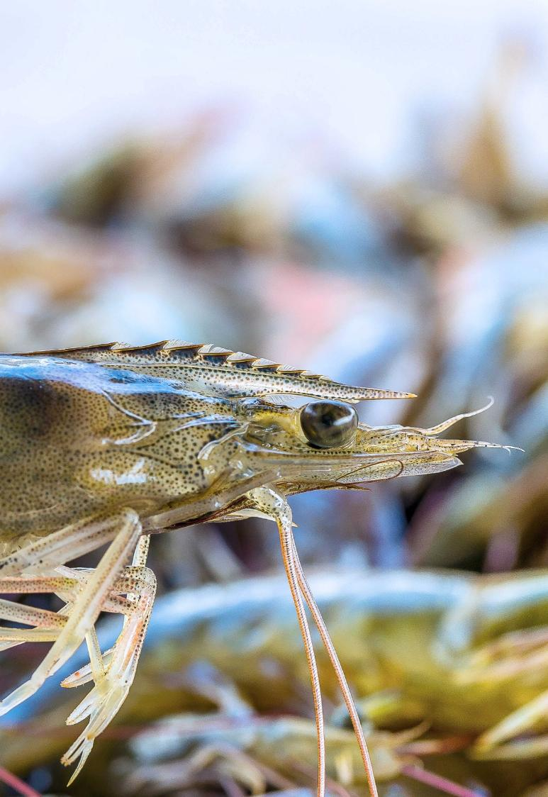

Food for thought
www.gsla.us
More trials to,
  extend database and verification with cultures using different genetic strains and production systems (regions)
  further finetune the optimal Artemia feeding combo in hatchery/nursery
  detailed economic analysis in the different regions
Further explore the scope of benefits of optimal Artemia usage in the hatchery/nursery, including a more solid shrimp robustness and immune response → challenge tests.
Efficient and practical ways to educate and train users in the optimal usage of Artemia, as to achieve more reliable and sustainable shrimp production practices.
Develop a better understanding of the LIVE FOOD FACTOR
THANKS FOR JOINING US

