Slide 1

Successful use of umbrella Artemia in commercial hatcheries of mud crab and shrimp in the Mekong Delta, Vietnam
VN Ut¹, LT Nguyen², Sorgeloos³ and NV Hoa¹
¹Cantho University, Vietnam,²Baclieu University, Vietnam³Ghent University, Belgium

Slide 2
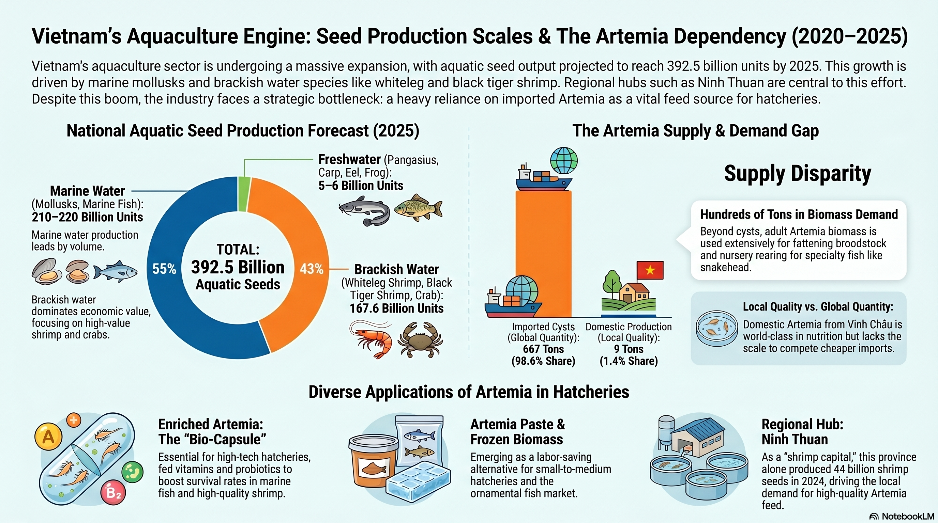

Slide 3
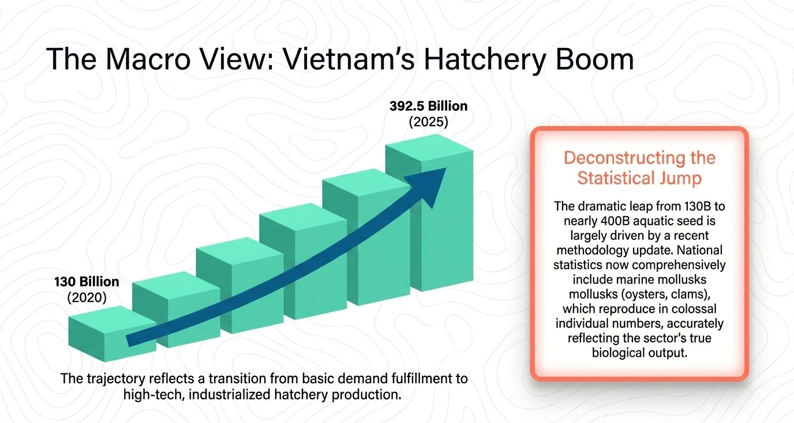

Slide 4
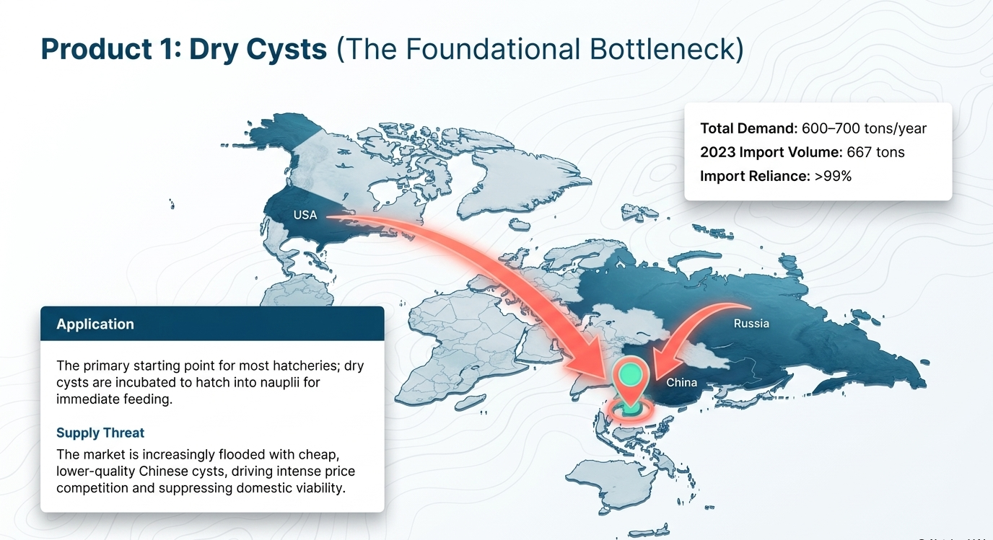

Slide 5
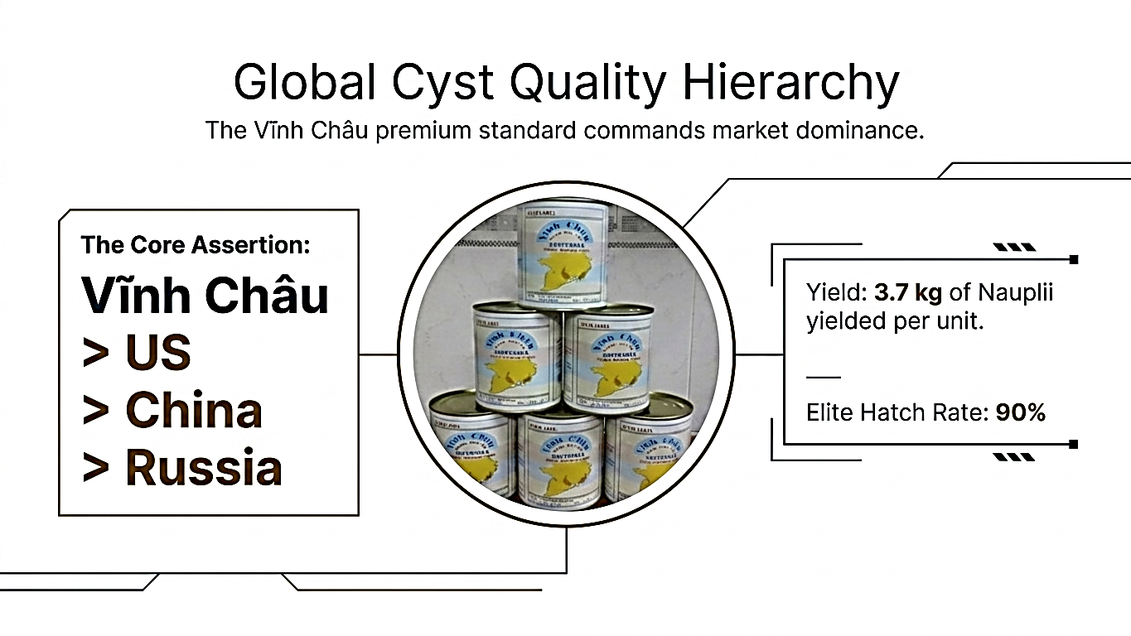

Slide 6
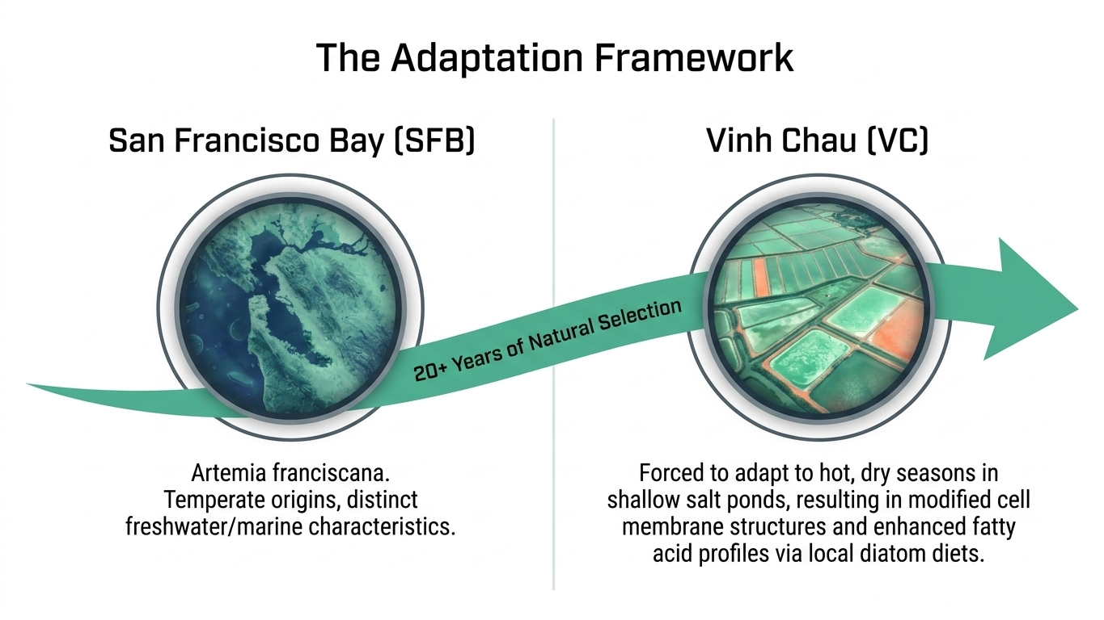

Slide 7
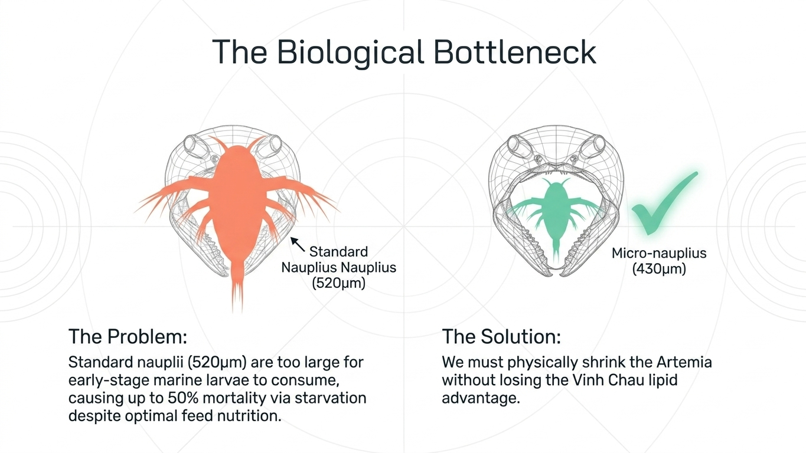

Slide 8
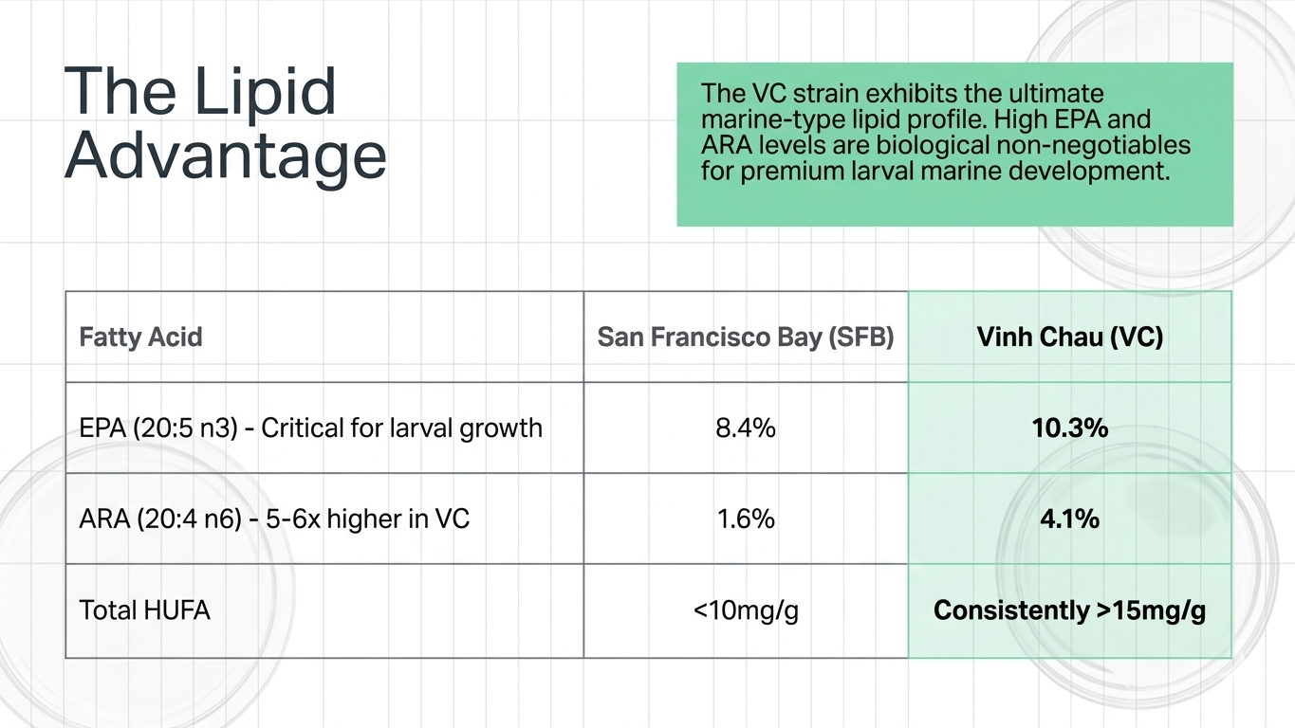

Slide 9
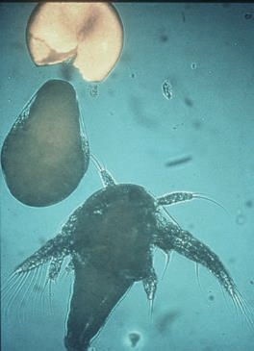
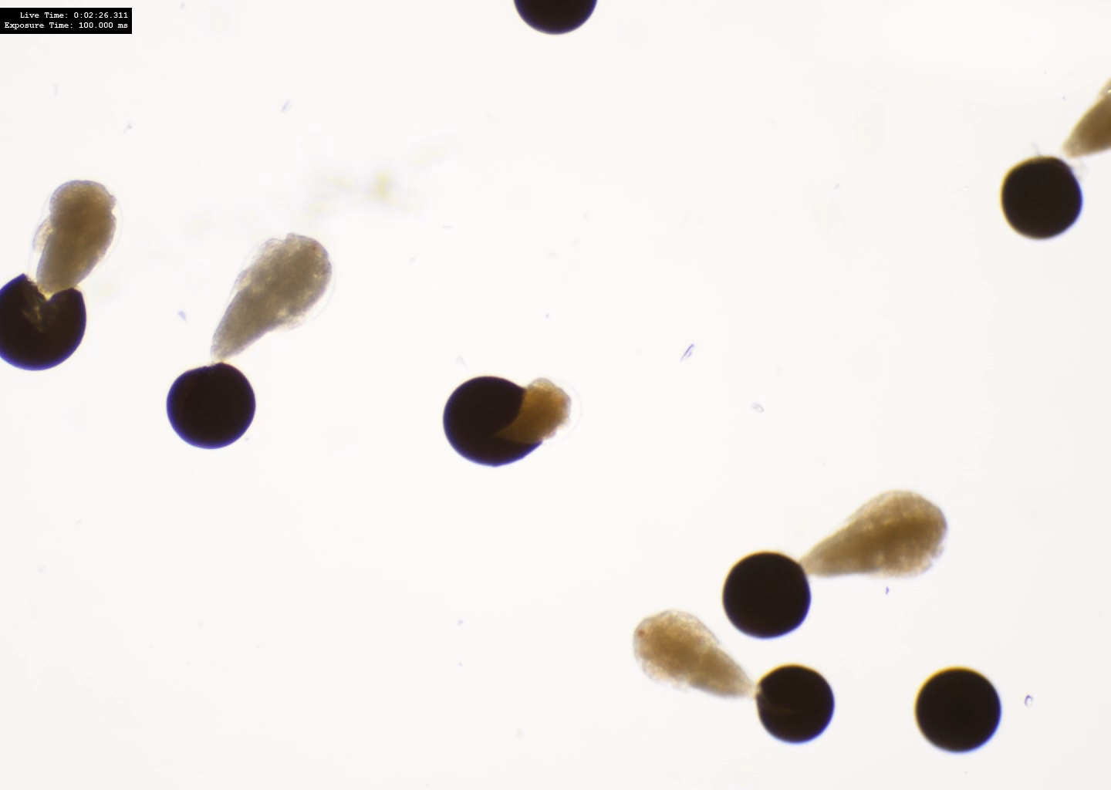
Artemia Vinhchau with its unique character (small size, rich in HUFA) becomes excellent life food in mub-crab (Scylla paramamosain) hatchery
Iodine 5 ppm/minute
formol 100 ppm/minute
Washing under tapwater 2-3 mins
light
light
Cyst shells
Umbrella
Unhatched cysts
Empty cyst shells were removed
10-12h incubation,
> 70% umbrella appeared
Switch off aeration,
Remove empty cyst shells
Drain off umbrella and unhatched cysts
umbrella
Mub-crab larval tank
Newly hatched nauplii

Slide 10
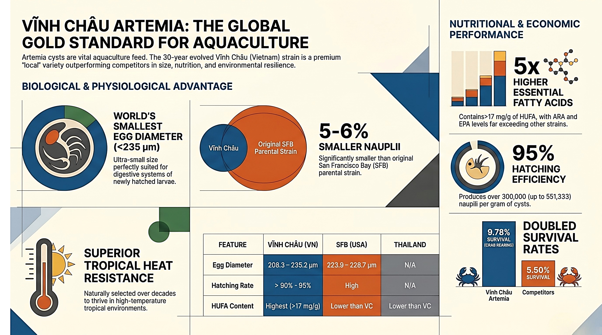
Vinh Chau Artemia: the global gold standard for aquaculture

Slide 11
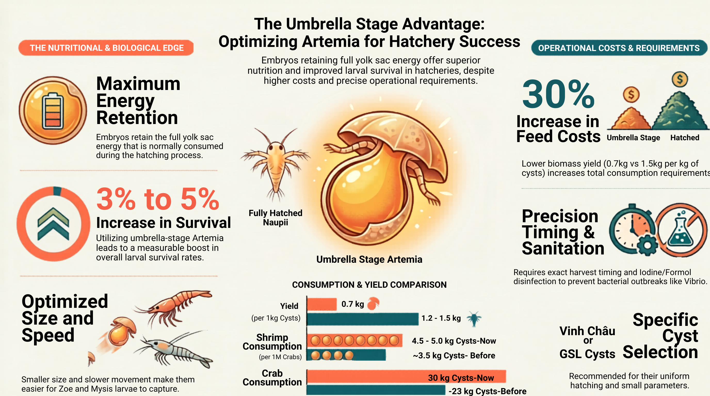
LOC VANG COMPANY-BACLIEU

Slide 12
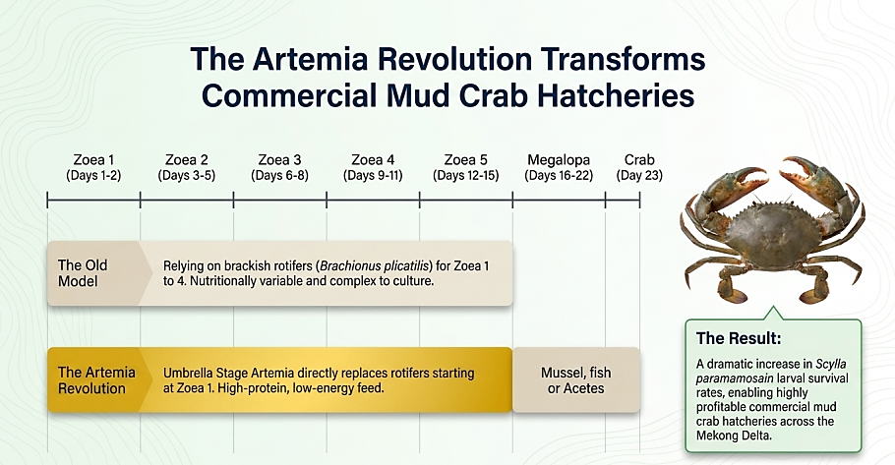

Slide 13
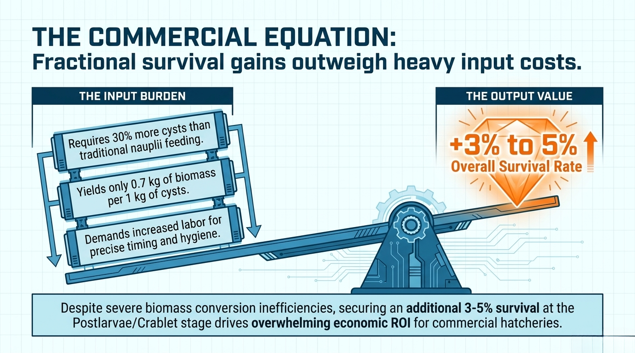

Slide 14
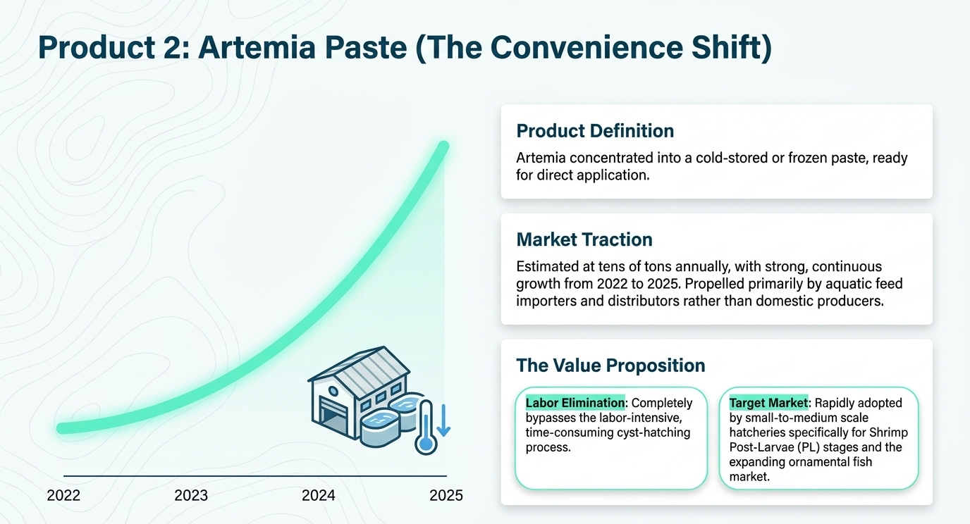
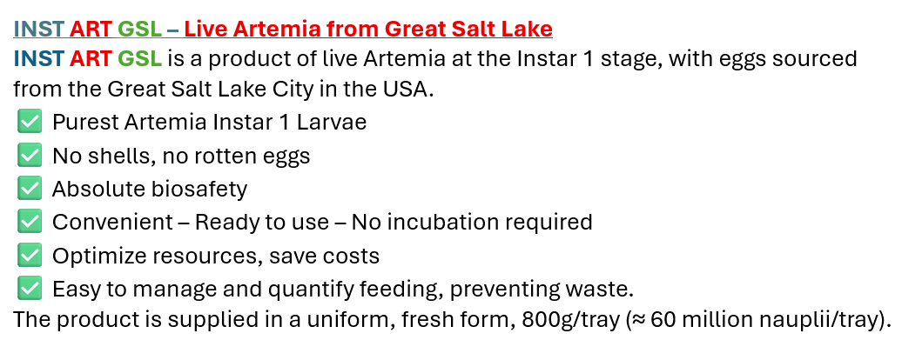
Our main markets today are penaeid shrimp and smaller sales in Macrobrachium and marine fishes. We did some tests with Pangasius with good results but too expensive for major commercial roll out (Rudi Bijnens, 2026 Pers. Comm.)

Slide 15
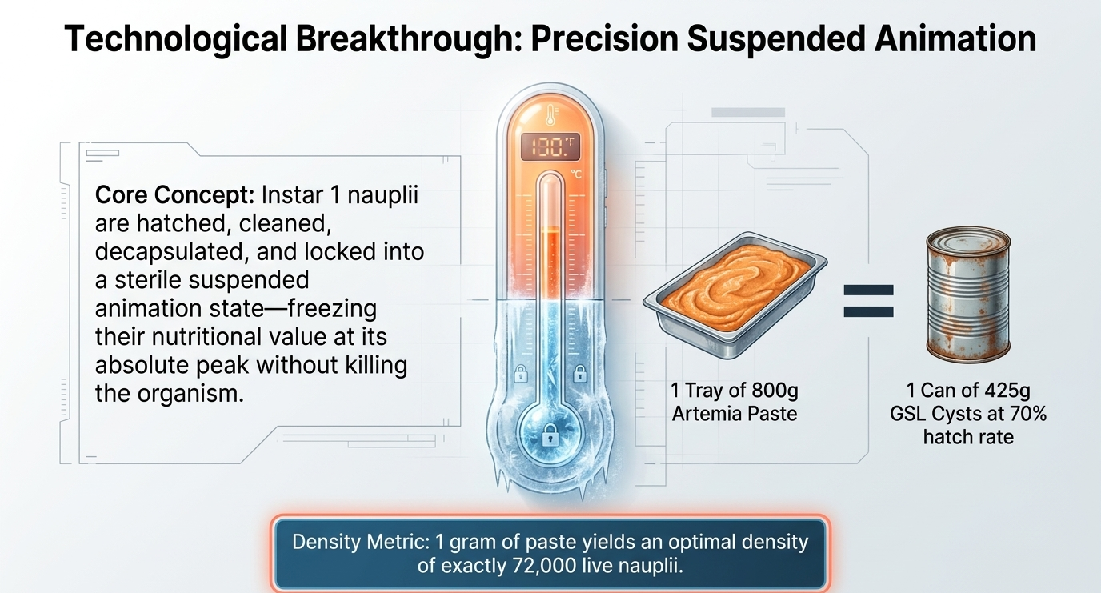

Slide 16
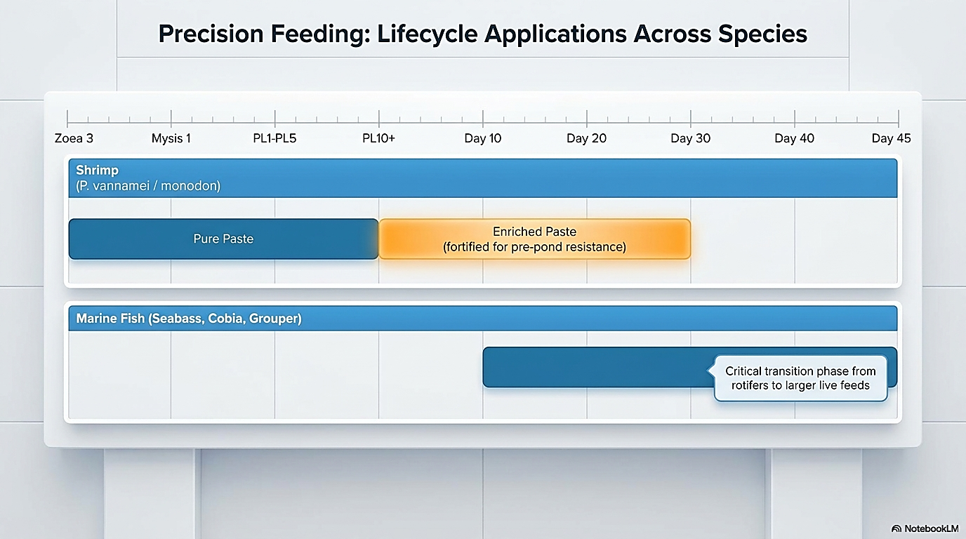

Slide 17
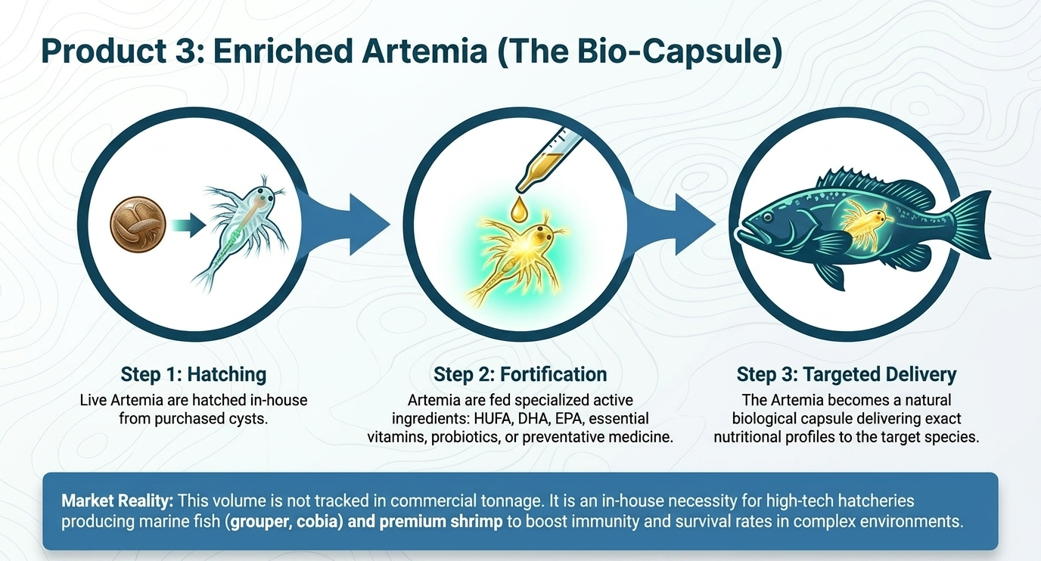

Slide 18
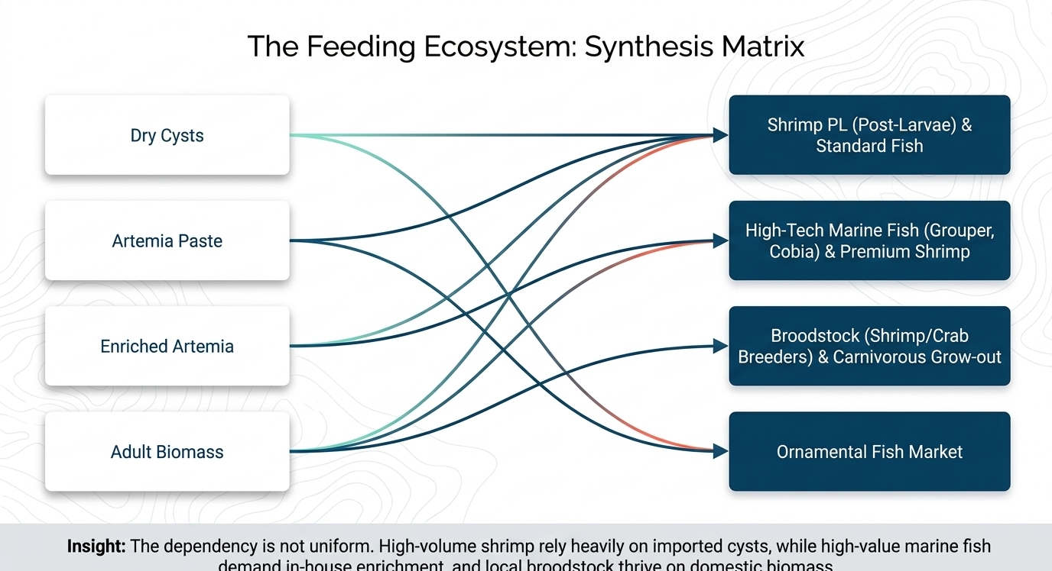

Slide 19
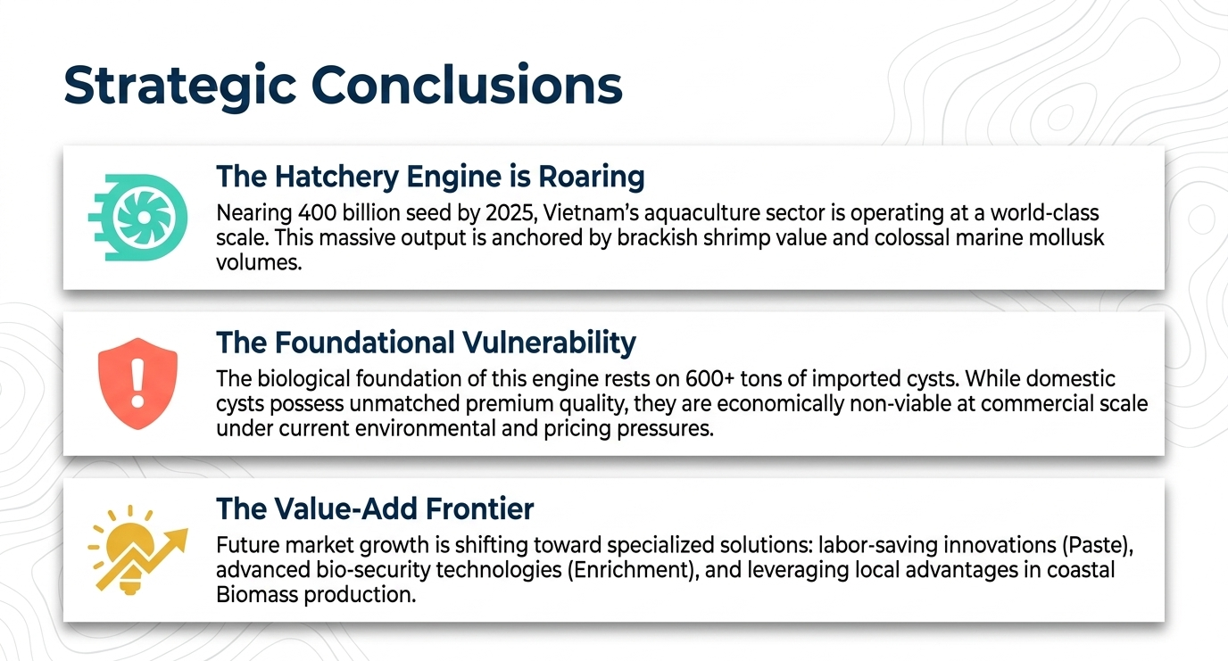

Slide 20
Thank you

