Slide 1
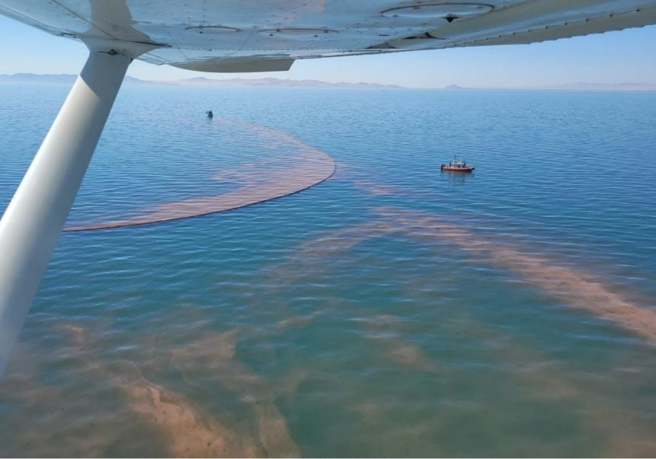
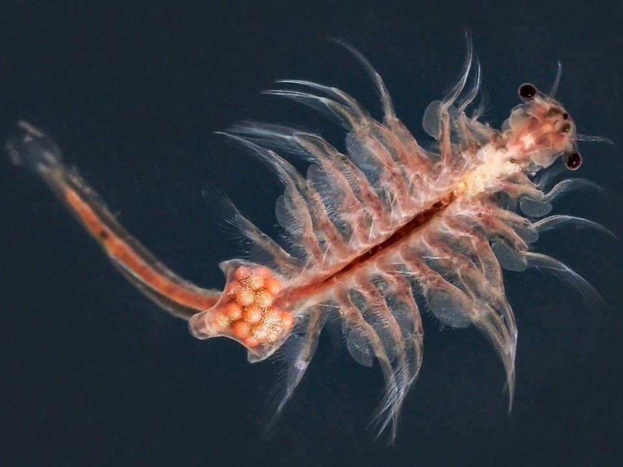
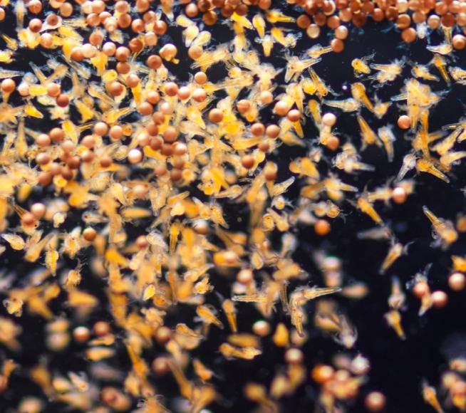

CONCEPTS AND DEVELOPMENTS TO SUPPORT A MORE SUSTAINABLE, OPTIMAL USAGE OF ARTEMIA
IN SHRIMP AND FISH PRODUCTION
Erik Van Ballaer, Patipon Srianek, Bunjonk Nissapawanich, and Thomas Bosteels
THE ARTEMIA YOU CAN TRUST

Slide 2
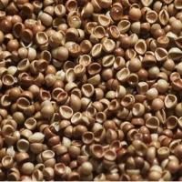

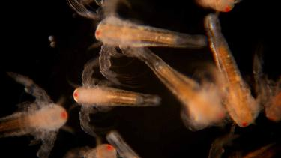
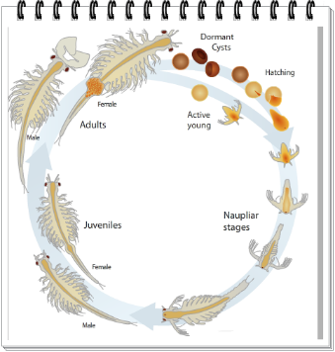
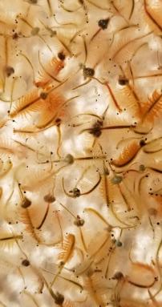
Artemia LIVE FEED
3,500-4,000 tons of Artemia cysts are used annually to produce over 900 billion crustacean and fish juveniles
A very significant portion of these Artemia are lost due to inefficient hatching, handling and feeding practices
Efficient application of Artemia in aquaculture:
  correct hatching and handling
    Artemia Nauplii Centers
  use of different Artemia stages
  use of specialty Artemia cysts
  enhancement of Artemia
THE ARTEMIA YOU CAN TRUST

Slide 3
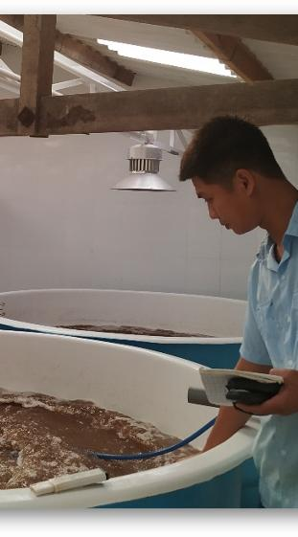

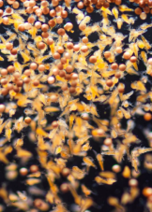
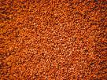

ARTEMIA HATCHING and HANDLING
  STORAGE
  keep cysts <5⁰C
  PRE-HATCH
  clean facilities
  disinfect equipment
  filtered/disinfected water
  salinity optimal = 25-30ppt
  HATCH
  temperature 28-30 ⁰C
  pH > 8-8.5
  cyst density 2-3 gr/L
  Vibrio suppression
  DO >4 mg/l
  light ≥2000 lux at surface
  Instar I stage
  POST-HATCH
  complete separation
  damage-free cleaning
  naup storage ≤10⁰C
light compliance ← 19-25%
1-2B PL
5 ton
↓1ton
$
5B PL
15 ton
↓5ton
Training programs for hatchery and nursery operators in the correct procedures of Artemia production, handling, enhancement and feeding
THE ARTEMIA YOU CAN TRUST

Slide 4
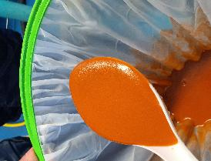
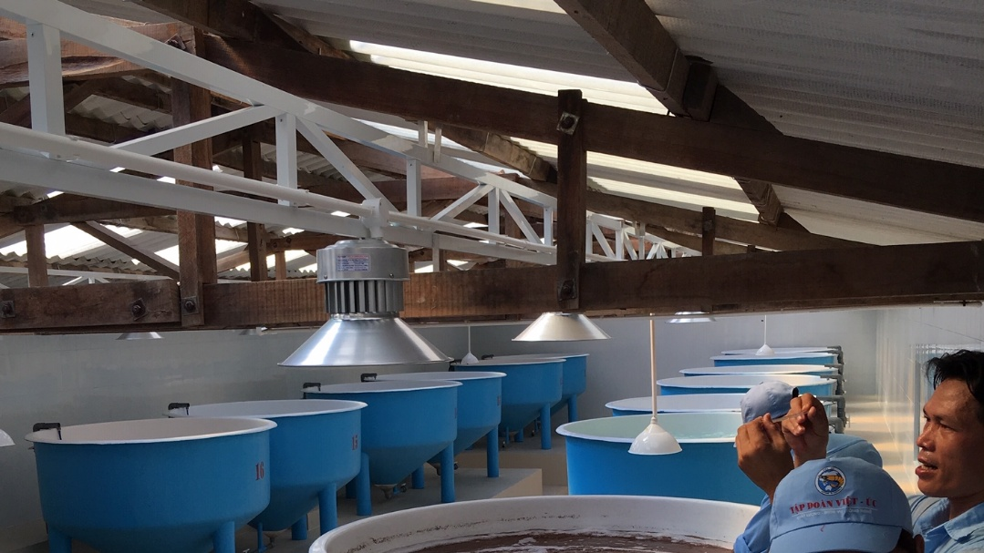
ARTEMIA HATCHING and HANDLING
Live Artemia Supply Centers
Managed by professional operators → zero to minimal losses of Artemia cysts
Add value through quality Artemia enhancement, e.g. via enrichment
Valorise the entire Artemia cyst product, including non-hatching cysts
→ much more efficient use of the available Artemia resources
THE ARTEMIA YOU CAN TRUST

Slide 5
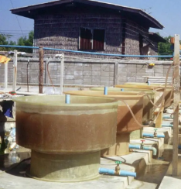
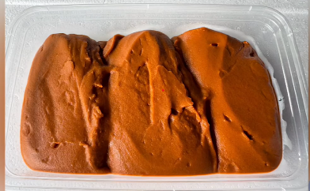
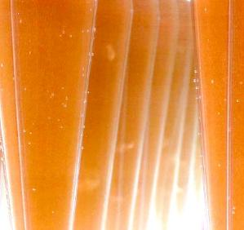
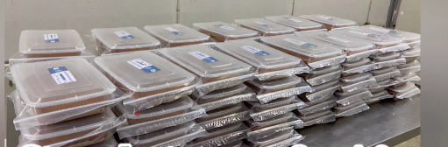

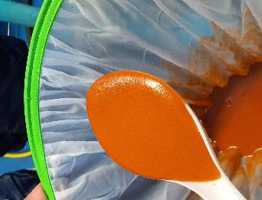
ARTEMIA
Live Artemia Supply Centers
hatched nauplii
1980-90
2012
→ 1st dedicated Live Artemia Nauplii Center in Thailand
live nauplii in a paste form
>24h storage (0-4 ⁰C)
instar I
Vibrio-free
→ Artemia is dormant in paste
↓
revive within 5 minutes in seawater
            For the user:
  Quality product: disease-free + optimal energy content
  Daily delivery
  >24 hour storage with access to live, vivid nauplii at any time
  No more uncertainty about the cyst hatch-out→ verifiable fixed number of nauplii/g paste
  Zero investment in Artemia room facilities and labor
  Zero investment in Artemia stock
THE ARTEMIA YOU CAN TRUST

Slide 6
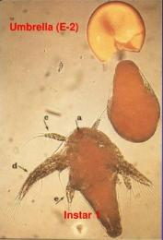
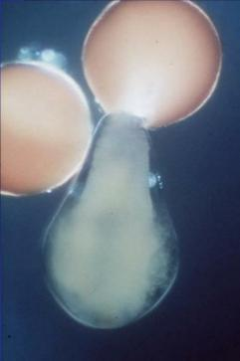
ARTEMIA USAGE: Umbrella Artemia
pre-nauplius
Why?
Floating in the water column, no active swimming → easier to catch
Umbrella are smaller vs instar I → first live stages
Energy content umbrella > instar I: 10+% → less cysts
Usage at present
Production of Scylla crablets in Vietnam: Zoea 1 + Zoea 2 (6 days)
Fraction of shrimp hatcheries, mainly in Vietnam
hatching membrane
Usage potential
Rotifer substitute/supplement in marine fish hatcheries
Substitute for knocked-down (cold or high temperature) Artemia nauplii in penaeid shrimp hatcheries: Zoea 2 – Mysis 3
Challenge
Develop a user-friendly, (semi-) automated system for the separation and harvest of umbrella stages during the Artemia hatching process
Industry Application
Live Artemia Supply Centers + selected fish and crustacean hatcheries
THE ARTEMIA YOU CAN TRUST

Slide 7
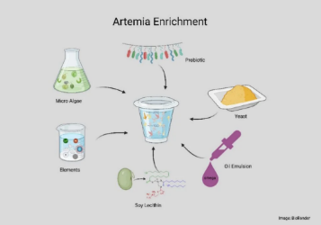
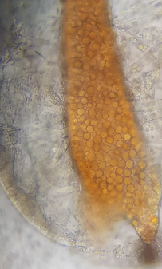
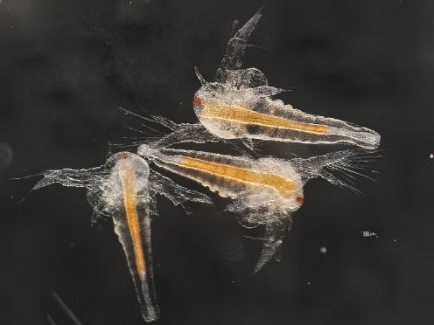
ARTEMIA USAGE: Artemia Enrichment
EXPAND THE ENRICHMENT PRODUCT RANGE FOR SHRIMP
Why?
Reduce the Artemia cyst quantity consumed
Expansion of the application of functional feeds → enrichment with probiotics, yeasts, …
Taking advantage of the live feed factor: intake of the active functional component via live feed
→ energy content of 24 hour enriched nauplius > instar I: up to 20%
→ less cysts
→ easier uptake and assimilation
Usage at present
Marine fish hatcheries (global), few freshwater shrimp hatcheries - main functional component = HUFA
Usage potential
Penaeid shrimp hatcheries from PL stage onwards
Early stages in penaeid shrimp nurseries
upgrade via
BIOENCAPSULATION
Challenge
Develop a user-friendly enrichment protocol for shrimp hatcheries
Develop a practical efficient storage procedure for the enriched nauplii
Secure the biosecurity of the enriched nauplii
Industry Application
Live Artemia Supply Centers + selected fish and crustacean hatcheries
THE ARTEMIA YOU CAN TRUST

Slide 8
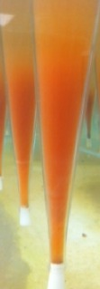
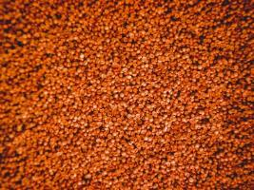
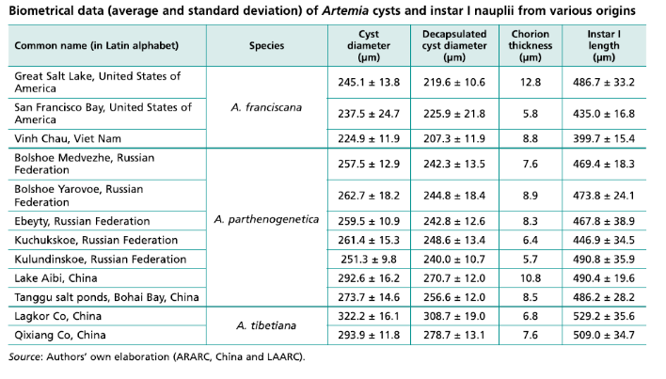
ARTEMIA USAGE: SPECIALTY Artemia
20:5Ѡ3
INCREASE THE AVAILABILITY OF SMALL, HIGH-NUTRIENT ARTEMIA CYSTS
Why?
More nutritious + more biosecure alternative for rotifers and other zooplankton that require growth cultures
Production and supply is limited → cost-efficiency of hatchery SOP
Usage at present
Marine fish hatcheries and crustacean Scylla hatcheries
Usage potential
Wider usage in marine fish hatcheries
Selected crustacean larvicultures (crab, lobster, …)
Novel aquaculture species
Challenge
Cost-efficiency of production and logistics → economics of scale
“New” more reliable production technologies
Develop a wider range of specialty cyst types
FAO Manual
Industry Application
Dedicated production of specialty cysts → environmental + nutrient management: private enterprises and public projects
Selected salt farms and salt farm cooperatives
Selective screening of harvested Artemia cysts from “wild” sources: current Artemia harvesters
THE ARTEMIA YOU CAN TRUST

Slide 9
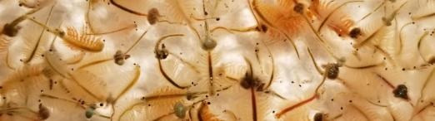

ARTEMIA USAGE: Artemia juvenile + adult Biomass
Why?
More energy-rich live feed for the larger shrimp stages
More efficient use of Artemia as a live feed component, including the introduction of enriched Artemia juveniles and adult biomass → functional live feeds
→ energy content of Artemia biomass >>> Artemia nauplius
→ less cysts
→ Artemia biomass can be fully enriched in 1 hour
Usage at present
Limited usage in penaeid shrimp maturation (iso polychaets) + pioneering trials in shrimp growout supplementation
Usage potential
Supplemental booster feed in shrimp and fish ongrowing
URGENCY
NECESSITY
BENEFIT
COST
Challenge
Extension/upscaling of cost efficient Artemia biomass production systems
Assurance of supply in shrimp producing areas
  regional production and/or efficient transport logistics
Secure the biosecurity of the live feed product
available Artemia resources
Industry Application
Dedicated production of Artemia biomass (+ cysts) ← nutrient management: private enterprises and public projects
Selected salt farms and salt farm cooperatives
THE ARTEMIA YOU CAN TRUST

Slide 10
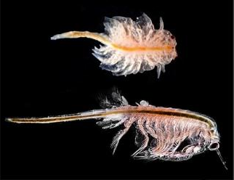
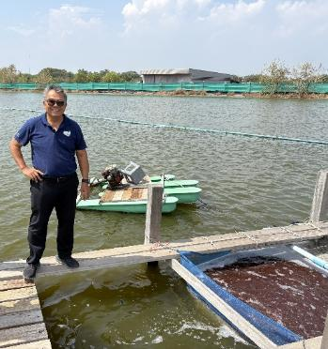
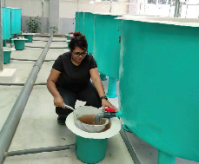
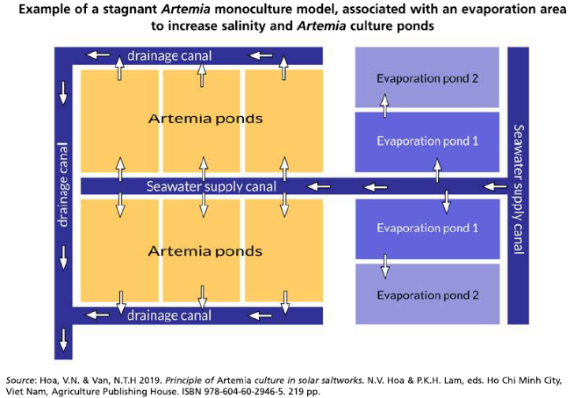
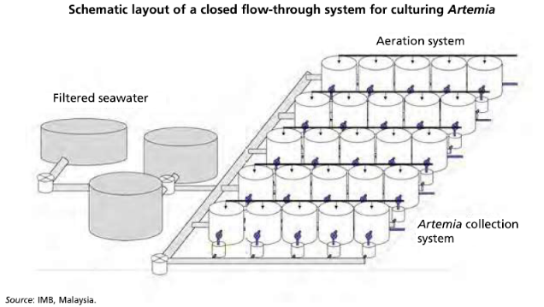
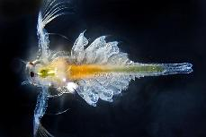
ARTEMIA USAGE: Artemia juvenile + adult Biomass
ARTEMIA BIOMASS PRODUCTION MODELS
Outdoor pond model
Indoor tank model
Artemia juveniles
timed partial harvest of outdoor biomass ponds
targeted production in tanks ← cost-efficiency
Source: IMB, Malaysia
THE ARTEMIA YOU CAN TRUST

Slide 11

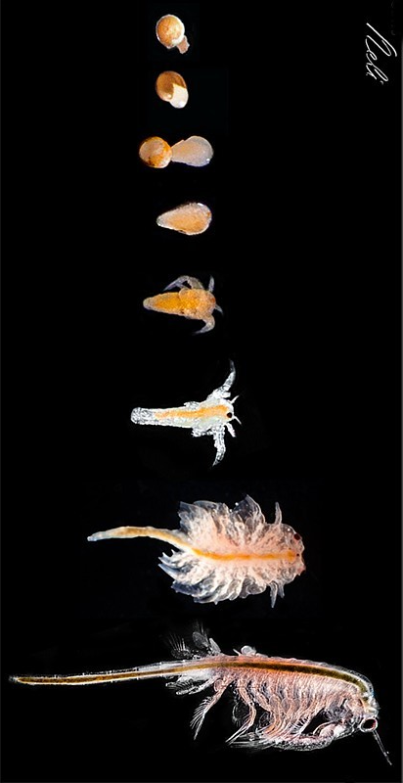
FINAL THOUGHTS
Live Artemia is essential to marine aquaculture
  substantial benefits in both hatchery and on-growing phases
Available Artemia resource is not being used to its full potential
  ToDo ← overall + site- and situation-specific scenarios
  short term
    Prioritize efficient ways to disseminate, train and support end users in more sustainable and optimal application of the available Artemia resource: hatching, handling and feeding ratios
    Develop practical systems and procedures for the production and usage of umbrellas and nauplii enrichment* (*) for shrimp
    Promote the expansion of Live Artemia Supply Centers, both stand-alone and in-house (large hatchery complexes)
  mid to long term
    Develop and extend sustainable production systems and usage procedures for Artemia biomass
    Develop and implement controlled production of specialty cysts
THANKS FOR JOINING US

