Slide 1
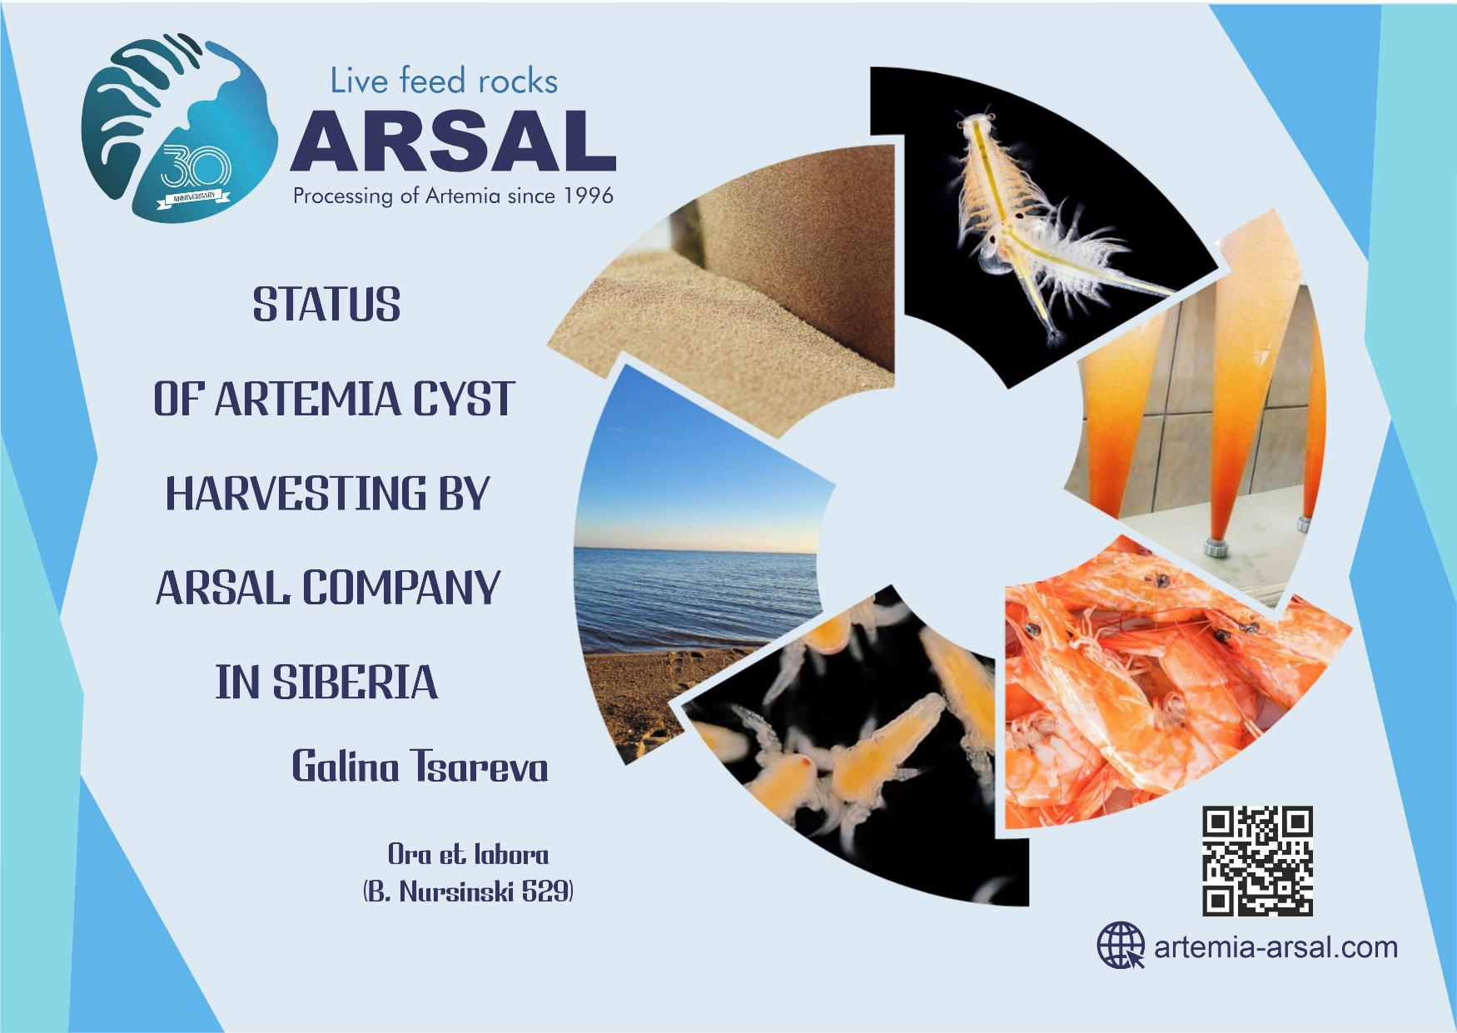

Slide 2
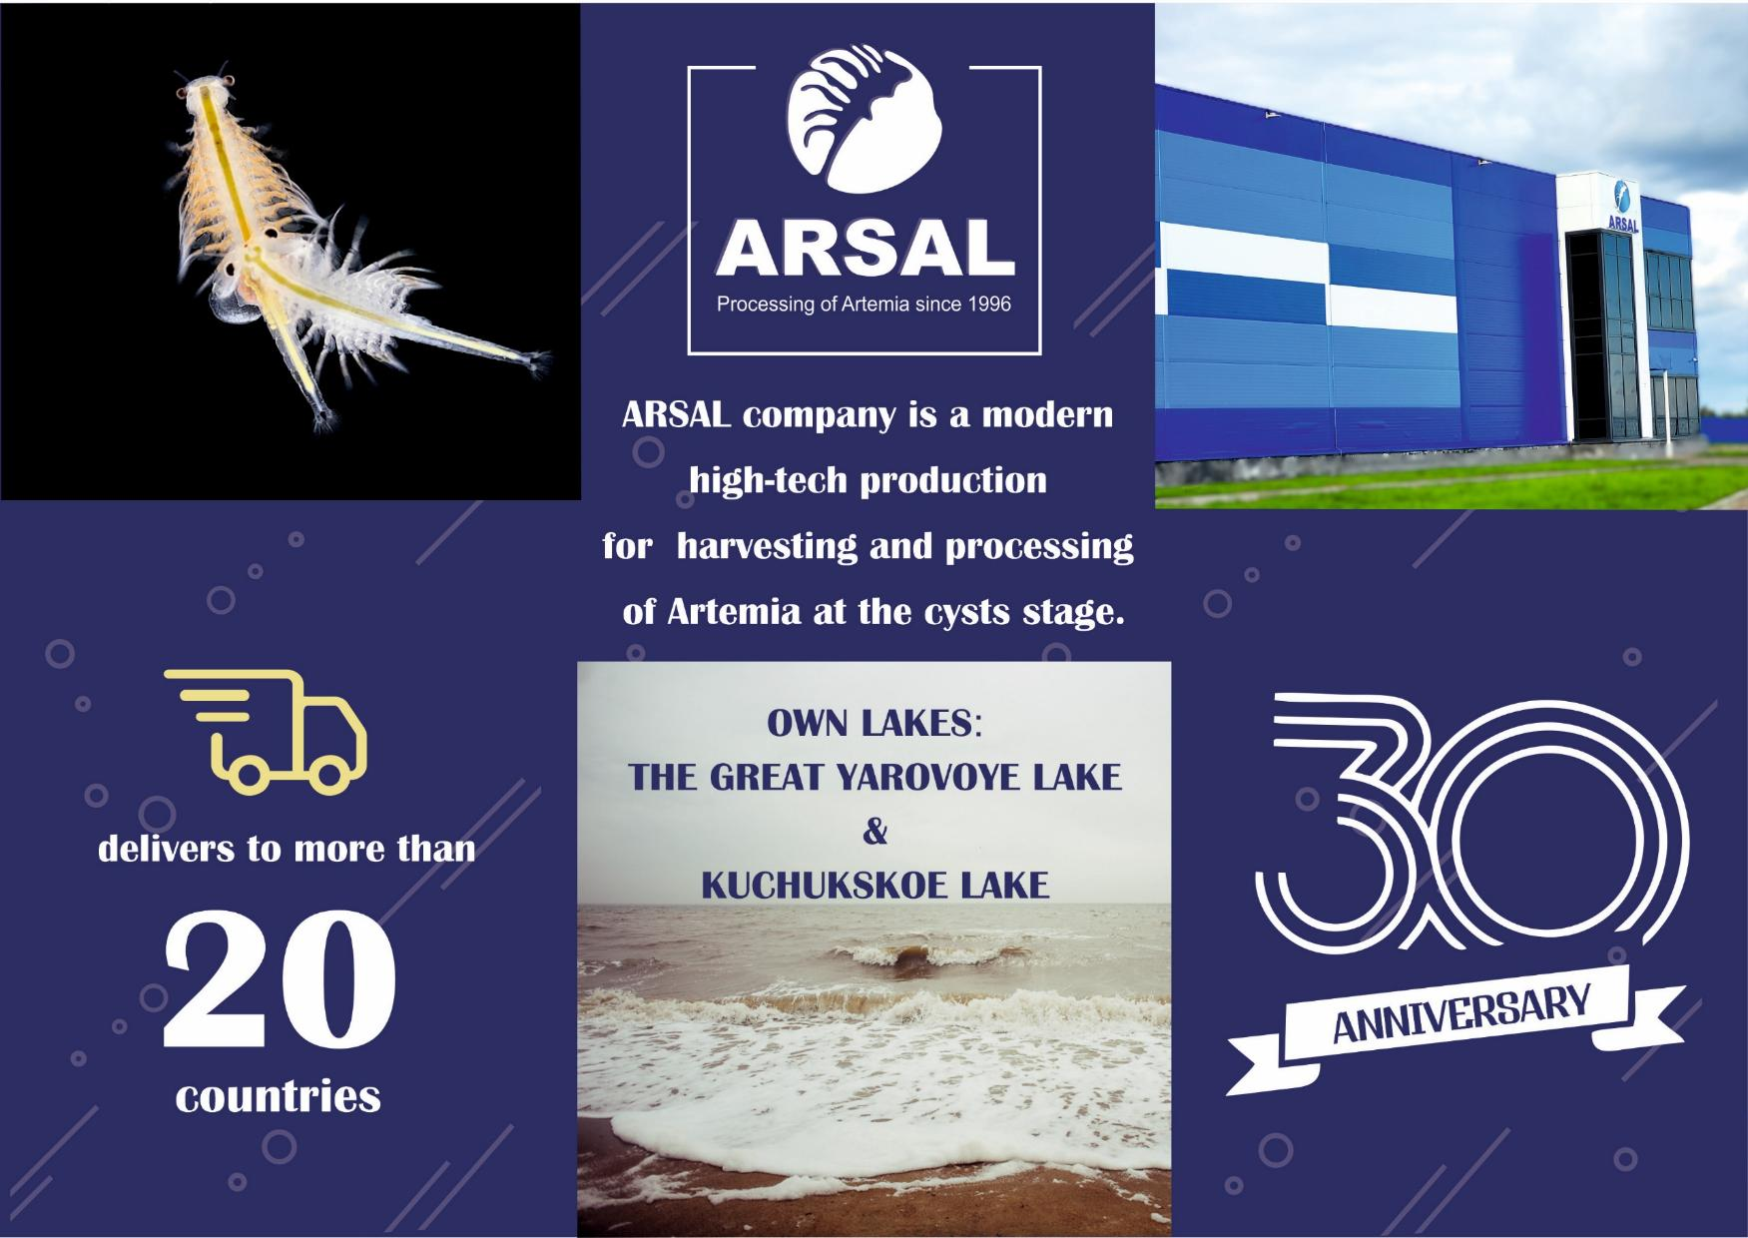






delivers to more than
20
countries

Slide 3


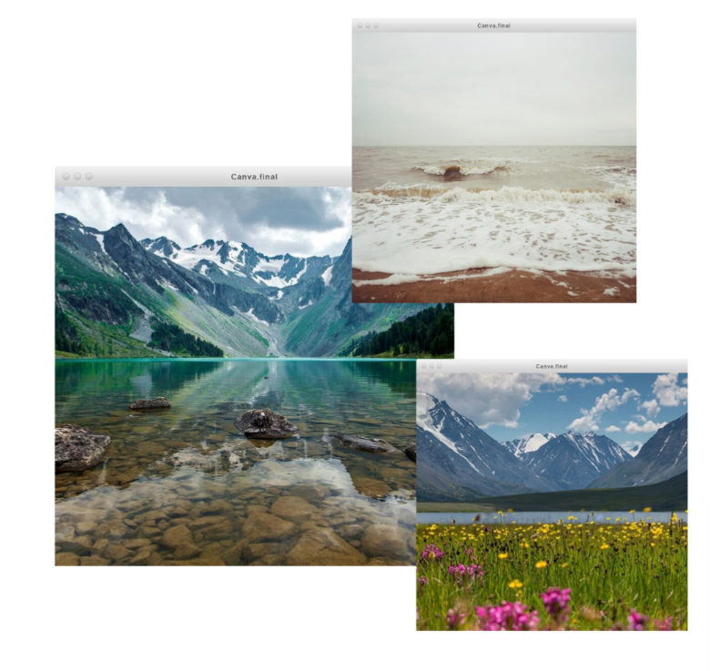

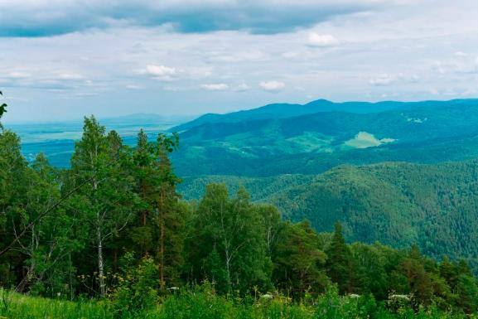


The Altai Territory is a region with a rich historical
and cultural heritage and rates among the top regions in Siberia in terms of the number of cultural landmarks.
It is one of the sunniest Western Siberian regions and at the same time one of Russia’s largest agricultural regions, which produces
a variety of organic foods.
In recent years, the Altai Territory has transformed into a rapidly developing tourism and recreation region.
The region is visited by around 2 million people each year.
Fresh air, friendly atmosphere, wilderness, natural products, peace and quiet, and the slow pace of rural life are its most attractive features for the Altai Territory.

Slide 4
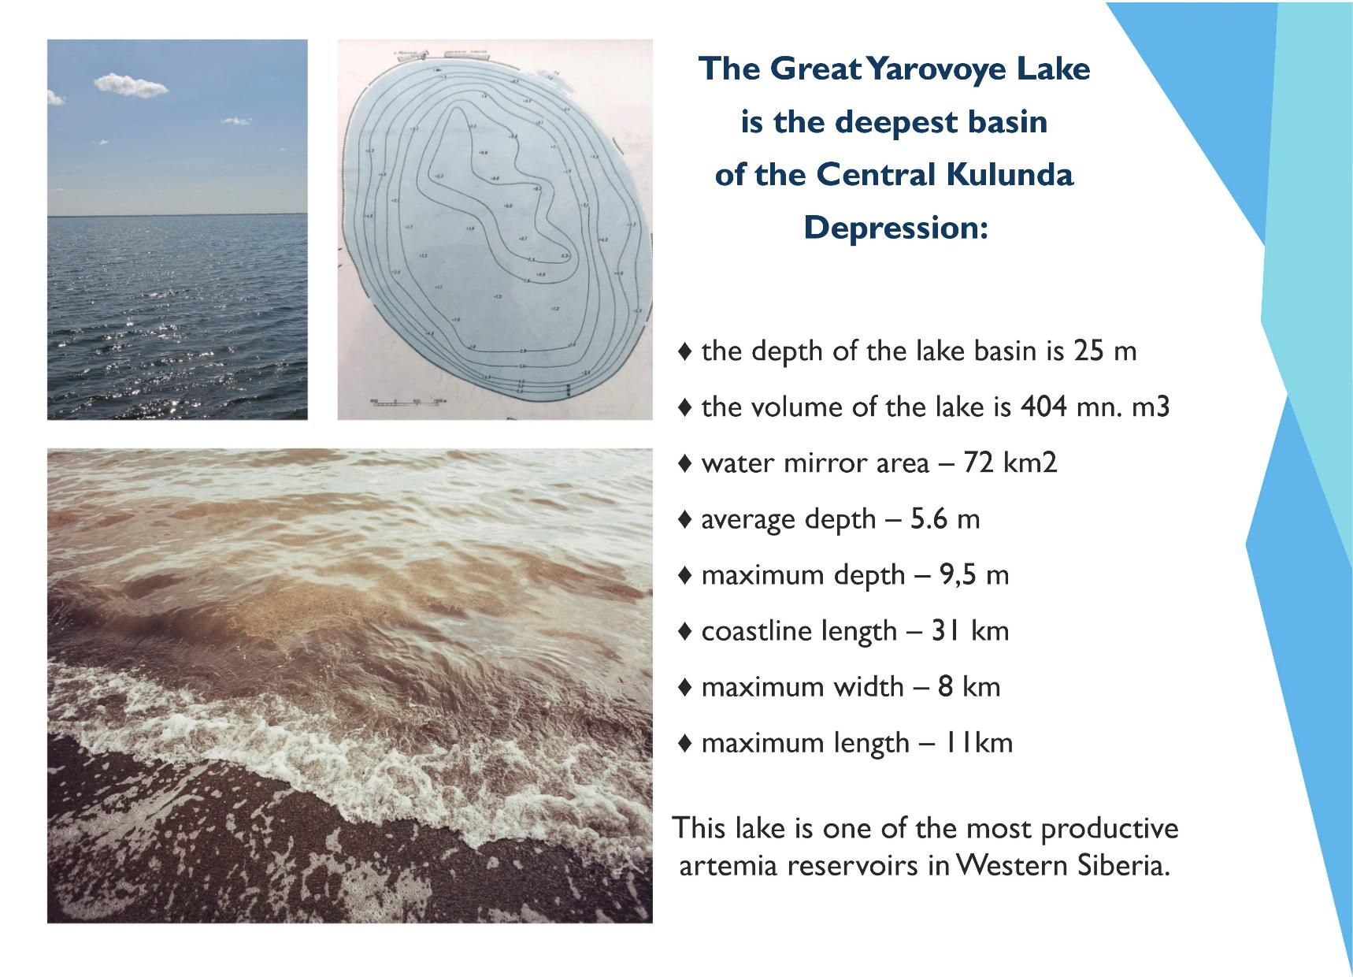

Slide 5
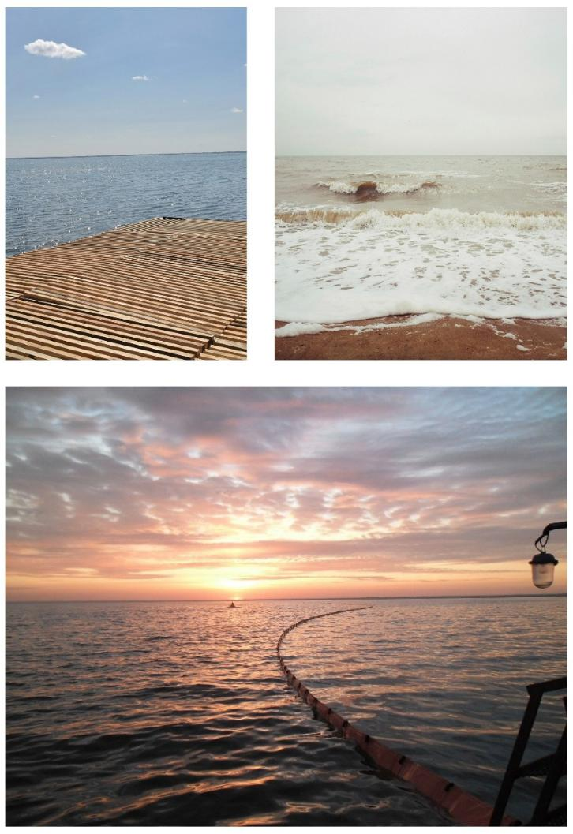
TEMPERATURE AND SALINITY
The area of the Great Yarovoye lake
is characterized by sharp continental climate: long, harsh winters, hot, dry summers and short transition seasons with
unstable weather - spring and autumn.
The average duration of a warm period with a stable above-zero
temperature is 190-200 days, with its onset in mid-April, and ends in the last ten days of October.The duration of the cold period is 165-170 days.
In winter, the lake is covered with thick ice.
The growing season normaly
begins in the last decade of April and lasts mainly until the second decade of October.
Usually, by the middle of the second decade of June, an equalization of the temperature regime
of the reservoir of 0.5-4 meter layers is noted.
The temperature of the 8 m layer does not always reach 10-15 degrees.

Slide 6
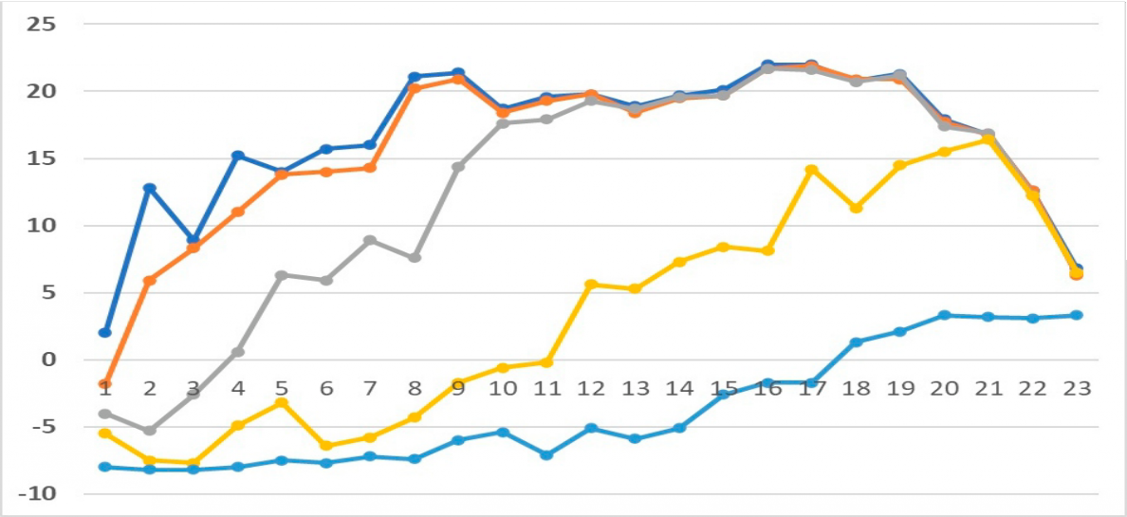
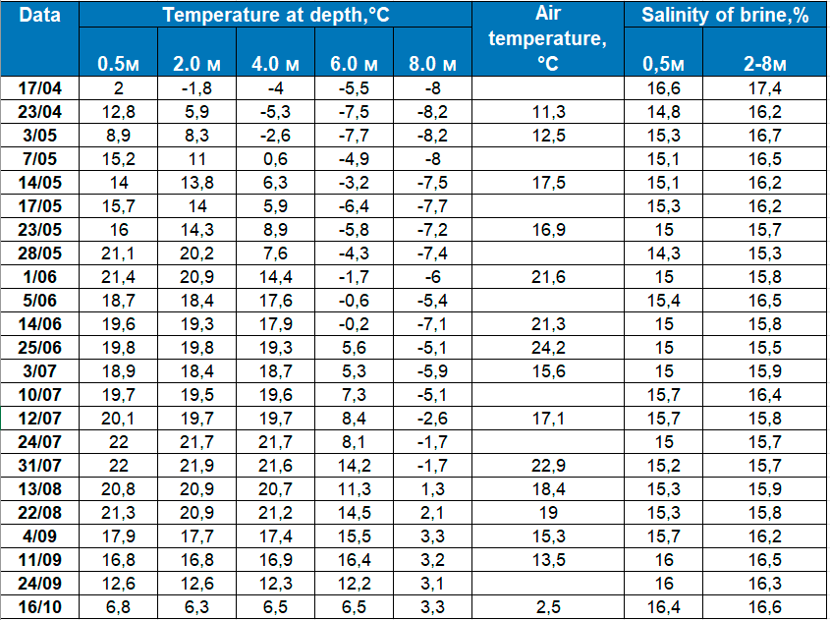
Temperature dynamics
at depth,°C 2001

Slide 7
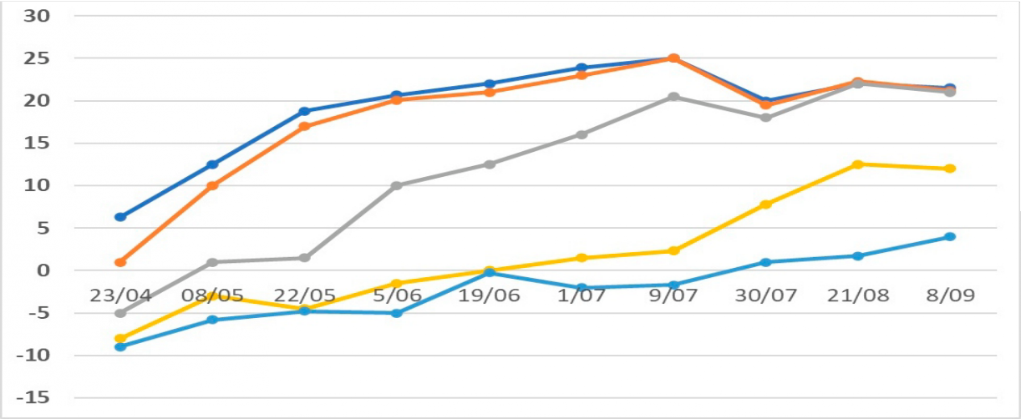
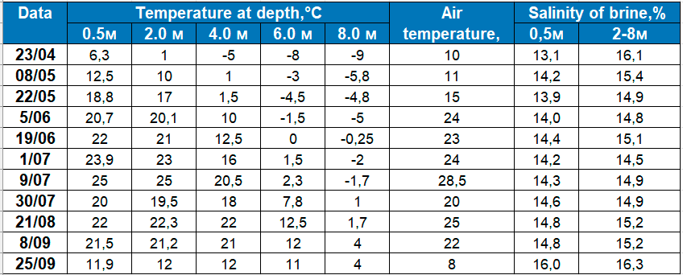
Temperature dynamics at depth,°C 2003

Slide 8
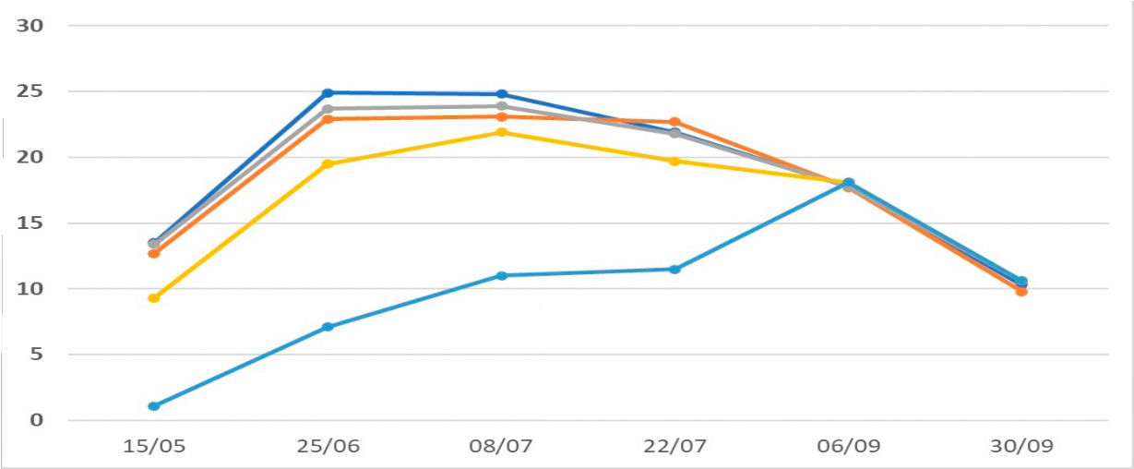
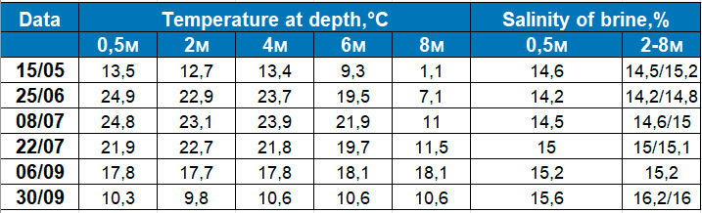
Temperature dynamics at depth,°C 2014

Slide 9
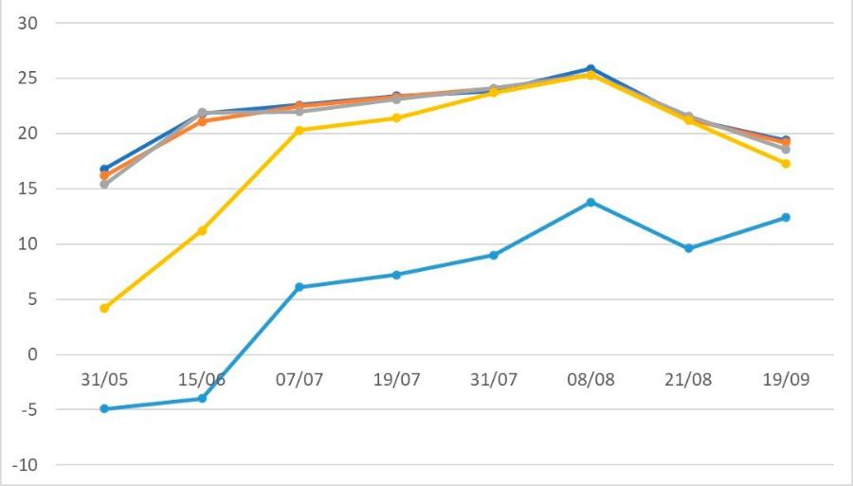
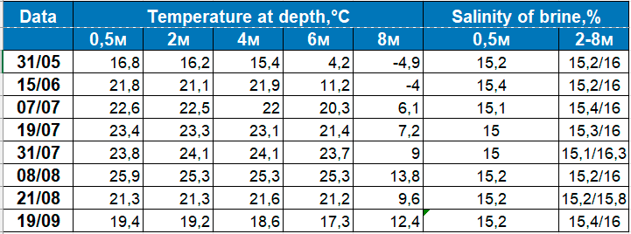
Temperature dynamics at depth,°C 2023

Slide 10

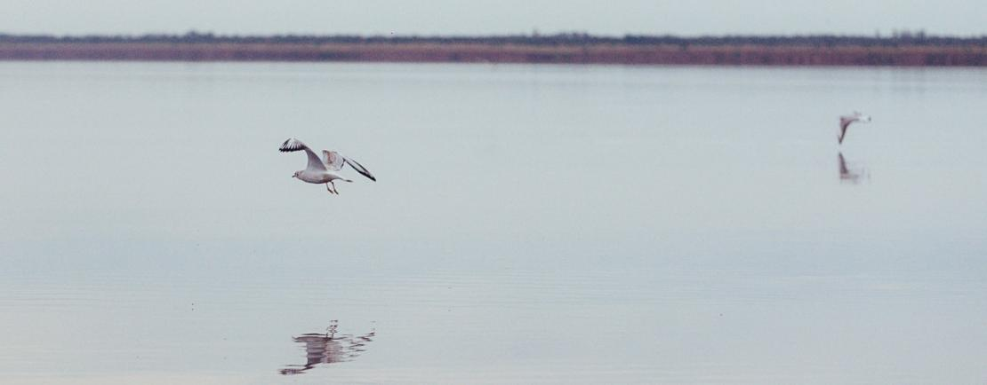
Based on the predominant anions in brine, lake is classiﬁed as chloride by its nature.
General natural mineralization of the Great Yarovoye lake ﬂuctuates between 150-165 g/l.
Salt composition of the Great Yarovoye Lake, g/l

Slide 11
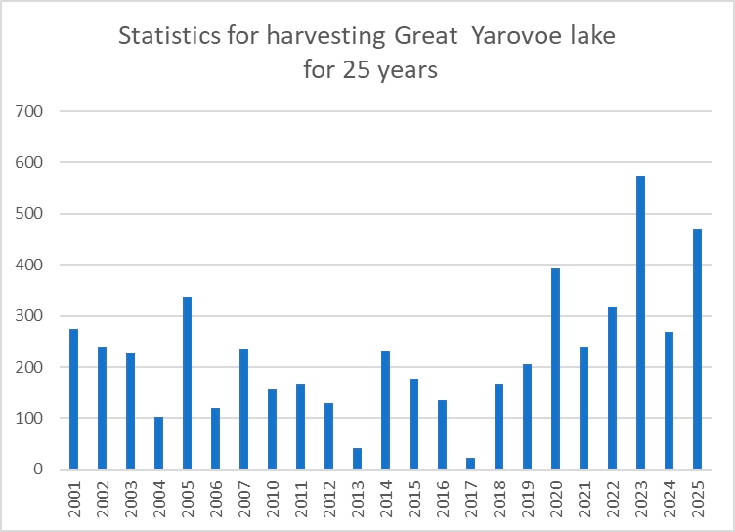
This reservoir is one of the most productive in Russia.
Statistics on harvesting are provided.

Slide 12
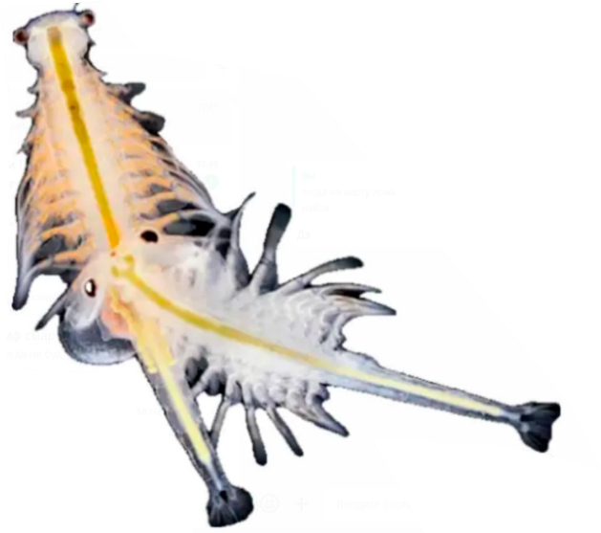
Artemia from the Great Yarovoye lake is a parthenogenetic species.
Over 25 years of monitoring studies of the lake, it has been noted
that during a season, the development of 2 generations is mainly observed, less often 3-4 generations.
All organisms, including aquatic organisms, interact with their environment and are exposed to a range of environmental factors.
For the crustacean Artemia, the most important factors are:
typically light (photoperiod)
temperature
oxygen
salinity
pressure
anthropogenic impacts
Among biotic factors, these include:
trophic conditions,
population density,
parasitic infestation and others.
In natural conditions, it is the complex of interrelated environmental factors that inﬂuences aquatic organisms.

Slide 13
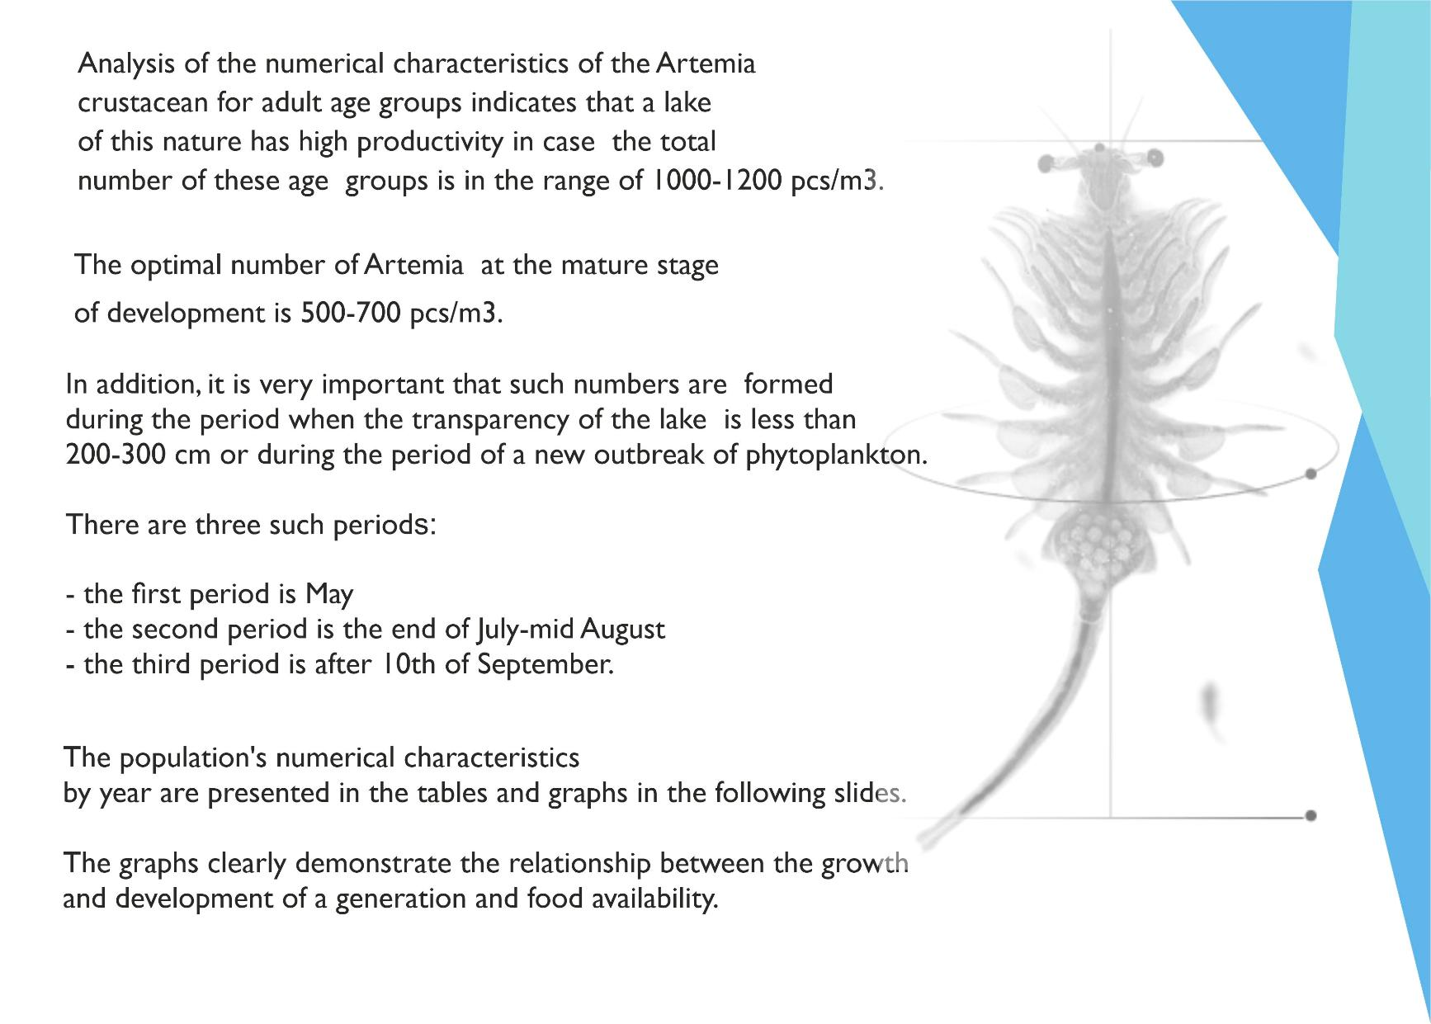

Slide 14
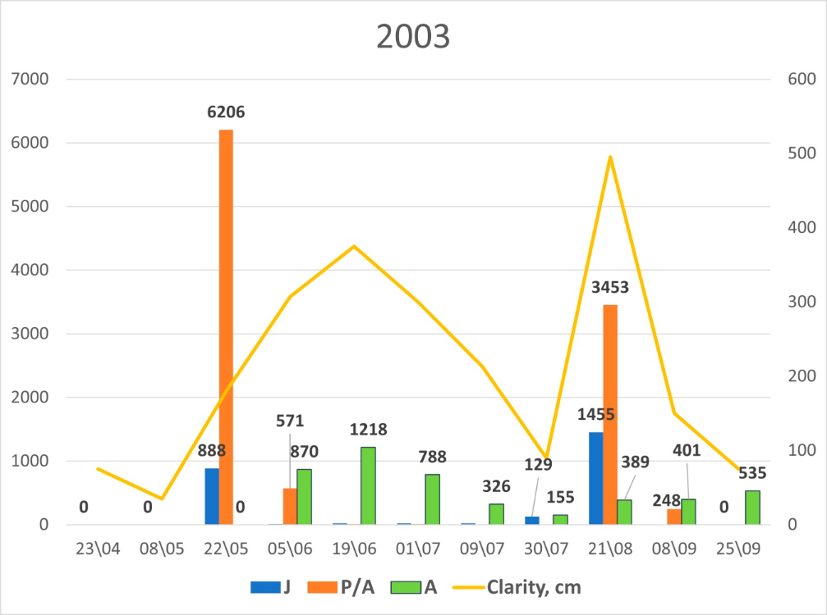
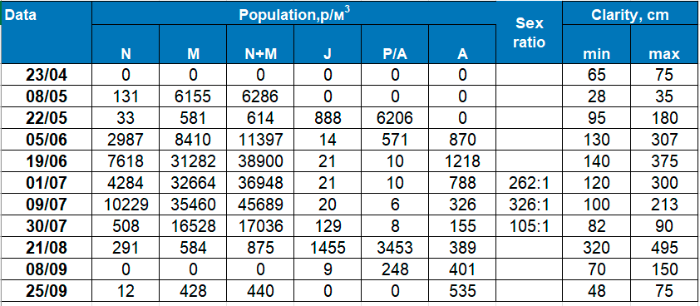
Numerical characteristics of the Artemia population 2003

Slide 15
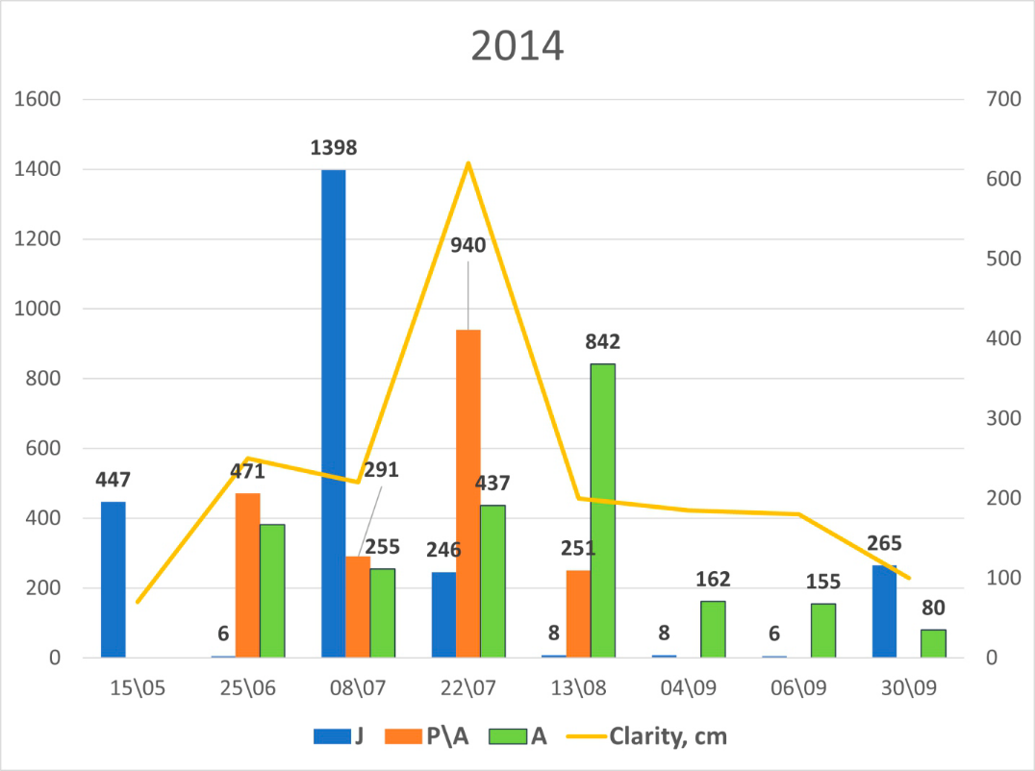
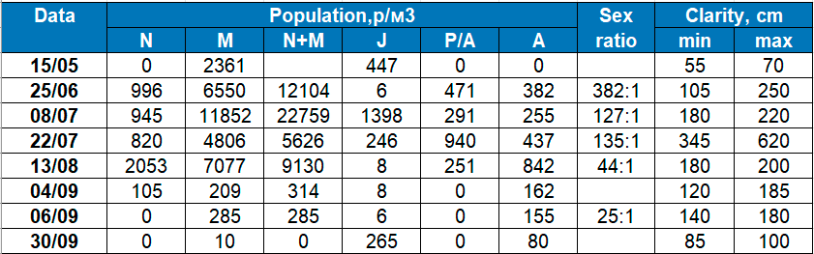
Numerical characteristics of the Artemia population 2014

Slide 16
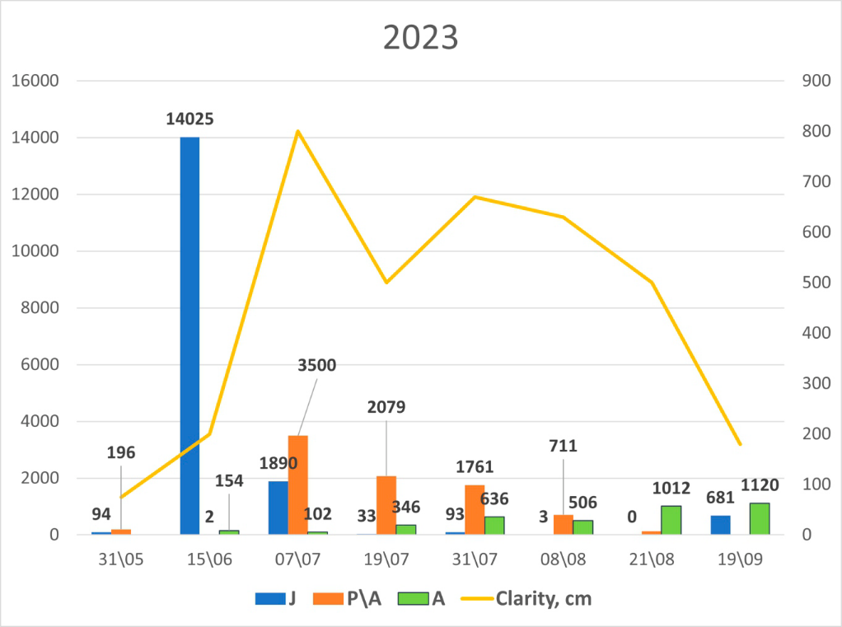
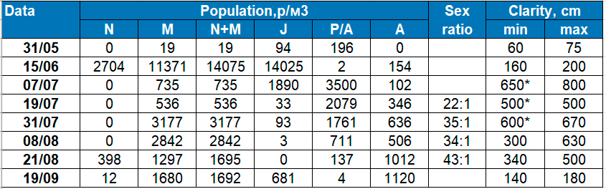
Numerical characteristics of the Artemia population 2023

Slide 17
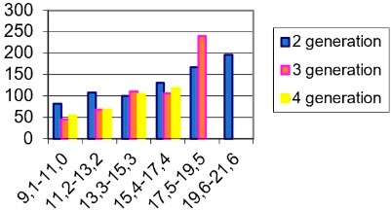
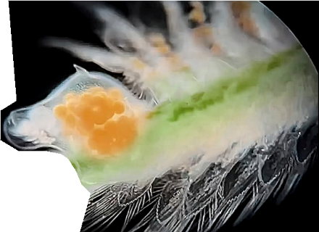
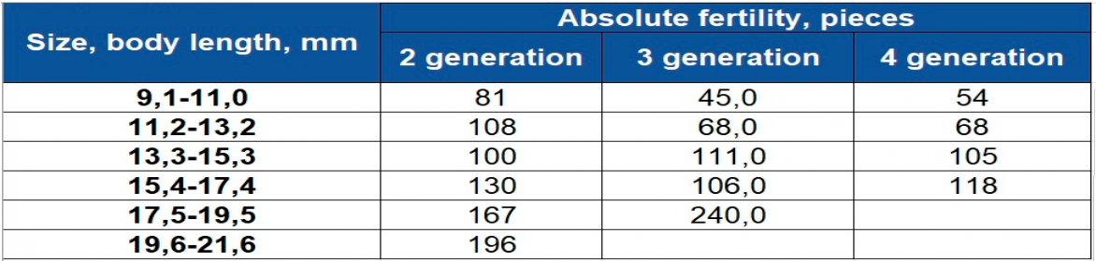
Considering the form of reproduction, it should be noted that over the entire observation period, the highest % of live births was observed in the ﬁrst generation of the crustacean and did not exceed 20-25%.
With a balanced abundance of crustaceans and food supply, the average egg sac in the Great Yarovoye Lake population typically contains 120-150 cysts.
The maximum number of cysts in an egg sac was recorded at one time, reaching up to 270.
When the water transparency reaches 5-6 meters, the egg sac generally does not form, and only a few females may contain approximately 20-30 cysts in their egg sac. It should also be noted that the more cysts in the egg sac,
the smaller the cyst diameter, and the higher the CPG value.
For Great Yarovoye Lake the highest CPG value is 240-245 thousand cysts/m³.

Slide 18
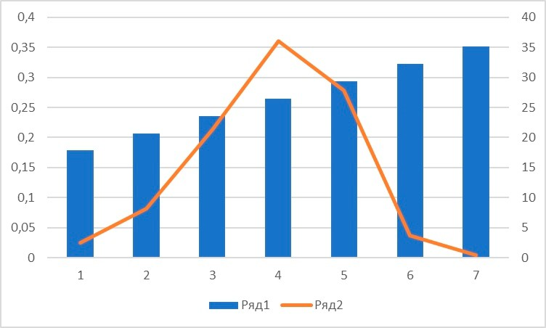
A clear correlation is observed between the number of cysts in the egg sac and the diameter of the cysts.
Analysis of the size of cysts in the egg sac
Diameter Share (%)

Slide 19
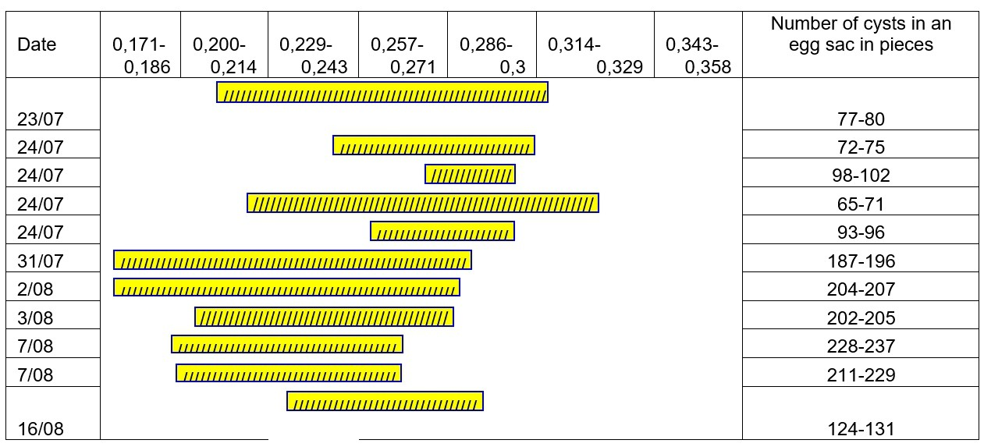
Analysis of the size of cysts in the egg sac

Slide 20
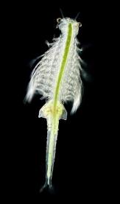
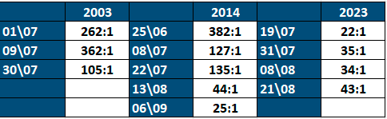
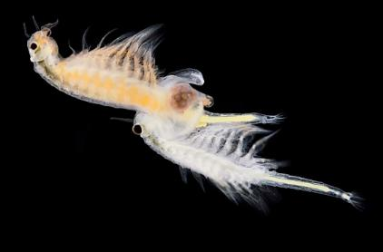
The feed and species composition greatly inﬂuence the generation characteristics
Some phytoplankton may be consumed by crustaceans proportionally to their concentration in the environment; some prey items may be present in the diet in greater quantities than
in the environment, while others may be less abundant.
This means that the consumption of certain prey items will be prioritized over others, which will undoubtedly impact the amount and availability of food.
With a good food supply (especially the presence of phytoplankton), the population of Great Yarovoye Lake is characterized by an F:M ratio of 1000:1 - 400:1
With a decrease in the quantitative indicator of phytoplankton, or the appearance of a
different class of phytoplankton (not beneﬁcial for Artemia), the appearance of males is observed, and the F:M ratio can reach values of 100:1 - 25:1.
F:M ratio of Artemia population

Slide 21
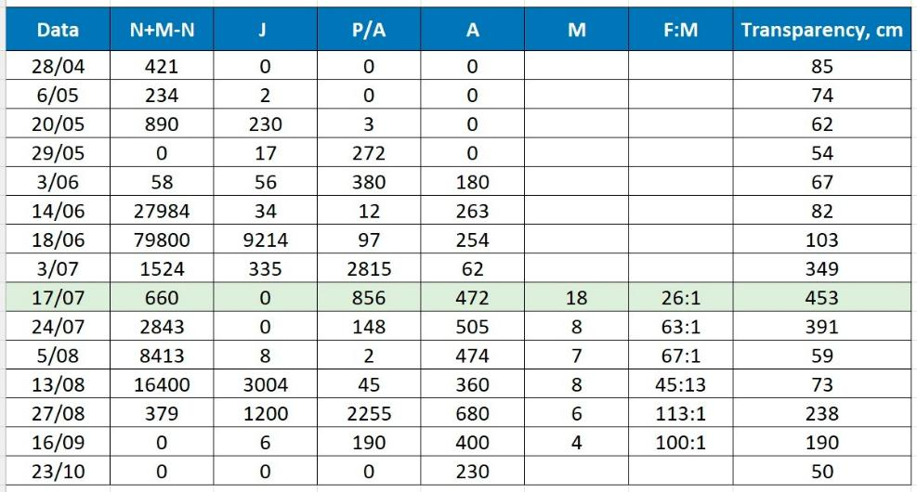
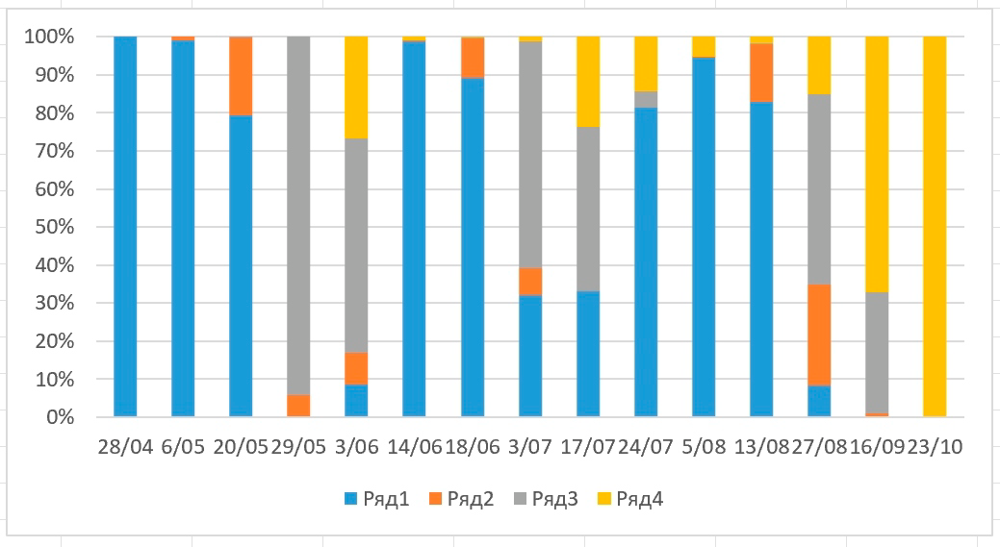
The feed and species composition greatly inﬂuence the generation characteristics
N+M-N J P/A A

Slide 22
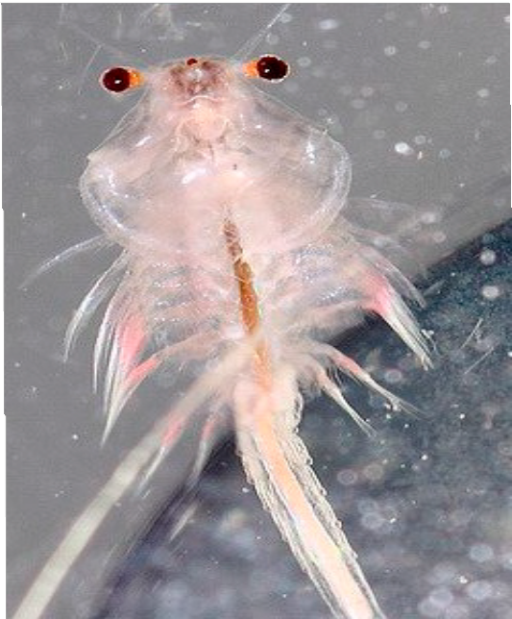
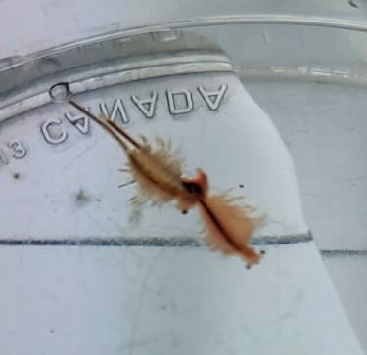
Whitish coloration of the crustacean
Observing males over 25 years of research, it was noted that they did not have
seed material, and only twice in 2014 and 2023 were detected males with seed material.
It is known that a decline in a particular phytoplankton species,
resulting from its grazing, can lead to the development of harmful species, including cyanobacteria.
Furthermore, with an excess of nutrients, phytoplankton can become uncontrollable,
which can lead to harmful algal blooms.These blooms can produce extremely toxic compounds that have harmful effects.
Evidence of this was observed during this period, including a whitish coloration of the crustacean.
We have encountered this situation twice in 25 years.
During this period, an unusual degree of esophageal ﬁlling and insufﬁcient digestion were observed. In addition, a whitish coloration of the crustacean was noted,
which is usually observed with high oxygen content.
In September 2014, almost the entire generation died.
With a drop in temperature and the establishment of a rainy period in the middle of August 2023,
the situation on the lake changed.The mass death of the crustacean stopped; the survival rate of the crustacean during this period was about 50%.
The second generation with a population of 1000-1200 pcs/m3 produced more than 1000 tons
during mid- August till the end of October.The volume of egg laying alone was estimated at approximately 280-310 tons.
It is important to note that the appearance of males in fairly large numbers in
the parthenogenetic population was noted in the experiments of the Russian scientis
V.P. Anikin in 1896 while studying the crustacean Artemia from the Mormyshan Lakes of the Altai Region.
According to the author, the species composition or the presence of a separate class of algae that are toxic to the crustacean are factors that complicate the life of the crustacean.
That’s why, we can conclude that the organism of Artemia crustaceans resorts to this last way in order to increase the chances of preserving its offspring.

Slide 23
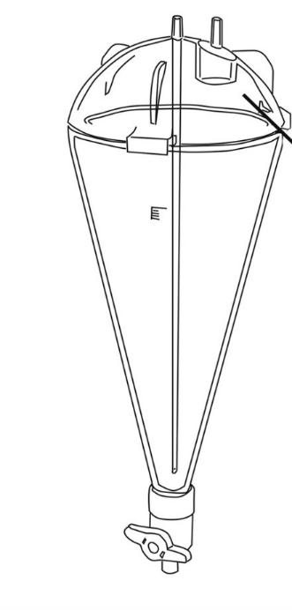

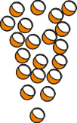

Presence of light cysts
In the process of collecting cysts from a number of lakes in the Altai Region and Kazakhstan
in some years, the presence of light cysts was established.
light cysts
Usually a cyst has an almost spherical shape, but upon decapsulation it is clear that
the embryo has a rather concave surface. Between the embryo and the chorion there is a space which in fresh water, ensures the buoyancy of the cyst.
It is difﬁcult to name the reason for the appearance of such cysts.
It has been noted that the appearance of such cysts is associated with a change in the characteristics
of the lake, and as in 2023 on the Great Yarovoye Lake
- the appearance of uncharacteristic algae (blue-green) and the appearance of a large number of males with seed material.
Fresh water
There is also a low survival rate for the crustacean Artemia in adult age groups. In the harvested products of the end of August and the ﬁrst ten days of September, the presence of light cysts ranged from 10 to 30%.

Slide 24
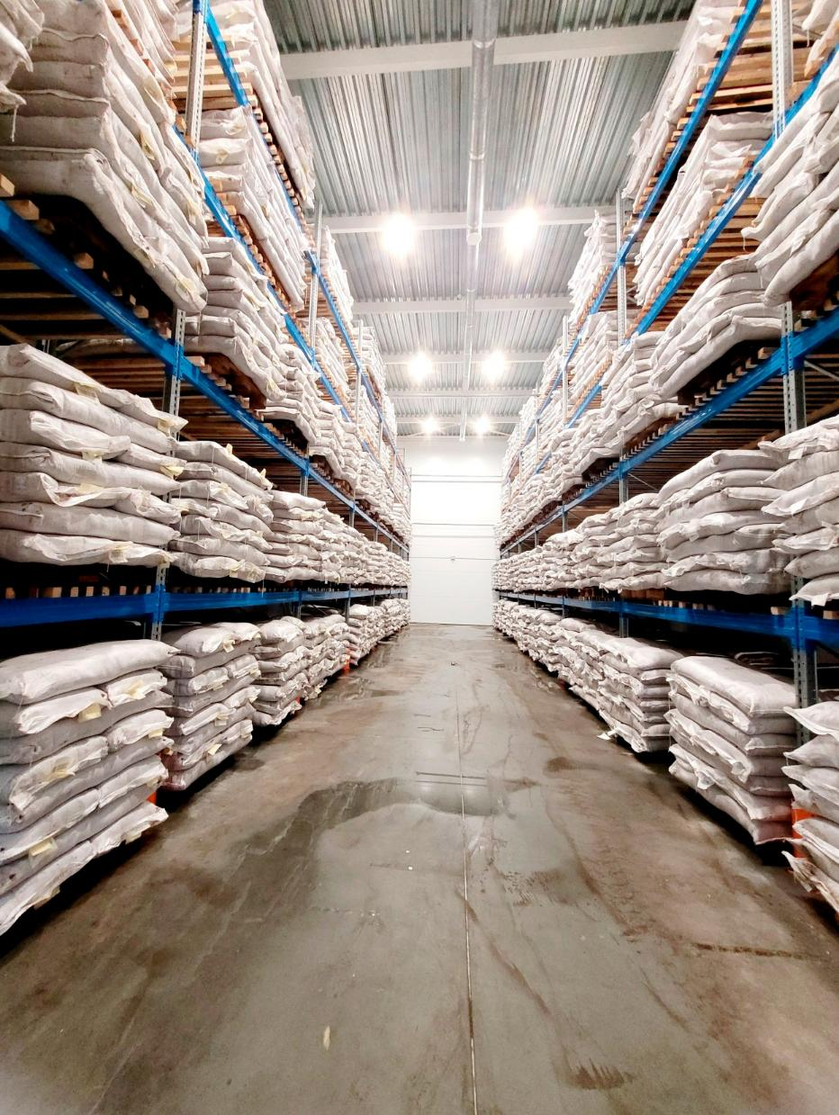
Over the years, the average annual supply of cysts which was not always related to the number of generations in the lake was estimated from 300 to 600 tons.
The main feature of the productivity of a generation is the balance between the number and the food supply.
It should also be noted that in the season when there is a critical situation
with the food supply in the reservoir and the crustacean is under stress,
a shorter period of diapause is observed, and, as a rule, cysts have
a high percentage of hatching.

Slide 25
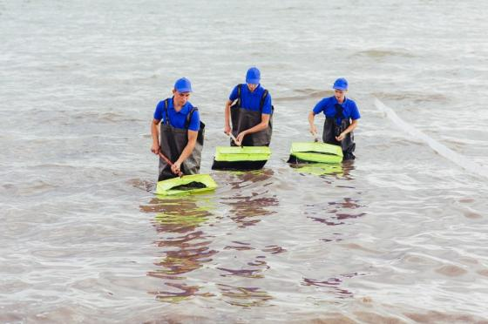
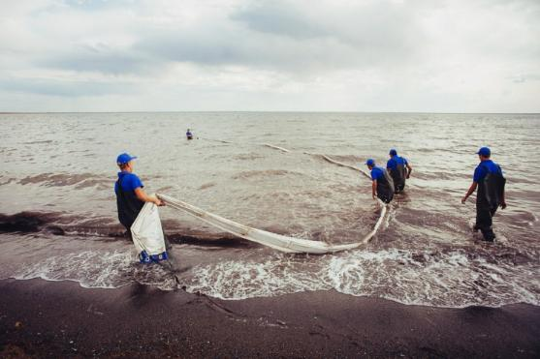
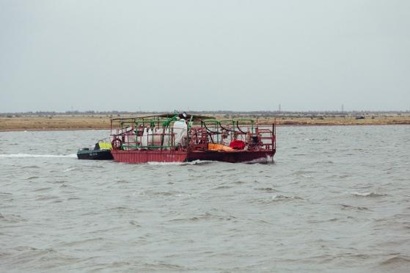
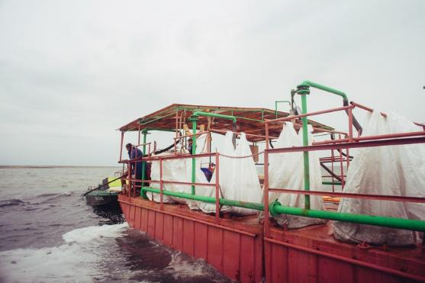
Harvesting methods
Collection of cysts on the lake is carried out in 2 ways:
collection of brine from the surface in the coastal zone
collection from any point of the lake using mechanical harvesting facilities.
The main volume of the harvest is produced from August to October.
There are two main factors that equally inﬂuence the harvest volume: the supply of cysts
in the lake and weather conditions.

Slide 26
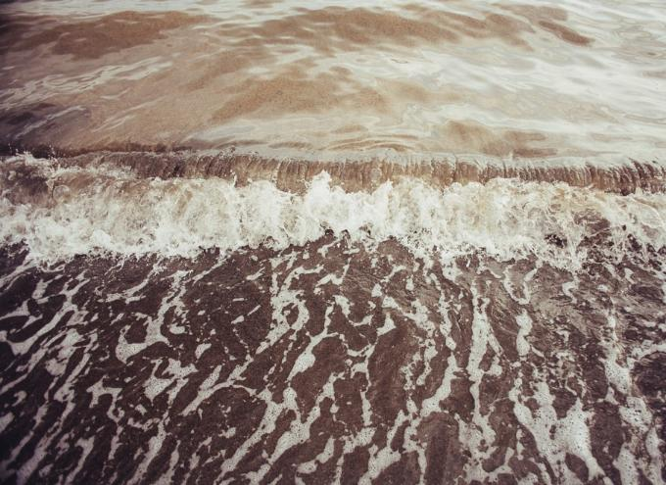
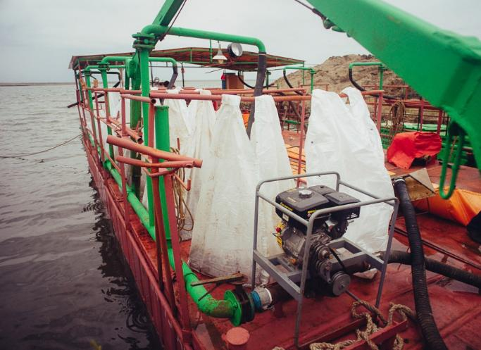
Main weather factors:
lack of precipitation,
steady wind of one direction at a speed of 2-3 m/s,
signiﬁcant changes in atmospheric pressure.
All of the above conditions, as well as the period of active discharge of cysts
(reproduction period), affects the artemia cyst supply formation.
For example, in September 2023, cysts were collected from two accumulations with a volume of 141 tons and 192 tons.
In some years, the volume of cysts in clusters reached 250-300 tons.
As a rule, cysts harvested from large formed clusters have high quality indicators.

Slide 27
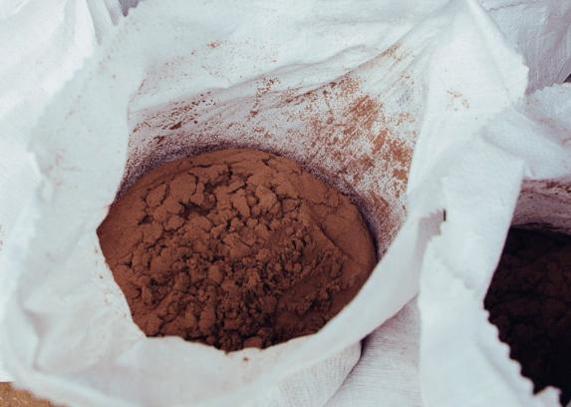
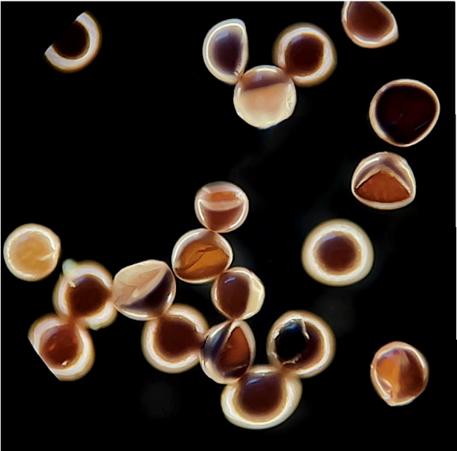
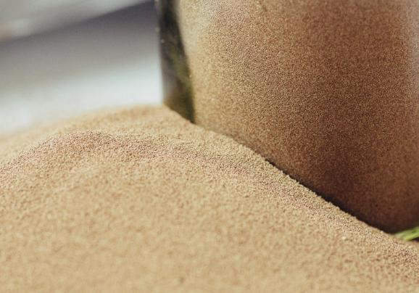
Speciﬁcity of Siberian Cysts
Siberian cysts, including cysts from the Great Yarovoye lake, have a certain speciﬁcity: with a low basic % of hatching, they have a high % of hatching when using activators of various classes that perform catalytic functions
in the process of biochemical oxidation.
Analyzing the data of diapause and the conditions of existence of the generation, it should be noted that cysts produced during the period of 1-2 generations
and formed in June-July have a shorter diapause and a higher percentage of hatching.
This observation is possibly associated with different nutritional properties of the phytoplankton formed during this period.
The minimum period for hatching to reach 80-85% can occur
on average after 3-4 months, but in some years it can take up to 12 months or more.
As for the fundamentals of procurement and production, the company strives to consider all factors,conditions and timing of procurement.
In this regard, there is a clear system of accounting and formation of batches according to timing, volume and location of procurement.
This allows for a fairly high-quality assessment of the progress of diapause in batches.
The main factor that makes it possible to decide to end diapause and begin processing is when the cysts reach the maximum reserve of the hatching rate at two minimum concentrations of the activator and remain at the same level for 10-20 days.

Slide 28
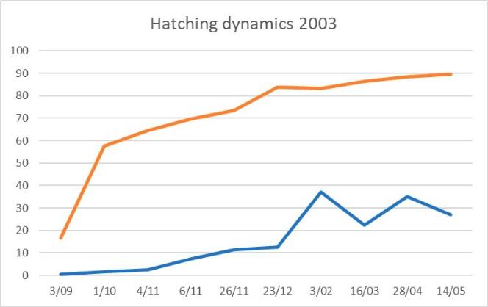
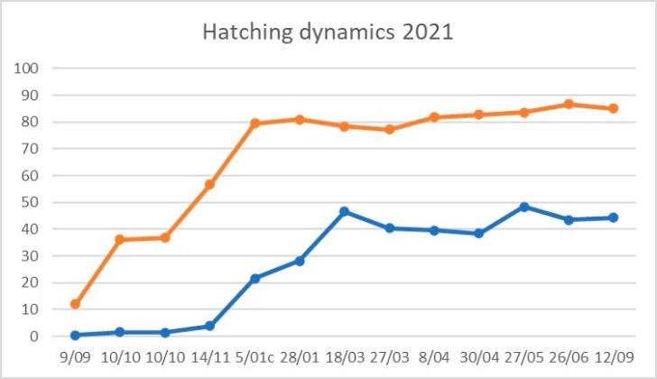

The last 5 years appear to be the most productive
and analysis shows that there are certain trends for this.

Slide 29




Data on the course of diapause are given in tables and graphs

Slide 30

Diagram for H- indicator
100,0
90,0
80,0
70,0
60,0
50,0
40,0
30,0
20,0
10,0
0,0
6 ppm
9 ppm
Series1
Series2 Series3

Slide 31

Quality of dry product obtained from batch N 1
In the case the timing of the end of diapause is set correctly, and the technological parameters
of drying correspond to the required indicators, the quality of the ﬁnished dry product has a consistently high hatching percentage. Some years of processing, more than 80% of the dry product was obtained with a hatching rate of more than 85%.

Slide 32




General characteristics of Artemia cysts:
the maximum % of cysts have
a diameter in the range of 220-230 microns.
the chorion has a dark color if the cysts are produced in July-August (solar period).
the light color of the chorion is usually observed in cysts produced in the autumn.
- the average CPG is 220,000-240,000.
Nauplii incubated from cysts of Great Yarovoye lake have a characteristic bright orange color,
with an average size of 480-500 microns.

Slide 33







Harvesting and processing of Artemia cysts
in the Great Yarovoye lake has been carried out by Arsal LLC since 1996.
Monitoring studies have been carried out in full strength
by the company's laboratory since 2001.
Arsal’s experience, location, speciﬁcs of the lake,
systematization of all material and its analysis allow
our team to have a consistently high quality of products.

Slide 34



It’s amazing how complex this small crustacean is, which scientists around the world have been studying
for more than 130 years, and how much remains unclear!
Perhaps, with the help of artiﬁcial intelligence, which allows us to identify and adapt information, we will be able
to recognize those features and patterns that are difﬁcult to explain today.
But we are convinced, according to the Russian proverb: “A journey of thousands miles begins with a single step”.

Slide 35


