Slide 1
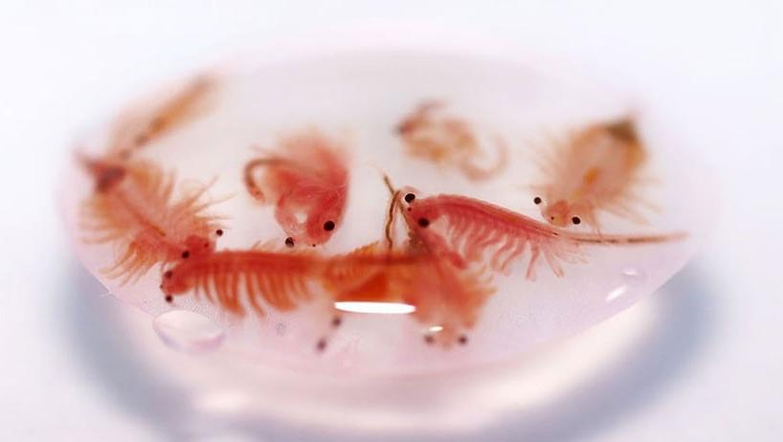


The Role of Artemia in Aquaculture
Patrick Sorgeloos
Emeritus Professor
Laboratory of Aquaculture & Artemia Reference Center
Ghent University, Belgium

Slide 2

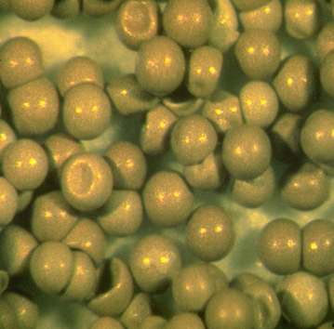
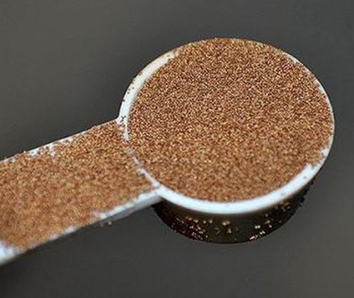
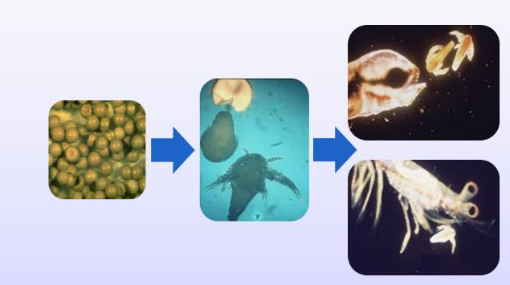
What is Artemia used for?
Dormant embryos that hatch into live feed (nauplii) in 15–48 hrs.
Long shelf life, easy transport, high in protein and lipids.
Market price: USD 30–200+ per kg, depending on quality.
Farmed cysts offer better control and nutrient enrichment.
Artemia
Cysts
0.5 mm
1 cm

Slide 3
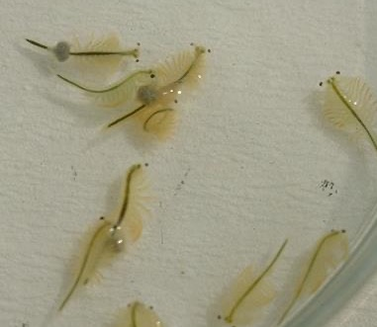
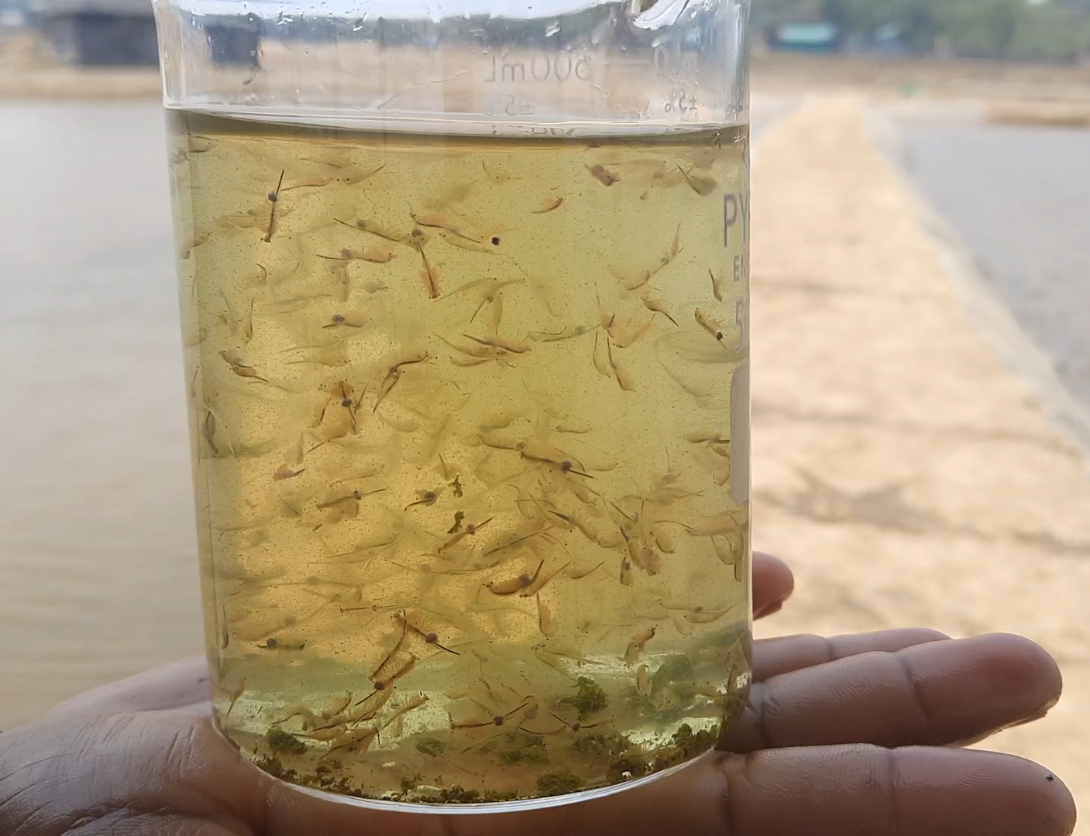
What is Artemia used for?
Dormant embryos that hatch into live feed (nauplii) in 15–48 hrs.
Long shelf life, easy transport, high in protein and lipids.
Market price: USD 30–200+ per kg, depending on quality.
Farmed cysts offer better control and nutrient enrichment.
Artemia
Cysts
0.5 mm
Artemia
Biomass
Live or processed Artemia used as feed for shrimp, fish, poultry, and livestock.
High in protein, digestible, and suitable as a fishmeal alternative.
Sold fresh, frozen, or dried; enables year-round production.
1 cm

Slide 4

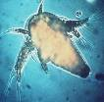
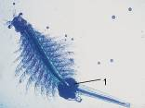

Life cycle of Artemia
OVOVIVIPAROUS REPRODUCTION
(under optimal conditions)
100-200 nauplii every 4-5 days during several months
adults
dry
cysts
±14 days
24h
nauplii
500 times weight increase
0.4mm
10mm
OVIPAROUS REPRODUCTION
(under sub-optimal conditions)
100-200 cysts every 4-5 days
Notes:
<culture-aspects, life-stage, life-cycle>

Slide 5
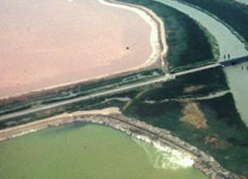
Ecological Characteristics
Common feature of Artemia biotopes : high salinity (density determined by food availability, temperature, salinity, strain….)
Physiological adaptations to high salinity :
  efficient osmoregulatory system
  efficient respiratory pigments (haemoglobins)
  ability to produce diapausing cysts
Lower salinity limit of Artemia habitats is determined by upper salinity tolerance of its local predators
Lonic composition : thalassohaline – athalassohaline (carbonate, sulphate, potassium salts…)
Non-selective filter feeder : organic detritus, bacteria, unicellular algae….
Notes:
<slide-content, just-text>

Slide 6
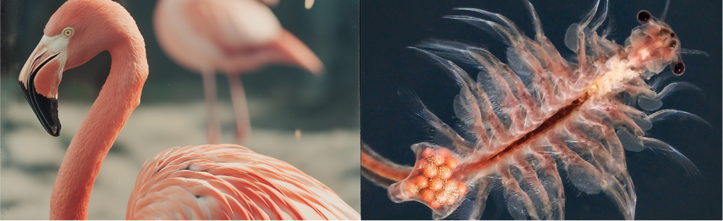
Dispersion
birds
wind
man (deliberate – undeliberate)
Notes:
<organisms, non-aquatic-organism, life-sciences, ecology, zoogeography, natural-distribution>

Slide 7
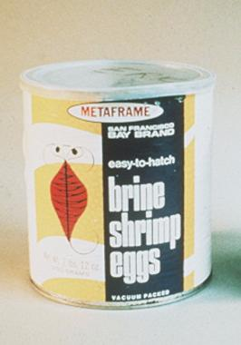
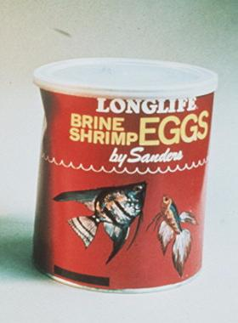
First commercial sources of Artemia cysts in the 1960s
main market = aquarium hobbyists <100 kg per year
San Francisco Bay, California
Great Salt Lake, Utah

Slide 8
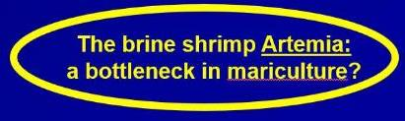
1976
1st UN-FAO Technical Aquaculture Conference – Kyoto, Japan

Slide 9
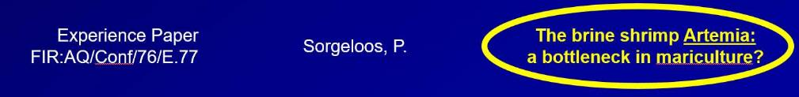
1st FAO Technical Aquaculture Conference – Kyoto, Japan 1976
Potential
improvements for Critical Artemia Situation
exploitation of more natural resources
transplantation and inoculation of suitable habitats
improved techniques for cyst
  harvesting
  processing
  storage
  hatching
use of juvenile/adult Artemia biomass as food source
Notes:
<other-aspects, sectors, research, research-nei, slide-content, just-text>

Slide 10
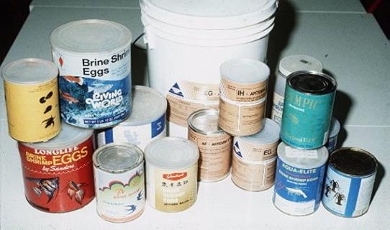
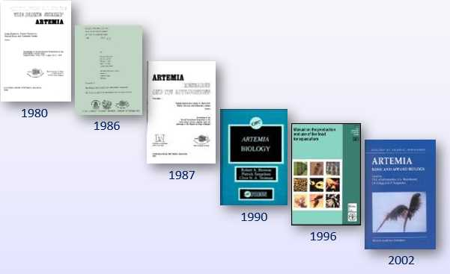
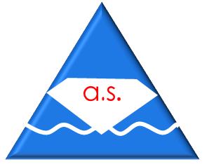
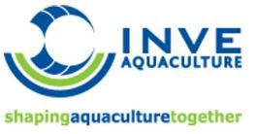


1978
1980s

Slide 11
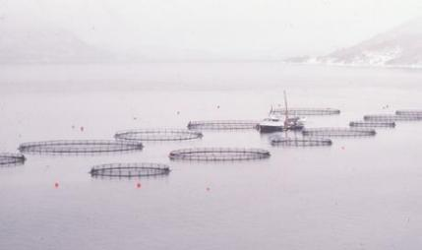
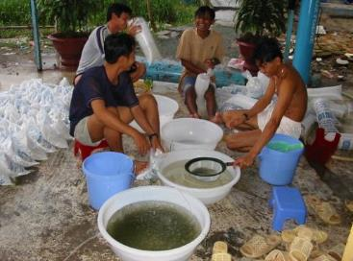
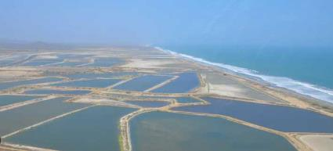
2 separate business units
growout cages/ponds
hatcheries
1990s
survival & growth
immune competence ?
critical role of live food (Artemia)

Slide 12
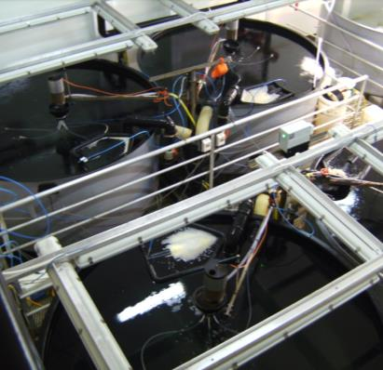
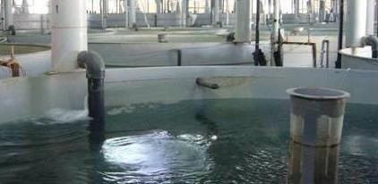

Marine fish & crustacean hatcheries – a multi-billion US$ industry
-> final production of over 10 million tons of high-value aquatic species

Slide 13
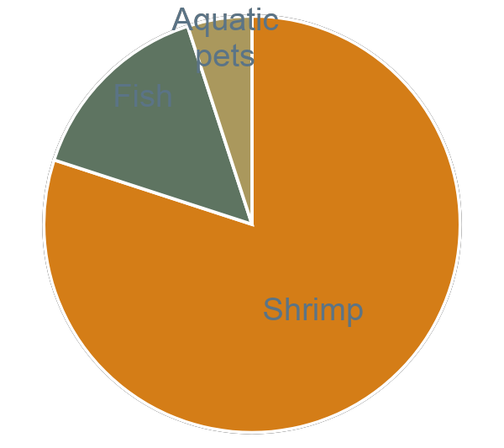
Artemia cyst consumption
Annual consumption of approx 3500 tons of Artemia cysts, value of 200m US $
1970 < 1 ton
1980 < 100 tons
1990 > 1500 tons
2000 > 2000 tons
2010 > 3000 tons

Slide 14
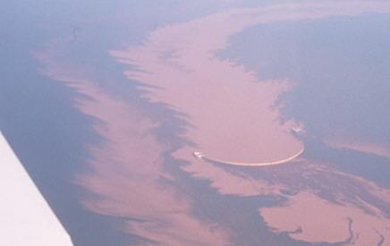
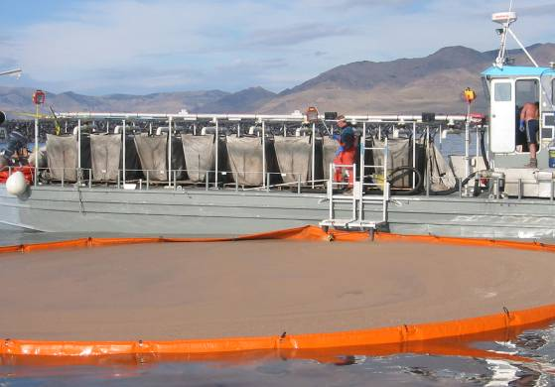

Slide 15
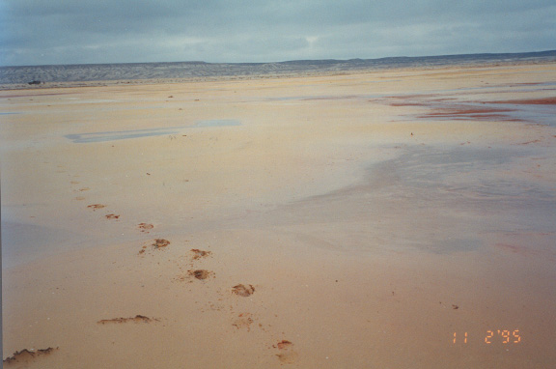
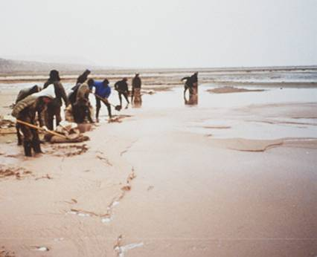
Notes:
We discovered Artemia in sufficient amounts for starting up operations..

Slide 16
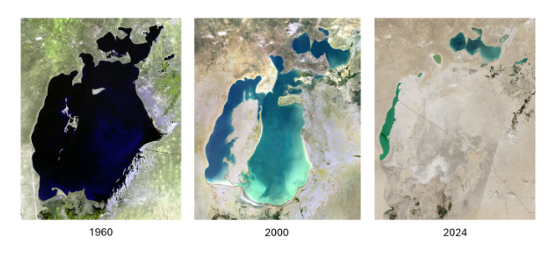
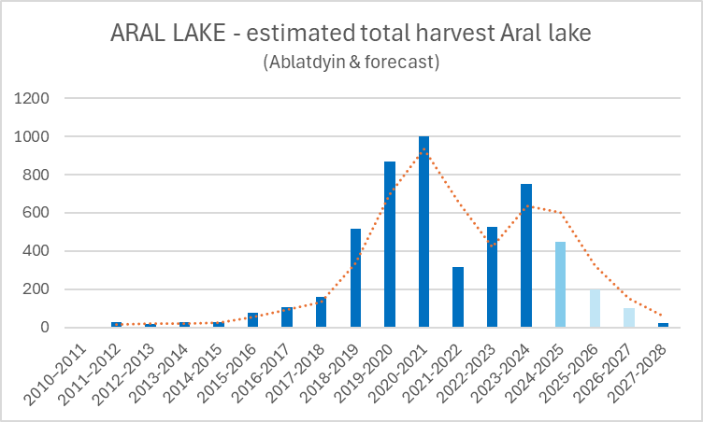
A Climate Change Story: Aral Sea Shrinkage & Impact
Aral Sea Area 68,000 km²
in 1960
6,800 km²
Today
Severe shrinkage in last 60 years due to large-scale water diversion from the Amu Darya and Syr Darya rivers for irrigation.
From 1960, the surface area of about 68,000 km² has shrunk to only 10% of this today covered by water.
Causes of long-term water-level variability include:
Climate change
Tectonic activity
Anthropogenic (human) impacts
In the late 1950s, the Aral Sea produced up to 45,000 tonnes of fish in a year. By 2004, Uzbekistan’s section had lost every species of fish due to high salinity.
In the West Aral, salinity levels were 175 grams per litre of water in 2021 (from 10 g/l in 1960) and are increasing by 4-5 g/l every year.
Fig: Aral sea shrinking, Source: retrospectjournal.com
Tons of raw cysts: Ablatdyin (2025) and forecast by P. Leger (2025)

Slide 17
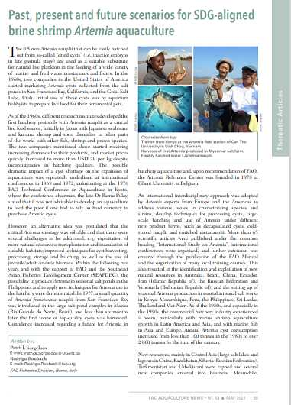


Slide 18
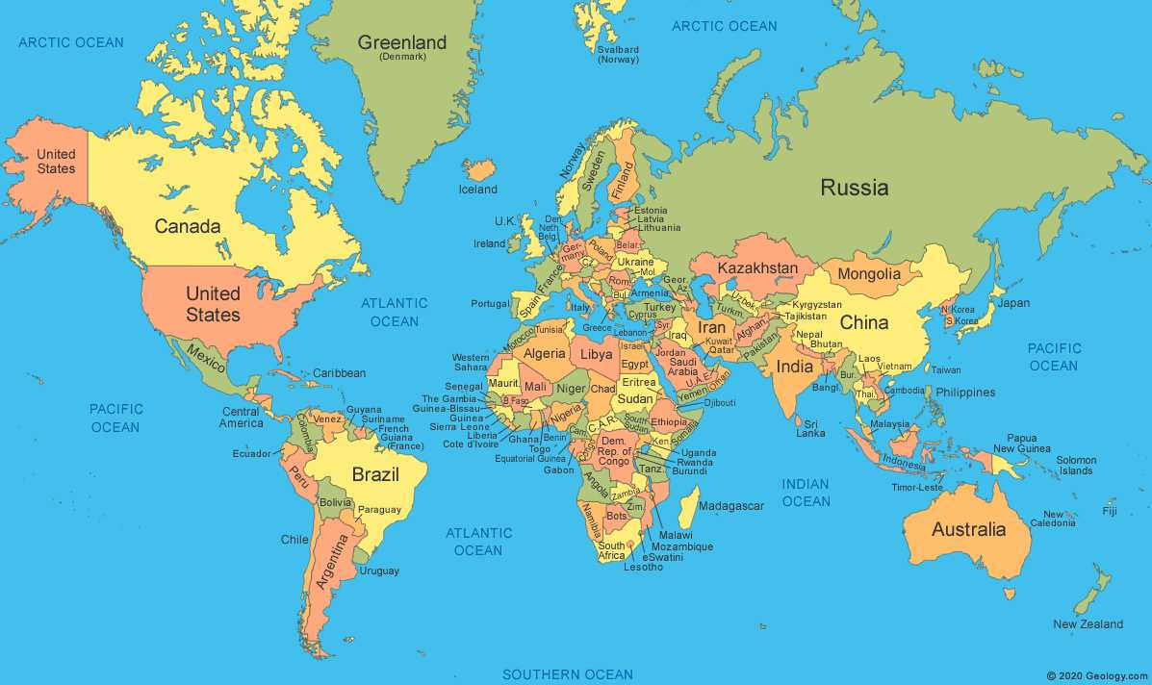
International Artemia Aquaculture Consortium to consolidate and expand sustainable use of Artemia in aquaculture
43 partners
(from public & private sector)
28 countries
Artemia research institute
Artemia production project

Slide 19
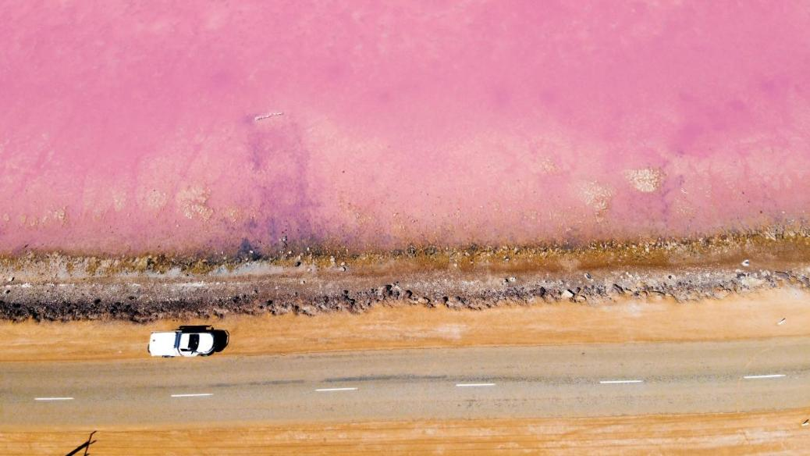

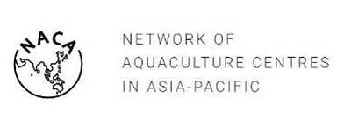
Established in 2022 - Recognized in 2023 by the FAO COFI Subcommittee on Aquaculture and hosted by
International Artemia Aquaculture Consortium
Conservation, management and sustainable utilization of Artemia biodiversity
Notes:
Thank you, I would like to present briefly about the rationale for, and role of, the International Artemia Aquaculture Consortium.

Slide 20
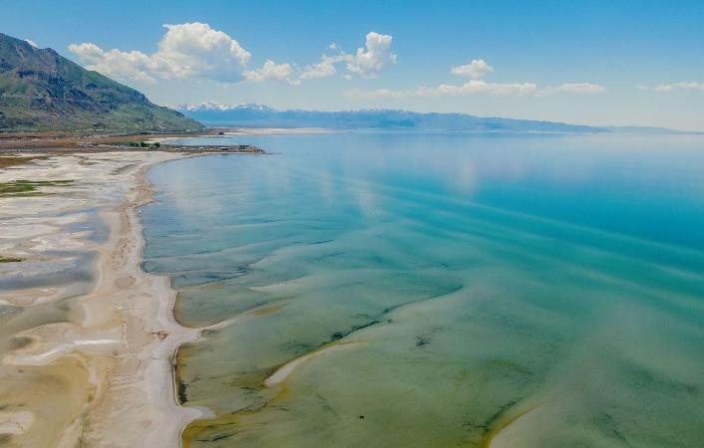
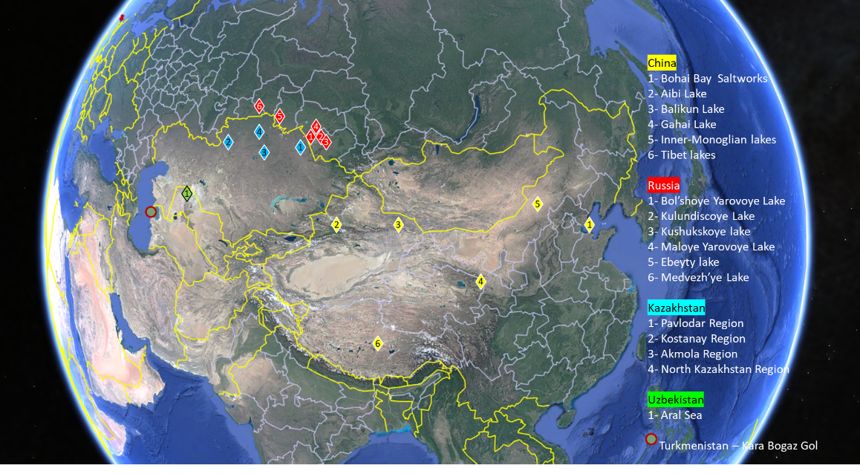
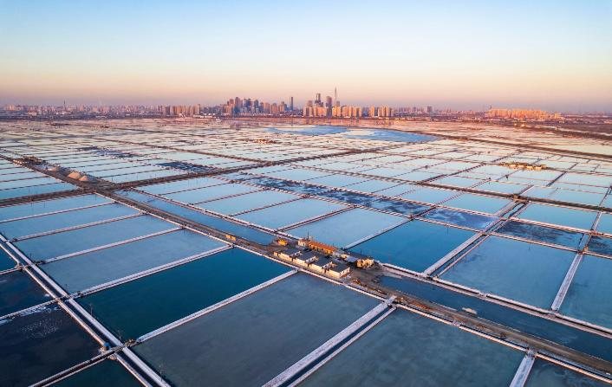
Artemia sources: wild fisheries supply >90% of cysts
Great Salt Lake, USA
Large Solar Salt Works, China

Slide 21

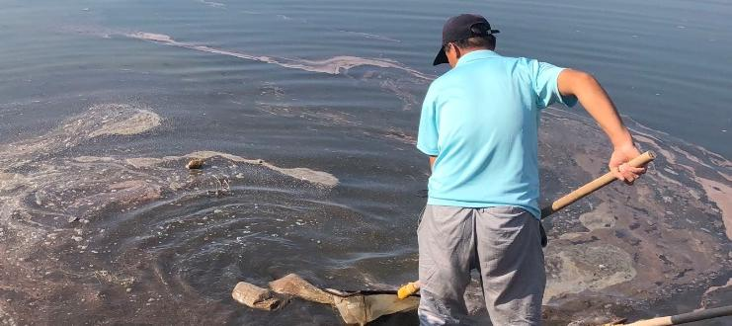
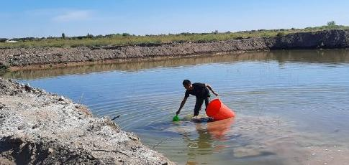
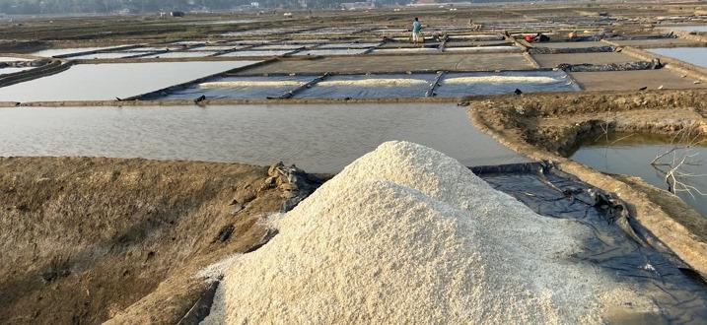
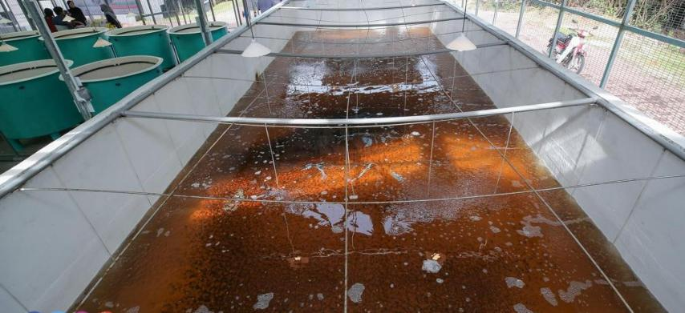
Artemia sources: farming is increasing, in diverse systems
Solar salt works
Pond farming
Artisanal salt farms
Tank systems

Slide 22

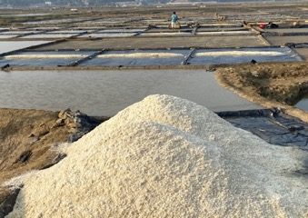
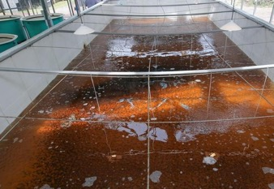
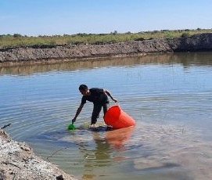


Artemia Farming as the New Frontier
Traceability & Biosecurity
Farming systems Farmed Artemia systems vary in design, with opportunities for efficiency gains and rapid scaling using existing technology.
produced in controlled environments: consistent quality & less contamination risks
Product Customization
biofortify cysts - added nutrients for improved hatchery outcomes.
Integrated Salt-Artemia Systems
Cyst-Focused Farming
Biomass-Focused Systems
Year-Round Production
continuous, reliable supply, addressing seasonal and geographic gaps.
Repurposes brine from salt production for Artemia cultivation; promotes circular use of resources.
Optimized for cyst yield through controlled salinity and strategic harvesting.
Produces live or processed Artemia biomass for markets like ornamental fish, and aquatic animal feed.

Slide 23
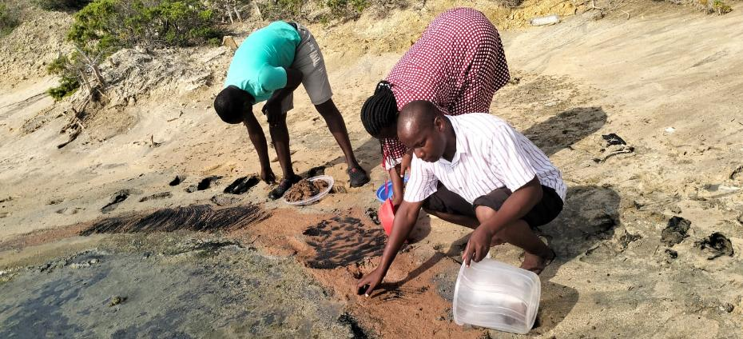
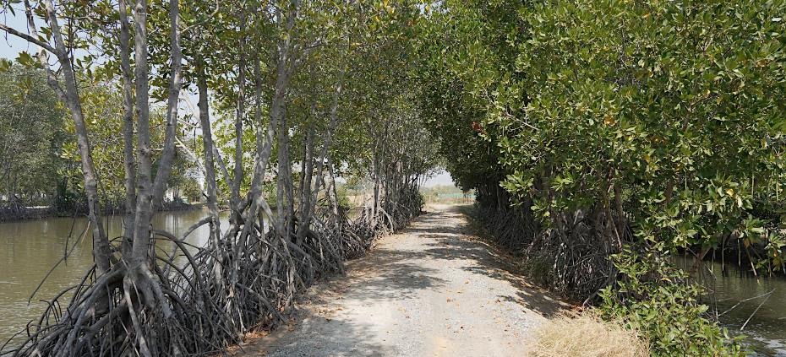
Artemia farming: its social and ecological values and impacts
Social Benefits
Environment and Climate
Targets very impoverished regions with few alternatives.
Empowering Women Through Livelihood Diversification
Attracting Youth to Aquaculture
Strengthening Community Cohesion
Enhanced incomes in poor salt impacted regions
Evidence of Strong Cooperatives
Artemia production in diverse hypersaline agro-ecologies,
with few alternatives
Climate resilience in hypersaline, salt impacted coastal
and inland region
Biomass production based on agro-processing waste streams - low environmental and GHG footprint
Biodiversity of Artemia

Slide 24
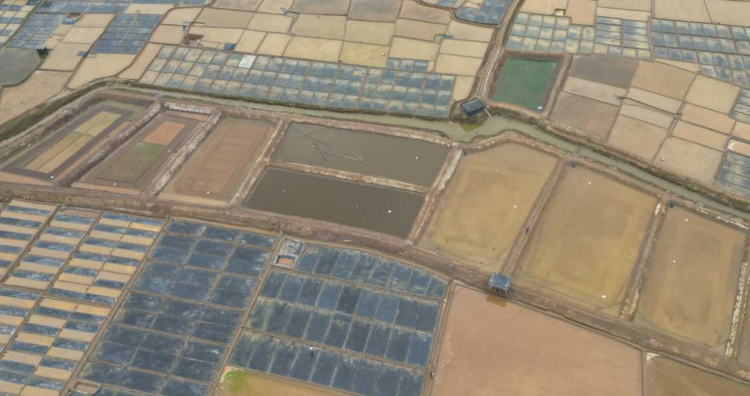
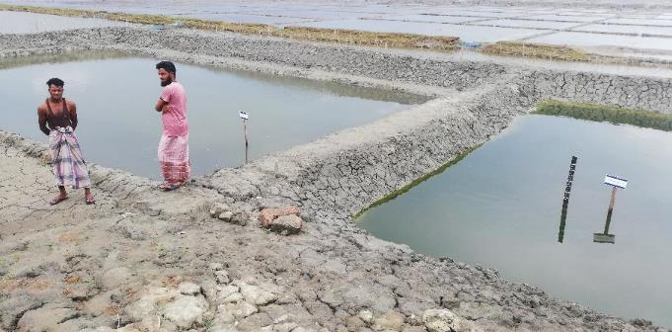

Slide 25

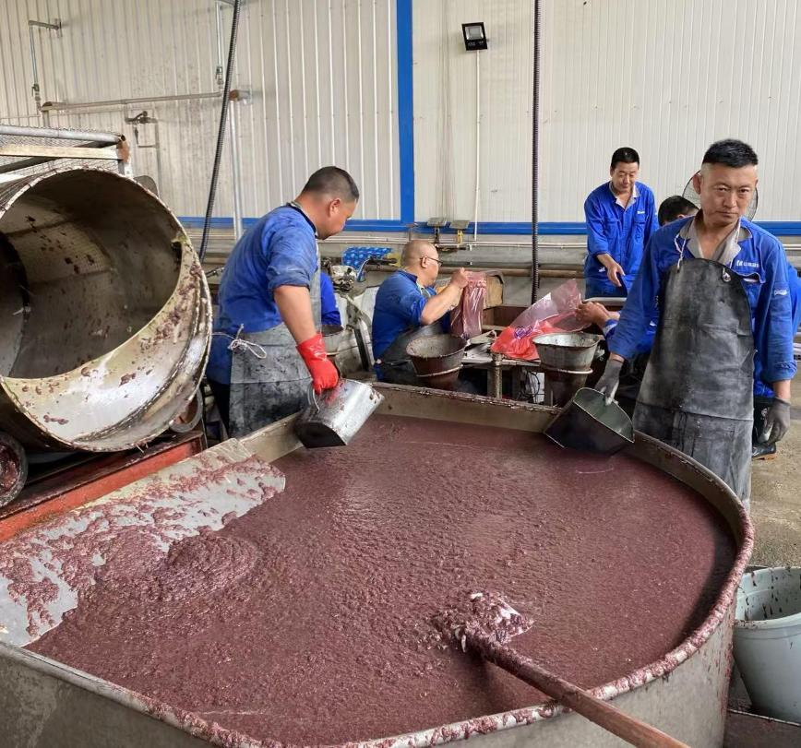
Artemia farming in Asia: a growing contribution
China
Production system
Solar salt works
High Productivity & Stable Production:
500-600 tons of cysts and 100,000 tons of biomass annually
Markets
High Demand & Usage:
Needs 1000-1500 tons of cysts annually
Biomass - 99% of global production - used domestically - shrimp farms, ornamental fish feed.
Supply Shortfall: imports 800-1000 tonnes of cysts.
Socio-economic impacts
Creates 1000 jobs and improves salt quality by reducing brine viscosity.
Challenges and opportunities
Challenges: Price fluctuations, quality issues,
declining production areas.
Opportunities: Scale production, improve infrastructure, invest in R&D, integrate with aquaculture.
Notes:
All figures need to be checked

Slide 26

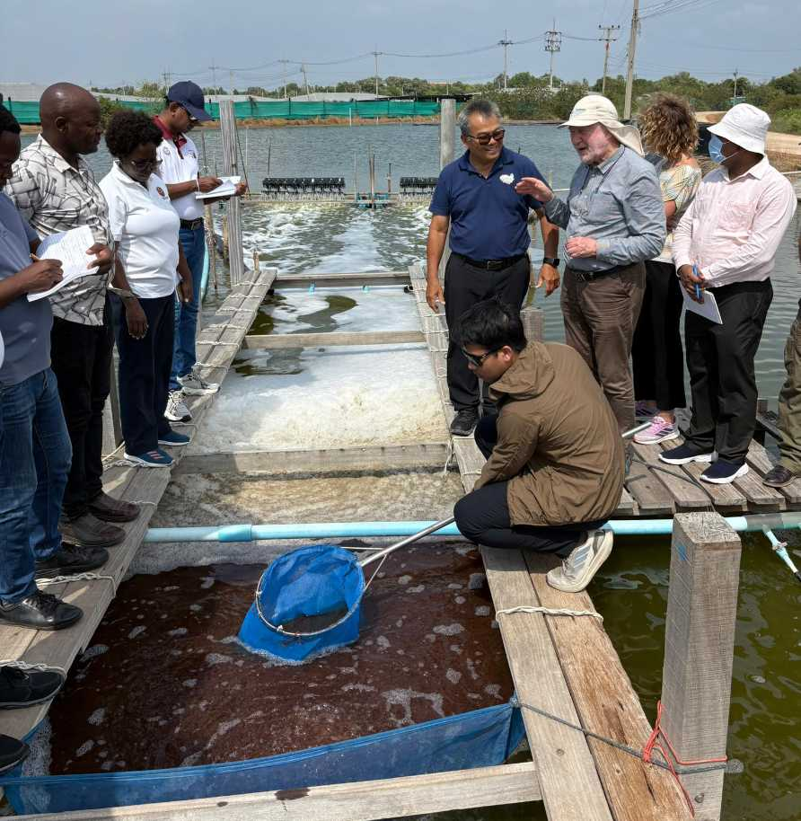
Artemia farming in Asia: a growing contribution
Thailand
Production system
Over 20 intensive and semi-intensive ponds
340 tons of biomass in ponds ($330k)
Markets
Export opportunity: 25% of biomass processed and exported
Supply shortfall: 110 tons of biomass
Reliance on imported cysts: 650 tons
Specialised market: biomass
Socio-economic impacts
decreased dependence on imports but still limited jobs
Challenges and opportunities
Challenges: Water resource competition
Opportunities: Strengthen local supply, support R&D for new applications, and investigate integration with salt farming (4, 300 ha of salt flats)
Notes:
All figures need to be checked

Slide 27


Artemia farming in Asia: a growing contribution
Vietnam
Production system
Cultivated in monoculture & integrated systems
(with salt, shrimp, crab, etc.)
20-30 tonnes cysts (dry weight) - $4-6 million
Markets
Market niche: Exceptional quality, high PUFAs
and hatchability
Local demand: 80% domestic but can be
exported over $200/kg
Shortfall: 500 tons of cysts still imported
Socio-economic impacts
Around 2,000 jobs
2-3 workers per hectare (20% women)
Challenges and opportunities
Challenges: land competition with shrimp farming
Opportunities: maximizes resource use by utilizing brine from salt production and recycling effluent from Artemia ponds.
3000 ha of salt production available in the
Mekong Delta
Notes:
All figures need to be checked

Slide 28


Artemia farming in Asia: a growing contribution
Bangladesh
Production system
54 integrated salt-artemia-tilapia farmers (5 ha)
6.7 tons biomass (1.6 MT/ha), 8kg cysts, 35 MT of tilapia
Markets
Diversification: integrated system allows for artemia and salt production in dry season and tilapia production in rainy season (year round income)
High price: biomass sold as high as $5/kg and local cysts sold cheaper than imports
Shortfall: 50 tons of cysts
Socio-economic impacts
Additional $1,300 per farmer per year (3-5 times higher than just salt farming)
Employed 144 seasonal workers
Challenges and opportunities
Challenges: High initial costs (excavation) and brine water prep = labour availability
Opportunities: biomass requires less processing than cysts and faster turn around + more reliable in different climate conditions
Notes:
All figures need to be checked

Slide 29


Artemia farming in Africa: novel with high potential
Kenya
Production system
Community-led artemia farmers with 85 ponds
33 kg of cysts, 250 kg of biomass ($3,000)
Markets
No captive market: very few applications currently despite one of the biggest tilapia sectors in Africa
High import price: Over $300/kg for cysts vs $55/kg for local cysts
Shortfall: est. 200 tons of cysts (in next 10 years)
Socio-economic impacts
Salt farming area with 350 participants, and over 2000 indirect beneficiaries (70% women and children)
Challenges and opportunities (for whole of Africa)
Challenges: Little is known of application in tilapia and catfish industries to grow new markets (or terrestrial feeds)
Opportunities: Excellent environmental conditions and fast growing aquaculture sector in many parts
of Africa
Notes:
All figures need to be checked

Slide 30


Thank you

